Slide 1

SMART CONTRACT
DISSERTATION
Submitted in partial fulfillment of the
Requirements for the award of the degree
of
BACHELOR OF TECHNOLOGY
in
Computer Science & Engineering
By:
Parmeet Singh Narula (005/CSE1/2014)
Deepanshu Lakra (017/CSE1/2014)
Mohit Puri (018/CSE1/2014)
Ankit Gupta (026/CSE1/2014)
Under the guidance of:
Ms. Poonam Narang
Department of Computer Science & Engineering
Guru Tegh Bahadur Institute of Technology
Guru Gobind Singh Indraprastha University
Dwarka, New Delhi
Year 2017-2018

Slide 2
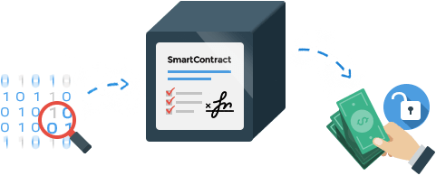
Smart contracts help you exchange money, property, shares, or anything of value in a transparent, conflict-free way while avoiding the services of a middleman.
The best way to describe smart contracts is to compare the technology to a vending machine. With smart contracts, you simply drop a bitcoin into the vending machine (i.e. ledger), and your escrow, driver’s license, or whatever drops into your account. More so, smart contracts not only define the rules and penalties around an agreement in the same way that a traditional contract does, but also automatically enforce those obligations.

Slide 3
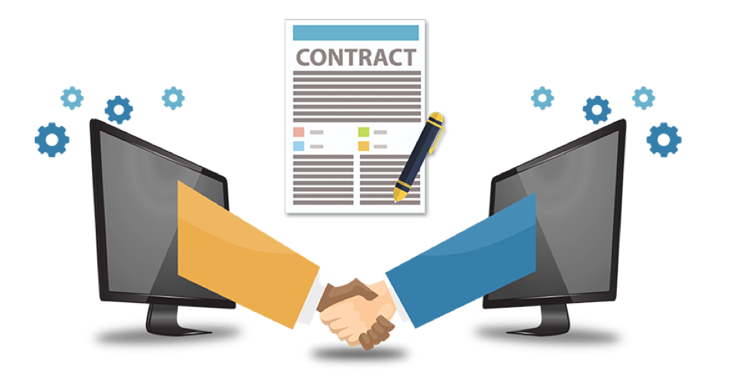

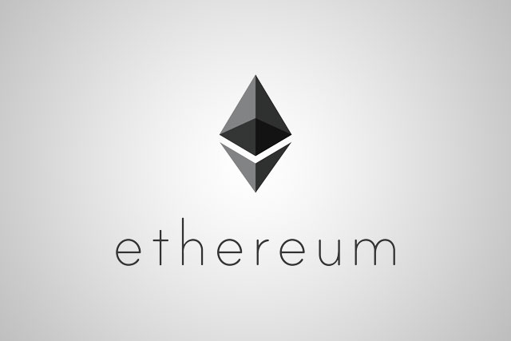
Go Ethereum
Protocol
Road map
Mist Wallet
Remix Solidity as
Programming Language
Smart Contract
Contract
Management

Slide 4
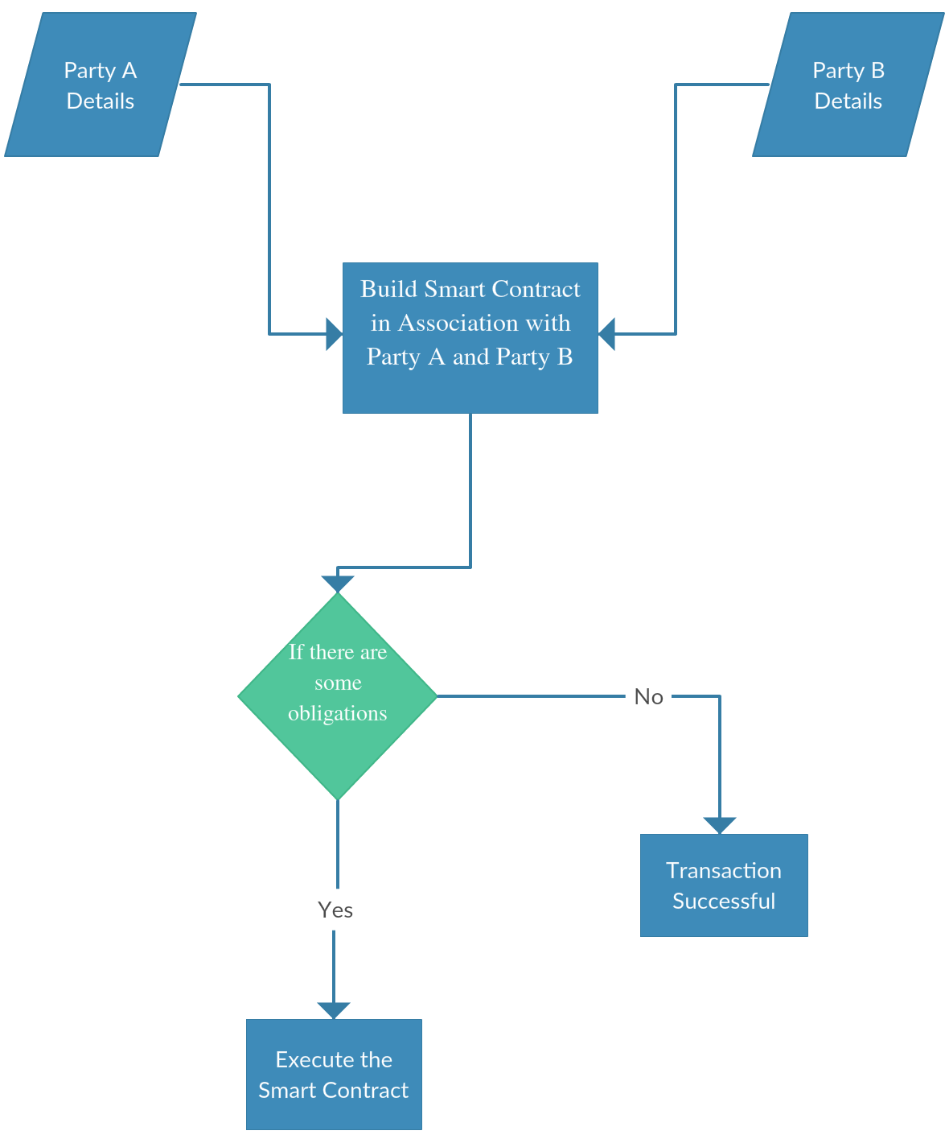
Flow Of Control for Smart Contract

Slide 5
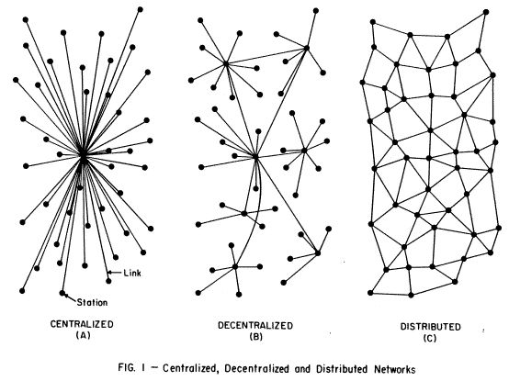
Centralized , Decentralized and Distributed networks

Slide 6
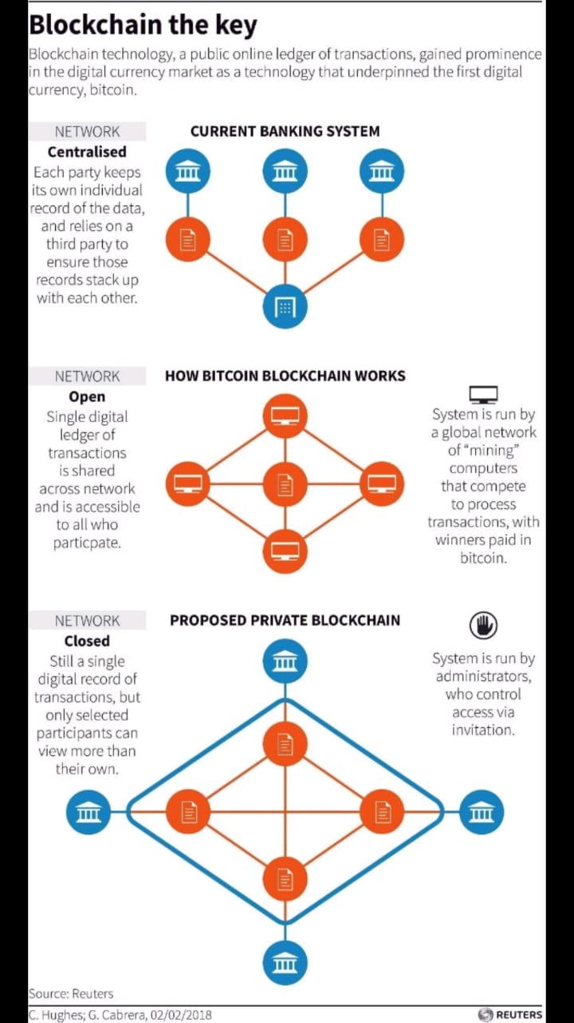

Slide 7
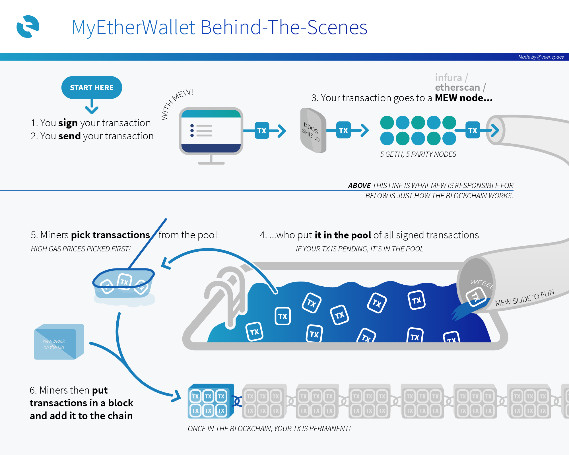

Slide 8
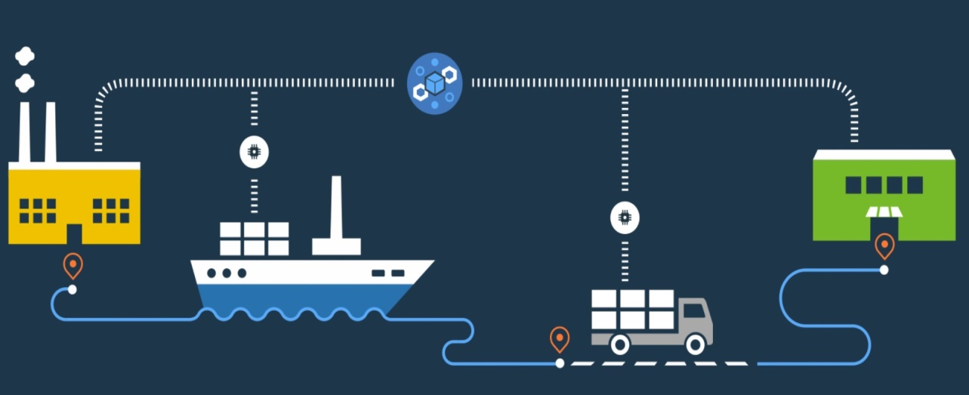
Use Case (1) (Supply Chain Management System)
In this use case ,we are trying to establish a shared and distributed network on blockchain for suppliers and retailers of different type of commodities.
Various other details related to order can also be retrieved by the retailer in a synchronized manner and thus helps to deal with the supply or shipment of large number of different commodities simultaneously.

Slide 9
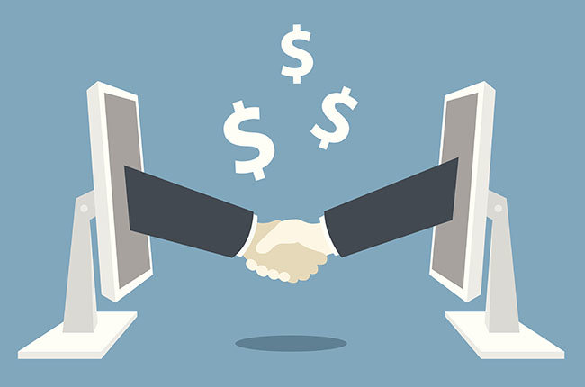
Use Case (2) (Project Management System)
In this use case , we are trying to create a management system for a contract that will be made between a freelancer developer and the company that will issue project to the developer.
Contract will include various obligations like time limit , priorities of different modules of project along with their associated costs.
The remuneration will be transferred to the developer side according to the number of modules completed in a stipulated amount of time.

Slide 10
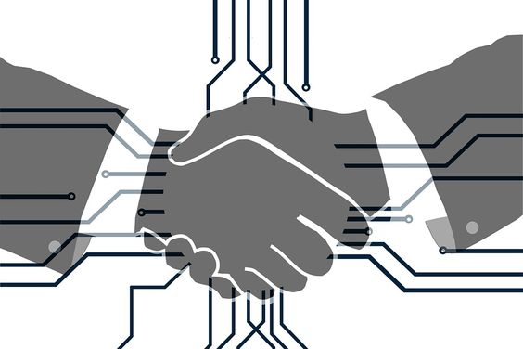
Use Case (3) (EMI based Smart-Contract)
Payment of installments by borrower to lender is a very common scenario which we encounter in our daily life and includes paper work including a number of contractual agreements between both parties.
Hence implementing this on blockchain provides us a number of benefits like automatic contract compliance by both the parties, timely payment of installments , negligible chances of contract breach and easy implementation.

Slide 11


