Slide 1
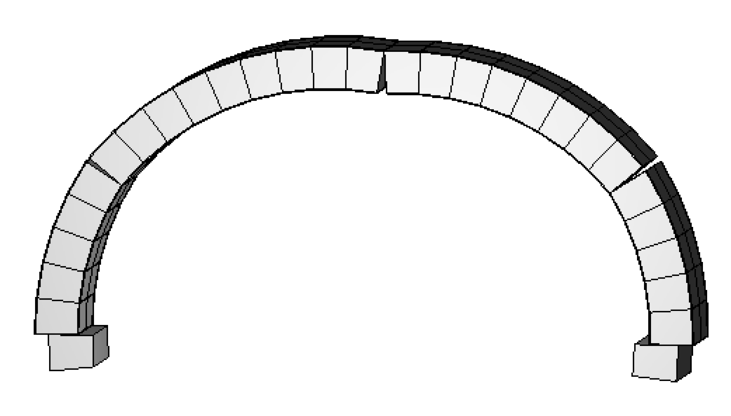
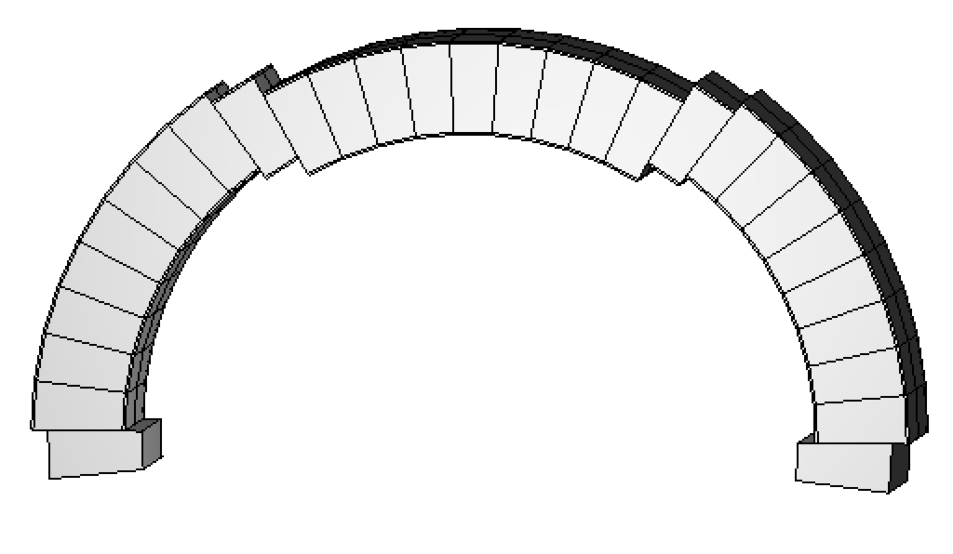
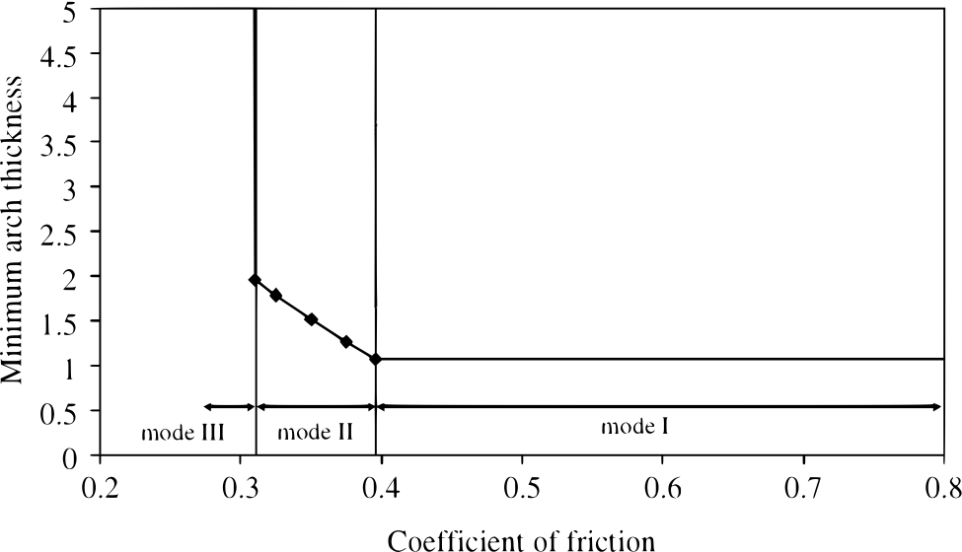
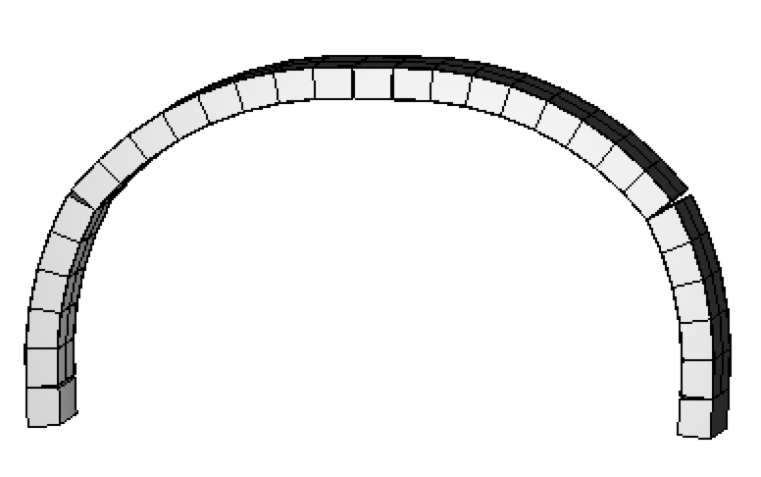

h/r=0.15, μ=0.35
mode II
h/r=0.25, μ=0.25
mode III
h/r=0.1, μ=0.5
mode I
mode I

