Slide 1
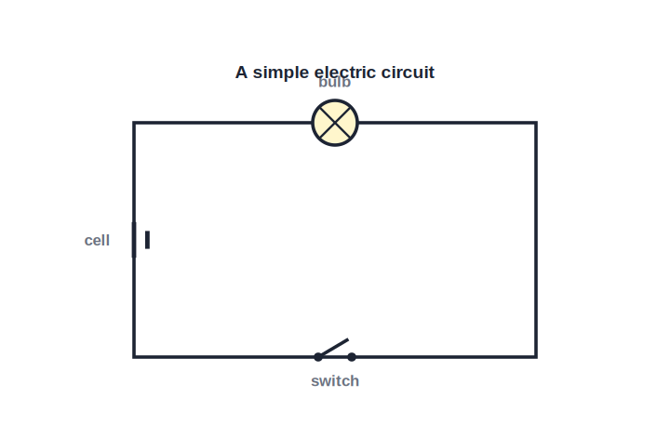
STD 9 • SCIENCE & TECHNOLOGY • ELECTRICITY
Current Electricity — 1
Electric current • Circuits and symbols • Potential difference • Ohm's law

Slide 2
INTRODUCTION
Learning Objectives
1
Explain electric current as the rate of flow of charge and give its unit
2
Describe conduction in solids in terms of free electrons
3
Draw an electric circuit using standard symbols and state each component's function
4
Define potential difference and its unit, the volt
5
State Ohm's law and verify it experimentally
6
Connect an ammeter and a voltmeter correctly in a circuit
Notes:
Open by previewing these objectives so students know what they should be able to do by the end of the session.

Slide 3
PART 1
Electric Current and Circuits
1
What flows, how it flows, and how we draw it

Slide 4
ELECTRIC CURRENT
What Is Electric Current?
Electric current is the rate of flow of electric charge through a conductor — the amount of charge passing through any cross-section of the conductor per unit time.
I = Q / t
• The SI unit of current is the ampere (A); 1 A = 1 coulomb per second.
• Charge Q is measured in coulombs (C); the charge on one electron is 1.6 x 10⁻¹⁹ C.
• Current is measured with an ammeter, connected in series in the circuit.
Notes:
Emphasise the definition I = Q/t; a steady current of 1 A means 1 coulomb of charge flows every second.

Slide 5
CONDUCTION
Electrical Conduction in Solids
Free electrons
In a metal, the outermost electrons of the atoms are loosely bound and can move freely through the metal — these are called free electrons.
Random motion without a cell
Normally these free electrons move about randomly, so there is no net flow of charge in any one direction.
Drift under a cell
When a cell is connected, it sets up a potential difference that makes the free electrons drift in a definite direction — this drift is the electric current.
Conventional current
By convention, the direction of current is taken as the direction in which positive charge would flow — opposite to the actual direction of electron flow.
Notes:
Clarify the historical convention: current direction is opposite to electron flow, a frequent point of confusion.

Slide 6
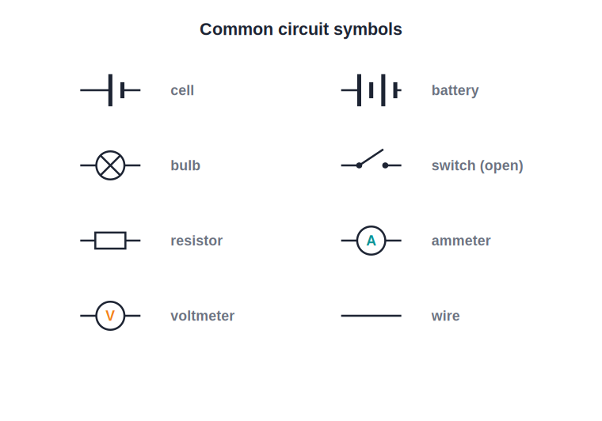
CIRCUIT SYMBOLS
Components of an Electric Circuit
Reading a circuit diagram
• An electric circuit is a closed conducting path through which an electric current flows.
• Standard symbols are used to draw circuit diagrams so that they are understood everywhere — a cell, a battery, a switch (key), a bulb, a resistor, an ammeter and a voltmeter each have their own symbol.
• The cell/battery drives the current; the switch makes or breaks the circuit; the resistor controls the current; the ammeter measures current and the voltmeter measures potential difference.
• Current flows only when the circuit is complete (closed); if the circuit is broken (open) at any point, no current flows.
Notes:
Have students copy the key symbols; they will use them in every circuit diagram for the rest of the syllabus.

Slide 7
QUIZ 1
Check — Current & Circuits
4 questions • think before the answer reveals on the next slide

Slide 8
QUIZ QUESTION
Q1 — Current
Electric current is defined as the:
charge stored in a conductor
rate of flow of electric charge
A
B
resistance of a conductor
work done by a cell
C
D

Slide 9
ANSWER REVEALED
Q1 — Current
Electric current is defined as the:
charge stored in a conductor
rate of flow of electric charge
A
✓
resistance of a conductor
work done by a cell
C
D
WHY
I = Q/t — current is the charge passing through a cross-section per unit time, measured in amperes.

Slide 10
QUIZ QUESTION
Q2 — Unit
One ampere of current is equal to:
one volt per second
one coulomb per second
A
B
one ohm per second
one joule per second
C
D

Slide 11
ANSWER REVEALED
Q2 — Unit
One ampere of current is equal to:
one volt per second
one coulomb per second
A
✓
one ohm per second
one joule per second
C
D
WHY
1 A = 1 C/s: a current of one ampere means one coulomb of charge flows each second.

Slide 12
QUIZ QUESTION
Q3 — Conduction
Electric current in a metal wire is due to the drift of:
protons
free electrons
A
B
neutrons
positive ions
C
D

Slide 13
ANSWER REVEALED
Q3 — Conduction
Electric current in a metal wire is due to the drift of:
protons
free electrons
A
✓
neutrons
positive ions
C
D
WHY
The loosely bound free electrons of the metal atoms drift under the applied potential difference, carrying the current.

Slide 14
QUIZ QUESTION
Q4 — Conventional current
The conventional direction of current is:
the same as the electron flow
opposite to the electron flow
A
B
always from low to high potential
undefined
C
D

Slide 15
ANSWER REVEALED
Q4 — Conventional current
The conventional direction of current is:
the same as the electron flow
opposite to the electron flow
A
✓
always from low to high potential
undefined
C
D
WHY
Conventional current is taken in the direction positive charge would move — opposite to the actual electron drift.

Slide 16
PART 2
Potential Difference and Ohm's Law
2
What drives the current, and how current depends on it

Slide 17
POTENTIAL DIFFERENCE
Potential Difference
The potential difference between two points of a conductor is the work done to carry a unit charge from one point to the other.
V = W / Q
• The SI unit of potential difference is the volt (V); 1 volt = 1 joule per coulomb.
• A cell or battery maintains the potential difference that drives the current through a circuit.
• Potential difference is measured with a voltmeter, connected in parallel across the two points.
Notes:
Contrast the ammeter (series) with the voltmeter (parallel) — a very common practical/diagram question.

Slide 18
OHM'S LAW
Ohm's Law
Ohm's law: the current through a conductor is directly proportional to the potential difference across it, provided its temperature and other physical conditions remain constant.
V = I R
• The constant of proportionality R is the resistance of the conductor; its SI unit is the ohm (Ω).
• A conductor that obeys Ohm's law is called an ohmic conductor.
• 1 ohm is the resistance of a conductor through which a current of 1 A flows when a potential difference of 1 V is applied across it.
Notes:
Stress the condition 'temperature constant' — Ohm's law holds only while the physical conditions do not change.

Slide 19
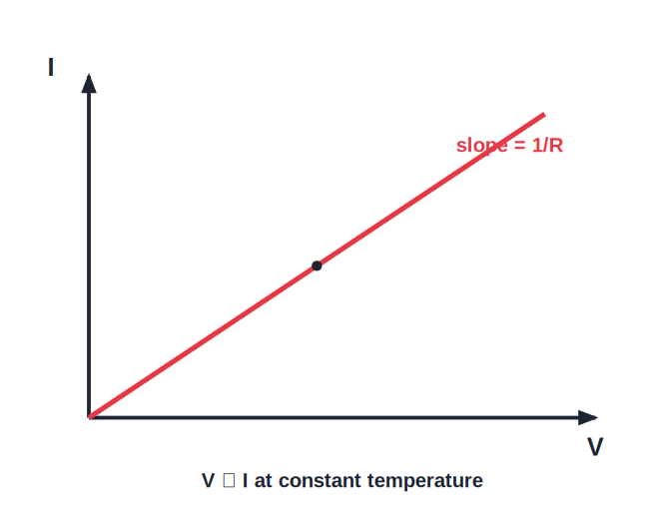
VERIFICATION
Experimental Verification of Ohm's Law
A straight-line V–I graph
• Connect a resistance wire, an ammeter (in series), a voltmeter (in parallel across the wire), a battery, a rheostat and a key in a circuit.
• Using the rheostat, change the current through the wire in steps and note the corresponding ammeter (I) and voltmeter (V) readings each time.
• Calculate the ratio V/I for each pair of readings — it is found to be constant, which is the resistance R of the wire.
• A graph of V against I is a straight line through the origin, confirming that V is directly proportional to I — this verifies Ohm's law.
Notes:
The straight line through the origin is the signature of an ohmic conductor; its slope equals the resistance.

Slide 20
WORKED EXAMPLE
Applying Ohm's Law
Problem. A potential difference of 6 V is applied across a resistor and a current of 0.5 A flows through it. Find the resistance.
V = I R
6 = 0.5 x R
R = 6 / 0.5
Answer: R = 12 Ω
Notes:
Rearranging V = IR for R is the most common numerical; check units (V in volts, I in amperes, R in ohms).

Slide 21
WRAP UP
Quick Recap
✓ Electric current — Rate of flow of charge, I = Q/t, unit ampere; measured by an ammeter in series.
✓ Conduction — Free electrons drift under a potential difference; conventional current is opposite to electron flow.
✓ Circuit & symbols — A closed conducting path; components have standard symbols and functions.
✓ Potential difference — V = W/Q, unit volt; measured by a voltmeter in parallel.
✓ Ohm's law — V = I R at constant temperature; a straight-line V–I graph verifies it.
Notes:
Cold-call the correct way to connect an ammeter and a voltmeter before ending.

Slide 22
QUIZ 2
Final Check — Potential Difference & Ohm's Law
4 questions • think before the answer reveals on the next slide

Slide 23
QUIZ QUESTION
Q1 — Potential difference
The potential difference between two points is the work done to move a unit ___ between them.
mass
charge
A
B
current
resistance
C
D

Slide 24
ANSWER REVEALED
Q1 — Potential difference
The potential difference between two points is the work done to move a unit ___ between them.
mass
charge
A
✓
current
resistance
C
D
WHY
V = W/Q — potential difference is the work done per unit charge, measured in volts (joules per coulomb).

Slide 25
QUIZ QUESTION
Q2 — Meters
In a circuit, the voltmeter and ammeter are connected respectively in:
series and series
parallel and series
A
B
series and parallel
parallel and parallel
C
D

Slide 26
ANSWER REVEALED
Q2 — Meters
In a circuit, the voltmeter and ammeter are connected respectively in:
series and series
parallel and series
A
✓
series and parallel
parallel and parallel
C
D
WHY
A voltmeter is connected in parallel across the component; an ammeter is connected in series so the whole current passes through it.

Slide 27
QUIZ QUESTION
Q3 — Ohm's law
According to Ohm's law, at constant temperature the current through a conductor is:
inversely proportional to the potential difference
directly proportional to the potential difference
A
B
independent of the potential difference
proportional to the square of the potential difference
C
D

Slide 28
ANSWER REVEALED
Q3 — Ohm's law
According to Ohm's law, at constant temperature the current through a conductor is:
inversely proportional to the potential difference
directly proportional to the potential difference
A
✓
independent of the potential difference
proportional to the square of the potential difference
C
D
WHY
V ∝ I (V = IR) as long as temperature and other physical conditions stay constant.

Slide 29
QUIZ QUESTION
Q4 — Numerical
A 12 V battery drives a current of 3 A through a resistor. The resistance is:
4 Ω
36 Ω
A
B
0.25 Ω
15 Ω
C
D

Slide 30
ANSWER REVEALED
Q4 — Numerical
A 12 V battery drives a current of 3 A through a resistor. The resistance is:
4 Ω
36 Ω
✓
B
0.25 Ω
15 Ω
C
D
WHY
R = V/I = 12/3 = 4 Ω.

Slide 31
Charge in Motion
A cell sets electrons drifting, Ohm's law tells us how much current flows, and a few standard symbols let us design and read any circuit.

