Slide 1
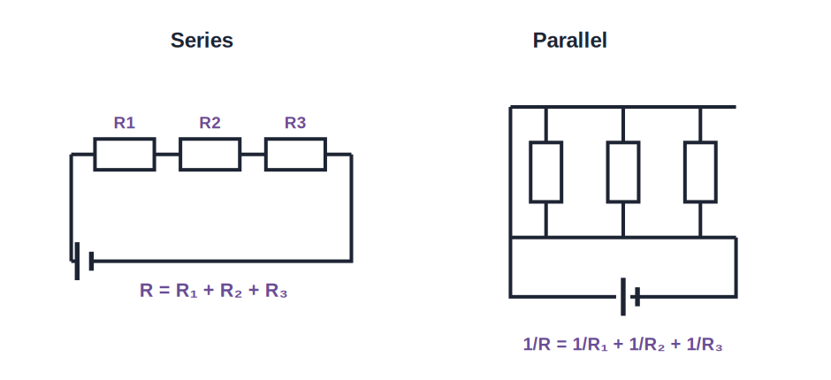
STD 9 • SCIENCE & TECHNOLOGY • ELECTRICITY
Current Electricity — 2
Resistance and resistivity • Resistors in series and parallel • Domestic circuits and safety

Slide 2
INTRODUCTION
Learning Objectives
1
Define resistance and resistivity of a conductor
2
State the factors on which the resistance of a wire depends
3
Derive and use the formula for resistors in series
4
Derive and use the formula for resistors in parallel
5
Describe domestic electrical connections
6
State the safety precautions to be taken while using electricity
Notes:
Open by previewing these objectives so students know what they should be able to do by the end of the session.

Slide 3
PART 1
Resistance and Resistivity
1
What opposes the current, and what it depends on

Slide 4
RESISTANCE
Resistance of a Conductor
The resistance of a conductor is the opposition it offers to the flow of electric current through it.
R = V / I
• The SI unit of resistance is the ohm (Ω).
• Resistance arises because the drifting electrons collide with the atoms of the conductor, losing energy as heat.
• A good conductor has low resistance; an insulator has very high resistance.
Notes:
Connect to Ohm's law from the previous session: R = V/I is the same relation rearranged.

Slide 5
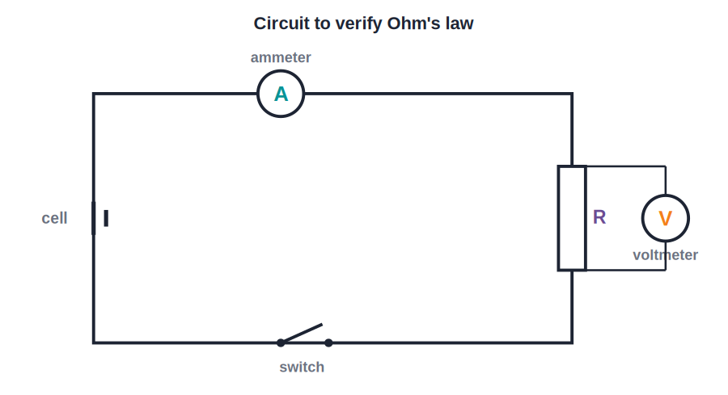
FACTORS
Factors Affecting the Resistance of a Wire
Length, thickness, material and temperature
• Length: the resistance of a wire is directly proportional to its length — a longer wire has more resistance.
• Area of cross-section: the resistance is inversely proportional to the area of cross-section — a thicker wire has less resistance.
• Material: different materials have different resistances for the same dimensions, described by a property called resistivity.
• Temperature: for most conductors the resistance increases as the temperature rises.
Notes:
Give the everyday link: thin, long wires (like a heater coil) have high resistance; thick, short copper wires have low resistance.

Slide 6
RESISTIVITY
Resistivity (Specific Resistance)
Combining the effects of length (l) and area of cross-section (A) gives the resistance in terms of a material constant called resistivity (ρ).
R = ρ l / A
• Resistivity is the resistance of a wire of that material of unit length and unit area of cross-section.
• Its SI unit is the ohm-metre (Ω·m); it depends only on the material (and temperature), not on the wire's dimensions.
• Metals such as silver and copper have very low resistivity (good conductors); alloys such as nichrome have high resistivity (used in heating elements).
Notes:
Distinguish resistance (depends on the specific wire) from resistivity (a property of the material).

Slide 7
QUIZ 1
Check — Resistance & Resistivity
4 questions • think before the answer reveals on the next slide

Slide 8
QUIZ QUESTION
Q1 — Resistance
The resistance of a conductor is the:
ease with which current flows
opposition it offers to the flow of current
A
B
charge stored in it
potential difference across it
C
D

Slide 9
ANSWER REVEALED
Q1 — Resistance
The resistance of a conductor is the:
ease with which current flows
opposition it offers to the flow of current
A
✓
charge stored in it
potential difference across it
C
D
WHY
Resistance opposes current; it arises from collisions of drifting electrons with the conductor's atoms.

Slide 10
QUIZ QUESTION
Q2 — Length
If the length of a wire is doubled (keeping everything else the same), its resistance:
halves
doubles
A
B
stays the same
becomes four times
C
D

Slide 11
ANSWER REVEALED
Q2 — Length
If the length of a wire is doubled (keeping everything else the same), its resistance:
halves
doubles
A
✓
stays the same
becomes four times
C
D
WHY
Resistance is directly proportional to length (R = ρl/A), so doubling the length doubles the resistance.

Slide 12
QUIZ QUESTION
Q3 — Thickness
A thicker wire (larger area of cross-section) of the same material and length has:
more resistance
less resistance
A
B
the same resistance
zero resistance
C
D

Slide 13
ANSWER REVEALED
Q3 — Thickness
A thicker wire (larger area of cross-section) of the same material and length has:
more resistance
less resistance
A
✓
the same resistance
zero resistance
C
D
WHY
Resistance is inversely proportional to the area of cross-section, so a thicker wire offers less resistance.

Slide 14
QUIZ QUESTION
Q4 — Resistivity
The resistivity of a material depends on:
the length of the wire
the thickness of the wire
A
B
the material and its temperature
the current through it
C
D

Slide 15
ANSWER REVEALED
Q4 — Resistivity
The resistivity of a material depends on:
the length of the wire
the thickness of the wire
A
B
the material and its temperature
the current through it
✓
D
WHY
Resistivity is a property of the material (and its temperature); it does not depend on the wire's dimensions.

Slide 16
PART 2
Combinations of Resistors and Domestic Circuits
2
Adding resistances, and using electricity safely at home

Slide 17
SERIES
Resistors in Series
When resistors are joined end to end so that the same current flows through each, they are said to be connected in series.
Rs = R₁ + R₂ + R₃ + ...
• The same current flows through every resistor in a series combination.
• The total potential difference is shared among the resistors and equals the sum of the individual potential differences.
• The equivalent (total) resistance is larger than the largest individual resistance.
Notes:
Everyday link: old decorative light strings are in series, so if one bulb fails the whole string goes off.

Slide 18
PARALLEL
Resistors in Parallel
Same voltage, shared current
• When resistors are connected between the same two points so that the same potential difference acts across each, they are in parallel.
• The potential difference is the same across every resistor, while the main current is shared among the branches.
• The reciprocal of the equivalent resistance equals the sum of the reciprocals of the individual resistances: 1/Rp = 1/R₁ + 1/R₂ + 1/R₃ + ...
• The equivalent resistance of a parallel combination is smaller than the smallest individual resistance.
Notes:
Household appliances are wired in parallel so each gets the full mains voltage and can be switched independently.

Slide 19
WORKED EXAMPLE
Series and Parallel Combinations
Problem. Two resistors of 6 Ω and 3 Ω are connected (i) in series and (ii) in parallel. Find the equivalent resistance in each case.
Series: Rs = R₁ + R₂ = 6 + 3 = 9 Ω
Parallel: 1/Rp = 1/6 + 1/3 = 1/6 + 2/6 = 3/6 = 1/2
Rp = 2 Ω
Answer: Series = 9 Ω; Parallel = 2 Ω
Notes:
Note the parallel result (2 Ω) is less than the smaller resistor (3 Ω) — a good check on the arithmetic.

Slide 20
DOMESTIC CIRCUITS & SAFETY
Domestic Connections and Safety
Parallel wiring at home
Appliances in a house are connected in parallel across the live and neutral wires, so each receives the full supply voltage and works independently.
Live, neutral and earth
The supply reaches a house through the live and neutral wires; a separate earth wire safely carries away leakage current.
Fuse and MCB
A fuse or a miniature circuit breaker (MCB) is placed in the live wire; it breaks the circuit if the current becomes dangerously large.
Safety precautions
Never touch switches or appliances with wet hands, use properly earthed three-pin plugs for heavy appliances, and use wires and fuses of the correct rating.
Notes:
Tie the fuse action back to the heating effect of current: an overload heats and melts the fuse wire, breaking the circuit.

Slide 21
WRAP UP
Quick Recap
✓ Resistance — Opposition to current, R = V/I, unit ohm.
✓ Factors — R increases with length, decreases with thickness; depends on material and temperature.
✓ Resistivity — R = ρl/A; ρ is a material property, unit ohm-metre.
✓ Series — Same current; Rs = R₁ + R₂ + ... (larger than any one).
✓ Parallel — Same voltage; 1/Rp = 1/R₁ + 1/R₂ + ... (smaller than any one).
✓ Domestic safety — Parallel wiring, earthing, fuse/MCB in the live wire, correct ratings.
Notes:
Ask students to predict whether combining resistors in parallel raises or lowers the total resistance, and why.

Slide 22
QUIZ 2
Final Check — Combinations & Domestic Circuits
4 questions • think before the answer reveals on the next slide

Slide 23
QUIZ QUESTION
Q1 — Series
Three resistors of 2 Ω, 3 Ω and 5 Ω are connected in series. Their equivalent resistance is:
10 Ω
0.97 Ω
A
B
3.3 Ω
1 Ω
C
D

Slide 24
ANSWER REVEALED
Q1 — Series
Three resistors of 2 Ω, 3 Ω and 5 Ω are connected in series. Their equivalent resistance is:
10 Ω
0.97 Ω
✓
B
3.3 Ω
1 Ω
C
D
WHY
In series, Rs = R₁ + R₂ + R₃ = 2 + 3 + 5 = 10 Ω.

Slide 25
QUIZ QUESTION
Q2 — Parallel
Two 4 Ω resistors are connected in parallel. Their equivalent resistance is:
8 Ω
4 Ω
A
B
2 Ω
0.5 Ω
C
D

Slide 26
ANSWER REVEALED
Q2 — Parallel
Two 4 Ω resistors are connected in parallel. Their equivalent resistance is:
8 Ω
4 Ω
A
B
2 Ω
0.5 Ω
✓
D
WHY
1/Rp = 1/4 + 1/4 = 1/2, so Rp = 2 Ω — for two equal resistors in parallel, the result is half of one.

Slide 27
QUIZ QUESTION
Q3 — Home wiring
Electrical appliances in a house are connected in parallel mainly so that:
they use less current
each gets the full supply voltage and can be operated independently
A
B
the wiring is cheaper
the fuse never blows
C
D

Slide 28
ANSWER REVEALED
Q3 — Home wiring
Electrical appliances in a house are connected in parallel mainly so that:
they use less current
each gets the full supply voltage and can be operated independently
A
✓
the wiring is cheaper
the fuse never blows
C
D
WHY
Parallel wiring gives every appliance the full mains voltage and lets each be switched on or off without affecting the others.

Slide 29
QUIZ QUESTION
Q4 — Safety
In domestic wiring, the fuse or MCB is connected in the ___ wire.
earth
neutral
A
B
live
any
C
D

Slide 30
ANSWER REVEALED
Q4 — Safety
In domestic wiring, the fuse or MCB is connected in the ___ wire.
earth
neutral
A
B
live
any
✓
D
WHY
The fuse/MCB is placed in the live wire so that, when it breaks, the appliance is disconnected from the live supply and is safe to handle.

Slide 31
Controlling the Current
Resistance and resistivity decide how much current flows; series and parallel rules let us combine resistors, and safe domestic wiring puts it all to everyday use.

