Slide 1
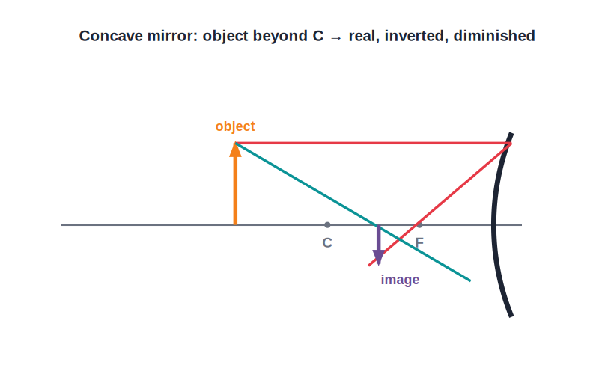
STD 9 • SCIENCE & TECHNOLOGY • OPTICS
Reflection of Light — 1
Reflection and mirrors • Spherical mirrors • Terms and the R = 2f relation • Convergence & divergence

Slide 2
INTRODUCTION
Learning Objectives
1
State the laws of reflection of light
2
Distinguish between plane, concave and convex mirrors
3
Explain how concave mirrors converge and convex mirrors diverge light
4
Define the terms related to spherical mirrors
5
Relate the focal length and radius of curvature (R = 2f)
6
Identify real and virtual foci for the two kinds of mirror
Notes:
Open by previewing these objectives so students know what they should be able to do by the end of the session.

Slide 3
PART 1
Reflection and Types of Mirrors
1
The laws of reflection and the two spherical mirrors

Slide 4
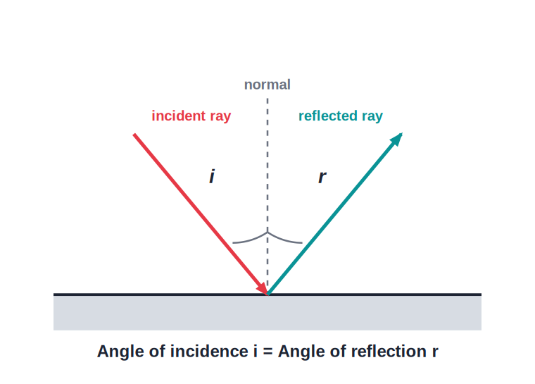
LAWS OF REFLECTION
The Laws of Reflection of Light
When light falls on a polished (reflecting) surface, it bounces back following two laws of reflection.
Notes:
First law: the angle of incidence equals the angle of reflection. Second law: the incident ray, the reflected ray and the normal at the point of incidence all lie in the same plane. These laws hold for every reflecting surface, plane or curved.

Slide 5


SPHERICAL MIRRORS
Plane and Spherical Mirrors
Plane mirror
Concave mirror
A flat reflecting surface; it forms a virtual, erect image of the same size as the object, as far behind the mirror as the object is in front.
A spherical mirror whose reflecting surface is the inner (caved-in) surface of the sphere; it converges a parallel beam of light to a real focus, so it is a converging mirror.
Convex mirror
Where they come from
A spherical mirror whose reflecting surface is the outer (bulging) surface; it diverges a parallel beam, which appears to come from a virtual focus behind the mirror — a diverging mirror.
A spherical mirror is a small part of a hollow sphere; silvering the outside gives a concave mirror and silvering the inside gives a convex mirror.
Notes:
Use a shiny spoon: the inner side (concave) inverts your image, the back (convex) gives a small upright image.

Slide 6
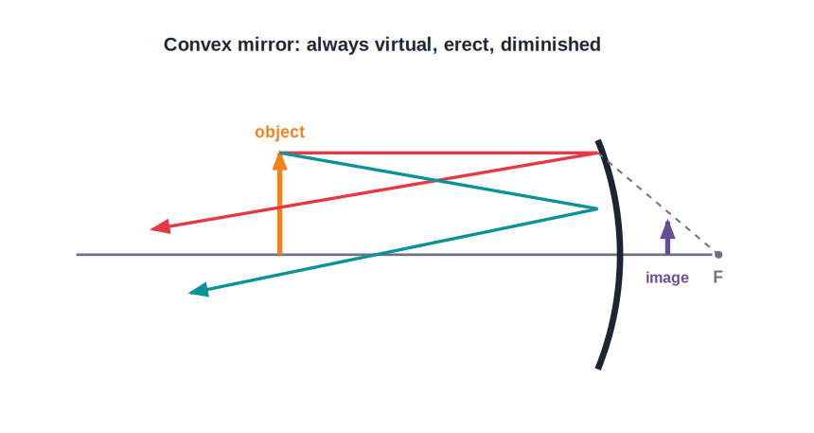
CONVERGENCE
Converging and Diverging Mirrors
Real vs virtual focus
• A concave mirror reflects a parallel beam of light so that the rays actually meet at a single point in front of the mirror — its principal focus. This is convergence.
• Because the rays really meet, a concave mirror has a real focus and can form real images.
• A convex mirror reflects a parallel beam so that the rays spread out (diverge); when produced backwards they appear to come from a point behind the mirror — a virtual focus.
• A convex mirror therefore always forms a virtual, erect and diminished image, whatever the position of the object.
Notes:
This convergence/divergence distinction decides everything about the images each mirror forms in the next session.

Slide 7
QUIZ 1
Check — Reflection & Mirrors
4 questions • think before the answer reveals on the next slide

Slide 8
QUIZ QUESTION
Q1 — Laws
According to the first law of reflection, the angle of incidence is:
greater than the angle of reflection
equal to the angle of reflection
A
B
less than the angle of reflection
always 90°
C
D

Slide 9
ANSWER REVEALED
Q1 — Laws
According to the first law of reflection, the angle of incidence is:
greater than the angle of reflection
equal to the angle of reflection
A
✓
less than the angle of reflection
always 90°
C
D
WHY
The angle of incidence always equals the angle of reflection, both measured from the normal at the point of incidence.

Slide 10
QUIZ QUESTION
Q2 — Concave mirror
A concave mirror reflects a parallel beam of light so that the rays:
diverge
converge to a real focus
A
B
are absorbed
pass straight through
C
D

Slide 11
ANSWER REVEALED
Q2 — Concave mirror
A concave mirror reflects a parallel beam of light so that the rays:
diverge
converge to a real focus
A
✓
are absorbed
pass straight through
C
D
WHY
A concave (converging) mirror brings a parallel beam together at its real principal focus in front of the mirror.

Slide 12
QUIZ QUESTION
Q3 — Convex mirror
The image formed by a convex mirror is always:
real and inverted
virtual, erect and diminished
A
B
real and magnified
the same size as the object
C
D

Slide 13
ANSWER REVEALED
Q3 — Convex mirror
The image formed by a convex mirror is always:
real and inverted
virtual, erect and diminished
A
✓
real and magnified
the same size as the object
C
D
WHY
A convex (diverging) mirror always forms a small, upright, virtual image, whatever the object's position.

Slide 14
QUIZ QUESTION
Q4 — Focus
A convex mirror is said to have a virtual focus because the reflected parallel rays:
actually meet in front of it
only appear to come from a point behind it
A
B
are absorbed at the surface
never leave the mirror
C
D

Slide 15
ANSWER REVEALED
Q4 — Focus
A convex mirror is said to have a virtual focus because the reflected parallel rays:
actually meet in front of it
only appear to come from a point behind it
A
✓
are absorbed at the surface
never leave the mirror
C
D
WHY
The diverging reflected rays, produced backwards, seem to start from a virtual focus behind the convex mirror.

Slide 16
PART 2
Terms Related to Spherical Mirrors
2
The vocabulary you need for ray diagrams and formulae

Slide 17
KEY TERMS
Terms Related to a Spherical Mirror
Pole (P)
The central point of the reflecting surface of the mirror.
Centre of curvature (C)
The centre of the hollow sphere of which the mirror is a part.
Radius of curvature (R)
The radius of that sphere — the distance PC.
Principal axis
The straight line passing through the pole P and the centre of curvature C.
Principal focus (F)
The point on the principal axis where rays parallel to the axis meet (concave) or appear to come from (convex) after reflection.
Focal length (f)
The distance between the pole P and the principal focus F.
Notes:
Draw and label all six terms on one clear diagram; students reuse this vocabulary throughout the chapter.

Slide 18
R = 2F
Relation Between Focal Length and Radius of Curvature
For a spherical mirror, the principal focus lies exactly midway between the pole and the centre of curvature.
R = 2f (so f = R / 2)
• The radius of curvature is twice the focal length of the mirror.
• So a mirror with a radius of curvature of 20 cm has a focal length of 10 cm.
• This relation lets us find one quantity if the other is known.
Notes:
A frequently used relation in numericals; derive it quickly from a ray parallel to the axis reflecting through F.

Slide 19
WORKED EXAMPLE
Using R = 2f
Problem. The radius of curvature of a concave mirror is 30 cm. Find its focal length.
R = 2f
f = R / 2 = 30 / 2
Answer: f = 15 cm
Notes:
Trivial arithmetic, but check the sign convention will be applied later — here we just relate the magnitudes.

Slide 20
WRAP UP
Quick Recap
✓ Laws of reflection — Angle of incidence = angle of reflection; incident ray, reflected ray and normal are coplanar.
✓ Concave mirror — Converging; real focus; can form real images.
✓ Convex mirror — Diverging; virtual focus; always a virtual, erect, diminished image.
✓ Terms — Pole, centre of curvature, radius, principal axis, focus, focal length.
✓ R = 2f — The focus is midway between the pole and the centre of curvature.
Notes:
Cold-call each term and the R = 2f relation before the final quiz.

Slide 21
QUIZ 2
Final Check — Terms & R = 2f
4 questions • think before the answer reveals on the next slide

Slide 22
QUIZ QUESTION
Q1 — Pole
The central point of the reflecting surface of a spherical mirror is called its:
centre of curvature
pole
A
B
focus
principal axis
C
D

Slide 23
ANSWER REVEALED
Q1 — Pole
The central point of the reflecting surface of a spherical mirror is called its:
centre of curvature
pole
A
✓
focus
principal axis
C
D
WHY
The pole (P) is the central point of the mirror's reflecting surface.

Slide 24
QUIZ QUESTION
Q2 — Centre of curvature
The centre of the sphere of which a spherical mirror forms a part is the:
pole
principal focus
A
B
centre of curvature
focal point
C
D

Slide 25
ANSWER REVEALED
Q2 — Centre of curvature
The centre of the sphere of which a spherical mirror forms a part is the:
pole
principal focus
A
B
centre of curvature
focal point
✓
D
WHY
The centre of curvature (C) is the centre of the hollow sphere; the distance PC is the radius of curvature.

Slide 26
QUIZ QUESTION
Q3 — R = 2f
A concave mirror has a focal length of 12 cm. Its radius of curvature is:
6 cm
12 cm
A
B
24 cm
36 cm
C
D

Slide 27
ANSWER REVEALED
Q3 — R = 2f
A concave mirror has a focal length of 12 cm. Its radius of curvature is:
6 cm
12 cm
A
B
24 cm
36 cm
✓
D
WHY
R = 2f = 2 × 12 = 24 cm.

Slide 28
QUIZ QUESTION
Q4 — Focus location
The principal focus of a spherical mirror lies:
at the pole
at the centre of curvature
A
B
midway between the pole and the centre of curvature
at infinity
C
D

Slide 29
ANSWER REVEALED
Q4 — Focus location
The principal focus of a spherical mirror lies:
at the pole
at the centre of curvature
A
B
midway between the pole and the centre of curvature
at infinity
✓
D
WHY
Because R = 2f, the focus F is exactly halfway between the pole P and the centre of curvature C.

Slide 30
Mirrors That Bend Light to a Point
Concave mirrors gather light to a real focus and convex mirrors spread it from a virtual one — the same two laws of reflection behind every curved mirror.

