Slide 1
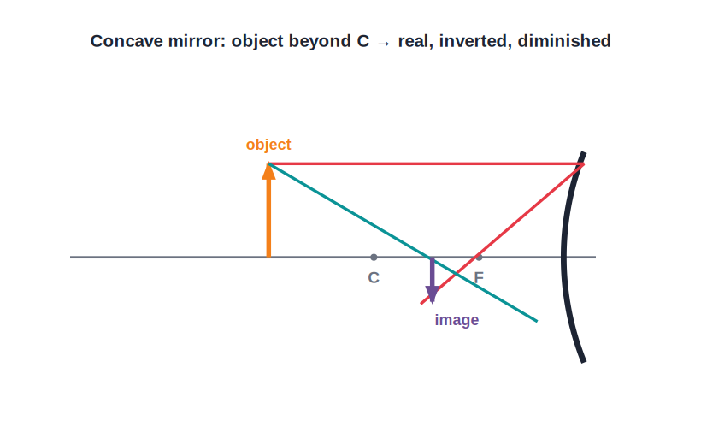
STD 9 • SCIENCE & TECHNOLOGY • OPTICS
Reflection of Light — 2
Ray diagrams • Images by concave & convex mirrors • Sign convention • Mirror formula & magnification

Slide 2
INTRODUCTION
Learning Objectives
1
State the rules for drawing ray diagrams for spherical mirrors
2
Draw and describe images formed by a concave mirror for different object positions
3
Describe the image formed by a convex mirror
4
Apply the Cartesian sign convention for spherical mirrors
5
Use the mirror formula 1/v + 1/u = 1/f
6
Calculate magnification and state the uses of spherical mirrors
Notes:
Open by previewing these objectives so students know what they should be able to do by the end of the session.

Slide 3
PART 1
Ray Diagrams and Images
1
Locating images formed by spherical mirrors

Slide 4
RAY RULES
Rules for Drawing Ray Diagrams
Ray parallel to the principal axis
After reflection it passes through the principal focus F (concave) or appears to come from F (convex).
Ray through the principal focus
A ray passing through F (concave) is reflected parallel to the principal axis.
Ray through the centre of curvature
A ray passing through (or directed towards) C strikes the mirror normally and is reflected back along the same path.
Ray to the pole
A ray striking the pole P is reflected making an equal angle with the principal axis.
Notes:
Any two of these rays are enough to locate the image; the others are useful checks.

Slide 5
CONCAVE IMAGES
Images Formed by a Concave Mirror
Depends on the object's position
• The nature of the image depends on where the object is placed relative to F and C.
• Object beyond C: image is real, inverted and diminished, formed between F and C.
• Object at C: image is real, inverted and the same size, formed at C; object between C and F: real, inverted and magnified, beyond C.
• Object between F and the pole: image is virtual, erect and magnified — the principle of a shaving/make-up mirror.
Notes:
Walk the object from far away inward, naming the image type at each stage; this table is a very common exam question.

Slide 6
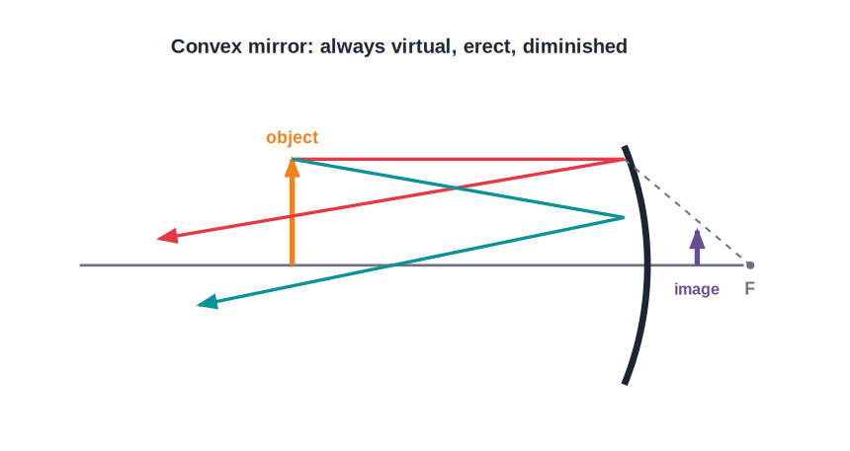
CONVEX IMAGES
Images Formed by a Convex Mirror
Always small, upright and virtual
• For a convex mirror the image is always of the same nature, whatever the object's position.
• The image is always virtual, erect and diminished, formed between the pole and the focus behind the mirror.
• As the object moves closer, the image grows a little but always stays smaller than the object.
• Because it gives a wide, upright field of view, a convex mirror is used as a rear-view mirror and as a security mirror in shops.
Notes:
Contrast strongly with the concave mirror, whose image changes; the convex mirror's image never changes in nature.

Slide 7
QUIZ 1
Check — Ray Diagrams & Images
4 questions • think before the answer reveals on the next slide

Slide 8
QUIZ QUESTION
Q1 — Ray rule
A ray parallel to the principal axis, after reflection from a concave mirror, passes through the:
pole
centre of curvature
A
B
principal focus
object
C
D

Slide 9
ANSWER REVEALED
Q1 — Ray rule
A ray parallel to the principal axis, after reflection from a concave mirror, passes through the:
pole
centre of curvature
A
B
principal focus
object
✓
D
WHY
A ray parallel to the axis reflects through the principal focus F of a concave mirror.

Slide 10
QUIZ QUESTION
Q2 — Concave image
An object placed between the focus and the pole of a concave mirror gives an image that is:
real, inverted and diminished
virtual, erect and magnified
A
B
real and the same size
virtual and diminished
C
D

Slide 11
ANSWER REVEALED
Q2 — Concave image
An object placed between the focus and the pole of a concave mirror gives an image that is:
real, inverted and diminished
virtual, erect and magnified
A
✓
real and the same size
virtual and diminished
C
D
WHY
With the object within the focus, a concave mirror forms a magnified, upright, virtual image — used in shaving and make-up mirrors.

Slide 12
QUIZ QUESTION
Q3 — Object at C
When an object is placed at the centre of curvature of a concave mirror, the image is:
diminished
the same size as the object
A
B
magnified
virtual
C
D

Slide 13
ANSWER REVEALED
Q3 — Object at C
When an object is placed at the centre of curvature of a concave mirror, the image is:
diminished
the same size as the object
A
✓
magnified
virtual
C
D
WHY
At C the image is real, inverted and exactly the same size as the object, also formed at C.

Slide 14
QUIZ QUESTION
Q4 — Convex use
A convex mirror is preferred as a vehicle rear-view mirror because it:
magnifies vehicles behind
gives a wide, upright field of view
A
B
forms real images
reverses left and right
C
D

Slide 15
ANSWER REVEALED
Q4 — Convex use
A convex mirror is preferred as a vehicle rear-view mirror because it:
magnifies vehicles behind
gives a wide, upright field of view
A
✓
forms real images
reverses left and right
C
D
WHY
Its always-diminished, erect virtual image covers a large area behind the vehicle, so more traffic is visible.

Slide 16
PART 2
Mirror Formula and Magnification
2
Calculating image position, size and nature

Slide 17
SIGN CONVENTION
Cartesian Sign Convention for Mirrors
Origin at the pole
All distances are measured from the pole P of the mirror, along the principal axis.
Direction of incident light
Distances measured in the direction of the incident light (to the right) are positive; those against it (to the left) are negative.
Object distance
The object is always placed to the left, so the object distance u is negative.
Heights
Heights measured upwards (above the axis) are positive; heights measured downwards are negative.
Notes:
Getting the signs right is the whole battle in mirror numericals; insist students write signs before substituting.

Slide 18
MIRROR FORMULA
The Mirror Formula and Magnification
The mirror formula relates the object distance (u), image distance (v) and focal length (f) of a spherical mirror, valid for all mirrors and all object positions with the sign convention.
1/v + 1/u = 1/f • m = h₂/h₁ = −v/u
• For a concave mirror f is negative; for a convex mirror f is positive.
• A negative magnification means a real, inverted image; a positive magnification means a virtual, erect image.
• |m| > 1 means magnified, |m| < 1 means diminished.
Notes:
Note the mirror formula uses 1/v + 1/u (a plus), unlike the lens formula which uses a minus — a classic slip.

Slide 19
WORKED EXAMPLE
Using the Mirror Formula
Problem. An object is placed 30 cm in front of a concave mirror of focal length 20 cm. Find the image distance and magnification.
Sign convention: u = −30 cm, f = −20 cm
1/v = 1/f − 1/u = 1/(−20) − 1/(−30) = −3/60 + 2/60 = −1/60
v = −60 cm (negative → real image, in front of the mirror)
m = −v/u = −(−60)/(−30) = −2 (real, inverted, magnified 2×)
Answer: v = −60 cm; real, inverted, magnified image
Notes:
Show every sign substitution; the negative v tells us the image is real and formed in front of the mirror.

Slide 20



USES
Uses of Spherical Mirrors
Concave — shaving/make-up mirror
Concave — headlamps & torches
With the face within the focus, it gives an enlarged, erect image.
A bulb at the focus produces a strong parallel beam of light.
Concave — solar devices & floodlights
Convex — rear-view & security mirrors
Concentrate sunlight at the focus, or give a bright beam when the source is beyond C.
Give a wide, upright field of view so a large area is visible.
Notes:
Link each use back to the image property that makes it work — magnification, parallel beam or wide field.

Slide 21
WRAP UP
Quick Recap
✓ Ray rules — Parallel→F; through F→parallel; through C→back along itself.
✓ Concave images — Vary with object position — real/inverted far off, virtual/magnified within F.
✓ Convex images — Always virtual, erect and diminished.
✓ Sign convention — Distances from the pole; incident-light direction positive; object distance negative.
✓ Mirror formula — 1/v + 1/u = 1/f; m = −v/u.
✓ Uses — Headlamps, shaving mirrors, solar devices, rear-view mirrors.
Notes:
Ask students to contrast the concave and convex image tables one more time.

Slide 22
QUIZ 2
Final Check — Formula & Magnification
4 questions • think before the answer reveals on the next slide

Slide 23
QUIZ QUESTION
Q1 — Sign convention
In the Cartesian sign convention for mirrors, the object distance u is always taken as:
positive
negative
A
B
zero
equal to f
C
D

Slide 24
ANSWER REVEALED
Q1 — Sign convention
In the Cartesian sign convention for mirrors, the object distance u is always taken as:
positive
negative
A
✓
zero
equal to f
C
D
WHY
The object is placed to the left of the pole, against the incident-light direction, so u is negative.

Slide 25
QUIZ QUESTION
Q2 — Mirror formula
The mirror formula relating u, v and f is:
1/v − 1/u = 1/f
1/v + 1/u = 1/f
A
B
v + u = f
1/f = 1/v × 1/u
C
D

Slide 26
ANSWER REVEALED
Q2 — Mirror formula
The mirror formula relating u, v and f is:
1/v − 1/u = 1/f
1/v + 1/u = 1/f
A
✓
v + u = f
1/f = 1/v × 1/u
C
D
WHY
The mirror formula is 1/v + 1/u = 1/f (a plus sign, unlike the lens formula).

Slide 27
QUIZ QUESTION
Q3 — Magnification
A magnification of −3 produced by a concave mirror means the image is:
virtual, erect and magnified
real, inverted and magnified
A
B
virtual and diminished
real and the same size
C
D

Slide 28
ANSWER REVEALED
Q3 — Magnification
A magnification of −3 produced by a concave mirror means the image is:
virtual, erect and magnified
real, inverted and magnified
A
✓
virtual and diminished
real and the same size
C
D
WHY
A negative magnification indicates a real, inverted image; its magnitude of 3 means it is three times the object's size.

Slide 29
QUIZ QUESTION
Q4 — Uses
The mirror used in vehicle headlamps to produce a powerful parallel beam is a:
plane mirror
convex mirror
A
B
concave mirror
flat glass sheet
C
D

Slide 30
ANSWER REVEALED
Q4 — Uses
The mirror used in vehicle headlamps to produce a powerful parallel beam is a:
plane mirror
convex mirror
A
B
concave mirror
flat glass sheet
✓
D
WHY
A bulb placed at the focus of a concave mirror produces a strong parallel beam, ideal for a headlamp.

Slide 31
From Rays to Images
A few ray rules, a careful sign convention and one mirror formula let us predict exactly where a spherical mirror forms its image and how big it will be.

