Slide 1
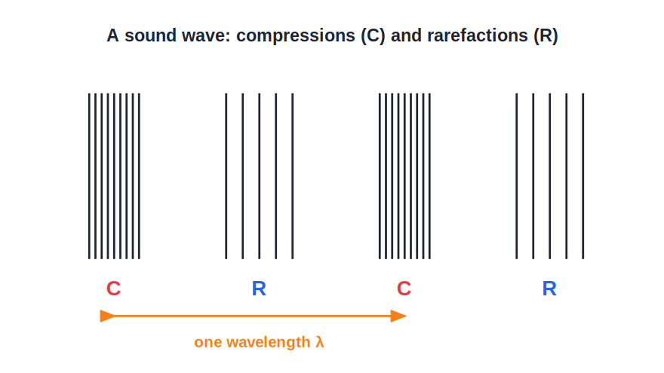
STD 9 • SCIENCE & TECHNOLOGY • SOUND
Study of Sound — 1
Sound waves • Longitudinal & transverse • Wave terms • Characteristics of sound

Slide 2
INTRODUCTION
Learning Objectives
1
Explain how sound is produced and why it needs a medium
2
Distinguish longitudinal and transverse waves
3
Describe compressions and rarefactions in a sound wave
4
Define the terms of a wave and use v = f λ
5
Relate loudness to amplitude and pitch to frequency
6
Explain the quality (timbre) of a sound
Notes:
Open by previewing these objectives so students know what they should be able to do by the end of the session.

Slide 3
PART 1
Nature and Propagation of Sound
1
What sound is and how it travels

Slide 4
PRODUCTION
How Sound Is Produced and Travels
Produced by vibration
A vibrating body produces sound.
Needs a medium
Sound travels through a medium; it cannot travel through a vacuum.
Travels as a wave
The vibration passes energy from particle to particle without the particles moving along.
Longitudinal in air
In air, sound travels as a longitudinal wave.
Notes:
Recall the bell-jar experiment: as air is pumped out the sound fades, proving sound needs a material medium.

Slide 5
WAVE TYPES
Longitudinal and Transverse Waves
Two kinds of wave
• Longitudinal: particles vibrate along the direction of travel
• Made of compressions (crowded) and rarefactions (spread out)
• Transverse: particles vibrate across the direction of travel
• Transverse waves have crests and troughs
• Sound in air is a longitudinal wave
Notes:
Compressions are high-pressure, high-density regions; rarefactions are low-pressure, low-density regions.

Slide 6
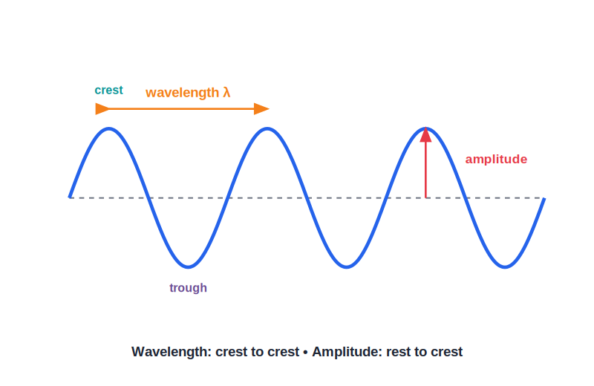
WAVE TERMS
Terms and the Wave Relation
Describing a wave
• Wavelength (λ): distance between two compressions
• Frequency (f): vibrations per second, unit hertz (Hz)
• Time period (T): time for one vibration, T = 1/f
• Amplitude: maximum displacement of a particle
• Wave relation: v = f λ
Notes:
v = f λ ties speed, frequency and wavelength together; it is used in almost every sound numerical.

Slide 7
QUIZ 1
Check — Nature of Sound
4 questions • think before the answer reveals on the next slide

Slide 8
QUIZ QUESTION
Q1 — Medium
Sound cannot travel through:
a solid
a liquid
A
B
a gas
a vacuum
C
D

Slide 9
ANSWER REVEALED
Q1 — Medium
Sound cannot travel through:
a solid
a liquid
A
B
a gas
a vacuum
C
✓
WHY
Sound needs a material medium; with no particles to pass on the vibration, it cannot travel through a vacuum.

Slide 10
QUIZ QUESTION
Q2 — Wave type
Sound travels through air as a:
transverse wave
longitudinal wave
A
B
water wave
light wave
C
D

Slide 11
ANSWER REVEALED
Q2 — Wave type
Sound travels through air as a:
transverse wave
longitudinal wave
A
✓
water wave
light wave
C
D
WHY
In air the particles vibrate back and forth along the direction of travel, forming compressions and rarefactions.

Slide 12
QUIZ QUESTION
Q3 — Regions
The region of a sound wave where the particles are crowded together is a:
rarefaction
compression
A
B
crest
trough
C
D

Slide 13
ANSWER REVEALED
Q3 — Regions
The region of a sound wave where the particles are crowded together is a:
rarefaction
compression
A
✓
crest
trough
C
D
WHY
A compression is a region of high density and high pressure; a rarefaction is the opposite.

Slide 14
QUIZ QUESTION
Q4 — Numerical
A sound wave has frequency 500 Hz and wavelength 0.66 m. Its speed is:
330 m/s
500 m/s
A
B
0.66 m/s
757 m/s
C
D

Slide 15
ANSWER REVEALED
Q4 — Numerical
A sound wave has frequency 500 Hz and wavelength 0.66 m. Its speed is:
330 m/s
500 m/s
✓
B
0.66 m/s
757 m/s
C
D
WHY
v = f λ = 500 × 0.66 = 330 m/s.

Slide 16
PART 2
Characteristics of Sound
2
Loudness, pitch and quality

Slide 17
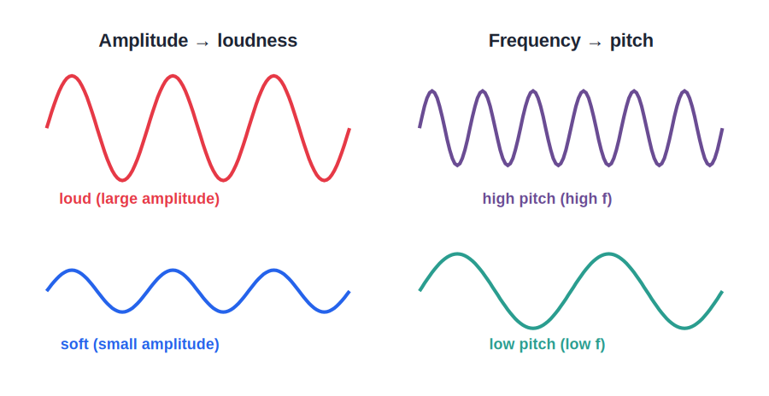
CHARACTERISTICS
The Three Characteristics of Sound
What makes sounds different
• Loudness depends on the amplitude of the wave
• Larger amplitude → louder sound
• Pitch depends on the frequency of the wave
• Higher frequency → higher pitch (shriller)
• Quality (timbre) depends on the waveform
Notes:
Quality lets us tell the same note apart on a flute and a violin, and lets us recognise a familiar voice.

Slide 18
CONTRAST
Loudness vs Pitch vs Quality
Loudness
Set by amplitude; measured in decibels (dB).
Pitch
Set by frequency; a high-pitch sound is shrill, a low-pitch sound is deep.
Quality (timbre)
Set by the shape of the waveform; identifies the source of the sound.
Independent
Two sounds can have the same loudness but different pitch, or the same pitch but different quality.
Notes:
Stress that loudness (amplitude) and pitch (frequency) are independent — a common confusion.

Slide 19
WRAP UP
Quick Recap
✓ Production — Sound is made by vibration and needs a medium.
✓ Longitudinal wave — Compressions and rarefactions travel through the medium.
✓ Wave terms — Wavelength, frequency, time period, amplitude; v = f λ.
✓ Loudness — Depends on amplitude.
✓ Pitch — Depends on frequency.
✓ Quality — Depends on the waveform — identifies the source.
Notes:
Cold-call which property changes when a guitar string is plucked harder (amplitude → loudness) versus tightened (frequency → pitch).

Slide 20
QUIZ 2
Final Check — Characteristics
4 questions • think before the answer reveals on the next slide

Slide 21
QUIZ QUESTION
Q1 — Loudness
The loudness of a sound depends on its:
frequency
amplitude
A
B
wavelength
speed
C
D

Slide 22
ANSWER REVEALED
Q1 — Loudness
The loudness of a sound depends on its:
frequency
amplitude
A
✓
wavelength
speed
C
D
WHY
A larger amplitude of vibration produces a louder sound.

Slide 23
QUIZ QUESTION
Q2 — Pitch
A shrill (high-pitched) sound has a high:
amplitude
frequency
A
B
speed
loudness
C
D

Slide 24
ANSWER REVEALED
Q2 — Pitch
A shrill (high-pitched) sound has a high:
amplitude
frequency
A
✓
speed
loudness
C
D
WHY
Pitch depends on frequency; the higher the frequency, the higher the pitch.

Slide 25
QUIZ QUESTION
Q3 — Quality
We can tell a flute from a violin playing the same note because of the sound's:
loudness
pitch
A
B
quality (timbre)
speed
C
D

Slide 26
ANSWER REVEALED
Q3 — Quality
We can tell a flute from a violin playing the same note because of the sound's:
loudness
pitch
A
B
quality (timbre)
speed
✓
D
WHY
Quality, set by the waveform, distinguishes the same note produced by different sources.

Slide 27
QUIZ QUESTION
Q4 — Period
A tuning fork vibrates with a frequency of 250 Hz. Its time period is:
0.004 s
250 s
A
B
4 s
0.25 s
C
D

Slide 28
ANSWER REVEALED
Q4 — Period
A tuning fork vibrates with a frequency of 250 Hz. Its time period is:
0.004 s
250 s
✓
B
4 s
0.25 s
C
D
WHY
T = 1/f = 1/250 = 0.004 s.

Slide 29
The Physics of What We Hear
A vibrating source, a medium to carry it, and three simple properties — loudness, pitch and quality — explain every sound we hear.

