Slide 1
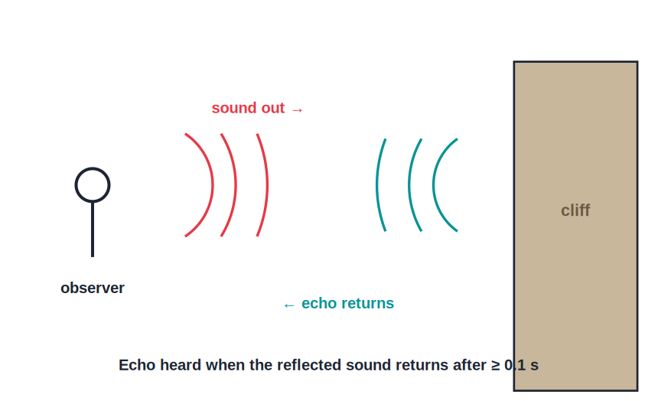
STD 9 • SCIENCE & TECHNOLOGY • SOUND
Study of Sound — 2
Speed of sound • Audible range • Reflection & echo • Reverberation, SONAR and sonography

Slide 2
INTRODUCTION
Learning Objectives
1
State the speed of sound and how it varies with the medium
2
Classify sounds as infrasonic, audible and ultrasonic
3
State the laws of reflection of sound
4
Explain echo and the condition for hearing one
5
Distinguish echo from reverberation
6
Describe SONAR and sonography as uses of ultrasound
Notes:
Open by previewing these objectives so students know what they should be able to do by the end of the session.

Slide 3
PART 1
Speed and Range of Sound
1
How fast sound travels and what we can hear

Slide 4
SPEED
Speed of Sound in Different Media
In air
About 340 m/s at ordinary room temperature.
Fastest in solids
Sound travels fastest in solids, slower in liquids, slowest in gases.
Why
The more closely packed the particles, the faster the vibration is passed on.
Temperature
In a gas, the speed of sound increases as the temperature rises.
Notes:
Contrast with light: sound is far slower, which is why we see lightning before we hear thunder.

Slide 5
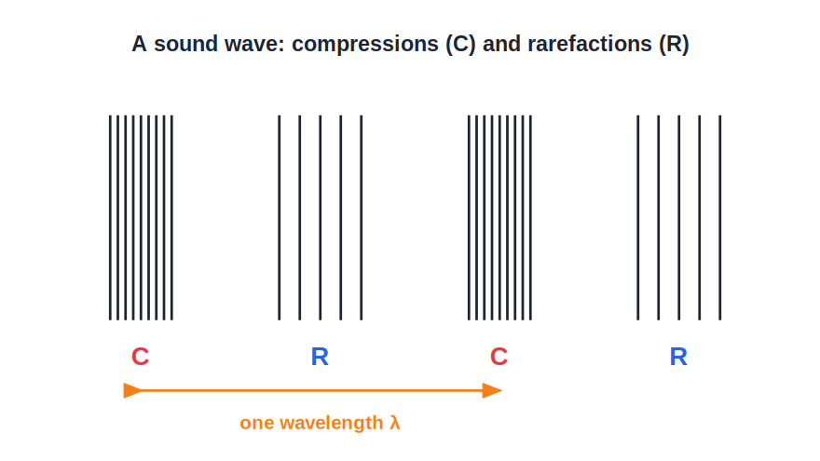
RANGE
Audible Range and Beyond
Infrasonic, audible, ultrasonic
• Audible sound: about 20 Hz to 20,000 Hz
• Infrasonic: below 20 Hz (e.g. earthquakes)
• Ultrasonic: above 20,000 Hz (e.g. bats, SONAR)
• The audible range narrows with age
• Many animals hear beyond the human range
Notes:
Dogs and bats hear ultrasonic frequencies; whales and elephants use infrasonic sound over long distances.

Slide 6
QUIZ 1
Check — Speed & Range
4 questions • think before the answer reveals on the next slide

Slide 7
QUIZ QUESTION
Q1 — Speed
Sound travels fastest in:
air
water
A
B
steel (a solid)
a vacuum
C
D

Slide 8
ANSWER REVEALED
Q1 — Speed
Sound travels fastest in:
air
water
A
B
steel (a solid)
a vacuum
✓
D
WHY
Closely packed particles pass on the vibration quickest, so sound is fastest in solids and cannot travel in a vacuum.

Slide 9
QUIZ QUESTION
Q2 — Air speed
The speed of sound in air at ordinary room temperature is about:
34 m/s
340 m/s
A
B
3400 m/s
3 × 10⁸ m/s
C
D

Slide 10
ANSWER REVEALED
Q2 — Air speed
The speed of sound in air at ordinary room temperature is about:
34 m/s
340 m/s
A
✓
3400 m/s
3 × 10⁸ m/s
C
D
WHY
Sound travels at roughly 340 m/s in air; the exact value rises a little as temperature increases.

Slide 11
QUIZ QUESTION
Q3 — Ultrasonic
Sounds of frequency above 20,000 Hz are called:
infrasonic
audible
A
B
ultrasonic
supersonic
C
D

Slide 12
ANSWER REVEALED
Q3 — Ultrasonic
Sounds of frequency above 20,000 Hz are called:
infrasonic
audible
A
B
ultrasonic
supersonic
✓
D
WHY
Above the human audible limit of 20,000 Hz, sound is ultrasonic — used by bats and in SONAR.

Slide 13
QUIZ QUESTION
Q4 — Infrasonic
A sound of frequency 10 Hz is:
audible
ultrasonic
A
B
infrasonic
supersonic
C
D

Slide 14
ANSWER REVEALED
Q4 — Infrasonic
A sound of frequency 10 Hz is:
audible
ultrasonic
A
B
infrasonic
supersonic
✓
D
WHY
Below 20 Hz the sound is infrasonic, beyond the lower limit of human hearing.

Slide 15
PART 2
Reflection of Sound and Its Uses
2
Echo, reverberation, SONAR and sonography

Slide 16
REFLECTION & ECHO
Reflection of Sound and Echo
Laws of reflection
Sound obeys the laws of reflection: angle of incidence = angle of reflection.
Echo
An echo is a sound heard again after reflection from a distant surface.
Condition for an echo
The reflecting surface must be far enough that the echo returns at least 0.1 s later — about 17 m or more away.
Distance formula
For an echo heard after time t, distance = (v × t) / 2.
Notes:
0.1 s is the minimum gap the ear can separate; hence the ~17 m minimum distance for a distinct echo at 340 m/s.

Slide 17
WORKED EXAMPLE
Finding Distance from an Echo
Problem. A person claps and hears the echo from a cliff after 2 s. If the speed of sound is 340 m/s, how far away is the cliff?
distance = (v × t) / 2
= (340 × 2) / 2
Answer: = 340 m
Notes:
The factor of 2 is because the sound travels to the cliff and back; always halve for the one-way distance.

Slide 18


USES
Reverberation, SONAR and Sonography
Reverberation
SONAR
Repeated reflections of sound in a closed hall make it persist; too much reverberation is reduced with soft, absorbing materials.
Ships send ultrasonic pulses and time the reflected echo to measure the depth of the sea or locate objects underwater.
Sonography
Other uses of ultrasound
Ultrasound is used in medicine to form images of internal organs and of a developing baby.
Cleaning delicate parts and detecting flaws (cracks) inside metal blocks.
Notes:
Reverberation is many overlapping reflections, unlike a single distinct echo — a common distinction question.

Slide 19
WRAP UP
Quick Recap
✓ Speed — ≈ 340 m/s in air; fastest in solids, slowest in gases.
✓ Range — Infrasonic < 20 Hz; audible 20–20,000 Hz; ultrasonic > 20,000 Hz.
✓ Echo — Reflected sound; needs ~17 m; distance = v t / 2.
✓ Reverberation — Many overlapping reflections in a hall.
✓ SONAR — Ultrasonic echo-ranging to find depth/objects underwater.
✓ Sonography — Medical imaging using ultrasound.
Notes:
Ask students to distinguish an echo (one reflection) from reverberation (many).

Slide 20
QUIZ 2
Final Check — Echo & Ultrasound
4 questions • think before the answer reveals on the next slide

Slide 21
QUIZ QUESTION
Q1 — Echo
An echo is heard when sound is ___ from a distant surface.
absorbed
reflected
A
B
refracted
produced
C
D

Slide 22
ANSWER REVEALED
Q1 — Echo
An echo is heard when sound is ___ from a distant surface.
absorbed
reflected
A
✓
refracted
produced
C
D
WHY
An echo is simply the original sound heard again after it has been reflected back.

Slide 23
QUIZ QUESTION
Q2 — Echo distance
A boy hears the echo of his shout from a wall 1 s later. If sound travels at 340 m/s, the wall is:
340 m away
170 m away
A
B
680 m away
34 m away
C
D

Slide 24
ANSWER REVEALED
Q2 — Echo distance
A boy hears the echo of his shout from a wall 1 s later. If sound travels at 340 m/s, the wall is:
340 m away
170 m away
A
✓
680 m away
34 m away
C
D
WHY
distance = (v × t)/2 = (340 × 1)/2 = 170 m.

Slide 25
QUIZ QUESTION
Q3 — Reverberation
The persistence of sound in a hall due to repeated reflections is called:
an echo
reverberation
A
B
refraction
resonance
C
D

Slide 26
ANSWER REVEALED
Q3 — Reverberation
The persistence of sound in a hall due to repeated reflections is called:
an echo
reverberation
A
✓
refraction
resonance
C
D
WHY
Many overlapping reflections make the sound linger — reverberation, reduced using sound-absorbing materials.

Slide 27
QUIZ QUESTION
Q4 — SONAR
SONAR measures the depth of the sea using:
infrasonic waves
ultrasonic waves
A
B
light waves
radio waves
C
D

Slide 28
ANSWER REVEALED
Q4 — SONAR
SONAR measures the depth of the sea using:
infrasonic waves
ultrasonic waves
A
✓
light waves
radio waves
C
D
WHY
SONAR sends ultrasonic pulses and times their echo from the sea-bed to calculate the depth.

Slide 29
Sound Put to Work
From the echo off a cliff to the SONAR of a ship and the sonography of a hospital, the reflection of sound turns a simple wave into a powerful tool.

