Slide 1
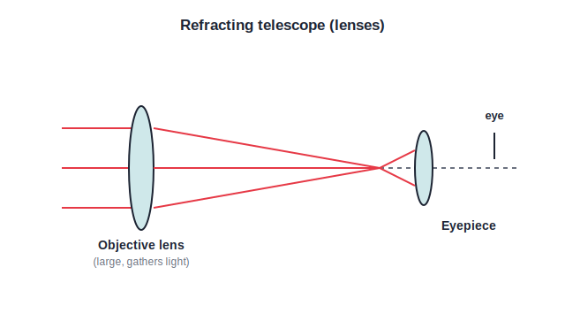
STD 9 • SCIENCE & TECHNOLOGY • ASTRONOMY
Observing Space: Telescopes
Observing space • Optical telescopes • Radio telescopes • Space telescopes and ISRO

Slide 2
INTRODUCTION
Learning Objectives
1
Explain why telescopes are needed to observe space
2
Describe the working of a refracting telescope
3
Describe the working of a reflecting telescope
4
Explain how a radio telescope observes space
5
State why some telescopes are placed in space
6
Name Indian contributions such as the GMRT and AstroSat
Notes:
Open by previewing these objectives so students know what they should be able to do by the end of the session.

Slide 3
PART 1
Optical Telescopes
1
Seeing the universe with lenses and mirrors

Slide 4
WHY TELESCOPES
Observing Space
Faint and far
Objects in space are very far away and their light is very faint.
Gather more light
A telescope collects far more light than the eye, so faint objects become visible.
Magnify
It also produces a larger image of a distant object.
Different forms of light
Space objects also send radio waves, X-rays and more, so different telescopes are needed for different radiations.
Notes:
Set up the two families coming next: optical telescopes for visible light, radio telescopes for radio waves.

Slide 5
REFRACTING
Refracting Telescope
Two lenses: objective + eyepiece
• Made of lenses
• A large objective lens gathers light from the object
• It forms a small real image inside the tube
• The eyepiece magnifies that image for the eye
• Bigger objective → brighter, sharper view
Notes:
The objective is made as large as possible to collect the maximum light from faint, distant objects.

Slide 6
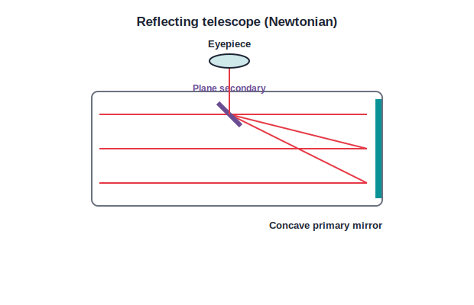
REFLECTING
Reflecting Telescope
Mirrors gather the light
• Uses a concave mirror instead of an objective lens
• The concave primary mirror gathers and converges the light
• A small secondary mirror sends it to the eyepiece
• Newtonian: concave + plane mirror
• Cassegrain: concave + convex mirror
Notes:
Large mirrors are easier and cheaper to make than large lenses, so the biggest telescopes are reflectors.

Slide 7
QUIZ 1
Check — Optical Telescopes
4 questions • think before the answer reveals on the next slide

Slide 8
QUIZ QUESTION
Q1 — Purpose
The main reason a telescope helps us see faint space objects is that it:
makes them hotter
collects much more light than the eye
A
B
slows the light down
changes their colour
C
D

Slide 9
ANSWER REVEALED
Q1 — Purpose
The main reason a telescope helps us see faint space objects is that it:
makes them hotter
collects much more light than the eye
A
✓
slows the light down
changes their colour
C
D
WHY
A large objective lens or mirror gathers far more light than the pupil, making faint objects visible and magnified.

Slide 10
QUIZ QUESTION
Q2 — Refracting
A refracting telescope is made using:
mirrors
lenses
A
B
radio dishes
prisms only
C
D

Slide 11
ANSWER REVEALED
Q2 — Refracting
A refracting telescope is made using:
mirrors
lenses
A
✓
radio dishes
prisms only
C
D
WHY
A refracting telescope uses a large objective lens and a smaller eyepiece lens.

Slide 12
QUIZ QUESTION
Q3 — Reflecting
In a reflecting telescope, the light is first gathered by a:
convex lens
concave mirror
A
B
plane mirror
prism
C
D

Slide 13
ANSWER REVEALED
Q3 — Reflecting
In a reflecting telescope, the light is first gathered by a:
convex lens
concave mirror
A
✓
plane mirror
prism
C
D
WHY
The concave primary mirror collects and converges the light; a secondary mirror directs it to the eyepiece.

Slide 14
QUIZ QUESTION
Q4 — Objective
The objective of a telescope is made large mainly to:
magnify more
gather the maximum light
A
B
reduce its cost
make it lighter
C
D

Slide 15
ANSWER REVEALED
Q4 — Objective
The objective of a telescope is made large mainly to:
magnify more
gather the maximum light
A
✓
reduce its cost
make it lighter
C
D
WHY
A larger objective collects more light from faint, distant objects, giving a brighter and clearer image.

Slide 16
PART 2
Radio and Space Telescopes
2
Beyond visible light, and above the atmosphere

Slide 17
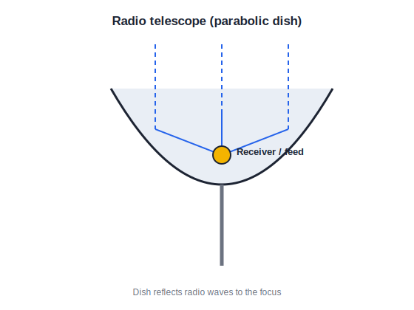
RADIO
Radio Telescope
Listening to the universe
• Many space objects emit radio waves, not just light
• A large parabolic dish reflects the radio waves
• They converge to a receiver at the focus
• A computer builds an image from the signal
• India's GMRT (near Pune) is one of the largest
Notes:
The GMRT (Giant Metrewave Radio Telescope) at Narayangaon near Pune is a major Indian radio-astronomy facility.

Slide 18
SPACE TELESCOPES
Telescopes in Space and Indian Missions
Why go to space
The atmosphere blurs and absorbs light, so telescopes placed in space give much clearer views.
Above the air
Space telescopes also observe X-rays and ultraviolet rays that the atmosphere blocks.
AstroSat
India's AstroSat is a space observatory that studies the sky in several kinds of radiation at once.
ISRO
The Indian Space Research Organisation builds and launches these observatories and satellites.
Notes:
Link back to the different forms of light: some radiations can only be observed from above the atmosphere.

Slide 19
WRAP UP
Quick Recap
✓ Why telescopes — Gather more light and magnify faint, distant objects.
✓ Refracting — Objective lens + eyepiece lens.
✓ Reflecting — Concave primary mirror + secondary mirror (Newtonian, Cassegrain).
✓ Radio telescope — Parabolic dish focuses radio waves onto a receiver; GMRT near Pune.
✓ Space telescopes — Placed above the atmosphere for clearer views; India's AstroSat.
Notes:
Cold-call the difference between a refracting and a reflecting telescope, and one Indian facility.

Slide 20
QUIZ 2
Final Check — Radio & Space
4 questions • think before the answer reveals on the next slide

Slide 21
QUIZ QUESTION
Q1 — Radio telescope
A radio telescope collects radio waves using a large:
convex lens
parabolic dish
A
B
concave lens
prism
C
D

Slide 22
ANSWER REVEALED
Q1 — Radio telescope
A radio telescope collects radio waves using a large:
convex lens
parabolic dish
A
✓
concave lens
prism
C
D
WHY
The dish reflects the incoming radio waves to a receiver at its focus, where a computer builds an image.

Slide 23
QUIZ QUESTION
Q2 — GMRT
The Giant Metrewave Radio Telescope (GMRT) is located near:
Bengaluru
Pune
A
B
Chennai
Delhi
C
D

Slide 24
ANSWER REVEALED
Q2 — GMRT
The Giant Metrewave Radio Telescope (GMRT) is located near:
Bengaluru
Pune
A
✓
Chennai
Delhi
C
D
WHY
The GMRT, one of the world's largest radio telescopes, is at Narayangaon near Pune.

Slide 25
QUIZ QUESTION
Q3 — Space telescope
Telescopes are placed in space mainly because:
space is closer to the stars
the atmosphere blurs and absorbs light
A
B
it is cheaper
there is no gravity
C
D

Slide 26
ANSWER REVEALED
Q3 — Space telescope
Telescopes are placed in space mainly because:
space is closer to the stars
the atmosphere blurs and absorbs light
A
✓
it is cheaper
there is no gravity
C
D
WHY
Above the atmosphere the view is much clearer, and radiations that the air blocks can also be observed.

Slide 27
QUIZ QUESTION
Q4 — AstroSat
India's dedicated space observatory that studies several radiations at once is:
Chandrayaan
AstroSat
A
B
Mangalyaan
GMRT
C
D

Slide 28
ANSWER REVEALED
Q4 — AstroSat
India's dedicated space observatory that studies several radiations at once is:
Chandrayaan
AstroSat
A
✓
Mangalyaan
GMRT
C
D
WHY
AstroSat is India's multi-wavelength space observatory, launched by ISRO.

Slide 29
Windows on the Universe
Lenses, mirrors and giant dishes — on the ground and in space — let us gather faint light and radio waves from across the cosmos.

