Slide 1
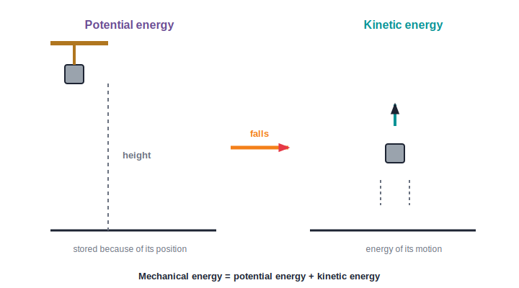
STD 6 • GENERAL SCIENCE • WORK AND ENERGY
Work and Energy
When is work done? • Energy • Potential and kinetic • Forms of energy • Sources of energy

Slide 2
INTRODUCTION
Learning Objectives
1
State clearly when work is said to be done
2
Explain that energy is the capacity to do work
3
Tell potential energy apart from kinetic energy
4
Name and describe the main forms of energy
5
Trace how energy changes from one form to another
6
Tell conventional from non-conventional energy sources
Notes:
Open by previewing these objectives so students know what they should be able to do by the end of the session.

Slide 3
PART 1
Work and Energy
1
What 'work' means in science, and what energy is

Slide 4
WORK
What is Work?
In science, work is done only when a force is applied to an object AND the object moves in the direction of the force.
• A force alone is not enough — the object must move.
• Movement alone is not enough — a force must cause it.
• Both together — a force and a movement — mean work is done.
Notes:
Nail the scientific definition of work: a force AND a displacement caused by it. This is different from the everyday sense of 'work'.

Slide 5

WORK OR NOT?
Is Work Being Done?
Lifting a bag ✔
Pushing a moving cart ✔
You apply an upward force and the bag moves up — work is done.
Your push moves the cart forward — work is done.
Pushing a still wall ✗
Holding a suitcase ✗
You push hard but the wall does not move — no work is done.
You hold it still; it does not move, so no scientific work is done.
Notes:
Sort clear cases of work from no-work. The key check every time: did the object actually move because of the force?

Slide 6
EVERYDAY VS SCIENCE
Two Meanings of 'Work'
Everyday meaning
Anything that makes us tired — studying, standing guard, thinking hard.
Scientific meaning
Only a force that moves an object through a distance.
Reading a book
May tire us, but nothing is moved by a force, so no scientific work is done.
Why it matters
Science needs one exact meaning so that work can be measured and compared.
Notes:
Separate the tiring, everyday sense of work from the precise scientific one. Only the scientific meaning can be measured.

Slide 7
ENERGY
Energy — the Capacity to Do Work
Energy is the capacity, or the ability, to do work. Anything that can do work has energy.
• We get our energy from the food we eat.
• Machines get energy from fuel, electricity or wind.
• The more energy a body has, the more work it can do.
Notes:
Define energy as the capacity to do work, and connect it to familiar sources — food for us, fuel and electricity for machines.

Slide 8
UNIT
Measuring Work and Energy
Same unit
Work and energy are measured in the same unit — the joule (J).
Why the same
Doing work uses up energy, so both are measured alike.
Small and large
One joule is small; lifting a school bag uses many joules.
Never destroyed
Energy is never lost — it only changes from one form into another.
Notes:
Both work and energy share the unit joule, because doing work spends energy. Introduce the idea that energy only changes form.

Slide 9
MECHANICAL ENERGY
Potential and Kinetic Energy
Stored vs moving
• Mechanical energy has two kinds: potential and kinetic.
• Potential energy is stored because of position or state.
• Kinetic energy is the energy of a moving object.
• As stored energy is released, it turns into energy of motion.
Potential energy → kinetic energy
Notes:
Mechanical energy = potential + kinetic. Stored energy becomes energy of motion when it is released.

Slide 10
POTENTIAL ENERGY
Energy That is Stored
Because of height
Water held high in a dam and a stone on a hill have potential energy.
Because of state
A stretched bow and a wound-up spring store potential energy.
Ready to act
This stored energy can do work the moment it is released.
Example
Release the bow and the stored energy shoots the arrow.
Notes:
Potential energy is stored by position (height) or by state (stretched/compressed). It is 'ready' energy waiting to act.

Slide 11
KINETIC ENERGY
Energy of Motion
Any moving body
A running child, a moving bus and a spinning fan all have kinetic energy.
Flowing water
A river and a waterfall carry large kinetic energy.
Blowing wind
Moving air has kinetic energy that can turn a windmill.
More speed, more energy
The faster a body moves, the more kinetic energy it has.
Notes:
Kinetic energy belongs to anything in motion — vehicles, water, wind. Faster motion means more kinetic energy.

Slide 12

PE ↔ KE
Watching Energy Change Kind
A falling stone
A swinging swing
Loses height (potential) and speeds up (kinetic) as it falls.
Highest point is all potential; lowest point is all kinetic.
Dam water
A drawn bow
Stored high (potential), it rushes down (kinetic) to the turbine.
Stored in the bent bow (potential), released into the flying arrow (kinetic).
Notes:
Everyday examples where potential and kinetic energy swap back and forth — swing, dam, bow, falling stone.

Slide 13
WORK IN LIFE
Work We Do Every Day
Lifting
Pushing & pulling
Raising a bucket of water from a well against gravity.
Moving a cart or dragging a box across the floor.
Climbing
Throwing
Walking up a staircase lifts our body — that is work.
Giving a ball a push sets it moving — work is done on it.
Notes:
Ground the idea of work in everyday actions — lifting, pushing, climbing, throwing — where a force clearly moves something.

Slide 14
QUIZ 1
Check — Work, Energy & Its Two Kinds
4 questions • think before the answer reveals on the next slide

Slide 15
QUIZ QUESTION
Q1 — When is work done
In science, work is done only when a force:
Is very large
Moves an object through a distance
A
B
Is applied by a machine
Makes us tired
C
D

Slide 16
ANSWER REVEALED
Q1 — When is work done
In science, work is done only when a force:
Is very large
Moves an object through a distance
A
✓
Is applied by a machine
Makes us tired
C
D
WHY
Work needs both a force and a movement (displacement). If nothing moves, no scientific work is done.

Slide 17
QUIZ QUESTION
Q2 — No work
In which case is no scientific work done?
Lifting a bucket of water
Pushing a car that starts moving
A
B
Pushing hard against a wall that does not move
Kicking a ball
C
D

Slide 18
ANSWER REVEALED
Q2 — No work
In which case is no scientific work done?
Lifting a bucket of water
Pushing a car that starts moving
A
B
Pushing hard against a wall that does not move
Kicking a ball
✓
D
WHY
However hard we push, if the wall does not move there is no displacement, so no work is done in the scientific sense.

Slide 19
QUIZ QUESTION
Q3 — Potential energy
Which of these has potential energy stored because of its position?
A running boy
Water held high in a dam
A
B
A moving bus
A spinning fan
C
D

Slide 20
ANSWER REVEALED
Q3 — Potential energy
Which of these has potential energy stored because of its position?
A running boy
Water held high in a dam
A
✓
A moving bus
A spinning fan
C
D
WHY
Water stored high in a dam has potential energy because of its raised position; the others are examples of kinetic energy.

Slide 21
QUIZ QUESTION
Q4 — Unit
Work and energy are both measured in the same unit, the:
Metre
Joule
A
B
Second
Newton
C
D

Slide 22
ANSWER REVEALED
Q4 — Unit
Work and energy are both measured in the same unit, the:
Metre
Joule
A
✓
Second
Newton
C
D
WHY
Energy is the capacity to do work, so it is measured in the same unit as work — the joule (J).

Slide 23
PART 2
Forms of Energy
2
The many forms of energy, how they change, and where they come from

Slide 24
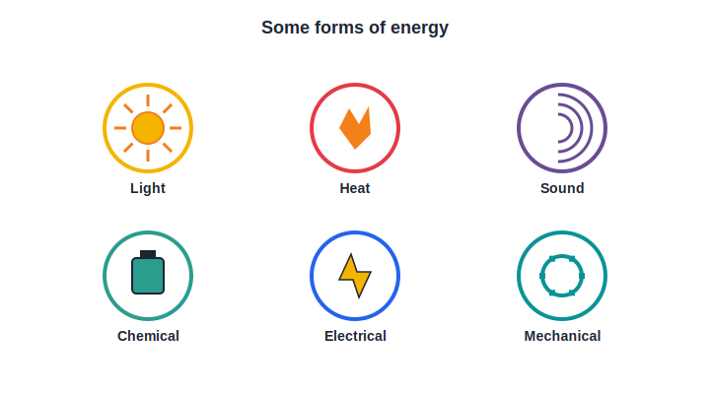
FORMS
Forms of Energy
Many forms
• Energy appears in many different forms around us.
• Light, heat, sound, chemical, electrical and mechanical are some forms.
• The Sun is our greatest source of light and heat energy.
• Food and fuels store chemical energy for later use.
Some everyday forms of energy
Notes:
Name the main forms of energy. The Sun is the chief source; food and fuels hold chemical energy.

Slide 25




FORMS I
A Closer Look — Four Forms
Light energy
Heat energy
Lets us see; comes from the Sun, a lamp or a flame.
Warms things and cooks food; comes from the Sun and from burning fuel.
Sound energy
Chemical energy
Carried by vibrations; reaches us as music, speech and noise.
Stored in food, fuels and cells, and released when they are used.
Notes:
Describe light, heat, sound and chemical energy with an everyday source for each.

Slide 26
FORMS II
A Closer Look — More Forms
Mechanical energy
Electrical energy
The energy of position and motion — potential plus kinetic.
Flows through wires to run our lights, fans and gadgets.
Solar energy
Wind & water
Energy from the Sun, caught by solar panels and cookers.
Moving air and flowing water carry energy we can harness.
Notes:
Describe mechanical, electrical, solar and wind/water energy — the forms we most often turn into useful work.

Slide 27
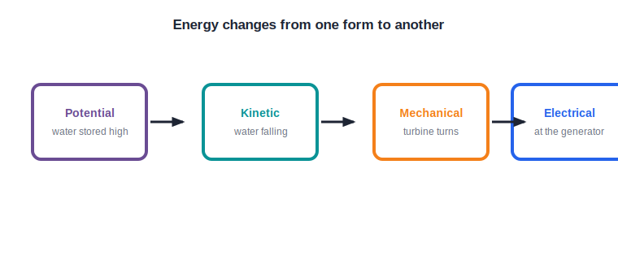
CONVERSION
Energy Changes its Form
One form to another
• Energy can change from one form into another.
• In a hydro-power dam, stored water starts to fall.
• Its potential energy becomes kinetic, which spins a turbine.
• The turning turbine runs a generator, giving electrical energy.
Potential → kinetic → mechanical → electrical
Notes:
Trace the energy conversion chain in a hydro-electric dam: potential → kinetic → mechanical → electrical.

Slide 28
CONVERSIONS
Energy Conversions Around Us
Electric bulb
Loudspeaker
Electrical energy → light energy (and some heat).
Electrical energy → sound energy.
Burning candle
Solar cooker
Chemical energy → light and heat energy.
Light/heat from the Sun → heat energy that cooks food.
Notes:
Everyday devices are energy converters. Ask students to name the 'before' and 'after' form for each.

Slide 29
CONSERVATION
Energy is Never Lost
Energy can change from one form to another, but it is never created out of nothing and never destroyed.
• Every device simply changes energy from one form to another.
• The total amount of energy always stays the same.
• Because of this, we must use our energy sources wisely.
Notes:
Introduce the conservation idea at a Std 6 level: energy only changes form, the total stays the same — which is why saving energy matters.

Slide 30
SOURCES
Two Kinds of Energy Sources
Conventional
They run out
Long-used sources — coal, petroleum and natural gas (the fossil fuels).
Fossil fuels took millions of years to form and will one day be used up.
Non-conventional
They renew
Renewable sources — the Sun, wind, flowing water and biogas.
These sources keep being replaced by nature and do not run out.
Notes:
Conventional (fossil, limited) vs non-conventional (renewable). The key contrast is 'runs out' vs 'renews'.

Slide 31
CLEAN ENERGY
Why We Turn to Clean Energy
Fossil fuels pollute
Burning coal and petrol dirties the air and warms the planet.
They are limited
There is only so much coal, oil and gas left in the Earth.
Sun and wind are clean
Solar and wind energy give power without polluting.
Can be reused
Renewable sources are available again and again, day after day.
Notes:
The case for non-conventional energy: fossil fuels are limited and polluting; solar and wind are clean and renewable.

Slide 32
SAVE ENERGY
Using Energy Wisely
Switch off
Turn off lights and fans when they are not needed.
Natural light
Use daylight and natural air where you can.
Walk or cycle
Save fuel by walking or cycling for short trips.
Choose efficient
Use star-rated, energy-saving appliances at home.
Notes:
Simple, practical energy-saving habits students can adopt, linking back to conservation.

Slide 33
THE SUN
The Sun — the Source of Most Energy
Almost all the energy we use can be traced back to the Sun, our nearest star.
• Plants trap the Sun's energy; our food comes from plants.
• Coal and petroleum formed from plants and animals of long ago.
• The Sun's heat also stirs the winds and lifts water into the clouds.
Notes:
Tie the forms and sources together: the Sun is the ultimate source of food energy, fossil fuels, wind and the water cycle.

Slide 34
WRAP UP
Quick Recap
✓ Work — force × movement; no movement, no work
✓ Energy — the capacity to do work; unit joule
✓ Potential — stored energy — dam water, stretched bow
✓ Kinetic — energy of motion — falling water, running
✓ Forms — light, heat, sound, chemical, electrical…
✓ Sources — conventional (fossil) vs non-conventional (clean)
Notes:
Recap work, energy, its two mechanical kinds, the forms and the sources.

Slide 35
QUIZ 2
Final Check — Forms of Energy
4 questions • think before the answer reveals on the next slide

Slide 36
QUIZ QUESTION
Q1 — Kinetic energy
A waterfall's rushing water is an example of:
Potential energy
Kinetic energy
A
B
Chemical energy
No energy
C
D

Slide 37
ANSWER REVEALED
Q1 — Kinetic energy
A waterfall's rushing water is an example of:
Potential energy
Kinetic energy
A
✓
Chemical energy
No energy
C
D
WHY
The falling, moving water has kinetic energy — the energy an object has because of its motion.

Slide 38
QUIZ QUESTION
Q2 — Conversion
In a hydro-power station, the potential energy of stored water is finally changed into ___ energy.
Sound
Chemical
A
B
Electrical
Light
C
D

Slide 39
ANSWER REVEALED
Q2 — Conversion
In a hydro-power station, the potential energy of stored water is finally changed into ___ energy.
Sound
Chemical
A
B
Electrical
Light
✓
D
WHY
Falling water (kinetic) spins a turbine (mechanical), which runs a generator to give electrical energy.

Slide 40
QUIZ QUESTION
Q3 — Chemical energy
The energy stored in food and fuels is mainly:
Sound energy
Chemical energy
A
B
Light energy
Mechanical energy
C
D

Slide 41
ANSWER REVEALED
Q3 — Chemical energy
The energy stored in food and fuels is mainly:
Sound energy
Chemical energy
A
✓
Light energy
Mechanical energy
C
D
WHY
Food and fuels store chemical energy, which is released when they are used up by our body or burnt.

Slide 42
QUIZ QUESTION
Q4 — Non-conventional
Which of these is a non-conventional (renewable) source of energy?
Coal
Petroleum
A
B
Solar energy
Natural gas
C
D

Slide 43
ANSWER REVEALED
Q4 — Non-conventional
Which of these is a non-conventional (renewable) source of energy?
Coal
Petroleum
A
B
Solar energy
Natural gas
✓
D
WHY
Solar energy comes from the Sun and does not run out, so it is a non-conventional, renewable source; the others are fossil fuels.

Slide 44
Energy Everywhere
From lifting a bag to lighting a city, work and energy explain how everything gets done — and why we must use energy wisely.

