Slide 1
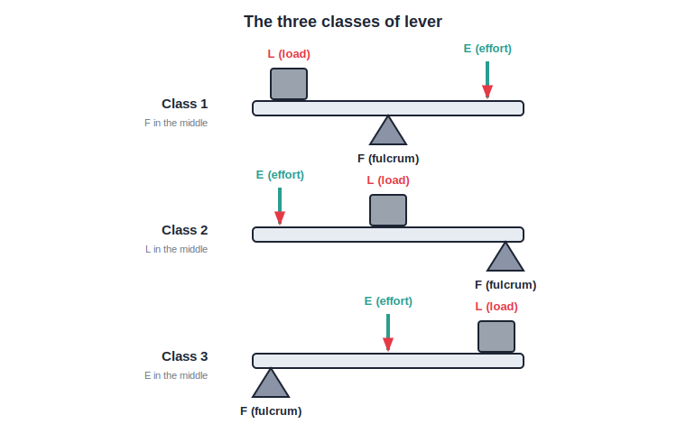
STD 6 • GENERAL SCIENCE • SIMPLE MACHINES
Simple Machines
Machines make work easier • Inclined plane • wedge • screw • Lever • pulley • wheel and axle • Care of machines

Slide 2
INTRODUCTION
Learning Objectives
1
Explain how a machine makes work easier
2
Tell simple machines from complex machines
3
Describe the inclined plane, the wedge and the screw
4
Describe a lever and name its three classes
5
Explain a pulley and a wheel and axle
6
See why machines need care and maintenance
Notes:
Open by previewing these objectives so students know what they should be able to do by the end of the session.

Slide 3
PART 1
Machines and the Inclined Plane
1
What a machine does, and the inclined-plane family

Slide 4
MACHINE
What is a Machine?
A machine is a device that makes our work easier, faster or more convenient to do.
• It may let us use a smaller effort to move a big load.
• It may let us apply the force in a handier direction.
• It may simply help us work faster or more safely.
Notes:
Define a machine by what it does for us — less effort, a better direction, or faster/safer work.

Slide 5


SIMPLE VS COMPLEX
Two Kinds of Machines
Simple machine
Complex machine
Has few or no moving parts — a lever, pulley, ramp, wheel and axle, wedge or screw.
Made by joining several simple machines together.
A bicycle
A sewing machine
A complex machine — it uses levers, wheels-and-axles and more.
Also complex, built from many simple machines working together.
Notes:
Simple machines are the building blocks; complex machines like a bicycle or sewing machine combine several of them.

Slide 6
THE SIX
The Six Simple Machines
Inclined plane
A sloping surface, such as a ramp.
Wedge and screw
Two special forms of the inclined plane.
Lever
A rigid bar that turns about a fixed point.
Pulley and wheel-and-axle
Turning machines that lift and drive loads.
Notes:
Preview the six simple machines that the rest of the chapter explains one by one.

Slide 7
HOW THEY HELP
A Machine Changes the Force
A simple machine changes the size or the direction of the force we apply — but it cannot do the work for free.
• Smaller effort: a ramp lets us push a load up gently.
• Handier direction: a pulley lets us pull down to lift up.
• There is always a trade — usually a longer distance to move.
Notes:
Machines change the size or direction of force. Hint at the trade-off: a smaller effort over a longer distance.

Slide 8
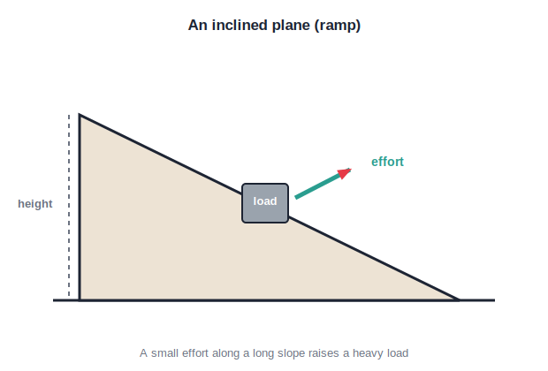
INCLINED PLANE
The Inclined Plane
A sloping surface
• An inclined plane is a slanting, sloping surface.
• It lets us raise a load with a smaller effort.
• A ramp, a staircase and a slide are inclined planes.
• The gentler (longer) the slope, the smaller the effort needed.
A ramp raises a load with less effort
Notes:
The inclined plane trades a longer push for a smaller effort. Ramps, stairs and slides are examples.

Slide 9
RAMPS AT WORK
Inclined Planes Around Us
Loading ramp
Wheelchair ramp
Heavy drums are rolled up a plank into a truck.
A gentle slope replaces steps for easy access.
Hill roads
Staircase
Winding roads climb a hill gradually, not straight up.
A staircase is a folded-up inclined plane.
Notes:
Real inclined planes: loading ramps, wheelchair ramps, hill roads and staircases — all trade distance for easier effort.

Slide 10
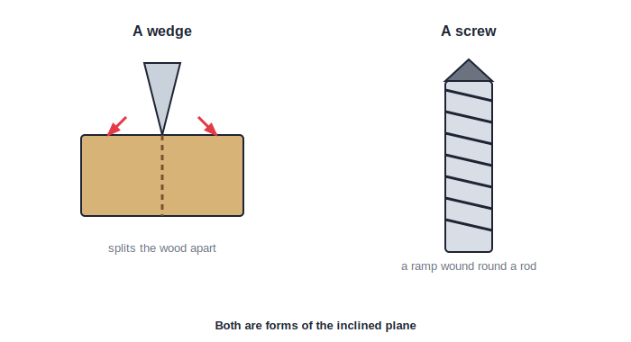
WEDGE & SCREW
The Wedge and the Screw
Two clever ramps
• A wedge is two inclined planes joined to a sharp edge.
• A wedge cuts or splits — an axe, a knife, a needle.
• A screw is an inclined plane wound round a rod.
• Both are really the inclined plane in another form.
The wedge splits; the screw grips
Notes:
The wedge (axe, knife) and the screw are both forms of the inclined plane — a good way to link the three.

Slide 11
WEDGE & SCREW USES
Where We Meet Them
The wedge cuts
The wedge holds
Axes, knives, chisels and needles all have a wedge edge.
A door wedge slipped under a door holds it open.
The screw joins
The screw lifts
Screws fasten pieces of wood or metal firmly together.
A screw jack raises a car; a bottle's cap is a screw.
Notes:
The wedge cuts, splits and holds; the screw joins and lifts. Both come from the humble inclined plane.

Slide 12
NO FREE WORK
Machines Make Work Easier — Not Less
A simple machine makes a job easier to do, but we still have to put in the work; it is not created for free.
• A ramp needs a smaller push, but over a longer path.
• The effort is smaller; the distance is larger.
• So a machine spreads the same work into an easier form.
Notes:
Correct the common idea that machines reduce the work itself. They reduce the effort, but you move a longer distance.

Slide 13
WHY MACHINES
Why We Use Machines
Less effort
Save time
They let a small effort move a big load.
Jobs get done faster than by bare hands.
Reach & convenience
Hard jobs possible
They let us work from a handy position or direction.
Some jobs simply cannot be done without a machine.
Notes:
Sum up the benefits of machines — less effort, saved time, convenience, and making hard jobs possible — before the quiz.

Slide 14
QUIZ 1
Check — Machines & the Inclined Plane
4 questions • think before the answer reveals on the next slide

Slide 15
QUIZ QUESTION
Q1 — Purpose
The main purpose of a simple machine is to:
Make work harder
Make our work easier or faster
A
B
Use more energy
Slow us down
C
D

Slide 16
ANSWER REVEALED
Q1 — Purpose
The main purpose of a simple machine is to:
Make work harder
Make our work easier or faster
A
✓
Use more energy
Slow us down
C
D
WHY
A machine lets us do a job with less effort, or in a more convenient way — it makes work easier.

Slide 17
QUIZ QUESTION
Q2 — Inclined plane
Which of these is an example of an inclined plane?
A pair of scissors
A ramp for wheelchairs
A
B
A pulley on a well
A see-saw
C
D

Slide 18
ANSWER REVEALED
Q2 — Inclined plane
Which of these is an example of an inclined plane?
A pair of scissors
A ramp for wheelchairs
A
✓
A pulley on a well
A see-saw
C
D
WHY
A ramp is a slanting surface — an inclined plane — that lets a load be raised with a smaller effort.

Slide 19
QUIZ QUESTION
Q3 — The wedge
An axe used to split wood works as a:
Pulley
Wheel and axle
A
B
Wedge
Lever only
C
D

Slide 20
ANSWER REVEALED
Q3 — The wedge
An axe used to split wood works as a:
Pulley
Wheel and axle
A
B
Wedge
Lever only
✓
D
WHY
The sharp blade of an axe is a wedge — two inclined planes meeting at an edge — that splits the wood apart.

Slide 21
QUIZ QUESTION
Q4 — The screw
A screw is best described as:
A straight rod
An inclined plane wound round a rod
A
B
A kind of pulley
A first-class lever
C
D

Slide 22
ANSWER REVEALED
Q4 — The screw
A screw is best described as:
A straight rod
An inclined plane wound round a rod
A
✓
A kind of pulley
A first-class lever
C
D
WHY
If you imagine unwinding the thread of a screw, it forms a long inclined plane — that is exactly what a screw is.

Slide 23
PART 2
Levers, Pulleys and the Wheel & Axle
2
The turning and lifting machines, and caring for them

Slide 24
LEVER
The Lever
Fulcrum • load • effort
• A lever is a rigid bar that can turn about a fixed point.
• The fixed point is called the fulcrum.
• The load is the weight we want to move.
• The effort is the force we apply to move it.
The three parts of every lever
Notes:
Define the three parts of a lever — fulcrum, load and effort — before sorting the three classes.

Slide 25
CLASS 1
First-Class Lever
Fulcrum in the middle
The fulcrum lies between the load and the effort.
See-saw
The pivot is in the centre, with a child on each side.
Scissors
Two first-class levers joined at a central pivot.
Also
A crowbar and a pair of pliers work this way.
Notes:
First-class lever: fulcrum between load and effort — see-saw, scissors, crowbar, pliers.

Slide 26
CLASS 2
Second-Class Lever
Load in the middle
The load lies between the fulcrum and the effort.
Wheelbarrow
The wheel is the fulcrum; the load sits in the middle.
Bottle opener
Lifts the cap with the load between hinge and hand.
Nutcracker
Cracks the nut placed between the pivot and your grip.
Notes:
Second-class lever: load between fulcrum and effort — wheelbarrow, bottle opener, nutcracker.

Slide 27
CLASS 3
Third-Class Lever
Effort in the middle
The effort is applied between the fulcrum and the load.
A pair of tongs
You press in the middle to grip food at the end.
Fishing rod
Your hand lifts in the middle to raise the far tip.
Forearm
Even our own forearm lifting a weight is a third-class lever.
Notes:
Third-class lever: effort between fulcrum and load — tongs, fishing rod, our forearm.

Slide 28
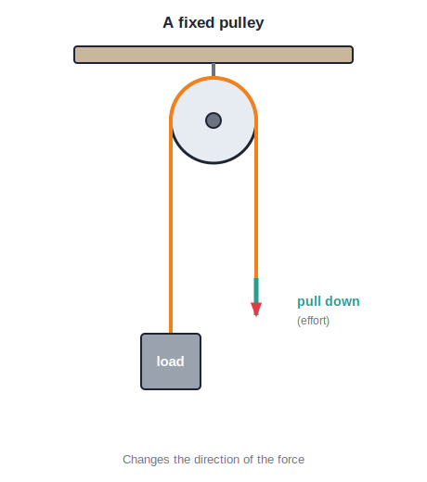
PULLEY
The Pulley
Pull down to lift up
• A pulley is a grooved wheel with a rope over it.
• A single fixed pulley changes the direction of the force.
• We pull down on the rope to raise a load up.
• Pulling down is easier because we can use our body weight.
A fixed pulley changes direction
Notes:
A fixed pulley does not reduce the effort but changes its direction, so pulling down (easy) raises the load up.

Slide 29

PULLEYS AT WORK
Where Pulleys Help
Water from a well
Hoisting a flag
A rope over a pulley lifts the bucket up easily.
The flag rides up the pole on a pulley rope.
A crane
Lifts and cranes
Big pulleys let cranes lift very heavy loads.
Several pulleys together can share a huge load.
Notes:
Pulleys at work: wells, flagpoles, cranes and lifts. Combined pulleys can even reduce the effort needed.

Slide 30
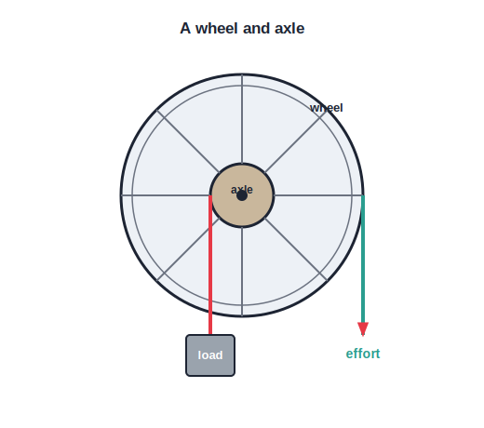
WHEEL & AXLE
The Wheel and Axle
Big wheel, small axle
• A large wheel is fixed to a thin rod called the axle.
• Turning the big wheel easily turns the axle with force.
• A steering wheel, a screwdriver and a doorknob use it.
• It makes turning and twisting jobs much easier.
Turn the wheel to turn the axle
Notes:
In the wheel and axle a large wheel turns a small axle, giving a turning advantage — steering wheels, screwdrivers, doorknobs.

Slide 31
MAINTENANCE
Taking Care of Machines
Oiling
Cleaning
Oil and grease reduce friction between moving parts.
Dust and dirt wear parts out, so keep machines clean.
Preventing rust
Regular checks
Paint or oil stops iron parts from rusting.
Timely repairs keep a machine safe and long-lasting.
Notes:
Machines need maintenance — oiling, cleaning, rust-proofing and checks — to reduce friction, last longer and stay safe.

Slide 32
COMPARE LEVERS
The Three Lever Classes at a Glance
Class 1
Fulcrum in the middle — see-saw, scissors, crowbar.
Class 2
Load in the middle — wheelbarrow, bottle opener, nutcracker.
Class 3
Effort in the middle — tongs, fishing rod, our forearm.
The trick
Just ask which part — F, L or E — sits in the middle.
Notes:
A single comparison slide for the three lever classes, with the quick trick: identify which part is in the middle.

Slide 33
WHEEL & AXLE USES
The Wheel and Axle Around Us
Steering wheel
Screwdriver
Turns the thin steering shaft of a vehicle.
The fat handle (wheel) turns the thin blade (axle).
Doorknob & tap
Pencil sharpener
A round knob or tap turns a thin spindle inside.
The handle turns the small cutting axle.
Notes:
More wheel-and-axle examples from daily life — steering wheel, screwdriver, doorknob, tap, sharpener.

Slide 34
WRAP UP
Quick Recap
✓ Machine — a device that makes work easier
✓ Inclined plane — a slope; ramp, stairs, slide
✓ Wedge & screw — inclined planes in other shapes
✓ Lever — bar on a fulcrum; three classes
✓ Pulley — grooved wheel; changes force direction
✓ Wheel & axle — big wheel turns a small axle
Notes:
Recap the six simple machines and how each helps us work.

Slide 35
QUIZ 2
Final Check — Levers, Pulleys & Wheels
4 questions • think before the answer reveals on the next slide

Slide 36
QUIZ QUESTION
Q1 — Fulcrum
The fixed point about which a lever turns is called the:
Load
Effort
A
B
Fulcrum
Axle
C
D

Slide 37
ANSWER REVEALED
Q1 — Fulcrum
The fixed point about which a lever turns is called the:
Load
Effort
A
B
Fulcrum
Axle
✓
D
WHY
A lever turns about a fixed point called the fulcrum; the load is what we move and the effort is the force we apply.

Slide 38
QUIZ QUESTION
Q2 — Class of lever
In a see-saw, the fulcrum lies between the load and the effort. This makes it a:
Class 1 lever
Class 2 lever
A
B
Class 3 lever
Not a lever
C
D

Slide 39
ANSWER REVEALED
Q2 — Class of lever
In a see-saw, the fulcrum lies between the load and the effort. This makes it a:
Class 1 lever
Class 2 lever
✓
B
Class 3 lever
Not a lever
C
D
WHY
When the fulcrum is in the middle, between the load and the effort, the lever is a first-class lever — like a see-saw or scissors.

Slide 40
QUIZ QUESTION
Q3 — Second-class lever
In which of these is the load between the fulcrum and the effort?
A see-saw
A wheelbarrow
A
B
A pair of tongs
A fishing rod
C
D

Slide 41
ANSWER REVEALED
Q3 — Second-class lever
In which of these is the load between the fulcrum and the effort?
A see-saw
A wheelbarrow
A
✓
A pair of tongs
A fishing rod
C
D
WHY
In a wheelbarrow the wheel is the fulcrum and the load sits between it and your hands (the effort) — a second-class lever.

Slide 42
QUIZ QUESTION
Q4 — Wheel and axle
Which everyday device is an example of a wheel and axle?
A knife
A ramp
A
B
A steering wheel
A see-saw
C
D

Slide 43
ANSWER REVEALED
Q4 — Wheel and axle
Which everyday device is an example of a wheel and axle?
A knife
A ramp
A
B
A steering wheel
A see-saw
✓
D
WHY
A steering wheel (the large wheel) turns a thin shaft (the axle), so it is a wheel-and-axle machine.

Slide 44
Work Made Easy
From a simple ramp to a turning wheel, simple machines let a small effort do a big job — and clever machines just combine them.

