Slide 1
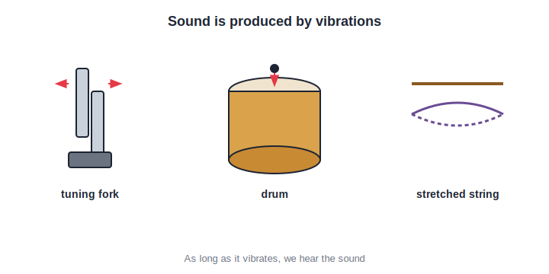
STD 6 • GENERAL SCIENCE • SOUND
Sound
Sound from vibrations • How sound travels • Sound needs a medium • The ear • Noise and its control

Slide 2
INTRODUCTION
Learning Objectives
1
Explain that sound is produced by vibrations
2
Describe how sound travels through a medium as a wave
3
Show that sound cannot travel through a vacuum
4
Compare how fast sound travels in solids, liquids and gases
5
Tell a pleasant sound from noise
6
Explain noise pollution and how to reduce it
Notes:
Open by previewing these objectives so students know what they should be able to do by the end of the session.

Slide 3
PART 1
Making Sound and How It Travels
1
Vibrations, the medium, the ear and the sound wave

Slide 4
PRODUCTION
Sound is Made by Vibrations
Vibration makes sound
• Every sound is produced by a vibrating object.
• A vibration is a fast to-and-fro movement.
• A drum, a bell, a string and our vocal cords all vibrate.
• As long as the object vibrates, we keep hearing the sound.
Vibrating bodies make sound
Notes:
Sound always begins with a vibration — a fast to-and-fro motion. Touch a ringing bell to feel it vibrate.

Slide 5
KEY IDEA
No Vibration, No Sound
A body makes a sound only while it is vibrating. The moment the vibration stops, the sound stops too.
• Pluck a stretched rubber band — it vibrates and hums.
• Touch it to stop the vibration — the sound stops at once.
• Strike a bell, then hold it — the ringing dies away.
Notes:
Reinforce the direct link: sound lasts exactly as long as the vibration. Damping the vibration kills the sound.

Slide 6
VIBRATING SOURCES
Things That Vibrate to Make Sound
Musical instruments
A drum skin, a sitar string and a flute's air column all vibrate.
Our voice
Air from the lungs makes the vocal cords in the larynx vibrate.
A bell
The metal of a struck bell vibrates and rings.
A buzzing insect
A bee's fast-beating wings vibrate the air.
Notes:
Survey the many vibrating sources — instruments, voice, bells, insect wings — to show vibration is behind every sound.

Slide 7
OUR VOICE
How We Produce Sound
The voice box
We have a voice box, the larynx, at the top of the windpipe.
Vocal cords
Two thin vocal cords stretch across the larynx.
Air makes them vibrate
Air pushed up from the lungs sets the cords vibrating.
Speech and song
We shape this sound with the mouth and tongue into words.
Notes:
Explain human sound production: lungs push air, vocal cords in the larynx vibrate, mouth and tongue shape it into speech.

Slide 8
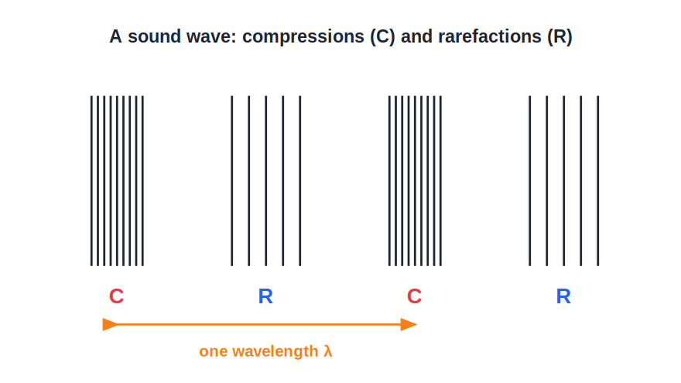
PROPAGATION
How Sound Travels
A wave through a medium
• Sound spreads out from its source as a wave.
• It travels through a medium — a solid, a liquid or a gas.
• The wave passes the vibration from particle to particle.
• In this way the sound energy reaches our ears.
Sound spreads as a wave
Notes:
Sound travels as a wave through a material medium, passing the vibration particle to particle until it reaches the listener.

Slide 9
THE MEDIUM
Sound Travels Through a Medium
The substance through which sound travels from its source to our ears is called the medium.
• Air is the most common medium for the sounds we hear.
• Sound also travels through water and through solids.
• Fish and whales hear sounds carried through water.
Notes:
Define the medium and show it can be a gas, a liquid or a solid — air, water, or the ground/rails.

Slide 10
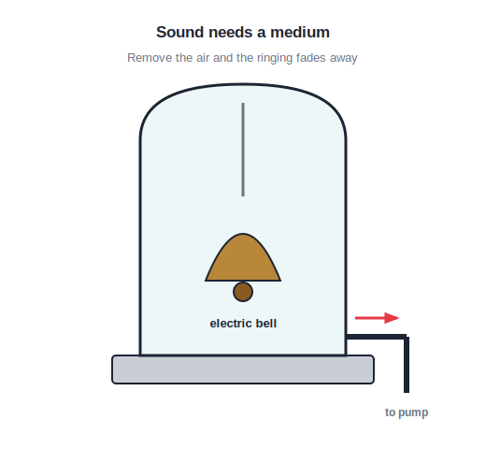
NEEDS A MEDIUM
Sound Needs a Medium
No medium, no sound
• Sound cannot travel through empty space (a vacuum).
• In a bell-jar, as the air is pumped out the ringing fades.
• With no air at all, no sound reaches us.
• This is why there is complete silence in outer space.
Remove the air and the bell falls silent
Notes:
The bell-jar experiment proves sound needs a medium: removing the air silences the bell. Space is a vacuum, so it is silent.

Slide 11
THE EAR
How We Hear — The Human Ear
Outer ear
Collects the sound and funnels it into the ear canal.
Eardrum
A thin skin that vibrates when the sound reaches it.
Middle ear
Tiny bones pass the vibrations further inward.
Inner ear
Sends the message to the brain, and we hear the sound.
Notes:
Trace the path of sound through the ear: outer ear → eardrum → middle-ear bones → inner ear → brain.

Slide 12


SOUND IS ENERGY
Sound Carries Energy
It does work
From the source
A loud sound can rattle windows and shake our chest.
The vibrating body gives its energy to the medium.
Spreads out
Fades with distance
The energy travels outward in all directions as a wave.
Sound grows fainter as its energy spreads thinner.
Notes:
Sound is a form of energy: it can shake objects, it spreads out from the source, and it weakens with distance as the energy spreads.

Slide 13

USES OF SOUND
Why Sound Matters to Us
Talking
Music
Speech lets us share ideas and feelings.
Songs and instruments give us joy.
Warnings
Animals too
Horns, bells and alarms keep us alert and safe.
Animals call to warn, find mates and stay together.
Notes:
Show why sound is useful — communication, music, warnings, and the calls animals use — before the first quiz.

Slide 14
QUIZ 1
Check — Producing & Carrying Sound
4 questions • think before the answer reveals on the next slide

Slide 15
QUIZ QUESTION
Q1 — Source of sound
Sound is produced by a body that is:
Hot
Vibrating
A
B
Coloured
Heavy
C
D

Slide 16
ANSWER REVEALED
Q1 — Source of sound
Sound is produced by a body that is:
Hot
Vibrating
A
✓
Coloured
Heavy
C
D
WHY
Every sound comes from a vibrating object; the moment the vibration stops, the sound stops as well.

Slide 17
QUIZ QUESTION
Q2 — Medium
The substance through which sound travels from its source to our ears is called the:
Wave
Vacuum
A
B
Medium
Echo
C
D

Slide 18
ANSWER REVEALED
Q2 — Medium
The substance through which sound travels from its source to our ears is called the:
Wave
Vacuum
A
B
Medium
Echo
✓
D
WHY
Sound needs a material — a solid, liquid or gas — to travel through. This material is called the medium.

Slide 19
QUIZ QUESTION
Q3 — Vacuum
Sound cannot travel through a vacuum because a vacuum has:
Too much air
No particles to carry it
A
B
Very cold air
Bright light
C
D

Slide 20
ANSWER REVEALED
Q3 — Vacuum
Sound cannot travel through a vacuum because a vacuum has:
Too much air
No particles to carry it
A
✓
Very cold air
Bright light
C
D
WHY
A vacuum is empty space with no particles, so there is nothing to pass the vibrations along — hence no sound.

Slide 21
QUIZ QUESTION
Q4 — The voice
Human sound is produced by the vibration of the:
Teeth
Vocal cords in the larynx
A
B
Tongue only
Nose
C
D

Slide 22
ANSWER REVEALED
Q4 — The voice
Human sound is produced by the vibration of the:
Teeth
Vocal cords in the larynx
A
✓
Tongue only
Nose
C
D
WHY
Air from the lungs makes the vocal cords in the larynx (voice box) vibrate, and the mouth shapes this into speech.

Slide 23
PART 2
Speed of Sound, Noise and Its Control
2
Where sound travels fastest, and taming noise

Slide 24

SPEED
How Fast Sound Travels
Fastest in solids
Slower in liquids
The tightly-packed particles of a solid pass the vibration on quickest.
In a liquid the particles are a little farther apart, so sound is slower.
Slowest in gases
An old trick
In a gas such as air the particles are far apart, so sound travels slowest.
An ear on a railway track hears a train through the steel before the air.
Notes:
Sound is fastest in solids, slower in liquids, slowest in gases — because of how closely the particles are packed.

Slide 25
WHY THE DIFFERENCE
Why Speed Depends on the Medium
Closely packed
In solids the particles are tightly packed and pass vibrations on at once.
A little apart
In liquids the particles are farther apart, so it takes longer.
Far apart
In gases the particles are very far apart, slowing the sound most.
Compare
So the same sound reaches us fastest through a solid, slowest through air.
Notes:
The closer the particles, the faster they hand the vibration on — so solid > liquid > gas for the speed of sound.

Slide 26
PLEASANT VS NOISE
Pleasant Sound and Noise
Pleasant sound
A soft, regular, tuneful sound — like music — is pleasant to hear.
Noise
A loud, harsh, unwanted sound — like a blaring horn — is noise.
It depends
The same sound can please one person and disturb another.
Too loud harms
Any sound that is too loud becomes harmful to the ears.
Notes:
Distinguish pleasant (regular, tuneful) sound from noise (loud, harsh, unwanted) — and note that any sound too loud is harmful.

Slide 27
SOURCES OF NOISE
Where Noise Comes From
Traffic
Loudspeakers
Vehicle horns and engines on busy roads.
Very loud music at functions and festivals.
Crackers
Machines
Firecrackers make sudden, very loud bangs.
Factory machines, generators and construction work.
Notes:
Common sources of noise pollution — traffic, loudspeakers, crackers and machinery — mostly human-made.

Slide 28
NOISE POLLUTION
What is Noise Pollution?
Unwanted, loud and continuous sound that disturbs us and harms our health is called noise pollution.
• It is a real form of pollution, like air or water pollution.
• It is worst in crowded cities and near busy roads.
• It builds up from many everyday sources together.
Notes:
Define noise pollution as harmful, unwanted, continuous loud sound — a genuine pollutant, worst in cities.

Slide 29
HARMFUL EFFECTS
How Noise Harms Us
Hearing loss
Poor sleep
Very loud noise can damage the ears and dull our hearing.
Continuous noise disturbs rest and sleep.
Stress
Poor focus
It causes headaches, tiredness and irritation.
It makes it hard to study, read or concentrate.
Notes:
The health effects of noise: hearing damage, disturbed sleep, stress and headaches, and difficulty concentrating.

Slide 30
CONTROL
Reducing Noise Pollution
Avoid needless horns
Do not blow vehicle horns unnecessarily, especially near hospitals and schools.
Lower the volume
Keep the TV, radio and loudspeakers at a reasonable volume.
Maintain vehicles
Well-serviced engines and silencers run more quietly.
Plan wisely
Keep noisy factories and stations away from homes, and plant trees to absorb sound.
Notes:
Practical ways to cut noise pollution — horns, volume, vehicle upkeep, planning and green cover.

Slide 31
OUR PART
What We Can Do
Silence zones
Speak softly
Respect no-horn zones near hospitals and schools.
Keep our own voices and music down indoors.
Say no to crackers
Grow trees
Enjoy festivals with fewer, quieter crackers.
Trees around homes and roads soak up a lot of noise.
Notes:
Personal and community actions students can take: honour silence zones, keep volumes low, avoid crackers and plant trees.

Slide 32
LOUD & SOFT
Loud and Soft Sounds
A bigger hit
Strike a drum harder and it sounds louder.
A gentle touch
Tap it softly and the sound is faint.
More energy
A louder sound simply carries more energy.
Fades with distance
Even a loud sound grows softer far away.
Notes:
Introduce loudness at a Std 6 level: a harder hit gives a louder sound because it carries more energy, and sound fades with distance.

Slide 33
SAFE EARS
Keeping Our Ears Safe
Avoid very loud sound
Turn volume down
Stay away from blaring speakers and loud crackers.
Keep earphones and music at a gentle level.
Cover your ears
Rest in quiet
Block your ears near a sudden very loud noise.
Give your ears quiet time to recover.
Notes:
Practical ear-care habits, linking the harm of loud noise to simple protective steps.

Slide 34
WRAP UP
Quick Recap
✓ Production — sound comes from vibrations
✓ Propagation — travels as a wave through a medium
✓ Medium — solid, liquid or gas; none in a vacuum
✓ Speed — fastest in solids, slowest in gases
✓ Noise — loud, harsh, unwanted sound
✓ Control — fewer horns, lower volume, upkeep, trees
Notes:
Recap production, propagation, the need for a medium, speed, and noise control.

Slide 35
QUIZ 2
Final Check — Speed & Noise
4 questions • think before the answer reveals on the next slide

Slide 36
QUIZ QUESTION
Q1 — Fastest medium
Sound travels fastest through a:
Gas
Liquid
A
B
Solid
Vacuum
C
D

Slide 37
ANSWER REVEALED
Q1 — Fastest medium
Sound travels fastest through a:
Gas
Liquid
A
B
Solid
Vacuum
✓
D
WHY
The closely-packed particles of a solid pass vibrations along quickest, so sound travels fastest in solids.

Slide 38
QUIZ QUESTION
Q2 — Slowest medium
Of these, sound travels slowest through:
Iron
Water
A
B
Air
Wood
C
D

Slide 39
ANSWER REVEALED
Q2 — Slowest medium
Of these, sound travels slowest through:
Iron
Water
A
B
Air
Wood
✓
D
WHY
Air is a gas, whose particles are far apart, so sound travels slowest through it compared with liquids and solids.

Slide 40
QUIZ QUESTION
Q3 — Noise pollution
Continuous, loud, unwanted sound that harms our health is called:
Music
An echo
A
B
Noise pollution
A vibration
C
D

Slide 41
ANSWER REVEALED
Q3 — Noise pollution
Continuous, loud, unwanted sound that harms our health is called:
Music
An echo
A
B
Noise pollution
A vibration
✓
D
WHY
Loud, harsh sound that goes on and on and damages health is noise pollution — a real form of pollution.

Slide 42
QUIZ QUESTION
Q4 — Control
Which of these helps to reduce noise pollution?
Blowing horns often
Playing music at full volume
A
B
Planting trees along roads
Running unserviced engines
C
D

Slide 43
ANSWER REVEALED
Q4 — Control
Which of these helps to reduce noise pollution?
Blowing horns often
Playing music at full volume
A
B
Planting trees along roads
Running unserviced engines
✓
D
WHY
Trees absorb and block a lot of sound, so a green belt along roads helps reduce noise pollution.

Slide 44
The World of Sound
Every sound is a vibration set travelling through a medium — knowing how it works helps us enjoy music and keep noise in check.

