Slide 1
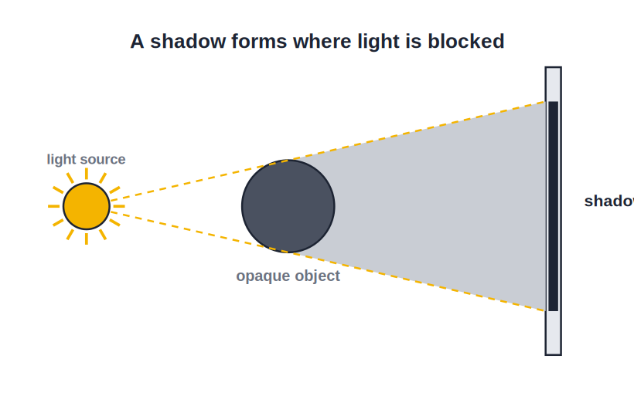
STD 6 • GENERAL SCIENCE • LIGHT
Light and the Formation of Shadows
Luminous objects • Transparent, translucent, opaque • Straight-line light • Shadows • The pinhole camera

Slide 2
INTRODUCTION
Learning Objectives
1
Tell luminous objects from non-luminous ones
2
Classify materials as transparent, translucent or opaque
3
State that light travels in straight lines
4
Explain how a shadow is formed and what it needs
5
Explain why shadows change in size and length
6
See how straight-line light forms a pinhole image
Notes:
Open by previewing these objectives so students know what they should be able to do by the end of the session.

Slide 3
PART 1
Light and Materials
1
Sources of light and how materials treat it

Slide 4
SOURCES
Luminous and Non-Luminous Objects
Luminous
Objects that give out their own light — the Sun, a star, a burning candle, a bulb.
Non-luminous
Objects that do not make their own light — the Moon, a book, a table.
We see by light
We see non-luminous things only when light falls on them and bounces to our eyes.
The Moon
The Moon shines only because it reflects the Sun's light — it is non-luminous.
Notes:
Luminous objects make their own light; non-luminous ones only reflect it. The Moon is the classic non-luminous example.

Slide 5

EXAMPLES
Sorting Light Sources
Luminous — natural
Luminous — man-made
The Sun and the other stars, and a firefly.
A bulb, a tube-light, a candle and a torch.
Non-luminous — natural
Non-luminous — man-made
The Moon, the planets, trees and rocks.
A mirror, a book, a wall and a car.
Notes:
Sort objects into luminous (natural/man-made) and non-luminous (natural/man-made) to sharpen the distinction.

Slide 6
HOW WE SEE
Why We Can See Things
We see a luminous object by the light it gives out, and a non-luminous object by the light it reflects into our eyes.
• In complete darkness we cannot see anything at all.
• Light must leave an object and reach the eye.
• That is why a dark room lights up the moment a bulb is switched on.
Notes:
Seeing needs light to travel from the object to the eye. No light, no sight — hence darkness in an unlit room.

Slide 7
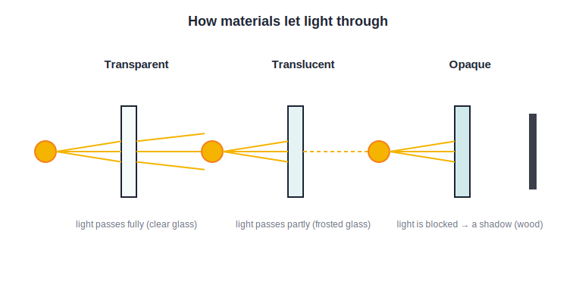
MATERIALS
Transparent, Translucent, Opaque
How much light passes
• Transparent materials let light pass fully — clear glass, water.
• Translucent materials let light pass partly — frosted glass, oiled paper.
• Opaque materials do not let light pass — wood, metal, a book.
• Only opaque objects can cast a clear, dark shadow.
Full, partial or no light through
Notes:
Three material types by how much light they let through. Only opaque objects cast a clear shadow.

Slide 8

MATERIALS IN LIFE
These Materials Around Us
Transparent use
Translucent use
Clear window glass and spectacles let us see through.
Frosted bathroom glass gives light but privacy.
Opaque use
Choosing wisely
Walls, doors and curtains block light for shade and privacy.
We pick a material for how much light we want through it.
Notes:
Everyday uses of each material type — clear glass, frosted glass, walls/curtains — chosen for how much light should pass.

Slide 9
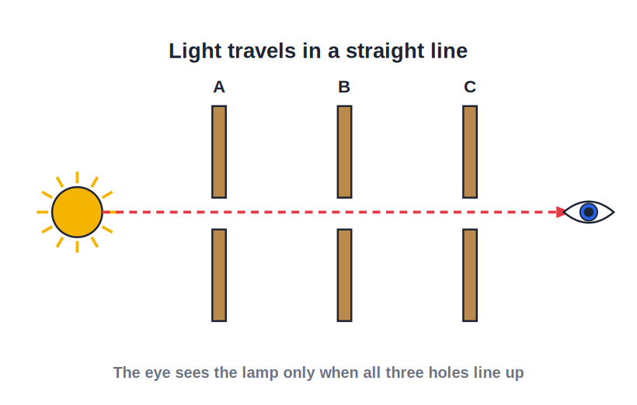
STRAIGHT LINE
Light Travels in Straight Lines
Rectilinear propagation
• Light travels in straight lines, called rays.
• We see this in a sunbeam through a gap or in dusty air.
• Because it goes straight, light cannot bend around a corner.
• This straight-line travel is what lets shadows form.
A straight beam of light
Notes:
Establish rectilinear propagation — light's straight-line travel is the reason opaque objects cast shadows.

Slide 10
EVIDENCE
How We Know Light Goes Straight
A sunbeam
A ray through a window or through leaves is dead straight.
Line up the holes
You can see through three cards only when their holes are in a straight line.
Cannot see round corners
We cannot see what is behind a wall — light will not bend to it.
Sharp shadows
The clean edge of a shadow shows light travelled straight to it.
Notes:
Give the classic evidence for rectilinear propagation: sunbeams, the three-card experiment, not seeing round corners, sharp shadow edges.

Slide 11
RAYS & BEAMS
Rays and Beams of Light
A ray
A ray is the straight path along which light travels.
A beam
A group of rays travelling together is a beam of light.
Arrows show direction
In diagrams we draw a ray as a straight line with an arrow.
From the source out
Rays spread outward from the light source in straight lines.
Notes:
Define a ray (the straight path of light) and a beam (a bundle of rays), and how we draw them — the language for the rest of optics.

Slide 12
LIGHT IS ENERGY
Light is a Form of Energy
Light is a form of energy that lets us see, and that plants use to make their food.
• Our eyes need light to see the world around us.
• Green plants use sunlight to prepare their food.
• Solar panels turn light energy into electricity.
Notes:
Frame light as a form of energy — essential for sight, for plants making food, and for solar electricity.

Slide 13

LIGHT IN LIFE
Light at Work Around Us
To see
For plants
We need light to read, walk and do our daily work.
Sunlight lets green leaves make food for all life.
Solar power
Signals
Sunlight is caught by panels to make electricity.
Traffic lights and lamps guide and warn us.
Notes:
Everyday roles of light — seeing, plant food, solar power and signals — reinforcing that light is useful energy.

Slide 14
QUIZ 1
Check — Light & Materials
4 questions • think before the answer reveals on the next slide

Slide 15
QUIZ QUESTION
Q1 — Luminous
Which of these is a luminous object?
The Moon
A burning candle
A
B
A mirror
A page of a book
C
D

Slide 16
ANSWER REVEALED
Q1 — Luminous
Which of these is a luminous object?
The Moon
A burning candle
A
✓
A mirror
A page of a book
C
D
WHY
A burning candle gives out its own light, so it is luminous. The Moon and a mirror only reflect light.

Slide 17
QUIZ QUESTION
Q2 — Transparent
A material through which we can see clearly because light passes fully is:
Opaque
Translucent
A
B
Transparent
A shadow
C
D

Slide 18
ANSWER REVEALED
Q2 — Transparent
A material through which we can see clearly because light passes fully is:
Opaque
Translucent
A
B
Transparent
A shadow
✓
D
WHY
Transparent materials such as clear glass let light pass right through, so we can see clearly through them.

Slide 19
QUIZ QUESTION
Q3 — Translucent
Frosted (ground) glass, which lets light pass only partly, is:
Transparent
Translucent
A
B
Opaque
Luminous
C
D

Slide 20
ANSWER REVEALED
Q3 — Translucent
Frosted (ground) glass, which lets light pass only partly, is:
Transparent
Translucent
A
✓
Opaque
Luminous
C
D
WHY
Frosted glass lets some light through but we cannot see clearly through it — that makes it translucent.

Slide 21
QUIZ QUESTION
Q4 — Straight line
Shadows can form because light travels:
In curved paths
Around corners
A
B
In straight lines
Only at night
C
D

Slide 22
ANSWER REVEALED
Q4 — Straight line
Shadows can form because light travels:
In curved paths
Around corners
A
B
In straight lines
Only at night
✓
D
WHY
Because light travels in straight lines, it cannot bend around an opaque object, so a shadow forms behind it.

Slide 23
PART 2
The Formation of Shadows
2
How shadows form, why they change, and the pinhole camera

Slide 24
SHADOWS
How a Shadow Forms
Light blocked → shadow
• A shadow forms when an opaque object blocks the light.
• Light cannot bend around the object, so a dark patch is left.
• The dark patch appears on the far side of the object.
• This dark patch is the shadow of the object.
An opaque object blocks the light
Notes:
A shadow is the dark region left where an opaque object blocks straight-travelling light.

Slide 25
THREE THINGS
What a Shadow Needs
A source of light
There must be light — the Sun, a lamp or a torch.
An opaque object
Something that blocks the light must be in the way.
A screen
A surface — a wall, the ground — for the shadow to fall on.
All three together
Remove any one and the shadow disappears.
Notes:
A shadow needs exactly three things: a light source, an opaque object and a screen. Missing any one, and there is no shadow.

Slide 26

SHADOW FACTS
Properties of a Shadow
Always dark
Only the outline
A shadow is always black — it has no colour of its own.
It shows just the shape of the object, not its colour or detail.
On the far side
Same shape
It always forms on the side away from the light.
The shadow has the same outline as the object facing the light.
Notes:
Key properties: a shadow is black, shows only the outline, forms on the far side, and matches the object's facing shape.

Slide 27
SIZE OF SHADOW
Why a Shadow Changes Size
Nearer the light
Move the object closer to the lamp and its shadow grows larger.
Nearer the screen
Move it closer to the wall and the shadow shrinks and sharpens.
Distance decides
The size depends on the distances between light, object and screen.
Hand shadows
This is why hand-shadow figures grow huge near a torch.
Notes:
Shadow size depends on the distances involved: closer to the light makes it bigger, closer to the screen makes it smaller and sharper.

Slide 28
CHANGING SHADOWS
Why Shadows Change Through the Day
Long or short
• The Sun appears to move across the sky during the day.
• In the morning and evening the Sun is low, so shadows are long.
• At noon the Sun is high overhead, so shadows are short.
• The direction of a shadow also changes as the Sun moves.
The Sun's height sets the shadow length
Notes:
The Sun's changing height changes the length and direction of shadows — long when the Sun is low, short at noon.

Slide 29

SHADOW FUN
Shadows at Work and Play
The sundial
Shadow play
An old clock that tells time from the Sun's moving shadow.
Hand and puppet shadows entertain us on a lit screen.
Eclipses
Finding direction
Even eclipses are giant shadows cast in space.
A shadow's direction hints at where the Sun, and so the east and west, lie.
Notes:
Fun and useful shadows: the sundial, shadow play, eclipses as space-shadows, and using shadow direction to find your bearings.

Slide 30
PINHOLE CAMERA
Straight-Line Light Makes an Image
Because light travels in straight lines, a tiny pinhole can form an upside-down image of a bright object on a screen.
• Rays from the top of the object cross to the bottom of the image.
• Rays from the bottom cross to the top — so the image is inverted.
• A pinhole camera is a simple box that shows this effect.
Notes:
The pinhole camera is a lovely proof of straight-line light: rays cross at the hole, giving an inverted image on the screen.

Slide 31
MAKE ONE
A Simple Pinhole Camera
A closed box
Take a box with a tiny pinhole on one side.
A screen
Replace the opposite side with tracing (butter) paper.
Point at a bright object
Aim the pinhole at a bright window or lamp.
See the image
A small, upside-down image appears on the paper.
Notes:
A hands-on activity: build a pinhole camera from a box, a pinhole and tracing paper, and observe the inverted image.

Slide 32

SHADOWS AROUND US
Shadows in Everyday Life
Under a tree
Buildings
A tree's shadow gives cool shade on a sunny day.
Tall buildings throw long shadows across a street.
Our own shadow
Shadow of the Earth
It walks with us, changing length through the day.
Even a lunar eclipse is the Earth's shadow on the Moon.
Notes:
Familiar shadows — shade under a tree, building shadows, our own shadow, and the Earth's shadow in a lunar eclipse.

Slide 33
SUNDIAL
Telling Time by a Shadow
Because a shadow moves in a steady way as the Sun crosses the sky, it can be used to tell the time — this is a sundial.
• A rod casts a shadow onto a marked dial.
• As the Sun moves, the shadow sweeps across the marks.
• The position of the shadow shows the hour of the day.
Notes:
The sundial turns the daily march of a shadow into a clock — a neat, historical application of shadows.

Slide 34
WRAP UP
Quick Recap
✓ Luminous — makes its own light — Sun, bulb, candle
✓ Transparent — light passes fully — clear glass
✓ Translucent — light passes partly — frosted glass
✓ Opaque — light blocked — casts a shadow
✓ Shadow — needs source, opaque object and screen
✓ Pinhole — straight-line light → inverted image
Notes:
Recap light sources, the three material types, how shadows form and change, and the pinhole camera.

Slide 35
QUIZ 2
Final Check — Shadows
4 questions • think before the answer reveals on the next slide

Slide 36
QUIZ QUESTION
Q1 — What forms a shadow
A clear shadow is cast by an object that is:
Transparent
Translucent
A
B
Opaque
Luminous
C
D

Slide 37
ANSWER REVEALED
Q1 — What forms a shadow
A clear shadow is cast by an object that is:
Transparent
Translucent
A
B
Opaque
Luminous
✓
D
WHY
Only an opaque object blocks the light fully, so only an opaque object casts a clear, dark shadow.

Slide 38
QUIZ QUESTION
Q2 — Needed for a shadow
Which three things are needed to form a shadow?
Source, mirror, lens
Source, opaque object, screen
A
B
Water, air, light
Sun, Moon, Earth
C
D

Slide 39
ANSWER REVEALED
Q2 — Needed for a shadow
Which three things are needed to form a shadow?
Source, mirror, lens
Source, opaque object, screen
A
✓
Water, air, light
Sun, Moon, Earth
C
D
WHY
A shadow needs a source of light, an opaque object to block it, and a screen on which the shadow falls.

Slide 40
QUIZ QUESTION
Q3 — Pinhole image
The image formed by a pinhole camera is always:
The right way up
Upside down (inverted)
A
B
Coloured brightly
Larger than life
C
D

Slide 41
ANSWER REVEALED
Q3 — Pinhole image
The image formed by a pinhole camera is always:
The right way up
Upside down (inverted)
A
✓
Coloured brightly
Larger than life
C
D
WHY
Straight rays from the object cross over at the pinhole, so the top goes to the bottom — the image is inverted.

Slide 42
QUIZ QUESTION
Q4 — Shortest shadow
A vertical pole casts its shortest shadow when the Sun is:
Rising at the horizon
Low in the evening
A
B
High overhead at noon
Below the horizon
C
D

Slide 43
ANSWER REVEALED
Q4 — Shortest shadow
A vertical pole casts its shortest shadow when the Sun is:
Rising at the horizon
Low in the evening
A
B
High overhead at noon
Below the horizon
✓
D
WHY
When the noon Sun is high overhead, its rays fall almost straight down, so the pole's shadow is at its shortest.

Slide 44
Light and Shadow
Because light travels straight and some things block it, we get shadows — long at dawn, short at noon, and always telling the shape of what stands in the way.

