Slide 1
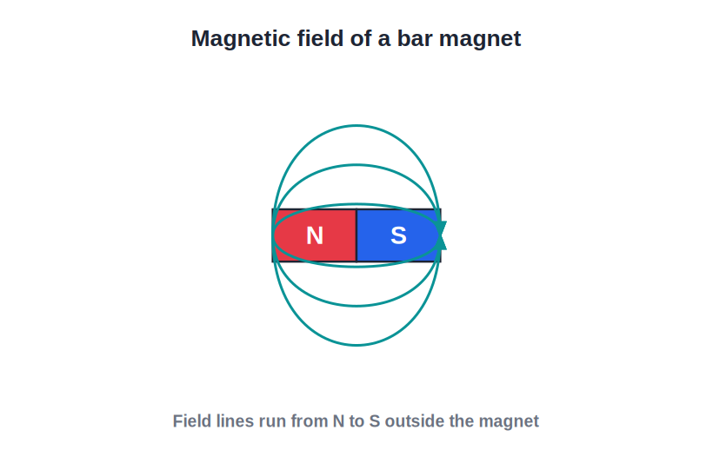
STD 6 • GENERAL SCIENCE • MAGNETS
Fun with Magnets
Magnetic materials • Poles of a magnet • Laws of magnetism • Making, caring for and using magnets

Slide 2
INTRODUCTION
Learning Objectives
1
Tell magnetic materials from non-magnetic ones
2
Describe the two poles of a magnet and the magnetic field
3
State the laws of magnetism (attraction and repulsion)
4
Explain that a free magnet points north–south
5
Make a magnet by the stroking method
6
List the uses and the proper care of magnets
Notes:
Open by previewing these objectives so students know what they should be able to do by the end of the session.

Slide 3
PART 1
Magnets, Materials and Poles
1
What magnets attract, their poles and their field

Slide 4
MAGNETS
What is a Magnet?
Attracts iron
A magnet is an object that attracts iron and a few other materials.
The discovery
Long ago, a natural stone called lodestone (magnetite) was found to attract iron.
A natural magnet
Lodestone is a natural magnet found in the Earth.
Artificial magnets
The bar and horseshoe magnets we use are made by people.
Notes:
A magnet attracts iron. Tell the story of lodestone (natural magnet) and note that our everyday magnets are artificial.

Slide 5


SHAPES
Magnets Come in Many Shapes
Bar magnet
Horseshoe / U
A straight rectangular bar — the one we use most in class.
Bent into a U so both poles face the same way and pull harder.
Ring magnet
Magnetic needle
A round magnet with a hole, used in many gadgets.
A slim magnet that can swing freely, as in a compass.
Notes:
Introduce the common magnet shapes — bar, horseshoe, ring and needle — and where each is used.

Slide 6
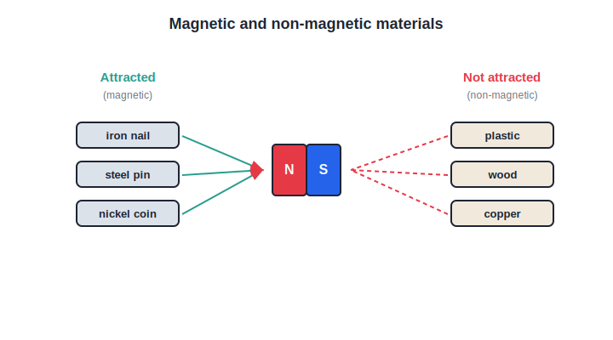
SORTING
Magnetic vs Non-Magnetic Materials
What sticks and what does not
• Some materials are pulled by a magnet; many are not.
• Magnetic: iron, nickel and cobalt are attracted.
• Non-magnetic: wood, plastic, paper and copper are not.
• A magnet can sort magnetic things out of a mixture.
A magnet picks out the magnetic materials
Notes:
Magnetic materials (iron, nickel, cobalt) are attracted; non-magnetic ones (wood, plastic, copper) are not. A magnet can separate them.

Slide 7

THE TWO GROUPS
Sorting Materials
Magnetic materials
Non-magnetic materials
Iron, steel, nickel and cobalt — attracted by a magnet.
Wood, plastic, paper, glass, copper and aluminium — not attracted.
A useful test
Sorting scrap
Bring a magnet near an object to check which group it is in.
Big magnets pull iron out of mixed scrap and rubbish.
Notes:
List the two groups with clear examples, and note the practical use of magnets to separate iron scrap.

Slide 8
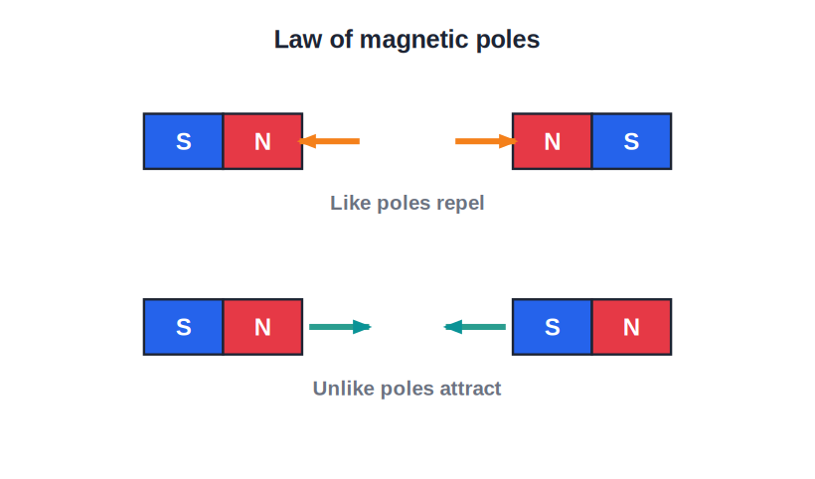
POLES
The Poles of a Magnet
North & south
• Every magnet has two poles — north (N) and south (S).
• The pull of a magnet is strongest at its poles.
• Iron filings cluster most thickly at the two ends.
• Break a magnet in two and each piece still has both poles.
Two poles, strongest at the ends
Notes:
Every magnet has an N and an S pole, strongest at the ends. Poles cannot be separated — breaking gives two smaller magnets.

Slide 9
POLES COME IN PAIRS
You Cannot Get a Single Pole
Every magnet always has two poles. If you break a bar magnet, each piece becomes a full magnet with its own N and S pole.
• Cut it again, and every new piece still has both poles.
• There is no such thing as a lone north or south pole.
• The pull is always strongest at these two poles.
Notes:
Poles always exist in pairs — breaking a magnet never isolates a single pole, it just makes more complete magnets.

Slide 10
DIRECTIVE PROPERTY
A Free Magnet Points North–South
Hang it freely
Suspend a bar magnet by a thread so it can turn.
It settles N–S
It always comes to rest pointing north–south.
Same every time
Turn it and let go — it swings back to north–south.
The north pole
The end that points north is called the north pole.
Notes:
The directive property: a freely suspended magnet always aligns north–south. This defines which end is the north pole.

Slide 11
FINDING DIRECTION
The Magnetic Compass
A tiny magnet
Points north
A compass is a small magnetic needle that turns freely.
Its coloured end always settles pointing north.
Ancient help
Still used
Sailors and travellers have used it for centuries.
Hikers, ships and planes use compasses even today.
Notes:
The compass puts the directive property to work — a free needle points north, guiding travellers for centuries.

Slide 12
MAGNETIC FIELD
The Magnetic Field
An invisible region
• The space around a magnet where its force acts is the magnetic field.
• Iron filings near a magnet line up along curved paths.
• These paths show the invisible field around the magnet.
• The field is strongest close to the poles.
Iron filings reveal the field
Notes:
Introduce the magnetic field as the region of influence around a magnet, revealed by iron filings and strongest at the poles.

Slide 13
PROPERTIES
The Main Properties of a Magnet
Attracts iron
Has two poles
It pulls iron, nickel and cobalt towards it.
Every magnet has a north and a south pole.
Strongest at poles
Points north–south
The pulling force is greatest at the two ends.
A free magnet always settles pointing north–south.
Notes:
Gather the key properties of a magnet into one summary card set before the first quiz.

Slide 14
QUIZ 1
Check — Materials & Poles
4 questions • think before the answer reveals on the next slide

Slide 15
QUIZ QUESTION
Q1 — Magnetic material
Which of these is a magnetic material?
Copper
Iron
A
B
Plastic
Wood
C
D

Slide 16
ANSWER REVEALED
Q1 — Magnetic material
Which of these is a magnetic material?
Copper
Iron
A
✓
Plastic
Wood
C
D
WHY
Iron (like nickel and cobalt) is attracted by a magnet, so it is a magnetic material; copper, plastic and wood are not.

Slide 17
QUIZ QUESTION
Q2 — Strongest part
The pull of a bar magnet is strongest at its:
Centre
Two poles
A
B
Top edge
Flat sides
C
D

Slide 18
ANSWER REVEALED
Q2 — Strongest part
The pull of a bar magnet is strongest at its:
Centre
Two poles
A
✓
Top edge
Flat sides
C
D
WHY
A magnet's force is strongest at its poles — the two ends — where iron filings cluster most thickly.

Slide 19
QUIZ QUESTION
Q3 — Free magnet
A bar magnet hung so that it can turn freely finally comes to rest pointing:
East–west
North–south
A
B
Straight up
In any random way
C
D

Slide 20
ANSWER REVEALED
Q3 — Free magnet
A bar magnet hung so that it can turn freely finally comes to rest pointing:
East–west
North–south
A
✓
Straight up
In any random way
C
D
WHY
A freely suspended magnet always settles pointing north–south — the very property used in a compass.

Slide 21
QUIZ QUESTION
Q4 — Breaking a magnet
If a bar magnet is broken into two pieces, each piece will have:
Only a north pole
Only a south pole
A
B
Both a north and a south pole
No poles
C
D

Slide 22
ANSWER REVEALED
Q4 — Breaking a magnet
If a bar magnet is broken into two pieces, each piece will have:
Only a north pole
Only a south pole
A
B
Both a north and a south pole
No poles
✓
D
WHY
Poles never exist alone. Break a magnet and each new piece becomes a complete magnet with both an N and an S pole.

Slide 23
PART 2
Laws, Making, Care and Uses
2
How poles behave, and putting magnets to work

Slide 24
LAWS
The Laws of Magnetism
Like poles repel
Two north poles, or two south poles, brought together push each other apart.
Unlike poles attract
A north pole and a south pole pull towards each other.
Try it
Bring two bar magnets close in different ways to feel both.
The basic rule
This push-and-pull is the fundamental law of magnets.
Notes:
State the laws of magnetism clearly: like poles repel, unlike poles attract — the basis of everything magnets do.

Slide 25
SURE TEST
Repulsion is the Real Test
A magnet attracts plain iron too, so attraction alone is not proof. Only repulsion proves that both objects are magnets.
• If two bars attract, one of them might just be iron.
• If two bars repel, both must certainly be magnets.
• So repulsion is the sure test of magnetism.
Notes:
A subtle but important point: attraction can be caused by ordinary iron, so only mutual repulsion is a sure test that both bars are magnets.

Slide 26
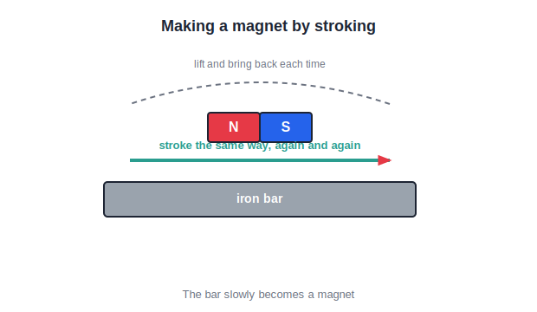
MAKING A MAGNET
Making a Magnet by Stroking
The single-touch method
• Lay an iron bar flat on the table.
• Stroke it with one pole of a magnet, always the same way.
• Lift the magnet at the end of each stroke and start again.
• After many strokes the iron bar becomes a magnet.
Stroke the same way, again and again
Notes:
The stroking (single-touch) method: repeatedly stroke the iron in one direction with one pole, lifting away between strokes.

Slide 27
OTHER WAYS
Other Ways to Make a Magnet
By stroking
Rubbing with a magnet, as we just saw — a simple method.
By electricity
A current in a coil of wire around iron makes an electromagnet.
Temporary or permanent
Soft iron makes a temporary magnet; steel keeps its magnetism.
Losing it
A magnet can also lose its magnetism if treated roughly.
Notes:
Beyond stroking, magnets can be made electrically. Note the difference between temporary (soft iron) and permanent (steel) magnets.

Slide 28


LOSING MAGNETISM
How a Magnet Loses its Power
Heating
Hammering
Strong heat disturbs a magnet and weakens it.
Repeated hammering or banging destroys magnetism.
Dropping
Careless storage
Dropping a magnet hard can leave it much weaker.
Storing magnets wrongly slowly weakens them.
Notes:
Magnets lose strength through heat, hammering, dropping and careless storage — which motivates the care rules next.

Slide 29
CARE & STORAGE
Caring for Magnets
Store in pairs
Keep two bar magnets together with unlike poles side by side.
Use keepers
Place soft-iron pieces (keepers) across the ends.
Handle gently
Do not heat, hammer or drop a magnet.
Keep them apart
Store away from devices that magnets could harm.
Notes:
Proper care: store bar magnets in pairs with keepers across the poles, and avoid heat, shock and dropping.

Slide 30

USES
Magnets at Work
Everyday
In machines
Compass, fridge and cupboard doors, pencil boxes, pin holders.
Electric bells, cranes, loudspeakers and MRI machines.
Sorting
Data & cards
Big magnets lift and drop heavy iron scrap in junkyards.
The strip on an ATM or metro card is magnetic.
Notes:
Round up the uses of magnets — everyday, in machines, for sorting scrap, and in cards and data storage.

Slide 31
ELECTROMAGNET
The Electromagnet — a Magnet from Electricity
Current in a coil
A current in a coil of wire makes a magnetic field.
An iron core
Winding the coil on soft iron makes it much stronger.
Only when 'on'
It is magnetic only while the current flows.
Switchable
It can be switched on and off — its great advantage.
Notes:
Introduce the electromagnet: a temporary magnet made by a current in a coil around iron, whose big advantage is that it can be switched on and off.

Slide 32

ELECTROMAGNET USES
Electromagnets at Work
Electric bell
Cranes
An electromagnet makes the hammer strike the gong.
Powerful electromagnets lift and drop heavy iron scrap.
Loudspeakers
MRI machines
They turn electrical signals into the sound we hear.
Huge electromagnets help doctors see inside the body.
Notes:
Show where electromagnets are used — bells, cranes, loudspeakers and MRI machines — all relying on being switchable.

Slide 33
MODERN LIFE
Magnets in Our Modern World
From the compass that guides travellers to the machines in our homes and hospitals, magnets quietly serve us everywhere.
• They store data on cards and in computers.
• They run motors in fans, mixers and toys.
• They help doctors, sailors, builders and engineers.
Notes:
Close Part 2 by placing magnets in the wider modern world — data, motors, medicine, navigation and construction.

Slide 34
WRAP UP
Quick Recap
✓ Magnetic — iron, nickel, cobalt are attracted
✓ Poles — every magnet has N and S; strongest there
✓ Free magnet — rests pointing north–south
✓ Laws — like poles repel, unlike attract
✓ Making — stroke iron one way, again and again
✓ Care — store in pairs; no heat, hammering or dropping
Notes:
Recap magnetic materials, poles, the field, the laws, making a magnet and caring for it.

Slide 35
QUIZ 2
Final Check — Laws, Making & Uses
4 questions • think before the answer reveals on the next slide

Slide 36
QUIZ QUESTION
Q1 — Like poles
When the north poles of two magnets are brought close together, they:
Attract
Repel
A
B
Do nothing
Join firmly
C
D

Slide 37
ANSWER REVEALED
Q1 — Like poles
When the north poles of two magnets are brought close together, they:
Attract
Repel
A
✓
Do nothing
Join firmly
C
D
WHY
Like poles repel. Two north poles (or two south poles) push each other away; only unlike poles attract.

Slide 38
QUIZ QUESTION
Q2 — Sure test
The only sure test that a bar of iron is really a magnet is:
Attraction of the ends
Repulsion between two poles
A
B
Its colour
Its weight
C
D

Slide 39
ANSWER REVEALED
Q2 — Sure test
The only sure test that a bar of iron is really a magnet is:
Attraction of the ends
Repulsion between two poles
A
✓
Its colour
Its weight
C
D
WHY
A magnet attracts plain iron too, so attraction is not proof. Only repulsion shows that both objects are magnets.

Slide 40
QUIZ QUESTION
Q3 — Stroking
In the stroking method of making a magnet, the iron bar should be stroked:
Back and forth quickly
In one direction, again and again
A
B
Only once
With both poles at once
C
D

Slide 41
ANSWER REVEALED
Q3 — Stroking
In the stroking method of making a magnet, the iron bar should be stroked:
Back and forth quickly
In one direction, again and again
A
✓
Only once
With both poles at once
C
D
WHY
The magnet is stroked along the bar in the same direction repeatedly, lifting it away between strokes, until the bar becomes magnetised.

Slide 42
QUIZ QUESTION
Q4 — Losing magnetism
A magnet is likely to lose its magnetism if it is:
Stored with a keeper
Kept away from heat
A
B
Heated or hammered
Kept in a pair
C
D

Slide 43
ANSWER REVEALED
Q4 — Losing magnetism
A magnet is likely to lose its magnetism if it is:
Stored with a keeper
Kept away from heat
A
B
Heated or hammered
Kept in a pair
✓
D
WHY
Strong heating, hammering or dropping disturbs a magnet and makes it lose its magnetism, so magnets must be handled gently.

Slide 44
The Magic of Magnets
Magnets attract, point the way and drive our machines — a little care keeps their invisible force working for us.

