Slide 1
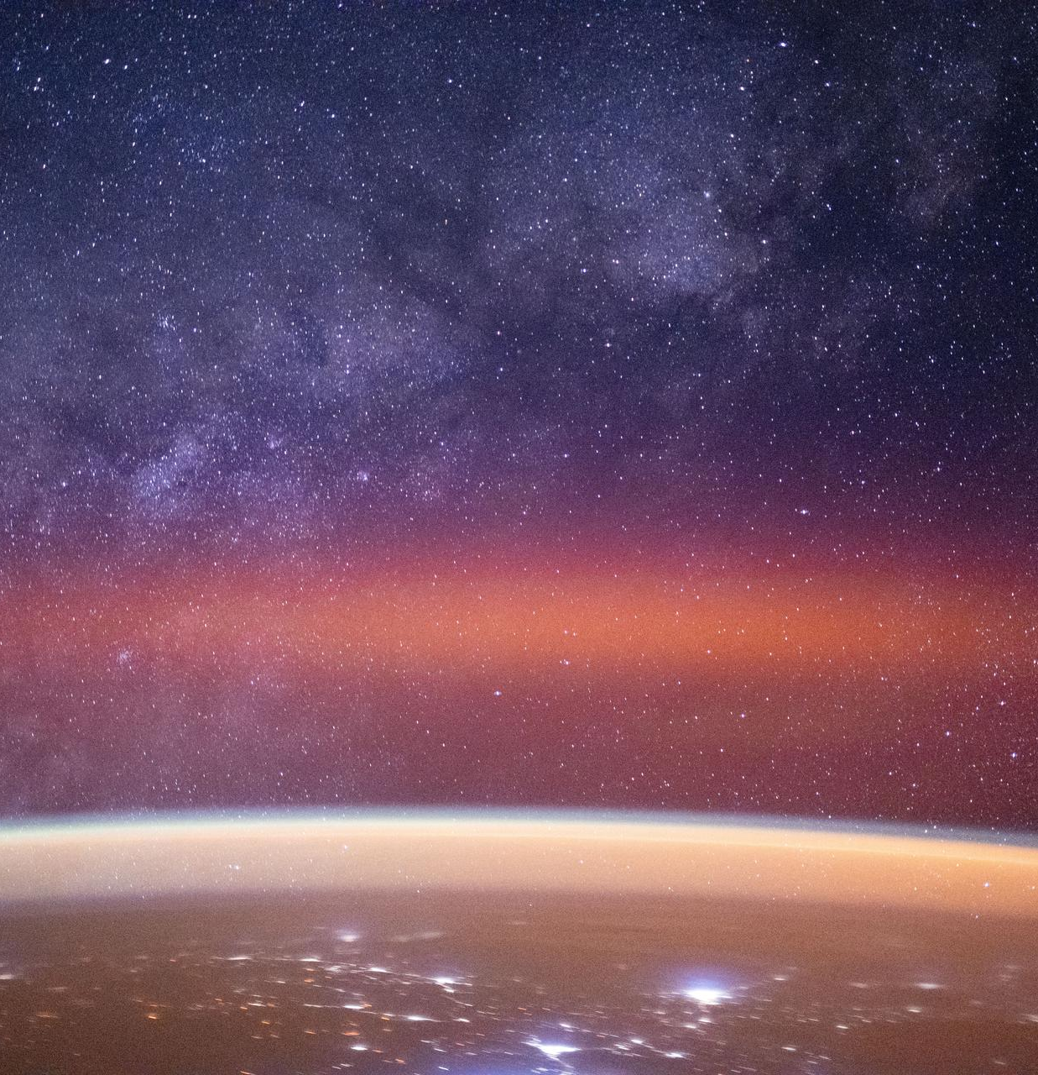
STD 6 • GENERAL SCIENCE • ASTRONOMY
The Universe
The universe • Galaxies • Stars and the Sun • Our solar system • Other heavenly bodies

Slide 2
INTRODUCTION
Learning Objectives
1
Describe what the universe contains
2
Explain what a galaxy is and name its shapes
3
Describe stars, their types and where they are born
4
Name the Sun as our nearest star
5
List the members of the solar system
6
Name the eight planets in order from the Sun
Notes:
Open by previewing these objectives so students know what they should be able to do by the end of the session.

Slide 3
PART 1
The Universe and Galaxies
1
Everything there is, and the great islands of stars

Slide 4
THE UNIVERSE
The Universe
Everything there is
• The universe is everything that exists — all of space and all it holds.
• It contains countless stars, planets, gas and dust.
• It is unimaginably huge and still being explored.
• Our Earth is a tiny part of this vast universe.
The Milky Way arching over Earth
Notes:
Set the scale of the universe — everything that exists, vast beyond imagining, with Earth a tiny part of it.

Slide 5
WHAT IT HOLDS
What the Universe Contains
Stars
Countless glowing balls of hot gas, like our Sun.
Planets & moons
Worlds that orbit stars, and moons that orbit planets.
Galaxies
Enormous groups of stars, spread across space.
Gas and dust
Vast clouds from which new stars are born.
Notes:
Inventory of the universe: stars, planets and moons, galaxies, and the gas-and-dust clouds that form new stars.

Slide 6
LIGHT YEAR
Measuring Huge Distances
Distances in the universe are so vast that we measure them in light years — the distance light travels in one year.
• Light is the fastest thing there is.
• In a whole year it covers an enormous distance — one light year.
• Even the nearest stars are several light years away.
Notes:
Introduce the light year as the unit of astronomical distance — the distance light travels in one year — because ordinary units are far too small.

Slide 7
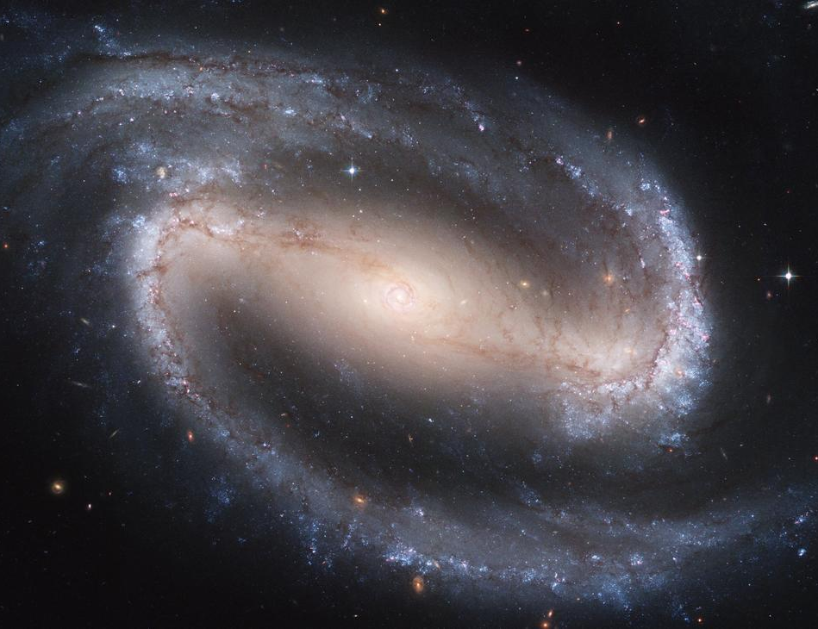
GALAXIES
Galaxies
Islands of stars
• A galaxy is a group of countless stars and their planetary systems.
• Gravity holds all the stars, gas and dust together.
• There are billions of galaxies in the universe.
• Each galaxy is like a giant island of stars in space.
A spiral galaxy
Notes:
A galaxy is a gravitationally bound island of countless stars; the universe holds billions of them.

Slide 8
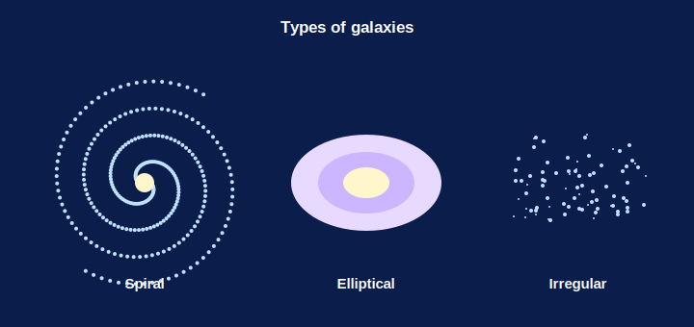
GALAXY SHAPES
The Shapes of Galaxies
Spiral • elliptical • irregular
• Galaxies are seen in several shapes.
• Spiral: a bright centre with curving arms.
• Elliptical: a smooth oval or ball of stars.
• Barred spiral and irregular are the other shapes.
Galaxies come in different shapes
Notes:
Name the galaxy shapes — spiral, elliptical, barred spiral and irregular — using the diagram.

Slide 9
OUR GALAXY
The Milky Way
Our home galaxy
Our Sun and its planets lie in the Milky Way galaxy.
A spiral
The Milky Way is a huge spiral galaxy.
Countless stars
It contains hundreds of billions of stars.
Nearest neighbour
Andromeda is the galaxy nearest to our Milky Way.
Notes:
Place ourselves: the Sun sits in the Milky Way, a spiral galaxy of hundreds of billions of stars, with Andromeda as its nearest neighbour.

Slide 10
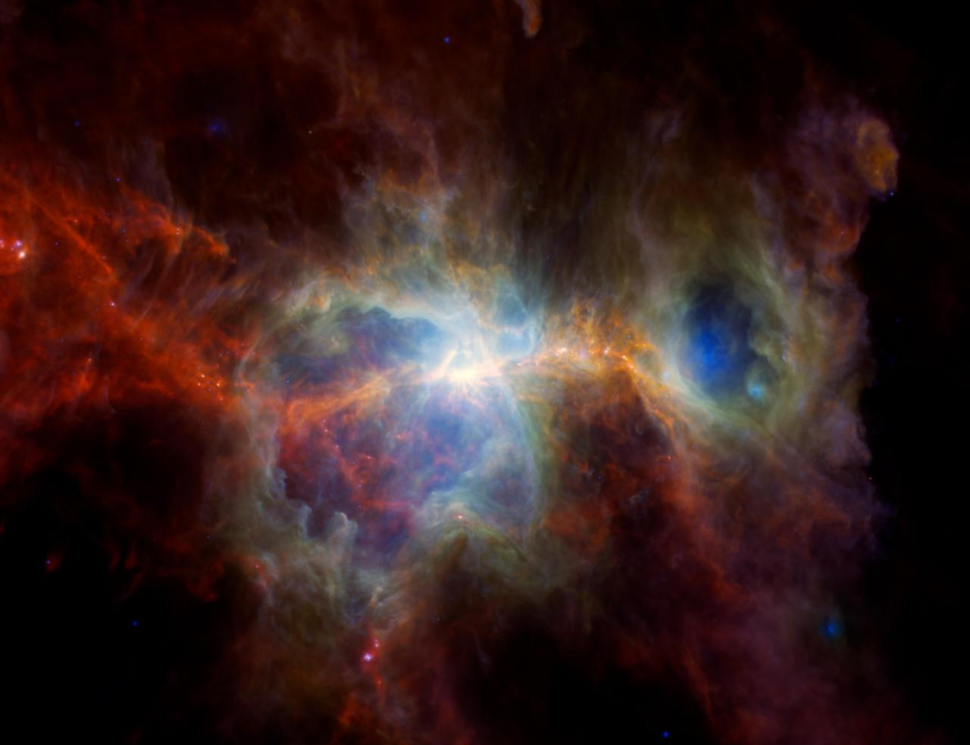
NEBULA
Nebulae — Where Stars are Born
Clouds of gas & dust
• A nebula is a vast cloud of gas and dust in space.
• Under gravity, parts of it clump together and heat up.
• When hot and dense enough, a new star begins to shine.
• So the huge nebulae are the birthplaces of stars.
A star-forming nebula
Notes:
Nebulae are the birthplaces of stars — a real NASA image gives a sense of their scale and colour.

Slide 11
BIRTH OF A STAR
How a Star is Born
A giant cloud
It begins in a huge nebula of gas and dust.
Gravity pulls in
Gravity draws the gas together into a dense clump.
It heats up
As it shrinks, the clump grows hotter and hotter.
A star shines
When hot enough, it starts to glow — a new star is born.
Notes:
Walk through star birth step by step: nebula → gravity gathers gas → it heats → it shines. A gentle first look at stellar formation.

Slide 12


TYPES OF STARS
Stars Come in Different Kinds
Sun-like stars
Red giants
Medium stars that shine steadily, like our own Sun.
Huge, cooler stars that glow red.
Binary stars
Variable stars
Two stars that circle around each other.
Stars whose brightness keeps changing.
Notes:
Introduce the star types from the chapter — Sun-like, red giant, binary and variable — to show stars are not all alike.

Slide 13

STUDYING THE SKY
How We Study the Universe
The naked eye
Telescopes
On a clear dark night we can see stars, planets and the Moon.
They gather more light to show faint, far-off objects.
Observatories
Space missions
Giant telescopes on hills study the sky night after night.
Satellites and probes explore beyond the Earth.
Notes:
Show the tools of astronomy — the naked eye, telescopes, observatories and space missions — that let us study the universe.

Slide 14
QUIZ 1
Check — Universe & Galaxies
4 questions • think before the answer reveals on the next slide

Slide 15
QUIZ QUESTION
Q1 — Light year
A light year is a unit of:
Time
Distance
A
B
Mass
Brightness
C
D

Slide 16
ANSWER REVEALED
Q1 — Light year
A light year is a unit of:
Time
Distance
A
✓
Mass
Brightness
C
D
WHY
A light year is the distance that light travels in one year — a handy way to measure the huge gaps between stars.

Slide 17
QUIZ QUESTION
Q2 — Galaxy
A galaxy is best described as a huge group of:
Only planets
Countless stars held together by gravity
A
B
Water and ice
Comets only
C
D

Slide 18
ANSWER REVEALED
Q2 — Galaxy
A galaxy is best described as a huge group of:
Only planets
Countless stars held together by gravity
A
✓
Water and ice
Comets only
C
D
WHY
A galaxy is an enormous collection of stars, along with gas and dust, all bound together by gravity.

Slide 19
QUIZ QUESTION
Q3 — Our galaxy
The galaxy in which our Sun lies is called the:
Andromeda
Milky Way
A
B
Orion
Solar System
C
D

Slide 20
ANSWER REVEALED
Q3 — Our galaxy
The galaxy in which our Sun lies is called the:
Andromeda
Milky Way
A
✓
Orion
Solar System
C
D
WHY
Our Sun is just one of the countless stars that make up the Milky Way galaxy; Andromeda is our nearest neighbouring galaxy.

Slide 21
QUIZ QUESTION
Q4 — Birthplace of stars
New stars are born inside a:
Comet
Nebula (cloud of gas and dust)
A
B
Crater
Planet
C
D

Slide 22
ANSWER REVEALED
Q4 — Birthplace of stars
New stars are born inside a:
Comet
Nebula (cloud of gas and dust)
A
✓
Crater
Planet
C
D
WHY
Stars form when parts of a nebula — a huge cloud of gas and dust — collapse under gravity and grow hot enough to shine.

Slide 23
PART 2
Stars, the Sun and the Solar System
2
Our own star and its family of worlds

Slide 24
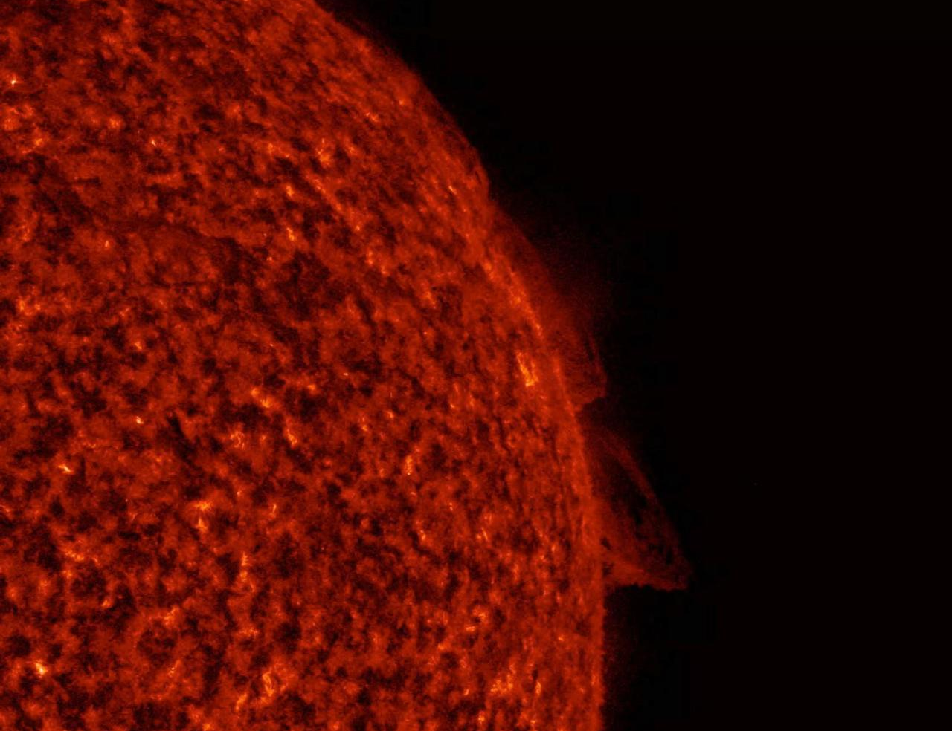
STARS & THE SUN
Stars and the Sun
Our nearest star
• A star is a huge ball of hot, glowing gas.
• The Sun is our nearest star — that is why it looks so big.
• Stars differ in size, brightness and colour.
• The Sun gives the Earth the light and heat that support life.
The Sun — a star seen close up
Notes:
A star is a glowing ball of gas. The Sun is the nearest star and looks huge only because it is so close; it sustains life on Earth.

Slide 25
THE SUN
More About the Sun
A medium star
The Sun is a medium-sized, Sun-like star.
Gives light & heat
It pours out the light and heat that warm the Earth.
The centre
All the planets move around the Sun.
Supports life
Without the Sun there would be no life on Earth.
Notes:
The Sun is a medium star at the centre of our system, the source of the light and heat that make life on Earth possible.

Slide 26
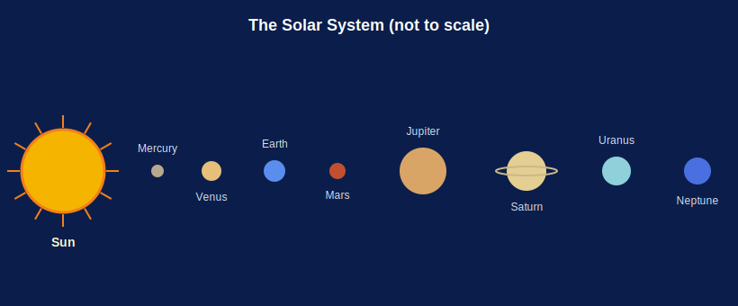
SOLAR SYSTEM
Our Solar System
The Sun's family
• The solar system is the Sun and everything that orbits it.
• Eight planets travel around the Sun in fixed paths.
• Moons, asteroids and comets are also part of it.
• The Sun's gravity holds the whole system together.
The Sun and its eight planets
Notes:
The solar system = the Sun plus all that orbits it, held together by the Sun's gravity.

Slide 27
THE PLANETS
The Eight Planets in Order
Nearest four
Mercury, Venus, Earth and Mars are closest to the Sun.
Farthest four
Jupiter, Saturn, Uranus and Neptune are far out.
Fixed paths
Each planet moves around the Sun in its own path, called an orbit.
A memory phrase
Try: 'My Very Easy Method Just Speeds Up Naming'.
Notes:
List the eight planets in order and give a mnemonic. Stress that each moves in its own fixed orbit around the Sun.

Slide 28

INNER PLANETS
The Inner (Rocky) Planets
Mercury
Venus
The closest planet to the Sun and the smallest.
The hottest planet, wrapped in thick clouds.
Earth
Mars
Our home — the only planet known to have life.
The 'red planet', with reddish, dusty ground.
Notes:
The four inner planets are small and rocky. Give each a memorable tag — closest, hottest, home, red planet.

Slide 29
OUTER PLANETS
The Outer (Giant) Planets
Jupiter
Saturn
The largest planet in the solar system.
Famous for its beautiful bright rings.
Uranus
Neptune
A cold, bluish-green giant that spins on its side.
The farthest planet, deep blue and very cold.
Notes:
The four outer planets are giants. Tag each — largest, ringed, tilted, farthest.

Slide 30
OTHER BODIES
Other Members of the Solar System
Satellites (moons)
Asteroids
Natural satellites orbit planets — the Moon orbits the Earth.
Small rocky bodies, most in a belt between Mars and Jupiter.
Comets
Meteors
Icy bodies that grow a bright glowing tail near the Sun.
Bits of rock that burn up in our air as a bright streak.
Notes:
Round out the solar-system family: moons, asteroids, comets and meteors, with a familiar example of each.

Slide 31
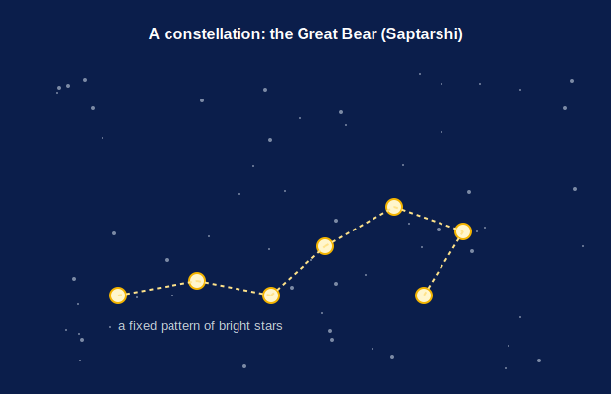
CONSTELLATIONS
Patterns in the Night Sky
Star patterns
• A constellation is a group of stars forming a pattern.
• People named them after animals, people and objects.
• The Great Bear (Saptarshi) and Orion are easy to spot.
• They help us find our way around the night sky.
A recognisable star pattern
Notes:
A constellation is a memorable star pattern used to navigate the sky — name a couple visible from India.

Slide 32
SPECIAL EARTH
Earth — Our Special Planet
Just right
The Earth is neither too hot nor too cold for life.
Air to breathe
It has an atmosphere with the oxygen we need.
Liquid water
It is the only planet with plenty of liquid water.
The only home
So far, Earth is the only place known to have life.
Notes:
Highlight why the Earth is special among the planets — right temperature, air, water and life — and worth protecting.

Slide 33
EXPLORING SPACE
Reaching Out into Space
People have always wondered about the sky, and today rockets and satellites let us explore space for real.
• Rockets carry satellites and astronauts above the Earth.
• Satellites help with weather, television and phones.
• India's space agency, ISRO, has reached the Moon and Mars.
Notes:
End on an inspiring note: space exploration by rockets and satellites, and India's own achievements through ISRO.

Slide 34
WRAP UP
Quick Recap
✓ Universe — everything that exists; measured in light years
✓ Galaxy — countless stars bound by gravity; ours is the Milky Way
✓ Nebula — gas-and-dust cloud where stars are born
✓ Star — a huge ball of hot glowing gas; the Sun is nearest
✓ Solar system — the Sun and its eight orbiting planets
✓ Planets — Mercury, Venus, Earth, Mars, Jupiter, Saturn, Uranus, Neptune
Notes:
Recap from the universe down through galaxies, stars and the solar system.

Slide 35
QUIZ 2
Final Check — Stars & the Solar System
4 questions • think before the answer reveals on the next slide

Slide 36
QUIZ QUESTION
Q1 — What is a star
A star is a huge ball of:
Cold rock
Hot glowing gas
A
B
Ice
Liquid water
C
D

Slide 37
ANSWER REVEALED
Q1 — What is a star
A star is a huge ball of:
Cold rock
Hot glowing gas
A
✓
Ice
Liquid water
C
D
WHY
A star is an enormous ball of hot gas that gives out its own light and heat — just like our Sun.

Slide 38
QUIZ QUESTION
Q2 — Nearest star
The star nearest to the Earth is the:
Pole Star
Sun
A
B
Sirius
Moon
C
D

Slide 39
ANSWER REVEALED
Q2 — Nearest star
The star nearest to the Earth is the:
Pole Star
Sun
A
✓
Sirius
Moon
C
D
WHY
The Sun is our nearest star. It looks far bigger and brighter than the others only because it is so much closer.

Slide 40
QUIZ QUESTION
Q3 — Order of planets
Which planet is nearest to the Sun?
Earth
Mercury
A
B
Jupiter
Neptune
C
D

Slide 41
ANSWER REVEALED
Q3 — Order of planets
Which planet is nearest to the Sun?
Earth
Mercury
A
✓
Jupiter
Neptune
C
D
WHY
Mercury is the closest planet to the Sun. The order outward is Mercury, Venus, Earth, Mars, Jupiter, Saturn, Uranus, Neptune.

Slide 42
QUIZ QUESTION
Q4 — Comet
A body of ice and dust that grows a glowing tail when it nears the Sun is a:
Planet
Comet
A
B
Satellite
Star
C
D

Slide 43
ANSWER REVEALED
Q4 — Comet
A body of ice and dust that grows a glowing tail when it nears the Sun is a:
Planet
Comet
A
✓
Satellite
Star
C
D
WHY
A comet is an icy body; as it nears the Sun it warms up and forms a long, bright, glowing tail.

Slide 44
Looking Up
From our own Sun to the farthest galaxy, the universe is vast beyond imagining — and its story begins with a look at the night sky.

