Slide 1
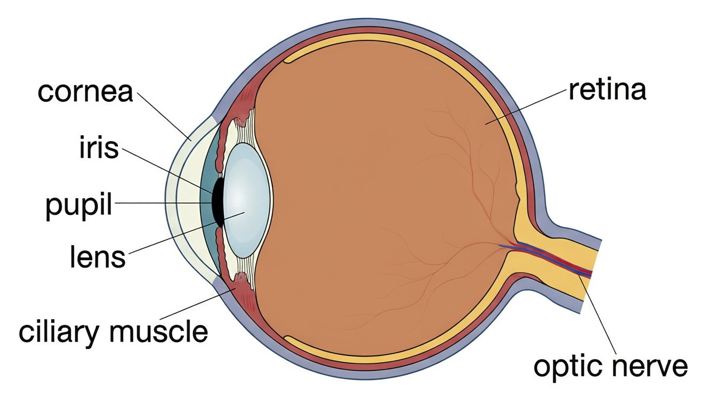
CLASS 10 • OPTICS
The Human Eye & Optical Instruments
Structure of the eye • Accommodation • Defects of vision • Microscope & telescope

Slide 2
INTRODUCTION
Learning Objectives
1
Describe the structure of the human eye and the function of each part
2
Explain how the eye forms an image on the retina
3
Explain accommodation and the near and far points of the eye
4
Identify the defects of vision and how each is corrected
5
Calculate the power of a corrective lens
6
Describe the simple microscope, compound microscope and telescope
Notes:
Open by previewing these objectives so students know what they should be able to do by the end of the session.

Slide 3
PART 1
The Human Eye
1
Its parts, how it forms an image, and how it focuses

Slide 4
STRUCTURE
Structure of the Human Eye
A living optical instrument
• The eye is a nearly spherical organ, about 2.3 cm across, filled with transparent fluids.
• Light enters through the cornea, passes the pupil and lens, and falls on the retina.
• The figure names the main parts from the cornea in front to the optic nerve behind.
• It works like a camera: a lens system throwing an image on a light-sensitive screen.
Labelled section of the human eye
Notes:
Orient students on the labelled figure. Light path: cornea → aqueous humour → pupil → lens → vitreous humour → retina.

Slide 5


THREE COATS
The Three Layers (Coats) of the Eyeball
Sclera (outer)
Choroid (middle)
The tough, white, protective coat; its transparent front bulge is the cornea.
A dark, blood-rich layer that nourishes the eye and stops internal reflection of light.
Retina (inner)
Cornea
The light-sensitive screen on which the image is formed.
The clear front of the sclera where MOST of the bending (refraction) of light happens.
Notes:
Three coats: sclera (protect), choroid (nourish + absorb stray light), retina (detect). The cornea is the front window doing most refraction.

Slide 6

LIGHT CONTROL & FOCUSING
Iris, Pupil, Lens & Humours
Iris
Pupil
The coloured ring that controls the size of the pupil — like a camera's aperture.
The central opening that widens in dim light and narrows in bright light.
Eye lens & ciliary muscles
Aqueous & vitreous humour
A flexible, jelly-like convex lens whose focal length the ciliary muscles adjust.
Transparent fluids that keep the eye in shape and help refract light.
Notes:
Iris/pupil = automatic light control; lens+ciliary = focusing; aqueous (front) and vitreous (back) humours keep shape and refract.

Slide 7
THE SCREEN
The Retina — Where the Image Forms
Rods
Cones
Very sensitive cells that work in dim light but see only shades of grey.
Cells that need bright light and give us colour vision (sensitive to red, green, blue).
Yellow spot (fovea)
Blind spot
The most sensitive point, where the sharpest image forms.
Where the optic nerve leaves the eye — no rods or cones, so no image is detected there.
Notes:
Retina cells: rods (dim, grey) vs cones (bright, colour). Fovea = sharpest vision; blind spot = optic-nerve exit, no receptors.

Slide 8
IMAGE FORMATION
How the Eye Forms an Image
The cornea and eye lens together act as a convex lens that forms a real, inverted, diminished image on the retina.
Object → cornea + lens → real inverted image on the retina
• Most refraction occurs at the cornea; the lens only fine-tunes the focus.
• The image on the retina is real and inverted.
• The brain interprets the signals so that we perceive the world upright.
Notes:
Cornea+lens = a convex system → real inverted image on retina. The brain re-inverts it. Same optics as a camera.

Slide 9
ACCOMMODATION
Power of Accommodation
The ability of the eye to change the focal length of its lens to focus objects at different distances is called accommodation.
near object → lens thick (short f) • far object → lens thin (long f)
• For a distant object the ciliary muscles relax and the lens becomes thin (long focal length).
• For a near object the ciliary muscles contract and the lens becomes thick (short focal length).
• The eye adjusts automatically and almost instantly.
Notes:
Accommodation = ciliary muscles changing the lens's focal length. Relaxed → thin lens (far); contracted → thick lens (near).

Slide 10
RANGE OF VISION
Near Point, Far Point & Range of Vision
Near point
Least distance of distinct vision
The closest point the eye can focus clearly — about 25 cm for a normal eye.
The near-point distance, D = 25 cm; objects nearer than this look blurred.
Far point
Range of vision
The farthest point the eye can focus — infinity for a normal eye.
A normal eye sees clearly all the way from 25 cm to infinity.
Notes:
Near point 25 cm (= least distance of distinct vision D), far point infinity. Range of clear vision = 25 cm → ∞.

Slide 11
MORE VISION FACTS
Persistence of Vision & Binocular Vision
Good to know
Persistence of vision
An image lingers on the retina for about 1/16 s after the object is removed — this is why rapid still frames look like a moving film.
Binocular vision
Using two eyes gives a wider field of view and lets us judge distance and depth.
Colour blindness
A genetic defect (mostly in males) in which certain cones are missing, so some colours cannot be told apart.
Notes:
Persistence of vision (~1/16 s) → cinema. Binocular vision → depth perception. Colour blindness = defective/missing cones.

Slide 12
QUIZ 1
Check — The Eye & Accommodation
4 questions • think before the answer reveals on the next slide

Slide 13
QUIZ QUESTION
Q1 — Most refraction
In the human eye, most of the refraction (bending) of incoming light takes place at the:
Retina
Cornea
A
B
Iris
Optic nerve
C
D

Slide 14
ANSWER REVEALED
Q1 — Most refraction
In the human eye, most of the refraction (bending) of incoming light takes place at the:
Retina
Cornea
A
✓
Iris
Optic nerve
C
D
WHY
The greatest change in direction of light happens as it enters the curved, transparent cornea. The eye lens then makes only the fine focusing adjustment.

Slide 15
QUIZ QUESTION
Q2 — Focusing
The eye focuses on objects at different distances by the ciliary muscles changing the lens's:
Diameter of the pupil
Focal length
A
B
Colour
Position on the retina
C
D

Slide 16
ANSWER REVEALED
Q2 — Focusing
The eye focuses on objects at different distances by the ciliary muscles changing the lens's:
Diameter of the pupil
Focal length
A
✓
Colour
Position on the retina
C
D
WHY
Accommodation works by the ciliary muscles altering the curvature — and hence the focal length — of the flexible eye lens, not by moving it.

Slide 17
QUIZ QUESTION
Q3 — Least distance
For a normal human eye, the least distance of distinct vision (near point) is about:
10 cm
25 cm
A
B
50 cm
infinity
C
D

Slide 18
ANSWER REVEALED
Q3 — Least distance
For a normal human eye, the least distance of distinct vision (near point) is about:
10 cm
25 cm
A
✓
50 cm
infinity
C
D
WHY
A normal eye can focus objects clearly from 25 cm (the near point) out to infinity (the far point). Objects closer than 25 cm look blurred.

Slide 19
QUIZ QUESTION
Q4 — Retinal image
The image formed on the retina of a normal eye is:
Virtual and erect
Real and inverted
A
B
Virtual and inverted
Real and erect
C
D

Slide 20
ANSWER REVEALED
Q4 — Retinal image
The image formed on the retina of a normal eye is:
Virtual and erect
Real and inverted
A
✓
Virtual and inverted
Real and erect
C
D
WHY
The convex eye-lens system forms a real, inverted image on the retina; the brain processes it so that we perceive the world the right way up.

Slide 21
PART 2
Defects of Vision & Optical Instruments
2
Correcting sight, and seeing the very small and very far

Slide 22
FOUR DEFECTS
Common Defects of Vision — Overview
Myopia (short sight)
Hypermetropia (long sight)
Can see near objects but not distant ones; image falls in front of the retina.
Can see distant objects but not near ones; image falls behind the retina.
Presbyopia
Astigmatism
Age-related loss of accommodation — both near and far vision weaken.
Uneven curvature of the cornea/lens blurs lines in certain directions.
Notes:
Overview of the four defects. The next slides show myopia and hypermetropia with corrections; then presbyopia and astigmatism.

Slide 23
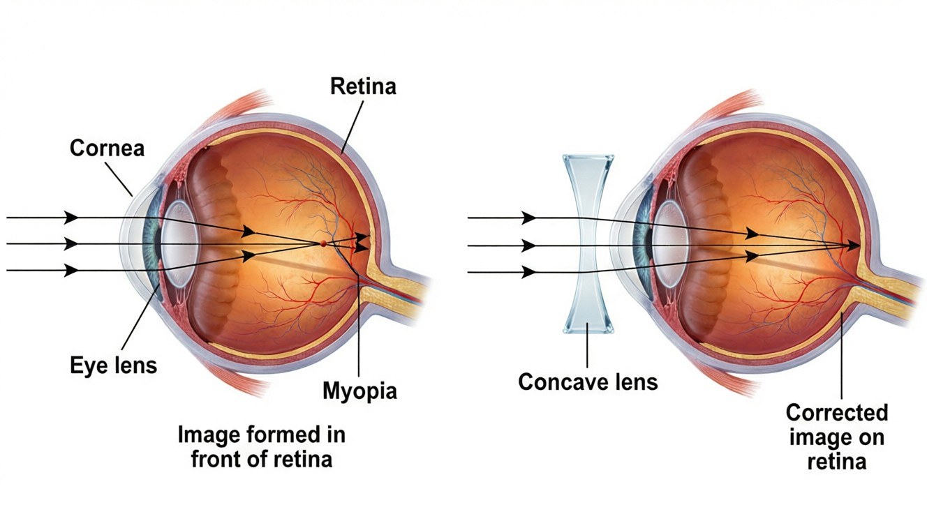
MYOPIA
Myopia (Short-sightedness) & Its Correction
Corrected by a concave lens
• The eyeball is too long, or the lens too strongly converging.
• The image of a distant object forms IN FRONT of the retina, so distant objects look blurred.
• A concave (diverging) lens spreads the light out a little before it enters the eye.
• This shifts the image back exactly onto the retina — clear vision restored.
Image forms in front of the retina
Notes:
Myopia: image before retina (long eyeball / strong lens). Concave lens of suitable negative power moves it onto the retina.

Slide 24
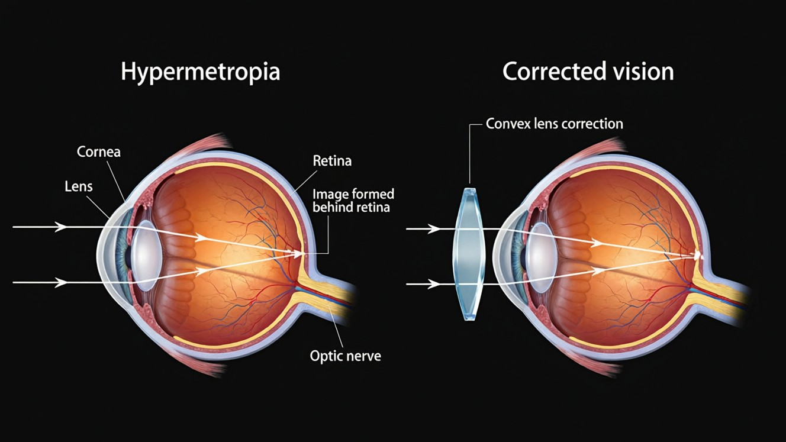
HYPERMETROPIA
Hypermetropia (Long-sightedness) & Its Correction
Corrected by a convex lens
• The eyeball is too short, or the lens too weakly converging.
• The image of a near object forms BEHIND the retina, so near objects look blurred.
• A convex (converging) lens adds the missing converging power before light enters the eye.
• This brings the image forward onto the retina.
Image forms behind the retina
Notes:
Hypermetropia: image behind retina (short eyeball / weak lens). Convex lens of positive power brings it forward onto the retina.

Slide 25


PRESBYOPIA & ASTIGMATISM
Two More Defects
Presbyopia — cause
Presbyopia — correction
With age the eye lens hardens and the ciliary muscles weaken, so accommodation is lost.
The near point recedes; bifocal lenses (concave top for distance, convex bottom for reading) are used.
Astigmatism — cause
Astigmatism — correction
The cornea or lens is not perfectly spherical, so some lines focus while others do not.
A cylindrical lens of the correct axis corrects the uneven focusing.
Notes:
Presbyopia = age loss of accommodation → bifocals. Astigmatism = uneven curvature → cylindrical lens.

Slide 26
POWER OF A LENS
Power of a Corrective Lens
The power of a lens tells us how strongly it converges or diverges light; it is the reciprocal of the focal length in metres.
P = 1 / f (metres) • unit: dioptre (D)
• A convex (converging) lens has POSITIVE power.
• A concave (diverging) lens has NEGATIVE power.
• The optician's prescription is written directly in dioptres.
Notes:
P = 1/f (f in metres), unit dioptre. Convex → +, concave → −. Used to work out the corrective lens needed.

Slide 27
WORKED EXAMPLE
Correcting Myopia
Problem. A short-sighted person's far point is only 2 m. Find the power of the spectacle lens that lets them see distant objects clearly.
The concave lens must form the image of a distant object at the far point: v = −2 m, u = −∞
1/f = 1/v − 1/u = (−1/2) − 0
f = −2 m
P = 1/f = 1 / (−2)
Answer: P = −0.5 D (a concave lens, as expected for myopia)
Notes:
For a distant object u → ∞ so 1/f = 1/v. Negative power confirms a concave lens corrects myopia.

Slide 28
WORKED EXAMPLE
Correcting Hypermetropia
Problem. A long-sighted person's near point is 50 cm. Find the power of the lens that lets them read at the normal 25 cm.
The convex lens forms a virtual image of the 25 cm object at the near point: u = −25 cm, v = −50 cm
1/f = 1/v − 1/u = (−1/50) − (−1/25) = −1/50 + 2/50 = 1/50
f = +50 cm = +0.5 m
P = 1/f = 1 / 0.5
Answer: P = +2.0 D (a convex lens, as expected for hypermetropia)
Notes:
The lens images the 25 cm object at the 50 cm near point. Positive power confirms a convex lens corrects hypermetropia.

Slide 29

SIMPLE MICROSCOPE
The Simple Microscope (Magnifying Glass)
What it is
Object position
A single convex lens of short focal length held close to the eye.
The object is placed within the focal length of the lens.
Image
Magnification
A virtual, erect and magnified image is seen on the same side as the object.
m = 1 + D/f, where D = 25 cm — a shorter focal length gives more magnification.
Notes:
Simple microscope = one short-focus convex lens; object within f → virtual, erect, magnified image. m = 1 + D/f.

Slide 30
COMPOUND MICROSCOPE
The Compound Microscope
Two lenses
Stage 1
An objective (short focal length) near the object and an eyepiece near the eye.
The objective forms a real, inverted, magnified image of the tiny object.
Stage 2
Total magnification
The eyepiece magnifies that image again, like a simple microscope.
m = m(objective) × m(eyepiece) — the two magnifications multiply, giving very high magnification.
Notes:
Compound microscope: objective + eyepiece, both convex. Two-stage magnification multiplies. Used for cells, microbes, tiny structures.

Slide 31
TELESCOPE
The Astronomical (Refracting) Telescope
Purpose
Objective lens
To see distant objects such as stars, planets and the Moon.
A large, long-focal-length lens that collects light and forms a real image of the distant object.
Eyepiece
Magnification
A short-focal-length lens that magnifies this image for the eye.
In normal adjustment m = f(objective) / f(eyepiece) — the opposite lens choice to the compound microscope.
Notes:
Astronomical telescope: long-focus objective + short-focus eyepiece; m = f_o/f_e. Opposite lens choice to the compound microscope, which uses a short-focus objective.

Slide 32

APPLICATIONS
Optical Instruments Around Us
Spectacles
Microscopes
Correct myopia, hypermetropia, presbyopia and astigmatism for clear everyday vision.
Reveal cells, bacteria and tiny structures in biology and medicine.
Telescopes
Cameras & projectors
Let astronomers study distant stars, planets and galaxies.
Use convex lenses to form real images, just like the eye does on the retina.
Notes:
Tie the physics to real devices: spectacles, microscopes, telescopes, cameras — all use controlled refraction by lenses.

Slide 33
WRAP UP
Quick Recap
✓ Structure — cornea refracts; lens+ciliary focus; retina detects
✓ Accommodation — lens changes focal length; near point 25 cm
✓ Myopia — image before retina → concave lens
✓ Hypermetropia — image behind retina → convex lens
✓ Microscope — simple = one lens; compound = objective + eyepiece
✓ Telescope — m = f(objective) / f(eyepiece)
Notes:
Rapid recap; the defect–correction pairs and the microscope/telescope distinction are the key exam points.

Slide 34
QUIZ 2
Final Check — Defects & Instruments
5 questions • think before the answer reveals on the next slide

Slide 35
QUIZ QUESTION
Q1 — Correct myopia
Myopia (short-sightedness) is corrected using a:
Convex lens
Concave lens
A
B
Cylindrical lens
Bifocal lens
C
D

Slide 36
ANSWER REVEALED
Q1 — Correct myopia
Myopia (short-sightedness) is corrected using a:
Convex lens
Concave lens
A
✓
Cylindrical lens
Bifocal lens
C
D
WHY
In myopia the image forms in front of the retina, so a concave (diverging) lens is used to push the image back onto the retina.

Slide 37
QUIZ QUESTION
Q2 — Old age
With advancing age a person finds it hard to read small print held close. This defect is:
Myopia
Astigmatism
A
B
Presbyopia
Colour blindness
C
D

Slide 38
ANSWER REVEALED
Q2 — Old age
With advancing age a person finds it hard to read small print held close. This defect is:
Myopia
Astigmatism
A
B
Presbyopia
Colour blindness
✓
D
WHY
Presbyopia is the age-related loss of accommodation as the lens stiffens; the near point recedes, so close work needs a converging (often bifocal) lens.

Slide 39
QUIZ QUESTION
Q3 — Power sign
The power of the lens used to correct hypermetropia is:
Negative (concave)
Positive (convex)
A
B
Zero
Always −0.5 D
C
D

Slide 40
ANSWER REVEALED
Q3 — Power sign
The power of the lens used to correct hypermetropia is:
Negative (concave)
Positive (convex)
A
✓
Zero
Always −0.5 D
C
D
WHY
Hypermetropia needs extra converging power to bring the image forward onto the retina, so a convex lens of positive power is used.

Slide 41
QUIZ QUESTION
Q4 — Compound microscope
A compound microscope uses two convex lenses because it must:
Correct colour
Magnify a small near object in two stages
A
B
See distant stars
Reduce the image
C
D

Slide 42
ANSWER REVEALED
Q4 — Compound microscope
A compound microscope uses two convex lenses because it must:
Correct colour
Magnify a small near object in two stages
A
✓
See distant stars
Reduce the image
C
D
WHY
The objective forms a real, enlarged image of the tiny object, and the eyepiece magnifies that image again — the two magnifications multiply for a very high total magnification.

Slide 43
QUIZ QUESTION
Q5 — Telescope magnification
In normal adjustment the magnification of an astronomical telescope is:
f(eyepiece) / f(objective)
f(objective) × f(eyepiece)
A
B
f(objective) / f(eyepiece)
f(objective) + f(eyepiece)
C
D

Slide 44
ANSWER REVEALED
Q5 — Telescope magnification
In normal adjustment the magnification of an astronomical telescope is:
f(eyepiece) / f(objective)
f(objective) × f(eyepiece)
A
B
f(objective) / f(eyepiece)
f(objective) + f(eyepiece)
✓
D
WHY
A telescope uses a long-focus objective and a short-focus eyepiece, so m = f_o/f_e — a large ratio gives high magnification of distant objects.

Slide 45
Seeing the World
From the near point of the eye to a distant star, lenses — natural and made — bend light so that we can see.

Slide 46
HOMEWORK
Homework — Quick MCQs (1–5 of 10)
1
Most of the refraction of light entering the eye occurs at the:
(A) lens (B) cornea (C) retina (D) pupil
2
The size of the pupil is controlled by the:
(A) cornea (B) iris (C) retina (D) ciliary muscle
3
The light-sensitive screen of the eye is the:
(A) cornea (B) iris (C) retina (D) sclera
4
Colour vision is due to the retinal cells called:
(A) rods (B) cones (C) nerves (D) muscles
5
The near point of a normal human eye is about:
(A) 10 cm (B) 25 cm (C) 50 cm (D) 100 cm
Notes:
Homework MCQs — let pupils attempt first. Answer key: Q1: B. cornea; Q2: B. iris; Q3: C. retina; Q4: B. cones; Q5: B. 25 cm.

Slide 47
HOMEWORK
Homework — Quick MCQs (6–10 of 10)
6
In myopia the image of a distant object is formed:
(A) on the retina (B) in front of the retina (C) behind the retina (D) at the cornea
7
Hypermetropia is corrected using a lens that is:
(A) concave (B) convex (C) cylindrical (D) plane
8
Astigmatism is corrected using a:
(A) concave lens (B) convex lens (C) cylindrical lens (D) bifocal lens
9
A simple microscope is essentially a single:
(A) concave lens (B) convex lens (C) plane mirror (D) prism
10
The magnification of an astronomical telescope is:
(A) f_e / f_o (B) f_o / f_e (C) f_o × f_e (D) f_o − f_e
Notes:
Homework MCQs — let pupils attempt first. Answer key: Q6: B. in front of the retina; Q7: B. convex; Q8: C. cylindrical lens; Q9: B. convex lens; Q10: B. f_o / f_e.

