Slide 1
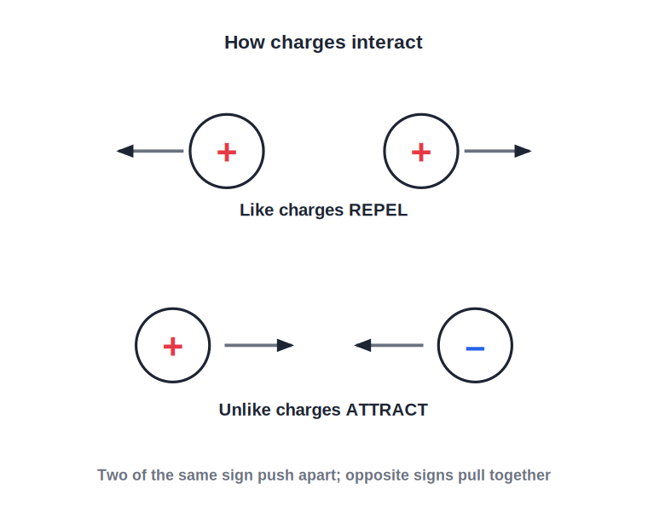
ICSE • CLASS 8 • ELECTRICITY
Static Electricity
Electric charge • Charging by friction • Two kinds of charge • Lightning

Slide 2
INTRODUCTION
Learning Objectives
1
Explain what electric charge is in terms of electrons
2
Describe how a body is charged by friction
3
State the two kinds of charge and how they interact
4
Distinguish conductors from insulators
5
Describe an electroscope and how it detects charge
6
Explain lightning and simple lightning safety
Notes:
Open by previewing these objectives so students know what they should be able to do by the end of the session.

Slide 3
PART 1
Electric Charge
1
Where charge comes from and how it behaves

Slide 4
WHAT IS CHARGE
Electric Charge
Every atom contains positive protons and negative electrons. Charge appears when a body gains or loses electrons.
• Equal protons and electrons → the body is neutral (uncharged).
• Lose electrons → fewer negatives → positively charged.
• Gain electrons → extra negatives → negatively charged.
Notes:
Charge is about electrons. Neutral = balanced. Losing electrons leaves a positive body; gaining them makes it negative. Only electrons move, not protons.

Slide 5

BY FRICTION
Charging by Friction
Rubbing
Glass & silk
Rubbing two suitable materials transfers electrons from one to the other.
Glass rubbed with silk loses electrons and becomes positively charged.
Ebonite & fur
Comb in hair
Ebonite rubbed with fur gains electrons and becomes negatively charged.
A comb run through dry hair picks up electrons and can then lift bits of paper.
Notes:
Charging by friction transfers electrons between materials. Standard examples: glass+silk (positive), ebonite+fur (negative), comb in hair.

Slide 6
TWO KINDS
Two Kinds of Charge and How They Interact
Like repel, unlike attract
• There are just two kinds of charge: positive and negative.
• Two like charges (both + or both –) push each other apart.
• Two unlike charges (+ and –) pull each other together.
• A charged body can also attract a light, uncharged object for a short while.
The basic rule of charges
Notes:
The fundamental rule: like charges repel, unlike attract. A charged body can also attract a neutral object by inducing opposite charge.

Slide 7
CONDUCTORS
Conductors and Insulators
Letting charge move or not
• Conductors Materials that let charge flow through them — metals, the human body, the earth.
• Insulators Materials that do not let charge flow — plastic, rubber, glass, dry wood.
• Why Conductors have free electrons; insulators hold their electrons tightly.
• Use Wires use copper to carry charge and plastic to keep it safely inside.
Notes:
Conductors (free electrons: metals) vs insulators (tightly held: plastic, rubber). A wire combines both — copper core, plastic sheath.

Slide 8
QUIZ 1
Check Your Understanding
4 questions • think before the answer reveals on the next slide

Slide 9
QUIZ QUESTION
Q1 — Comb Trick
A plastic comb rubbed on dry hair picks up tiny bits of paper because rubbing has made the comb:
Hotter
Electrically charged
A
B
Magnetic
Wet
C
D

Slide 10
ANSWER REVEALED
Q1 — Comb Trick
A plastic comb rubbed on dry hair picks up tiny bits of paper because rubbing has made the comb:
Hotter
Electrically charged
A
✓
Magnetic
Wet
C
D
WHY
Rubbing transfers electrons to the comb, giving it a charge. The charged comb then attracts the light, uncharged paper bits — a static-electricity effect, not magnetism.

Slide 11
QUIZ QUESTION
Q2 — Lost Electrons
A glass rod rubbed with silk loses some electrons. The rod therefore becomes:
Negatively charged
Positively charged
A
B
Neutral
A conductor
C
D

Slide 12
ANSWER REVEALED
Q2 — Lost Electrons
A glass rod rubbed with silk loses some electrons. The rod therefore becomes:
Negatively charged
Positively charged
A
✓
Neutral
A conductor
C
D
WHY
Losing electrons leaves the rod with more protons than electrons, so it carries a net positive charge. The silk, which gains those electrons, becomes negative.

Slide 13
QUIZ QUESTION
Q3 — Two Balloons
Two balloons rubbed on the same wool both gain the same kind of charge. Brought near each other they will:
Attract
Repel
A
B
Do nothing
Stick together
C
D

Slide 14
ANSWER REVEALED
Q3 — Two Balloons
Two balloons rubbed on the same wool both gain the same kind of charge. Brought near each other they will:
Attract
Repel
A
✓
Do nothing
Stick together
C
D
WHY
Rubbed on the same material, both balloons carry like charges. Like charges repel, so the balloons push apart when brought close.

Slide 15
QUIZ QUESTION
Q4 — Safe Wire
A copper wire is given a plastic covering because copper is a good conductor and plastic is a good:
Conductor
Insulator
A
B
Magnet
Fuel
C
D

Slide 16
ANSWER REVEALED
Q4 — Safe Wire
A copper wire is given a plastic covering because copper is a good conductor and plastic is a good:
Conductor
Insulator
A
✓
Magnet
Fuel
C
D
WHY
The copper core carries the charge, while the plastic sheath is an insulator that stops the charge escaping and keeps us safe from shocks.

Slide 17
PART 2
Detecting Charge & Lightning
2
The electroscope and electricity in the sky

Slide 18
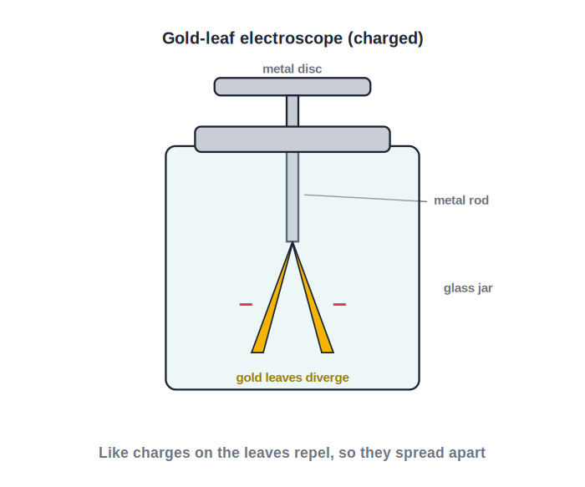
ELECTROSCOPE
The Gold-Leaf Electroscope
Leaves diverge when charged
• An electroscope detects whether a body is charged.
• It has a metal disc and rod ending in two thin gold leaves.
• Touch it with a charged body and the leaves gain like charge.
• Like charges repel, so the leaves diverge — the more charge, the wider they spread.
Diverging leaves reveal a charge
Notes:
Electroscope detects charge. Charge spreads to the gold leaves; like charges repel so they diverge. Wider divergence = more charge.

Slide 19

TRANSFER
Transferring Charge
By contact
By earthing
Touching a charged body to a conductor shares the charge between them.
Connecting a charged conductor to the earth lets its charge flow away.
The earth
Why it matters
The earth is a huge conductor that can give or take almost any amount of charge.
Earthing safely removes unwanted static charge from a body.
Notes:
Charge can be shared by contact and removed by earthing. The earth acts as an unlimited reservoir of charge.

Slide 20
LIGHTNING
Lightning
Lightning is a giant spark of static electricity. Charges build up in storm clouds until they jump suddenly to another cloud or to the ground.
• Rising air rubs water and ice, charging the cloud.
• When the charge is large enough it leaps as a brilliant flash.
• The flash heats the air, which expands and bangs as thunder.
Notes:
Lightning = large-scale static discharge. Cloud charges build, then jump as a spark. Thunder is the sound of the suddenly heated air.

Slide 21

STAY SAFE
Lightning Safety
Get indoors
Avoid tall, lone objects
A building or a car is far safer than open ground.
Do not shelter under a single tall tree in a field.
Lightning conductor
Keep low
A metal rod on a building guides the charge safely to the earth.
In the open, crouch low and keep away from water and metal.
Notes:
Lightning safety: shelter indoors/in a car, avoid lone tall objects, lightning conductors protect buildings.

Slide 22
ALL AROUND US
Static Electricity Around Us
Crackling clothes
Clinging wrap
Synthetic clothes rub and charge up, crackling and sparking as you undress.
Charged plastic wrap clings to a bowl because of attraction to opposite charge.
Dusty screens
A shock from a doorknob
A charged TV or computer screen pulls fine dust particles onto it.
Charge picked up while walking jumps as a tiny spark when you touch metal.
Notes:
Everyday static effects: crackling clothes, clinging wrap, dusty screens, doorknob sparks. Relates the topic to daily life.

Slide 23
WRAP UP
Quick Recap
✓ Charge — from gaining or losing electrons
✓ Friction — rubbing transfers electrons between materials
✓ Two kinds — like charges repel, unlike attract
✓ Conductors — let charge flow; insulators do not
✓ Electroscope — diverging leaves reveal a charge
✓ Lightning — a huge static spark; shelter and use conductors
Notes:
Rapid recap of charge, friction, the two-charge rule, conductors, the electroscope and lightning.

Slide 24
QUIZ 2
Final Check — Static Electricity
5 questions • think before the answer reveals on the next slide

Slide 25
QUIZ QUESTION
Q1 — Wider Leaves
When a more strongly charged rod touches an electroscope, its gold leaves diverge more widely. This is because the leaves now carry:
Opposite charges that attract
More like charge, so they repel harder
A
B
No charge
Heat
C
D

Slide 26
ANSWER REVEALED
Q1 — Wider Leaves
When a more strongly charged rod touches an electroscope, its gold leaves diverge more widely. This is because the leaves now carry:
Opposite charges that attract
More like charge, so they repel harder
A
✓
No charge
Heat
C
D
WHY
The extra charge spreads onto both leaves, which then carry the same kind of charge. Greater like charge means a stronger repulsion, so the leaves spread further apart.

Slide 27
QUIZ QUESTION
Q2 — Thunder Sound
We hear thunder after a lightning flash because the flash suddenly:
Cools the air
Heats the air, which expands and makes a loud sound
A
B
Freezes the cloud
Stops the wind
C
D

Slide 28
ANSWER REVEALED
Q2 — Thunder Sound
We hear thunder after a lightning flash because the flash suddenly:
Cools the air
Heats the air, which expands and makes a loud sound
A
✓
Freezes the cloud
Stops the wind
C
D
WHY
The lightning spark heats the surrounding air violently. The air expands with a sharp bang we hear as thunder. We see the flash first because light travels faster than sound.

Slide 29
QUIZ QUESTION
Q3 — Earthing
Connecting a charged metal sphere to the ground with a wire makes it lose its charge because the earth:
Is an insulator
Is a huge conductor that absorbs the charge
A
B
Is positively charged
Heats the sphere
C
D

Slide 30
ANSWER REVEALED
Q3 — Earthing
Connecting a charged metal sphere to the ground with a wire makes it lose its charge because the earth:
Is an insulator
Is a huge conductor that absorbs the charge
A
✓
Is positively charged
Heats the sphere
C
D
WHY
The earth is an enormous conductor. A wire lets the sphere's excess charge flow away into the ground, leaving the sphere neutral — this is earthing.

Slide 31
QUIZ QUESTION
Q4 — Attracting Paper
A charged rod attracts tiny uncharged paper bits. The rod can do this because it:
Is magnetic
Induces an opposite charge on the nearby paper
A
B
Is hot
Is heavy
C
D

Slide 32
ANSWER REVEALED
Q4 — Attracting Paper
A charged rod attracts tiny uncharged paper bits. The rod can do this because it:
Is magnetic
Induces an opposite charge on the nearby paper
A
✓
Is hot
Is heavy
C
D
WHY
The charged rod pulls opposite charge to the near side of each paper bit. Since unlike charges attract and the opposite charge is closer, the light paper is drawn to the rod.

Slide 33
QUIZ QUESTION
Q5 — Lightning Conductor
A metal lightning conductor on a tall building protects it by:
Attracting clouds
Carrying the lightning's charge safely to the earth
A
B
Making thunder louder
Storing the charge
C
D

Slide 34
ANSWER REVEALED
Q5 — Lightning Conductor
A metal lightning conductor on a tall building protects it by:
Attracting clouds
Carrying the lightning's charge safely to the earth
A
✓
Making thunder louder
Storing the charge
C
D
WHY
The conductor offers an easy metal path from the highest point of the building down to the ground, so the lightning's charge flows harmlessly to earth instead of damaging the building.

Slide 35
Charge in Action
From a crackling comb to a bolt of lightning, static electricity is simply electrons on the move — and balanced again.

