Slide 1
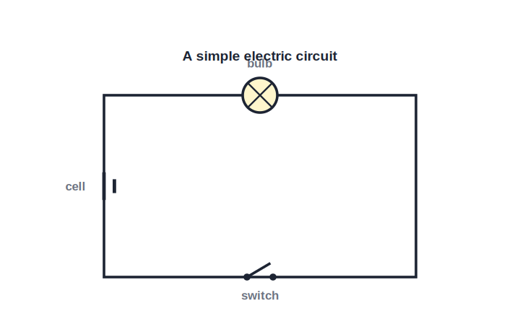
ICSE • CLASS 8 • ELECTRICITY
Electricity in the Home
Cells & circuits • Wire colour codes • Earthing & fuse • The electricity meter

Slide 2
INTRODUCTION
Learning Objectives
1
Describe a cell and a simple electric circuit
2
State the dangers of electricity
3
Give the colour code of the wires in a cable
4
Explain the purpose of earthing and of a fuse
5
Describe a simple household circuit
6
Explain the unit in which electrical energy is sold
Notes:
Open by previewing these objectives so students know what they should be able to do by the end of the session.

Slide 3
PART 1
Cells, Circuits & Safety
1
Making a current flow and using it safely

Slide 4
CIRCUITS
Cells and Circuits
A complete path
• A cell pushes electric charge around a circuit.
• A circuit is a closed path of conductors for the current.
• Current flows only when the path is complete and the switch is on.
• A switch simply makes or breaks the path to turn things on or off.
Cell, switch and bulb in a closed loop
Notes:
A cell drives current; a circuit is a closed conducting path. Current flows only when the loop is complete. The switch makes/breaks the path.

Slide 5




DANGERS
The Dangers of Electricity
Electric shock
Overheating
A current through the body can injure or even kill.
Too much current heats wires and can start a fire.
Damaged wires
Water
Bare or frayed wires expose live conductors.
Wet hands or floors make shocks far more likely — water conducts.
Notes:
Main dangers: shock, fire from overheating, exposed wires, and water. These motivate the safety devices that follow.

Slide 6
COLOUR CODE
The Colour Code of Wires
Live, neutral and earth
• Live wire Brown (older cables red) — carries the dangerous current to the appliance.
• Neutral wire Blue (older cables black) — completes the circuit back to the supply.
• Earth wire Green-and-yellow — a safety wire connected to the earth.
• Why it matters Correct colours make sure each wire is connected to the right pin.
Notes:
Three-wire colour code: live (brown/red), neutral (blue/black), earth (green-yellow). Correct wiring is a safety essential.

Slide 7
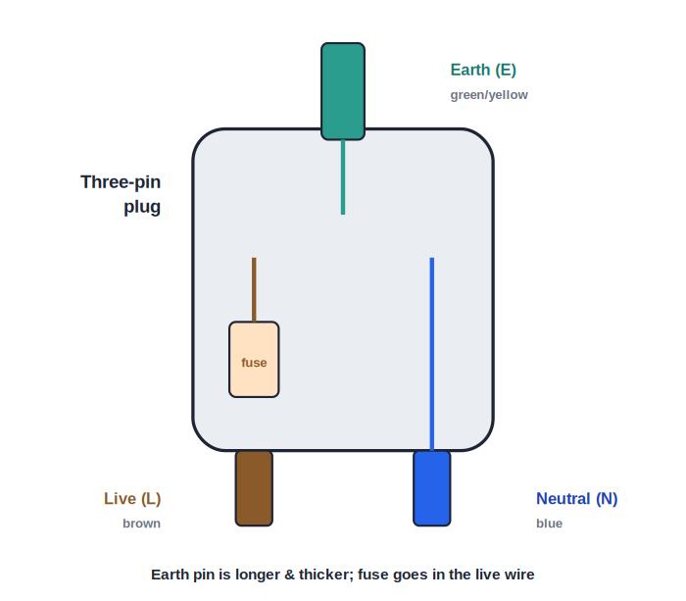
THREE-PIN PLUG
The Three-Pin Plug and Earthing
The earth pin protects you
• A three-pin plug connects an appliance to the mains safely.
• The longest, thickest pin is the earth pin.
• Earthing connects the metal body of an appliance to the ground.
• If a fault makes the body live, the current escapes to earth instead of through us.
Live, neutral and earth pins
Notes:
Three-pin plug: the long top pin is earth. Earthing sends fault current safely to ground, protecting the user from a shock via a metal body.

Slide 8
QUIZ 1
Check Your Understanding
4 questions • think before the answer reveals on the next slide

Slide 9
QUIZ QUESTION
Q1 — No Light
A torch bulb will not light even though the cell is good. The most likely reason is that the circuit is:
Too short
Broken somewhere, so the path is open
A
B
Too cold
Earthed
C
D

Slide 10
ANSWER REVEALED
Q1 — No Light
A torch bulb will not light even though the cell is good. The most likely reason is that the circuit is:
Too short
Broken somewhere, so the path is open
A
✓
Too cold
Earthed
C
D
WHY
Current flows only around a complete, closed loop. A loose connection or open switch breaks the path, so no current reaches the bulb and it stays dark.

Slide 11
QUIZ QUESTION
Q2 — Green-Yellow
In a modern cable, the wire coloured green and yellow is the:
Live wire
Neutral wire
A
B
Earth wire
Heating wire
C
D

Slide 12
ANSWER REVEALED
Q2 — Green-Yellow
In a modern cable, the wire coloured green and yellow is the:
Live wire
Neutral wire
A
B
Earth wire
Heating wire
✓
D
WHY
Green-and-yellow always marks the earth wire — the safety wire that carries fault current to the ground. Brown is live and blue is neutral.

Slide 13
QUIZ QUESTION
Q3 — Wet Hands
Touching a switch with wet hands is dangerous because water:
Is an insulator
Conducts electricity, making a shock more likely
A
B
Cools the wire
Stops the current
C
D

Slide 14
ANSWER REVEALED
Q3 — Wet Hands
Touching a switch with wet hands is dangerous because water:
Is an insulator
Conducts electricity, making a shock more likely
A
✓
Cools the wire
Stops the current
C
D
WHY
Water is a conductor, so wet skin lets current pass through the body much more easily. That is why we must keep electrical switches and appliances away from water.

Slide 15
QUIZ QUESTION
Q4 — Earth Pin Job
The earth pin of a three-pin plug protects us by:
Carrying the normal current
Sending fault current from the metal body safely to the ground
A
B
Lighting a bulb
Saving energy
C
D

Slide 16
ANSWER REVEALED
Q4 — Earth Pin Job
The earth pin of a three-pin plug protects us by:
Carrying the normal current
Sending fault current from the metal body safely to the ground
A
✓
Lighting a bulb
Saving energy
C
D
WHY
If a fault makes an appliance's metal body live, the earth wire gives that current an easy path to the ground. It flows to earth instead of through anyone who touches the body.

Slide 17
PART 2
Household Circuit & Energy
2
Fuses, the meter and the unit of energy

Slide 18
THE FUSE
The Fuse
A fuse is a short piece of thin wire that melts and breaks the circuit if the current grows dangerously large.
• It is joined in the live wire of a circuit.
• A large fault current heats the thin wire until it melts.
• The broken circuit cuts off the supply, preventing fire.
Notes:
The fuse is a deliberate weak link in the live wire. Excess current melts it, breaking the circuit and preventing overheating and fire.

Slide 19

HOUSEHOLD CIRCUIT
A Simple Household Circuit
From the meter
Parallel connection
Supply enters the house through the electricity meter and a main fuse.
Lights and sockets are joined in parallel, so each works on its own.
Switches in the live
Each circuit fused
Switches are placed in the live wire to make appliances safe when off.
Separate circuits for lights and power each have their own fuse.
Notes:
Household wiring: meter + main fuse, appliances in parallel, switches in the live wire, separate fused circuits.

Slide 20
UNIT OF ENERGY
Measuring Electrical Energy
An electricity meter records how much electrical energy a home uses, measured in kilowatt-hours (kWh).
1 unit = 1 kilowatt-hour (kWh) = energy used by a 1 kW appliance in 1 hour
• The meter counts the units used over time.
• The electricity bill charges for these units.
• Using fewer, more efficient appliances lowers the bill.
Notes:
Commercial unit of electrical energy = kilowatt-hour (kWh). The meter records units; the bill charges per unit. 1 kWh = a 1 kW device for 1 hour.

Slide 21
FUSE VS MCB
The Fuse and Its Modern Cousin
Choosing the right protection
• Rating A fuse is marked with a safe current, such as 5 A or 15 A.
• Right value A lighting circuit uses a low-rated fuse; a heater needs a higher one.
• After it blows A blown fuse wire must be replaced before the circuit works again.
• Circuit breaker (MCB) A switch that trips on a large current and can simply be switched back on.
Notes:
Fuses are rated in amperes; pick the right value for the circuit. Modern homes use MCBs (resettable circuit breakers) in place of fuse wire.

Slide 22
BE SAFE
Precautions While Using Electricity
Dry hands
Good wiring
Never touch switches or plugs with wet hands.
Replace frayed wires and use correctly rated fuses.
Don't overload
Earth appliances
Avoid plugging many appliances into one socket.
Use three-pin plugs so metal-bodied appliances are earthed.
Notes:
Everyday safety precautions: dry hands, sound wiring, correct fuses, no overloading, proper earthing.

Slide 23
WRAP UP
Quick Recap
✓ Circuit — current flows in a complete, switched path
✓ Dangers — shock, fire, bare wires, water
✓ Colour code — live brown, neutral blue, earth green-yellow
✓ Earthing — fault current goes safely to the ground
✓ Fuse — thin wire melts to break a dangerous current
✓ Energy unit — the kilowatt-hour (kWh) — the billed unit
Notes:
Rapid recap of circuits, dangers, colour codes, earthing, the fuse and the kilowatt-hour.

Slide 24
QUIZ 2
Final Check — Electricity at Home
5 questions • think before the answer reveals on the next slide

Slide 25
QUIZ QUESTION
Q1 — Why a Fuse Melts
A fuse protects a circuit by melting when the current is too large. It is therefore connected:
In the earth wire
In the live wire
A
B
Across the bulb
Outside the house
C
D

Slide 26
ANSWER REVEALED
Q1 — Why a Fuse Melts
A fuse protects a circuit by melting when the current is too large. It is therefore connected:
In the earth wire
In the live wire
A
✓
Across the bulb
Outside the house
C
D
WHY
The fuse is placed in the live wire so that, when it melts, it cuts off the dangerous live supply to the whole circuit, stopping the excess current and preventing a fire.

Slide 27
QUIZ QUESTION
Q2 — One Unit
One 'unit' on an electricity bill is the energy used by a 1 kilowatt appliance running for:
One minute
One hour
A
B
One day
One second
C
D

Slide 28
ANSWER REVEALED
Q2 — One Unit
One 'unit' on an electricity bill is the energy used by a 1 kilowatt appliance running for:
One minute
One hour
A
✓
One day
One second
C
D
WHY
One unit is one kilowatt-hour: the energy a 1 kW appliance uses in 1 hour. The meter counts these units and the bill charges for them.

Slide 29
QUIZ QUESTION
Q3 — Parallel Homes
House lights are wired in parallel so that:
They share one switch
Each can be switched on or off on its own
A
B
They use less wire
They glow dimmer
C
D

Slide 30
ANSWER REVEALED
Q3 — Parallel Homes
House lights are wired in parallel so that:
They share one switch
Each can be switched on or off on its own
A
✓
They use less wire
They glow dimmer
C
D
WHY
In parallel, every light gets the full supply voltage and has its own path. So one lamp can be switched off without affecting the others — unlike a series chain.

Slide 31
QUIZ QUESTION
Q4 — Overloaded Socket
Plugging many high-power appliances into one socket is dangerous because it draws a large current that can:
Cool the wires
Overheat the wiring and start a fire
A
B
Save energy
Stop the meter
C
D

Slide 32
ANSWER REVEALED
Q4 — Overloaded Socket
Plugging many high-power appliances into one socket is dangerous because it draws a large current that can:
Cool the wires
Overheat the wiring and start a fire
A
✓
Save energy
Stop the meter
C
D
WHY
Each appliance adds to the current in the same wire. A very large current heats the wiring beyond its safe limit, which can melt insulation and start a fire — so we avoid overloading.

Slide 33
QUIZ QUESTION
Q5 — Metal Body
An earthed metal-bodied appliance is safer because, if a live wire touches the body, the current will:
Stay in the body
Flow harmlessly to earth through the earth wire
A
B
Light a bulb
Increase the bill
C
D

Slide 34
ANSWER REVEALED
Q5 — Metal Body
An earthed metal-bodied appliance is safer because, if a live wire touches the body, the current will:
Stay in the body
Flow harmlessly to earth through the earth wire
A
✓
Light a bulb
Increase the bill
C
D
WHY
The earth wire connects the body to the ground. A fault current takes this easy path to earth rather than passing through a person who touches the appliance, preventing a shock.

Slide 35
Power Used Wisely
From a single cell to the wiring of a whole house, electricity serves us best when it is understood — and treated with respect.

