Slide 1
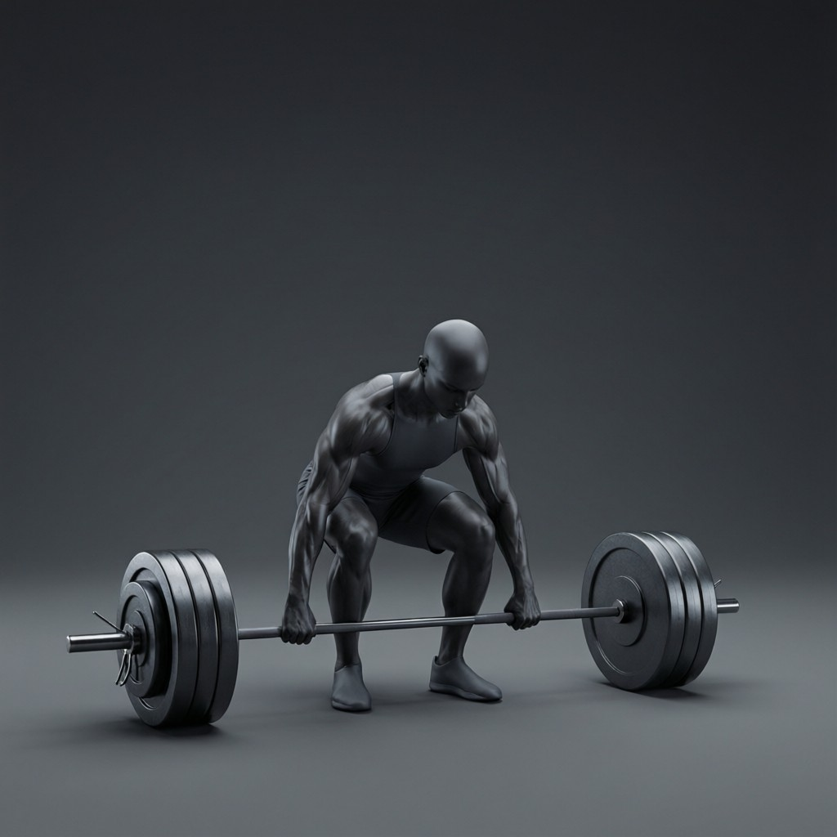
ICSE • CLASS 8 • ENERGY
Work & Energy
Work and its units • Energy • Mechanical energy • Potential energy

Slide 2
INTRODUCTION
Learning Objectives
1
Define work and state when work is done
2
Use the relation work = force × distance
3
State the units of work and energy
4
Define energy and mechanical energy
5
Define potential energy
6
Give everyday examples of potential energy
Notes:
Open by previewing these objectives so students know what they should be able to do by the end of the session.

Slide 3
PART 1
Work and Its Units
1
What 'work' means in physics

Slide 4
WORK
Work Done by a Force
In physics, work is done when a force moves a body in the direction of the force.
Work W = Force × distance moved (W = F × d)
• Both a force AND movement are needed for work.
• If there is no movement, no work is done.
• Work is a scalar quantity.
Notes:
Define work precisely: force × distance in the force's direction. No movement → no work, even if you feel tired.

Slide 5


WHEN?
When Is Work Done — and Not Done?
Work is done
Pushing a car
Lifting a box: you apply a force and it moves upward.
If the car moves, work is done on it.
No work
No work
Pushing hard against a wall that does not move — no movement, no work.
Carrying a bag while standing still — it does not move in the force's direction.
Notes:
Contrast cases. The wall and standing-still examples surprise students: effort without movement is not work in physics.

Slide 6
UNITS
Units of Work and Energy
Work and energy are measured in the same unit, the joule.
1 joule (J) = 1 newton × 1 metre (1 N·m)
• 1 joule of work is done when a force of 1 N moves a body 1 m.
• Larger amounts are measured in kilojoules (kJ).
• Energy is the capacity to do work, so it shares the same unit.
Notes:
The joule links work and energy. 1 J = 1 N·m. Energy is measured in joules because it is the ability to do work.

Slide 7
WORKED EXAMPLE
Calculating Work
Problem. A boy lifts a 5 kg bag through a height of 2 m. How much work does he do against gravity? (g = 10 m/s²)
Force needed = weight = m g = 5 × 10 = 50 N
Work = Force × distance = 50 × 2
Work = 100 J
Answer: Work done = 100 J
Notes:
First find the force (the weight), then multiply by the height. A clean two-step calculation.

Slide 8
POWER
Power — the Rate of Doing Work
Power is the rate at which work is done, or the rate at which energy is used.
Power = work done / time taken (unit: watt, W)
• 1 watt = 1 joule of work done in 1 second.
• A more powerful machine does the same work in less time.
• Larger powers are measured in kilowatts (1 kW = 1000 W).
Notes:
Power = work/time, measured in watts. Distinguish from work: the same job done faster needs more power.

Slide 9
WORKED EXAMPLE
Calculating Power
Problem. A motor does 600 J of work in 4 seconds. Find its power.
Power = work done / time taken
Power = 600 / 4
Power = 150 W
Answer: Power = 150 W (150 joules per second)
Notes:
Divide work by time to get power in watts. Reinforces the difference between work and power.

Slide 10
QUIZ 1
Check Your Understanding
5 questions • think before the answer reveals on the next slide

Slide 11
QUIZ QUESTION
Q1 — Is Work Done?
In which case is NO work done in the scientific sense?
Lifting a book onto a shelf
Pushing a trolley that rolls forward
A
B
Pushing hard against a wall that does not move
Kicking a football
C
D

Slide 12
ANSWER REVEALED
Q1 — Is Work Done?
In which case is NO work done in the scientific sense?
Lifting a book onto a shelf
Pushing a trolley that rolls forward
A
B
Pushing hard against a wall that does not move
Kicking a football
✓
D
WHY
Work needs movement in the direction of the force. However hard you push, if the wall does not move, the distance is zero and so the work done is zero.

Slide 13
QUIZ QUESTION
Q2 — How Much Work?
A force of 20 N moves a box 3 m in the direction of the force. The work done is:
6.7 J
23 J
A
B
60 J
17 J
C
D

Slide 14
ANSWER REVEALED
Q2 — How Much Work?
A force of 20 N moves a box 3 m in the direction of the force. The work done is:
6.7 J
23 J
A
B
60 J
17 J
✓
D
WHY
Work = force × distance = 20 × 3 = 60 J. The joule is a newton-metre.

Slide 15
QUIZ QUESTION
Q3 — Same Unit
Work and energy are measured in the same unit because:
They are both forces
Energy is the capacity to do work
A
B
They are both distances
They are unrelated
C
D

Slide 16
ANSWER REVEALED
Q3 — Same Unit
Work and energy are measured in the same unit because:
They are both forces
Energy is the capacity to do work
A
✓
They are both distances
They are unrelated
C
D
WHY
Energy is defined as the ability to do work, so it is naturally measured in the same unit as work — the joule.

Slide 17
QUIZ QUESTION
Q4 — Carrying a Bag
A girl walks along a level road holding a heavy bag at constant height. The work she does on the bag is:
Very large
Zero, as the bag does not move in the direction of the force
A
B
Equal to its weight
Negative
C
D

Slide 18
ANSWER REVEALED
Q4 — Carrying a Bag
A girl walks along a level road holding a heavy bag at constant height. The work she does on the bag is:
Very large
Zero, as the bag does not move in the direction of the force
A
✓
Equal to its weight
Negative
C
D
WHY
She supports the bag with an upward force, but the bag moves horizontally, not upward. With no movement in the direction of the force, the work done on it is zero.

Slide 19
QUIZ QUESTION
Q5 — More Work
Doing the same job in less time means you use more:
Work
Power
A
B
Force
Distance
C
D

Slide 20
ANSWER REVEALED
Q5 — More Work
Doing the same job in less time means you use more:
Work
Power
A
✓
Force
Distance
C
D
WHY
The work done is the same, but doing it faster means a higher rate of doing work — that rate is called power. Work depends only on force and distance, not on the time taken.

Slide 21
PART 2
Energy & Potential Energy
2
The capacity to do work, stored up

Slide 22
ENERGY
Energy and Mechanical Energy
Energy is the capacity to do work. Mechanical energy is the energy a body has due to its motion or its position.
• A body that can do work possesses energy.
• Mechanical energy comes in two forms: kinetic and potential.
• Kinetic energy is due to motion; potential energy is due to position or state.
Notes:
Energy = capacity to do work. Mechanical energy splits into kinetic (motion) and potential (position) — set up for the next slides.

Slide 23
POTENTIAL ENERGY
Potential Energy
Potential energy is the energy a body has because of its position or its state (its condition).
• A raised body has gravitational potential energy.
• A stretched or compressed spring has elastic potential energy.
• The energy is stored, ready to do work when released.
Notes:
PE is stored energy from position or state. Raised objects and stretched springs are the key examples.

Slide 24

EXAMPLES
Examples of Potential Energy
Water in a dam
A stretched bow
Stored high up, ready to fall and turn turbines.
A drawn bow stores elastic PE to launch the arrow.
A wound spring
A raised hammer
A wound clock spring stores energy to run the clock.
Lifted up, it stores PE to drive in a nail.
Notes:
Everyday stores of potential energy. Each can later do work when released.

Slide 25
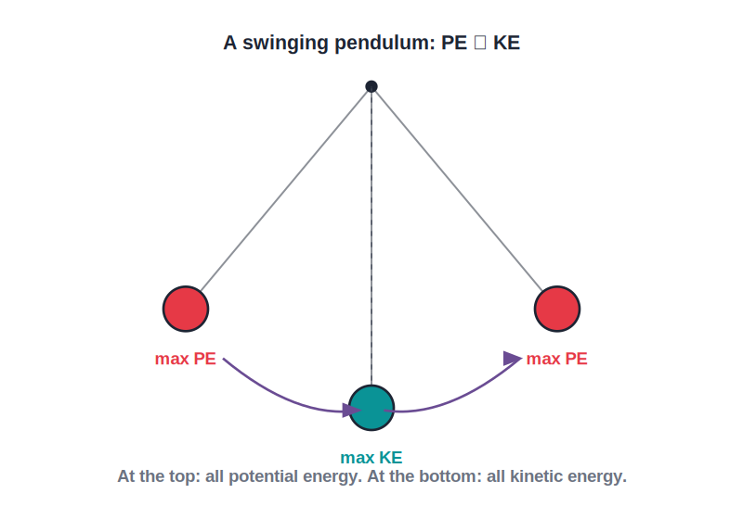
PE ⇄ KE
Potential and Kinetic Energy
Energy keeps changing form
• A swinging pendulum shows energy changing form.
• At the highest points it has maximum potential energy and is momentarily still.
• At the lowest point it moves fastest — maximum kinetic energy.
• Energy continually converts between PE and KE as it swings.
Top: all PE. Bottom: all KE.
Notes:
The pendulum is the classic PE↔KE demo, leading into kinetic energy and conservation next lesson.

Slide 26
WRAP UP
Quick Recap
✓ Work — force × distance moved in the force's direction
✓ No movement — no work, however large the force
✓ Unit — the joule (J) = 1 newton-metre; same for energy
✓ Energy — the capacity to do work
✓ Potential energy — stored energy due to position or state
✓ Examples — dam water, stretched bow, wound spring, raised hammer
Notes:
Rapid recap; W = F × d and the meaning of potential energy are the key ideas.

Slide 27
QUIZ 2
Final Check — Energy & PE
5 questions • think before the answer reveals on the next slide

Slide 28
QUIZ QUESTION
Q1 — Stored Energy
A stretched rubber band possesses:
Kinetic energy
Elastic potential energy
A
B
Heat energy
No energy
C
D

Slide 29
ANSWER REVEALED
Q1 — Stored Energy
A stretched rubber band possesses:
Kinetic energy
Elastic potential energy
A
✓
Heat energy
No energy
C
D
WHY
Stretching the band stores energy in it because of its changed state. This elastic potential energy is released — doing work — when the band is let go.

Slide 30
QUIZ QUESTION
Q2 — Water in a Tank
Water stored in a tank on a roof has potential energy because of its:
Motion
Temperature
A
B
Raised position
Colour
C
D

Slide 31
ANSWER REVEALED
Q2 — Water in a Tank
Water stored in a tank on a roof has potential energy because of its:
Motion
Temperature
A
B
Raised position
Colour
✓
D
WHY
Being lifted to a height gives the water gravitational potential energy. As it falls it can do work — for example, providing water pressure or turning a small turbine.

Slide 32
QUIZ QUESTION
Q3 — Pendulum Bottom
At the lowest point of its swing, a pendulum bob has:
Maximum potential energy
Maximum kinetic energy
A
B
No energy
Only heat energy
C
D

Slide 33
ANSWER REVEALED
Q3 — Pendulum Bottom
At the lowest point of its swing, a pendulum bob has:
Maximum potential energy
Maximum kinetic energy
A
✓
No energy
Only heat energy
C
D
WHY
At the bottom the bob moves fastest, so its kinetic energy is greatest. Its potential energy is least there, having been converted into motion.

Slide 34
QUIZ QUESTION
Q4 — Lift It Higher
Lifting the same box twice as high gives it potential energy that is:
Half as much
The same
A
B
Twice as much
Four times as much
C
D

Slide 35
ANSWER REVEALED
Q4 — Lift It Higher
Lifting the same box twice as high gives it potential energy that is:
Half as much
The same
A
B
Twice as much
Four times as much
✓
D
WHY
Gravitational potential energy increases in proportion to the height. Lifting the box twice as high stores twice the potential energy.

Slide 36
QUIZ QUESTION
Q5 — Joule
One joule of work is done when a force of:
1 N moves a body 1 m
1 N moves a body 10 m
A
B
10 N moves a body 1 m
1 N is applied without movement
C
D

Slide 37
ANSWER REVEALED
Q5 — Joule
One joule of work is done when a force of:
1 N moves a body 1 m
1 N moves a body 10 m
✓
B
10 N moves a body 1 m
1 N is applied without movement
C
D
WHY
By definition, 1 joule = 1 newton × 1 metre — the work done when a force of one newton moves a body one metre in its direction.

Slide 38
The Energy to Do Work
Work moves things; energy is the power to do it — and stored potential energy is just waiting to be released.

