Slide 1
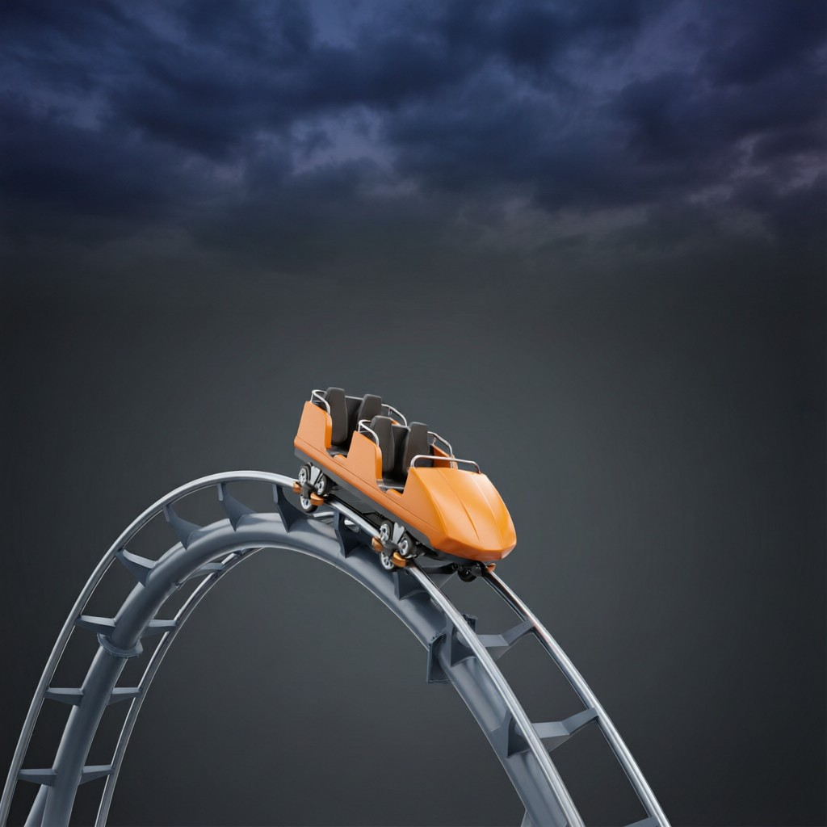
ICSE • CLASS 8 • ENERGY
Kinetic Energy & Its Forms
Gravitational PE • Kinetic energy • PE → KE • Forms & transformations

Slide 2
INTRODUCTION
Learning Objectives
1
Use the expression for gravitational potential energy
2
Define kinetic energy and what it depends on
3
Describe the conversion of potential energy into kinetic energy
4
Recall the different forms of energy
5
Give examples of energy transformations
6
State that energy is conserved
Notes:
Open by previewing these objectives so students know what they should be able to do by the end of the session.

Slide 3
PART 1
Gravitational PE & Kinetic Energy
1
Energy of height and energy of motion

Slide 4
GRAVITATIONAL PE
Gravitational Potential Energy
The potential energy of a raised body equals the work done in lifting it to that height.
PE = m g h (mass × gravity × height)
• m = mass (kg), g = 10 m/s², h = height (m).
• PE increases with both mass and height.
• It is the energy stored by lifting the body.
Notes:
PE = mgh. Larger mass or greater height stores more energy. It equals the work done lifting the body.

Slide 5
WORKED EXAMPLE
Potential Energy
Problem. Find the potential energy gained by a 4 kg block raised to a height of 3 m. (g = 10 m/s²)
PE = m g h
PE = 4 × 10 × 3
PE = 120 J
Answer: Potential energy = 120 J
Notes:
Direct substitution into PE = mgh. Reinforce the units give joules.

Slide 6
KINETIC ENERGY
Kinetic Energy
Kinetic energy is the energy a body has because of its motion.
KE = ½ m v² (half × mass × speed²)
• KE depends on the mass and on the square of the speed.
• Doubling the speed gives four times the kinetic energy.
• A moving body can do work — a hammer drives a nail.
Notes:
KE = ½mv². The speed-squared dependence is important: double the speed, quadruple the KE.

Slide 7
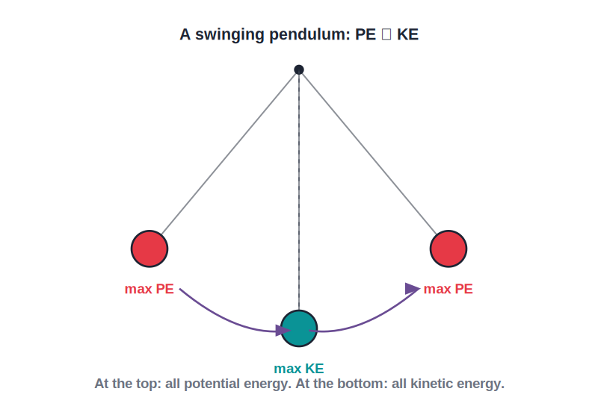
PE → KE
Conversion of PE into KE
Falling turns PE into KE
• Lift a ball: you give it potential energy.
• Let it fall: the PE converts into kinetic energy as it speeds up.
• At the moment it lands, almost all the PE has become KE.
• A pendulum swaps PE and KE back and forth on every swing.
PE at the top becomes KE at the bottom
Notes:
A falling body converts PE to KE. The total mechanical energy stays the same — energy is conserved.

Slide 8
QUIZ 1
Check Your Understanding
5 questions • think before the answer reveals on the next slide

Slide 9
QUIZ QUESTION
Q1 — PE Calculation
A 2 kg object is lifted 5 m. Its gravitational potential energy is (g = 10 m/s²):
10 J
100 J
A
B
20 J
50 J
C
D

Slide 10
ANSWER REVEALED
Q1 — PE Calculation
A 2 kg object is lifted 5 m. Its gravitational potential energy is (g = 10 m/s²):
10 J
100 J
A
✓
20 J
50 J
C
D
WHY
PE = mgh = 2 × 10 × 5 = 100 J. Multiply mass, g and height.

Slide 11
QUIZ QUESTION
Q2 — Double the Speed
If a car's speed doubles, its kinetic energy becomes:
Double
Half
A
B
Four times as great
Unchanged
C
D

Slide 12
ANSWER REVEALED
Q2 — Double the Speed
If a car's speed doubles, its kinetic energy becomes:
Double
Half
A
B
Four times as great
Unchanged
✓
D
WHY
KE = ½mv² depends on the square of the speed. Doubling v multiplies the kinetic energy by 2² = 4 — which is why high speed is so dangerous in a crash.

Slide 13
QUIZ QUESTION
Q3 — Falling Ball
As a ball falls from a height, its potential energy:
Increases
Is converted into kinetic energy
A
B
Stays the same
Disappears completely
C
D

Slide 14
ANSWER REVEALED
Q3 — Falling Ball
As a ball falls from a height, its potential energy:
Increases
Is converted into kinetic energy
A
✓
Stays the same
Disappears completely
C
D
WHY
As the ball falls it loses height (PE) and gains speed (KE). The potential energy is steadily converted into kinetic energy, the total staying the same.

Slide 15
QUIZ QUESTION
Q4 — Heaviest Hit
Which moving object has the most kinetic energy?
A light ball moving slowly
A heavy ball moving slowly
A
B
A heavy ball moving fast
A light ball at rest
C
D

Slide 16
ANSWER REVEALED
Q4 — Heaviest Hit
Which moving object has the most kinetic energy?
A light ball moving slowly
A heavy ball moving slowly
A
B
A heavy ball moving fast
A light ball at rest
✓
D
WHY
Kinetic energy grows with both mass and the square of speed. A heavy ball moving fast has the largest of both, so it carries the most kinetic energy.

Slide 17
QUIZ QUESTION
Q5 — Top of the Swing
At the highest point of a pendulum's swing, its kinetic energy is:
Maximum
Zero
A
B
Equal to its potential energy
Negative
C
D

Slide 18
ANSWER REVEALED
Q5 — Top of the Swing
At the highest point of a pendulum's swing, its kinetic energy is:
Maximum
Zero
A
✓
Equal to its potential energy
Negative
C
D
WHY
At the top of the swing the bob is momentarily at rest before swinging back, so its speed — and therefore its kinetic energy — is zero. All its energy is potential there.

Slide 19
PART 2
Forms & Transformations of Energy
2
Energy comes in many forms and changes between them

Slide 20



FORMS
Different Forms of Energy
Mechanical
Heat & light
Kinetic and potential energy of moving or raised bodies.
Thermal energy and the energy carried by light.
Sound & electrical
Chemical & nuclear
Energy of vibrations, and energy carried by currents.
Stored in fuels and food, and in the nuclei of atoms.
Notes:
Survey the forms of energy. Students should be able to name several and recognise them in devices.

Slide 21

TRANSFORMATIONS
Energy Transformations
Torch
Loudspeaker
Chemical (cell) → electrical → light and heat.
Electrical → sound.
Falling water
Our bodies
Potential → kinetic → electrical (in a dam).
Chemical energy in food → movement and heat.
Notes:
Each device transforms one form of energy into others. Trace the chain for each example.

Slide 22
CONSERVATION
Energy Is Conserved
Energy can be transformed from one form to another, but it can never be created or destroyed.
Total energy always stays the same
• This is the law of conservation of energy.
• In any change, the energy is only converted, not lost.
• Some energy usually becomes heat, which spreads out.
Notes:
The conservation law: energy is only transformed, never created or destroyed. Some always ends up as heat.

Slide 23


SOURCES
Sources of Energy
The Sun
Renewable
The ultimate source of almost all energy on Earth.
Replenished naturally and clean — solar, wind, water (hydro) and biomass.
Non-renewable
Use wisely
Finite and polluting — coal, petroleum and natural gas (the fossil fuels).
Save energy and prefer renewables, since fossil fuels will run out.
Notes:
Energy sources: the Sun is ultimate; renewables (clean, replenished) vs non-renewables (finite fossil fuels). Conserve and shift to renewables.

Slide 24
WRAP UP
Quick Recap
✓ Gravitational PE — PE = m g h; grows with mass and height
✓ Kinetic energy — KE = ½ m v²; grows with the square of speed
✓ PE → KE — a falling body converts PE into KE
✓ Forms — mechanical, heat, light, sound, electrical, chemical, nuclear
✓ Transformations — devices change one form into others
✓ Conservation — energy is never created or destroyed
Notes:
Rapid recap; PE = mgh, KE = ½mv² and conservation are the key results.

Slide 25
QUIZ 2
Final Check — KE & Transformations
5 questions • think before the answer reveals on the next slide

Slide 26
QUIZ QUESTION
Q1 — KE Value
A 2 kg ball moves at 3 m/s. Its kinetic energy is:
3 J
6 J
A
B
9 J
18 J
C
D

Slide 27
ANSWER REVEALED
Q1 — KE Value
A 2 kg ball moves at 3 m/s. Its kinetic energy is:
3 J
6 J
A
B
9 J
18 J
✓
D
WHY
KE = ½ m v² = ½ × 2 × 3² = ½ × 2 × 9 = 9 J. Remember to square the speed first.

Slide 28
QUIZ QUESTION
Q2 — Hydroelectric
In a hydroelectric dam, the main energy transformation is:
Heat → light
Potential → kinetic → electrical
A
B
Sound → electrical
Chemical → nuclear
C
D

Slide 29
ANSWER REVEALED
Q2 — Hydroelectric
In a hydroelectric dam, the main energy transformation is:
Heat → light
Potential → kinetic → electrical
A
✓
Sound → electrical
Chemical → nuclear
C
D
WHY
Water stored high up has potential energy. Falling, it gains kinetic energy, which spins turbines and generators to produce electrical energy.

Slide 30
QUIZ QUESTION
Q3 — Energy Lost?
A bouncing ball rises a little less after each bounce. The 'lost' energy has mainly become:
Destroyed
Heat and sound
A
B
Light
Chemical energy
C
D

Slide 31
ANSWER REVEALED
Q3 — Energy Lost?
A bouncing ball rises a little less after each bounce. The 'lost' energy has mainly become:
Destroyed
Heat and sound
A
✓
Light
Chemical energy
C
D
WHY
Energy is conserved, not destroyed. At each bounce some mechanical energy is converted into heat (from the impact) and sound, so less is left to lift the ball.

Slide 32
QUIZ QUESTION
Q4 — Conservation Law
The law of conservation of energy states that energy can be:
Created but not destroyed
Destroyed but not created
A
B
Transformed but neither created nor destroyed
Both created and destroyed
C
D

Slide 33
ANSWER REVEALED
Q4 — Conservation Law
The law of conservation of energy states that energy can be:
Created but not destroyed
Destroyed but not created
A
B
Transformed but neither created nor destroyed
Both created and destroyed
✓
D
WHY
Energy only changes form. The total amount in a closed system stays constant — it is never made from nothing or lost to nothing.

Slide 34
QUIZ QUESTION
Q5 — In a Torch
The sequence of energy changes in a working torch is:
Light → electrical → chemical
Chemical → electrical → light and heat
A
B
Electrical → chemical → sound
Heat → light → chemical
C
D

Slide 35
ANSWER REVEALED
Q5 — In a Torch
The sequence of energy changes in a working torch is:
Light → electrical → chemical
Chemical → electrical → light and heat
A
✓
Electrical → chemical → sound
Heat → light → chemical
C
D
WHY
The cell's chemical energy becomes electrical energy, which the bulb converts into light (and some heat) — a chain of transformations with energy conserved.

Slide 36
Energy Never Lost
From a falling apple to a power station, energy only changes form — the grand bookkeeping of the universe always balances.

