Slide 1
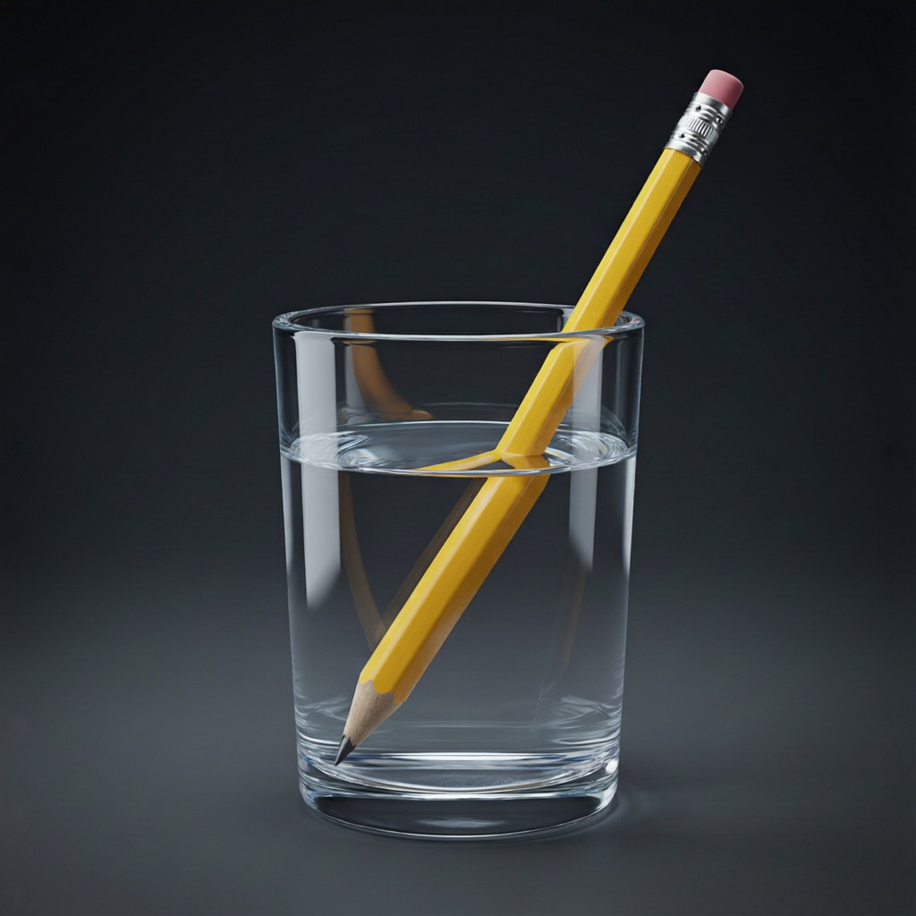
ICSE • CLASS 8 • LIGHT
Refraction of Light
Speed of light • Refraction & its laws • The glass block • Dispersion

Slide 2
INTRODUCTION
Learning Objectives
1
Compare the speed of light in different media
2
Define refraction and the terms used
3
State the laws of refraction
4
Explain everyday effects of refraction
5
Trace light through a glass block and a prism
6
Describe the dispersion of white light
Notes:
Open by previewing these objectives so students know what they should be able to do by the end of the session.

Slide 3
PART 1
Refraction of Light
1
Why light bends when it changes medium

Slide 4


SPEED OF LIGHT
Speed of Light in Different Media
Fastest in vacuum/air
Slower in water
Light travels at 3 × 10⁸ m/s in a vacuum.
Light slows down on entering water.
Slower still in glass
Why it matters
Denser media slow light down more.
This change of speed is what causes refraction.
Notes:
Light is fastest in vacuum, slower in denser media. The change of speed is the cause of bending.

Slide 5
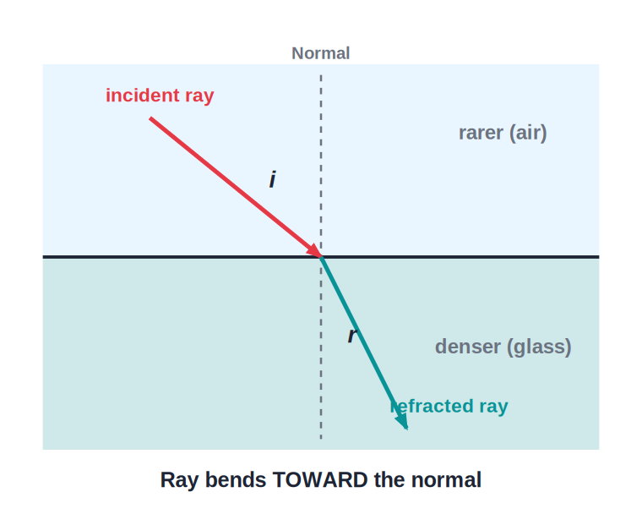
REFRACTION
What Is Refraction?
Bending at the boundary
• Refraction is the bending of light as it passes from one medium into another.
• It happens because light changes speed at the boundary.
• Going into a denser medium (air → glass), light bends toward the normal.
• Going into a rarer medium (glass → air), it bends away from the normal.
Air → glass: bends toward the normal
Notes:
Define refraction and the toward/away rule. Bending only happens at the surface.

Slide 6
TERMS & LAWS
Terms and Laws of Refraction
The rules of bending
• Incident & refracted ray the ray arriving at, and the ray leaving, the surface.
• Angle of incidence (i) & refraction (r) measured from the normal.
• Law 1 the incident ray, refracted ray and normal lie in one plane.
• Law 2 (Snell's law) sin i / sin r is a constant for two given media.
Notes:
Introduce the terms and the two laws. Angles always from the normal.

Slide 7

EFFECTS
Everyday Effects of Refraction
Bent pencil
Shallow pool
A pencil in water looks bent at the surface.
Water looks shallower than it really is.
Early sunrise
Mirage
We see the Sun a little before it rises, as light bends through the air.
Hot air over a road bends light, showing a watery shimmer.
Notes:
Everyday refraction effects. The bent pencil and mirage are memorable examples.

Slide 8
QUIZ 1
Check Your Understanding
5 questions • think before the answer reveals on the next slide

Slide 9
QUIZ QUESTION
Q1 — Why Bend?
Light bends when it passes from air into water because it:
Changes colour
Changes speed at the boundary
A
B
Gets brighter
Stops momentarily
C
D

Slide 10
ANSWER REVEALED
Q1 — Why Bend?
Light bends when it passes from air into water because it:
Changes colour
Changes speed at the boundary
A
✓
Gets brighter
Stops momentarily
C
D
WHY
Refraction happens because light travels at different speeds in different media. The change of speed at the surface makes the ray bend.

Slide 11
QUIZ QUESTION
Q2 — Which Way?
A ray of light passing from air into glass bends:
Away from the normal
Toward the normal
A
B
Along the surface
Straight back
C
D

Slide 12
ANSWER REVEALED
Q2 — Which Way?
A ray of light passing from air into glass bends:
Away from the normal
Toward the normal
A
✓
Along the surface
Straight back
C
D
WHY
Glass is denser than air, so light slows down on entering it and bends toward the normal — the angle of refraction is smaller than the angle of incidence.

Slide 13
QUIZ QUESTION
Q3 — Bent Pencil
A pencil dipped in a glass of water looks bent at the water surface because of:
Reflection
Refraction
A
B
Dispersion
Shadow formation
C
D

Slide 14
ANSWER REVEALED
Q3 — Bent Pencil
A pencil dipped in a glass of water looks bent at the water surface because of:
Reflection
Refraction
A
✓
Dispersion
Shadow formation
C
D
WHY
Light from the underwater part of the pencil bends as it leaves the water, so the pencil appears broken or bent at the surface — an effect of refraction.

Slide 15
QUIZ QUESTION
Q4 — Measured From
The angle of incidence and the angle of refraction are both measured from the:
Surface
Normal
A
B
Refracted ray
Horizontal
C
D

Slide 16
ANSWER REVEALED
Q4 — Measured From
The angle of incidence and the angle of refraction are both measured from the:
Surface
Normal
A
✓
Refracted ray
Horizontal
C
D
WHY
Both angles are measured between the ray and the normal (the line at 90° to the surface) — never from the surface itself.

Slide 17
QUIZ QUESTION
Q5 — Shallow Pool
A swimming pool always looks shallower than it really is because of:
Reflection
Refraction of light from the bottom
A
B
Dispersion
The colour of the water
C
D

Slide 18
ANSWER REVEALED
Q5 — Shallow Pool
A swimming pool always looks shallower than it really is because of:
Reflection
Refraction of light from the bottom
A
✓
Dispersion
The colour of the water
C
D
WHY
Light from the pool floor bends away from the normal as it leaves the water, so our eyes trace it back to a raised position. The bottom looks nearer the surface — the pool seems shallower.

Slide 19
PART 2
Glass Block, Prism & Dispersion
2
Light through glass, and the colours within

Slide 20
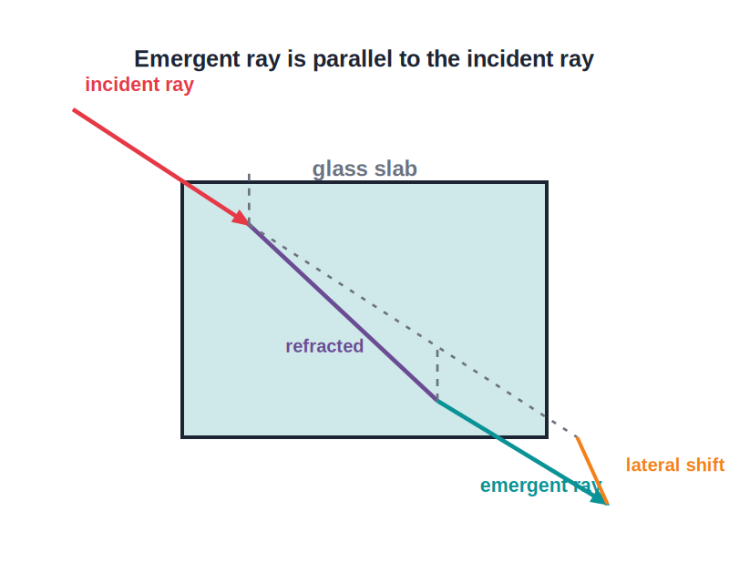
GLASS BLOCK
Light Through a Glass Block
Emergent ray is parallel
• Light refracts twice — entering and leaving the block.
• It bends toward the normal on entering and away on leaving.
• The two faces are parallel, so the emergent ray is parallel to the incident ray.
• The ray is simply shifted sideways (lateral displacement).
Parallel emergent ray, shifted sideways
Notes:
Through a glass block: parallel emergent ray, only shifted sideways. Contrast with the prism next.

Slide 21
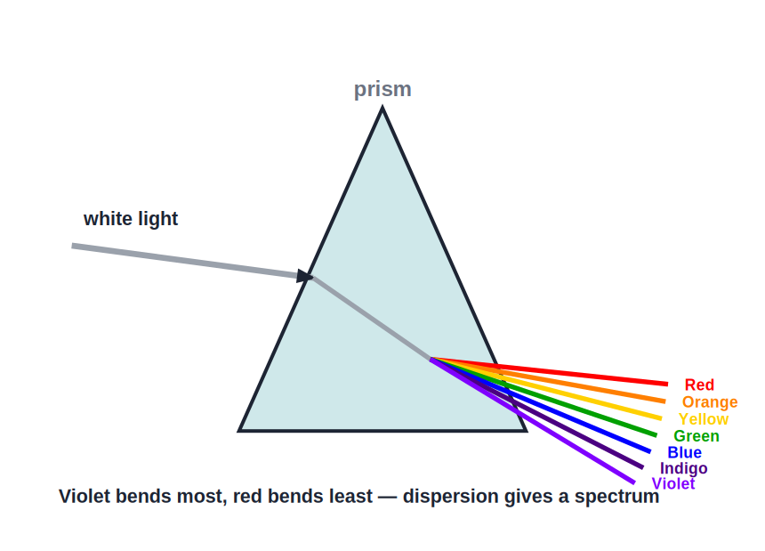
DISPERSION
Dispersion of White Light
White light → a spectrum
• A prism splits white light into seven colours.
• Each colour bends by a slightly different amount.
• Violet bends most and red bends least.
• The band of colours produced is called the spectrum (VIBGYOR).
Violet bends most, red least
Notes:
Dispersion: white light splits into VIBGYOR because each colour refracts differently. A rainbow is natural dispersion.

Slide 22
DISPERSION FACTS
Understanding Dispersion
Why it splits
Order
White light is a mixture of seven colours that bend by different amounts.
Violet, Indigo, Blue, Green, Yellow, Orange, Red (VIBGYOR).
Rainbow
Recombine
Raindrops act as tiny prisms to make a rainbow.
A second prism can recombine the colours into white light.
Notes:
Dispersion facts: cause, VIBGYOR order, the rainbow, and recombination proving white is a mixture.

Slide 23
WRAP UP
Quick Recap
✓ Speed of light — fastest in vacuum; slower in denser media
✓ Refraction — bending when light changes speed between media
✓ Toward/away — toward the normal into denser; away into rarer
✓ Laws — rays & normal in one plane; sin i / sin r constant
✓ Glass block — emergent ray parallel, shifted sideways
✓ Dispersion — prism splits white light into VIBGYOR
Notes:
Rapid recap; the toward/away rule and dispersion are the key ideas.

Slide 24
QUIZ 2
Final Check — Glass Block & Dispersion
5 questions • think before the answer reveals on the next slide

Slide 25
QUIZ QUESTION
Q1 — Emergent Ray
After passing through a parallel-sided glass block, the emergent ray is:
Bent toward the normal
Parallel to the incident ray but shifted sideways
A
B
Turned back
Split into colours
C
D

Slide 26
ANSWER REVEALED
Q1 — Emergent Ray
After passing through a parallel-sided glass block, the emergent ray is:
Bent toward the normal
Parallel to the incident ray but shifted sideways
A
✓
Turned back
Split into colours
C
D
WHY
Because the block's faces are parallel, the bending on entering is undone on leaving. The emergent ray comes out parallel to the incident ray, only displaced sideways.

Slide 27
QUIZ QUESTION
Q2 — Most Bent Colour
When white light passes through a prism, the colour that bends the most is:
Red
Green
A
B
Yellow
Violet
C
D

Slide 28
ANSWER REVEALED
Q2 — Most Bent Colour
When white light passes through a prism, the colour that bends the most is:
Red
Green
A
B
Yellow
Violet
C
✓
WHY
Violet light is slowed and bent the most by the prism, so it emerges nearest the base. Red bends the least.

Slide 29
QUIZ QUESTION
Q3 — Rainbow
A rainbow in the sky is formed when sunlight is dispersed by:
Clouds
Raindrops acting as tiny prisms
A
B
The Moon
Dust only
C
D

Slide 30
ANSWER REVEALED
Q3 — Rainbow
A rainbow in the sky is formed when sunlight is dispersed by:
Clouds
Raindrops acting as tiny prisms
A
✓
The Moon
Dust only
C
D
WHY
Each raindrop refracts and disperses sunlight into its colours and reflects them back, so millions of drops together produce the arc of a rainbow.

Slide 31
QUIZ QUESTION
Q4 — White Again
Passing the spectrum from one prism through a second, inverted prism produces:
More colours
White light again
A
B
Only red
Darkness
C
D

Slide 32
ANSWER REVEALED
Q4 — White Again
Passing the spectrum from one prism through a second, inverted prism produces:
More colours
White light again
A
✓
Only red
Darkness
C
D
WHY
The second prism recombines the seven colours back into white light, proving that white light was a mixture of those colours all along.

Slide 33
QUIZ QUESTION
Q5 — Block vs Prism
Unlike a glass block, a prism makes the emergent light:
Parallel to the incident ray
Change direction (deviate) and spread into colours
A
B
Disappear
Travel faster
C
D

Slide 34
ANSWER REVEALED
Q5 — Block vs Prism
Unlike a glass block, a prism makes the emergent light:
Parallel to the incident ray
Change direction (deviate) and spread into colours
A
✓
Disappear
Travel faster
C
D
WHY
A prism's faces are inclined, not parallel, so the light is bent into a new direction and, being white, is also dispersed into a spectrum.

Slide 35
Bending and Splitting Light
Refraction bends light and reveals the rainbow of colours hidden inside ordinary white light.

