Slide 1
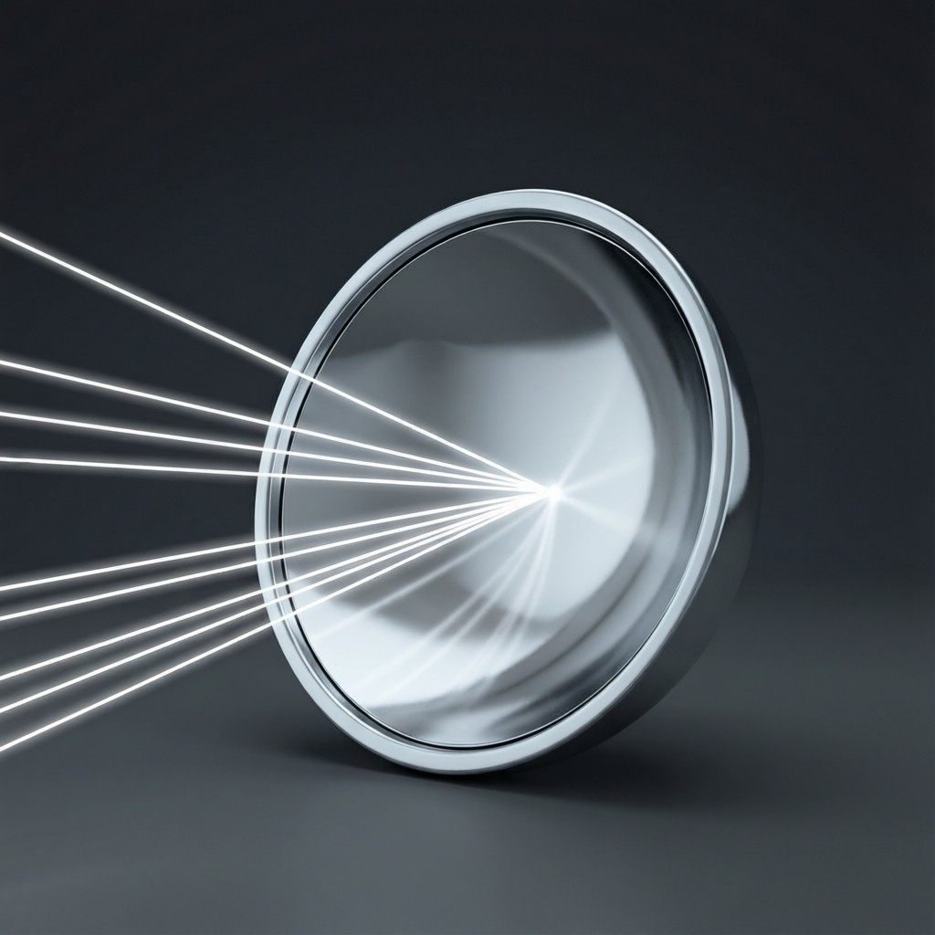
ICSE • CLASS 8 • LIGHT
Spherical Mirrors
Concave & convex mirrors • Focus & focal length • Ray diagrams • Images & uses

Slide 2
INTRODUCTION
Learning Objectives
1
Identify concave and convex spherical mirrors
2
Define the terms used for spherical mirrors
3
State the rules for making ray diagrams
4
Distinguish real from virtual images
5
Describe images formed by a concave mirror
6
State the uses of a concave mirror
Notes:
Open by previewing these objectives so students know what they should be able to do by the end of the session.

Slide 3
PART 1
Reflection & Spherical Mirrors
1
Bouncing light, and curved reflecting surfaces

Slide 4



LAWS OF REFLECTION
Reflection of Light
Reflection
First law
The bouncing back of light when it strikes a polished surface like a mirror.
The angle of incidence equals the angle of reflection (i = r).
Second law
Regular vs irregular
The incident ray, reflected ray and the normal all lie in one plane.
Smooth surfaces reflect regularly (clear image); rough ones scatter light (diffuse).
Notes:
Recap the laws of reflection (i = r) and regular vs irregular reflection before moving to curved mirrors.

Slide 5

PLANE MIRROR
Image in a Plane Mirror
Virtual & erect
Same size
The image cannot be caught on a screen and is the right way up.
It is exactly as large as the object.
As far behind
Laterally inverted
The image is as far behind the mirror as the object is in front.
Left and right are swapped — as in the word AMBULANCE on vehicles.
Notes:
Plane-mirror image: virtual, erect, same size, as far behind, and laterally inverted. The AMBULANCE example sticks.

Slide 6

TWO KINDS
Kinds of Spherical Mirror
Spherical mirror
Concave
A mirror that is part of a hollow sphere.
Curves inward; it converges light (a converging mirror).
Convex
Everyday
Bulges outward; it diverges light (a diverging mirror).
Shaving mirrors are concave; vehicle mirrors are convex.
Notes:
Concave caves in and converges; convex bulges and diverges. Anchor with real mirrors.

Slide 7
TERMS
Terms for a Spherical Mirror
Pole, centre, focus, focal length
• Pole (P) the centre of the mirror's surface.
• Centre of curvature (C) the centre of the sphere the mirror is part of.
• Principal focus (F) where rays parallel to the axis meet (or appear to).
• Focal length (f) the distance from the pole to the focus; f = R/2.
Notes:
Define the terms and f = R/2. These feed the ray diagrams.

Slide 8

RAY RULES
Rules for Making Ray Diagrams
Parallel ray
Focal ray
reflects through the focus F.
a ray through F reflects parallel to the axis.
Central-of-curvature ray
Two rays
a ray through C returns along itself.
any two of these locate the image.
Notes:
The standard rays for mirror ray diagrams. Two rays fix the image.

Slide 9
REAL VS VIRTUAL
Real and Virtual Images
Real image
Virtual image
Formed where reflected rays actually meet; can be caught on a screen; inverted.
Formed where rays appear to meet; cannot be caught on a screen; erect.
Concave
Convex
Can form real images, or a virtual one when the object is close.
Always forms a virtual, erect, diminished image.
Notes:
Real (on a screen, inverted) vs virtual (behind the mirror, erect). The screen test is the clearest distinction.

Slide 10
QUIZ 1
Check Your Understanding
5 questions • think before the answer reveals on the next slide

Slide 11
QUIZ QUESTION
Q1 — Which Converges?
A mirror that converges a parallel beam of light to a focus is:
A convex mirror
A concave mirror
A
B
A plane mirror
Any mirror
C
D

Slide 12
ANSWER REVEALED
Q1 — Which Converges?
A mirror that converges a parallel beam of light to a focus is:
A convex mirror
A concave mirror
A
✓
A plane mirror
Any mirror
C
D
WHY
A concave mirror curves inward and brings parallel rays together at a real focus in front of it. A convex mirror spreads them out.

Slide 13
QUIZ QUESTION
Q2 — Focal Length
A concave mirror has a radius of curvature of 30 cm. Its focal length is:
60 cm
30 cm
A
B
15 cm
10 cm
C
D

Slide 14
ANSWER REVEALED
Q2 — Focal Length
A concave mirror has a radius of curvature of 30 cm. Its focal length is:
60 cm
30 cm
A
B
15 cm
10 cm
✓
D
WHY
f = R/2 = 30/2 = 15 cm. The focus lies halfway between the pole and the centre of curvature.

Slide 15
QUIZ QUESTION
Q3 — On a Screen
An image that can be caught on a screen is always:
Virtual and erect
Real and inverted
A
B
Diminished only
Behind the mirror
C
D

Slide 16
ANSWER REVEALED
Q3 — On a Screen
An image that can be caught on a screen is always:
Virtual and erect
Real and inverted
A
✓
Diminished only
Behind the mirror
C
D
WHY
Only a real image is formed by rays that actually meet, so it can fall on a screen — and real images from a single mirror are inverted.

Slide 17
QUIZ QUESTION
Q4 — Centre Ray
A ray passing through the centre of curvature of a concave mirror, after reflection:
Goes parallel to the axis
Returns along the same path
A
B
Passes through the focus
Is not reflected
C
D

Slide 18
ANSWER REVEALED
Q4 — Centre Ray
A ray passing through the centre of curvature of a concave mirror, after reflection:
Goes parallel to the axis
Returns along the same path
A
✓
Passes through the focus
Is not reflected
C
D
WHY
A ray through C hits the mirror along the normal, so it reflects straight back on itself.

Slide 19
QUIZ QUESTION
Q5 — Parallel Ray
A ray of light travelling parallel to the principal axis of a concave mirror, after reflection, passes through the:
Pole
Centre of curvature
A
B
Focus
Edge of the mirror
C
D

Slide 20
ANSWER REVEALED
Q5 — Parallel Ray
A ray of light travelling parallel to the principal axis of a concave mirror, after reflection, passes through the:
Pole
Centre of curvature
A
B
Focus
Edge of the mirror
✓
D
WHY
By the first ray rule, a ray parallel to the principal axis reflects off a concave mirror and passes through its principal focus F.

Slide 21
PART 2
Concave-Mirror Images & Uses
2
What a concave mirror does, and where we use it

Slide 22
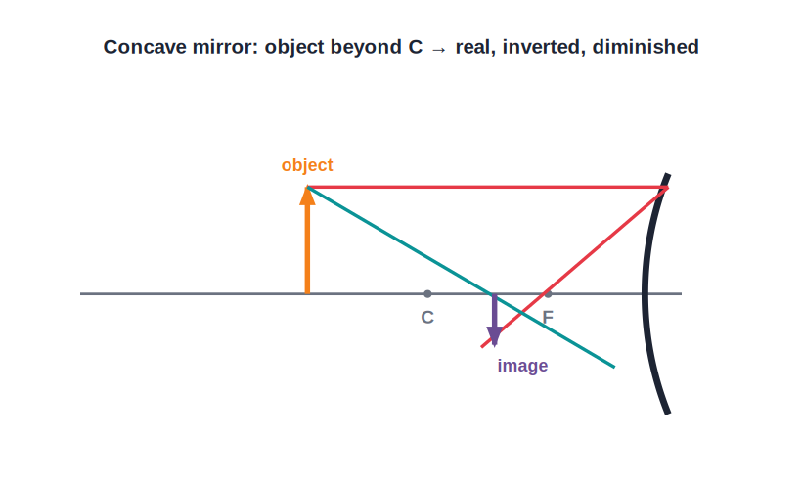
CONCAVE IMAGES
Images in a Concave Mirror
Depends on object position
• The image depends on where the object is placed.
• Object far away (beyond C): real, inverted and diminished.
• Object between F and C: real, inverted and magnified.
• Object closer than F: virtual, erect and magnified.
Object beyond C → real, inverted, diminished
Notes:
Concave mirror images change with object position. Within F gives the magnified, erect (shaving-mirror) image.

Slide 23
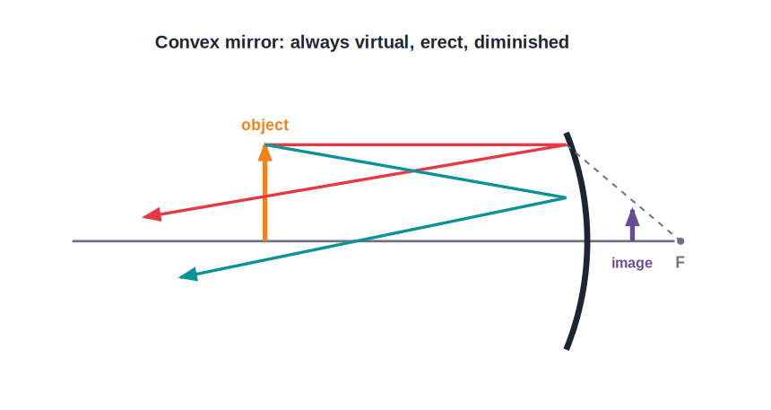
CONVEX IMAGES
Images in a Convex Mirror
Always virtual, erect, diminished
• A convex mirror always forms the same kind of image.
• The image is virtual, erect and diminished.
• It lies behind the mirror.
• Being small, it gives a wide field of view.
A wide field of view
Notes:
Convex mirror: always virtual, erect, diminished, wide view — used for rear-view and security mirrors.

Slide 24
USES
Uses of Concave (and Convex) Mirrors
Shaving mirror
Torch & headlight
A concave mirror gives a magnified, erect image of the face.
A concave reflector throws a strong parallel beam.
Dentist's mirror
Convex — rear-view
A concave mirror magnifies the teeth.
Gives a wide, erect view of traffic behind.
Notes:
Match mirror to use: concave magnifies/focuses; convex gives a wide view.

Slide 25
WRAP UP
Quick Recap
✓ Spherical mirrors — concave converges; convex diverges
✓ Terms — pole, centre of curvature, focus, focal length (f = R/2)
✓ Ray rules — parallel→F, through F→parallel, through C→back
✓ Real vs virtual — on a screen & inverted vs behind & erect
✓ Concave images — vary with position; magnified & erect within F
✓ Uses — shaving, headlights, dentist; convex for rear-view
Notes:
Rapid recap; f = R/2 and the concave image cases are the key points.

Slide 26
QUIZ 2
Final Check — Mirror Images
5 questions • think before the answer reveals on the next slide

Slide 27
QUIZ QUESTION
Q1 — Shaving Mirror
To get a magnified, erect image of your face, you use a concave mirror with your face:
Beyond C
At C
A
B
Closer than the focus
At the focus
C
D

Slide 28
ANSWER REVEALED
Q1 — Shaving Mirror
To get a magnified, erect image of your face, you use a concave mirror with your face:
Beyond C
At C
A
B
Closer than the focus
At the focus
✓
D
WHY
When the object is nearer than the focal length of a concave mirror, the image is virtual, erect and magnified — just what a shaving or make-up mirror needs.

Slide 29
QUIZ QUESTION
Q2 — Wide View
A convex mirror is used as a rear-view mirror because it gives an image that is:
Magnified and inverted
Erect with a wide field of view
A
B
Real and large
Upside down
C
D

Slide 30
ANSWER REVEALED
Q2 — Wide View
A convex mirror is used as a rear-view mirror because it gives an image that is:
Magnified and inverted
Erect with a wide field of view
A
✓
Real and large
Upside down
C
D
WHY
A convex mirror always gives a small, erect image and covers a wide area, letting the driver see much more of the road behind at a glance.

Slide 31
QUIZ QUESTION
Q3 — Torch Beam
A torch produces a parallel beam by placing its bulb at the concave reflector's:
Pole
Focus
A
B
Centre of curvature
Edge
C
D

Slide 32
ANSWER REVEALED
Q3 — Torch Beam
A torch produces a parallel beam by placing its bulb at the concave reflector's:
Pole
Focus
A
✓
Centre of curvature
Edge
C
D
WHY
A source at the focus of a concave mirror reflects its rays parallel to the axis, giving the strong straight beam a torch needs.

Slide 33
QUIZ QUESTION
Q4 — Always Smaller
A mirror that always gives an erect, diminished image whatever the object distance is:
Plane
Concave
A
B
Convex
None
C
D

Slide 34
ANSWER REVEALED
Q4 — Always Smaller
A mirror that always gives an erect, diminished image whatever the object distance is:
Plane
Concave
A
B
Convex
None
✓
D
WHY
Only a convex mirror forms an image that is always erect AND smaller for every object position. A plane mirror keeps the same size; a concave mirror can magnify or invert.

Slide 35
QUIZ QUESTION
Q5 — Object at C
An object at the centre of curvature of a concave mirror gives an image that is:
Virtual and erect
Real, inverted and the same size
A
B
Diminished and erect
At infinity
C
D

Slide 36
ANSWER REVEALED
Q5 — Object at C
An object at the centre of curvature of a concave mirror gives an image that is:
Virtual and erect
Real, inverted and the same size
A
✓
Diminished and erect
At infinity
C
D
WHY
With the object at C, a concave mirror forms a real, inverted image of the same size, also located at C.

Slide 37
Mirrors That Shape Light
Concave mirrors gather light to a point; convex mirrors widen the view — curved glass put to clever use.

