Slide 1
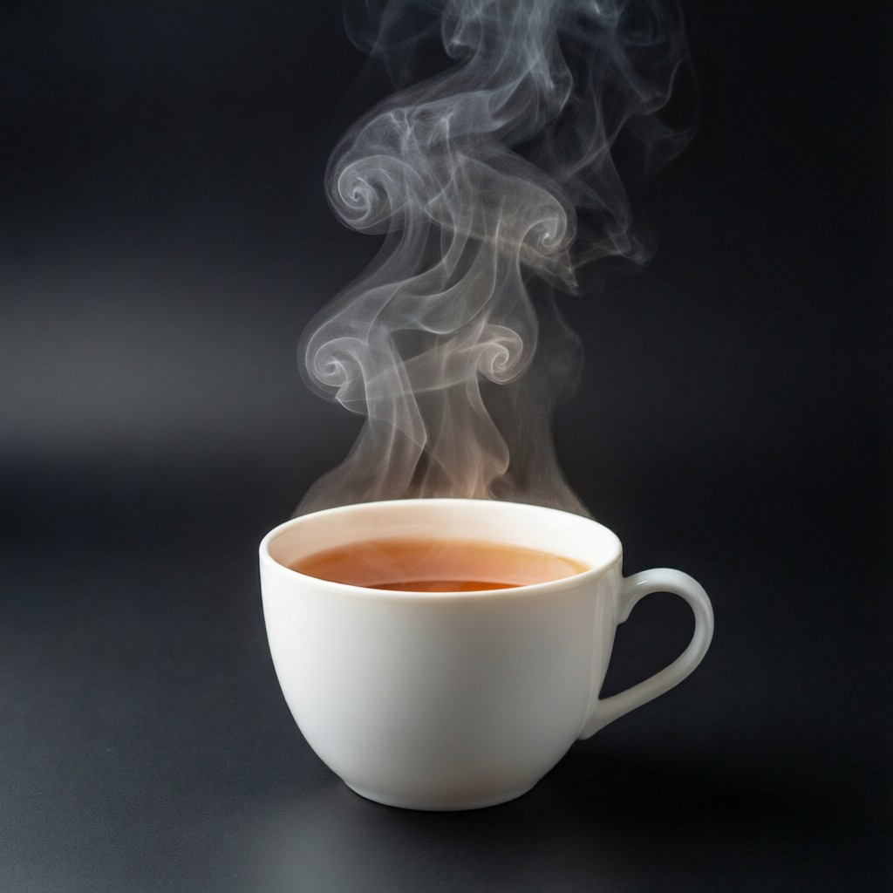
ICSE • CLASS 8 • HEAT
Heat, Molecules & Change of State
Effects of heat • Molecular motion • Evaporation • Boiling

Slide 2
INTRODUCTION
Learning Objectives
1
List the effects of heat on a body
2
Explain how heat affects molecular motion
3
Describe how a liquid changes into vapour
4
Explain evaporation using molecular motion
5
Describe boiling and explain it by molecular motion
6
Distinguish evaporation from boiling
Notes:
Open by previewing these objectives so students know what they should be able to do by the end of the session.

Slide 3
PART 1
Heat & Molecular Motion
1
What heat does to the particles of matter

Slide 4


EFFECTS
Effects of Heat
Rise in temperature
Expansion
Heating usually makes a body hotter.
Most substances expand on heating.
Change of state
Other changes
Heat can melt a solid or boil a liquid.
Heat can also speed up reactions and cause chemical change.
Notes:
Survey the effects of heat: temperature rise, expansion, change of state. These set up the rest of the chapter.

Slide 5
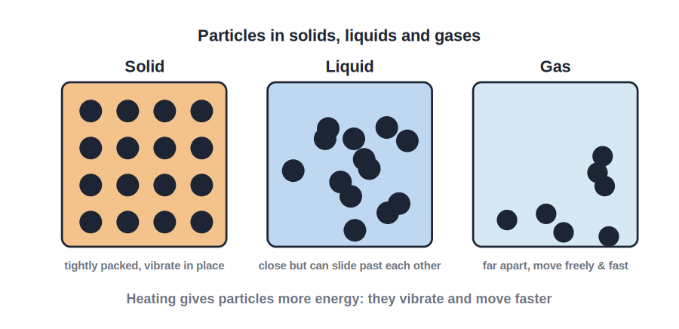
MOLECULAR MOTION
Heat and Molecular Motion
Faster particles = hotter
• All matter is made of tiny moving particles.
• In a solid they vibrate in fixed positions; in a liquid they slide past each other; in a gas they fly about freely.
• Heating gives the particles more energy, so they move faster.
• This faster motion is what we measure as a higher temperature.
Solid, liquid and gas particle arrangements
Notes:
The molecular model: heat = faster particle motion. Arrangement differs across the three states.

Slide 6
THREE WAYS
The Three Modes of Heat Transfer
Conduction
Convection
Heat passes through a solid from particle to particle, without the particles moving along.
Heat moves through liquids and gases as warm, less dense fluid rises and cool fluid sinks.
Radiation
Hotter to colder
Heat travels as invisible waves that need no medium — how the Sun's heat reaches us.
In every mode, heat always flows from the hotter body to the colder one.
Notes:
The three modes: conduction (solids), convection (fluids), radiation (no medium). This is the heart of the Heat Transfer chapter.

Slide 7
CONDUCTION
Conduction — Heat Through Solids
Particle to particle
• How it works Heated particles vibrate harder and pass the energy to their neighbours.
• Good conductors Metals like copper and aluminium carry heat quickly — used for cooking pans.
• Poor conductors (insulators) Wood, plastic, air and water carry heat slowly — used for pan handles and warm clothing.
• Everyday A metal spoon in hot tea soon feels hot; a wooden one does not.
Notes:
Conduction is mainly in solids. Metals conduct well; wood, plastic and trapped air are insulators.

Slide 8
CONVECTION & RADIATION
Convection and Radiation
Moving fluids and invisible waves
• Convection currents Warm fluid rises, cool fluid sinks, setting up a circulating current that carries heat.
• Everyday convection Land and sea breezes, boiling water and room heaters all work by convection.
• Radiation All hot bodies radiate heat as infrared waves; it needs no medium and crosses empty space.
• Surfaces Dull black surfaces absorb and emit radiation best; shiny white surfaces reflect it.
Notes:
Convection: circulating fluid (breezes, heaters). Radiation: infrared, no medium; black absorbs/emits, shiny reflects.

Slide 9

CHANGE OF STATE
The Three Changes of State
Melting
Boiling / Evaporation
A solid takes in heat and becomes a liquid (ice → water).
A liquid takes in heat and becomes a vapour (water → steam).
Condensation
Freezing
A vapour gives out heat and becomes a liquid (steam → water).
A liquid gives out heat and becomes a solid (water → ice).
Notes:
The reversible changes of state. Taking in heat moves toward gas; giving out heat moves toward solid.

Slide 10
HEAT VS TEMPERATURE
Heat is Not the Same as Temperature
Energy vs hotness
• Heat A form of energy that flows from a hotter body to a cooler one.
• Temperature How hot or cold a body is — it decides the direction of heat flow.
• Different things A bucket of warm water holds more heat than a cup at the same temperature.
• Units Heat is measured in joules; temperature in degrees Celsius.
Notes:
A common confusion: heat is energy (joules); temperature is how hot (°C). More mass at the same temperature holds more heat.

Slide 11
EVAPORATION
Evaporation
A surface phenomenon
• What it is The slow change of a liquid into vapour from its surface.
• At any temperature It happens at all temperatures, not just at boiling point.
• Molecular view The faster surface molecules escape into the air as vapour.
• Cooling effect Because the fastest molecules leave, the liquid left behind cools down.
Notes:
Evaporation: surface only, any temperature, fast molecules escape, causing cooling.

Slide 12
BOILING
Boiling
Throughout the liquid
• What it is The rapid change of a liquid into vapour throughout the liquid.
• Fixed temperature It occurs at a definite temperature, the boiling point.
• Molecular view Enough heat makes molecules everywhere break free and form bubbles of vapour.
• Constant while boiling The temperature stays the same while the liquid boils.
Notes:
Boiling: throughout the liquid, at a fixed temperature, with bubbles. Temperature is constant during boiling.

Slide 13
QUIZ 1
Check Your Understanding
4 questions • think before the answer reveals on the next slide

Slide 14
QUIZ QUESTION
Q1 — Hotter Particles
When a substance is heated, its particles begin to:
Move more slowly
Move faster and with more energy
A
B
Stop moving
Disappear
C
D

Slide 15
ANSWER REVEALED
Q1 — Hotter Particles
When a substance is heated, its particles begin to:
Move more slowly
Move faster and with more energy
A
✓
Stop moving
Disappear
C
D
WHY
Heating gives particles more energy, so they vibrate or move faster. This increased motion is what a higher temperature measures.

Slide 16
QUIZ QUESTION
Q2 — Wet Cloth
A wet cloth left in the breeze dries because of:
Boiling
Evaporation from its surface
A
B
Melting
Condensation
C
D

Slide 17
ANSWER REVEALED
Q2 — Wet Cloth
A wet cloth left in the breeze dries because of:
Boiling
Evaporation from its surface
A
✓
Melting
Condensation
C
D
WHY
Water molecules at the cloth's surface escape into the air as vapour, even at ordinary temperature. This is evaporation, which needs no boiling.

Slide 18
QUIZ QUESTION
Q3 — Cooling Effect
Sweating cools our body because, as sweat evaporates, it:
Adds heat to the skin
Takes heat from the skin as the fastest molecules escape
A
B
Freezes the skin
Has no effect
C
D

Slide 19
ANSWER REVEALED
Q3 — Cooling Effect
Sweating cools our body because, as sweat evaporates, it:
Adds heat to the skin
Takes heat from the skin as the fastest molecules escape
A
✓
Freezes the skin
Has no effect
C
D
WHY
When sweat evaporates, its most energetic molecules leave, carrying energy away. The skin loses heat and feels cooler — evaporation causes cooling.

Slide 20
QUIZ QUESTION
Q4 — During Boiling
While a pan of water is boiling steadily, its temperature:
Keeps rising
Stays constant at the boiling point
A
B
Falls
Doubles
C
D

Slide 21
ANSWER REVEALED
Q4 — During Boiling
While a pan of water is boiling steadily, its temperature:
Keeps rising
Stays constant at the boiling point
A
✓
Falls
Doubles
C
D
WHY
Once boiling begins, the added heat goes into turning water into steam rather than raising the temperature, so the thermometer holds steady at the boiling point.

Slide 22
PART 2
Evaporation vs Boiling
2
Two ways a liquid becomes vapour

Slide 23
DIFFERENCES
Evaporation Compared With Boiling
Where
Temperature
Evaporation is only at the surface; boiling is throughout the liquid.
Evaporation at any temperature; boiling at a fixed boiling point.
Speed
Cooling
Evaporation is slow and quiet; boiling is fast with bubbles.
Evaporation cools the liquid; boiling needs continuous heating.
Notes:
Side-by-side comparison — a very common exam table. Surface vs throughout, any temp vs fixed, slow vs bubbling.

Slide 24
FASTER EVAPORATION
What Speeds Up Evaporation
Higher temperature
Larger surface area
Warmer liquid evaporates faster.
Spreading a liquid out makes it evaporate quicker.
Moving air / wind
Lower humidity
A breeze carries vapour away, speeding evaporation.
Dry air takes up vapour faster than damp air.
Notes:
Factors that speed evaporation — useful for explaining drying clothes and puddles.

Slide 25

COOLING USES
Cooling by Evaporation Around Us
Sweating
Earthen pots
Evaporating sweat draws heat from the skin and cools the body.
Water seeping through the pores evaporates and keeps the water inside cool.
Desert coolers
Spirit on skin
A fan blows air over wet pads; evaporation cools the room.
Spirit evaporates very fast, feeling cold as it takes heat from the hand.
Notes:
Real-life cooling by evaporation — links the science to everyday experience.

Slide 26
WRAP UP
Quick Recap
✓ Effects of heat — temperature rise, expansion, change of state
✓ Molecular motion — heating makes particles move faster
✓ Evaporation — surface, any temperature, causes cooling
✓ Boiling — throughout, fixed temperature, with bubbles
✓ Differences — surface vs throughout; any temp vs fixed
✓ Faster evaporation — heat, area, wind, dry air
Notes:
Rapid recap; the evaporation-vs-boiling comparison is the key exam point.

Slide 27
QUIZ 2
Final Check — Evaporation & Boiling
5 questions • think before the answer reveals on the next slide

Slide 28
QUIZ QUESTION
Q1 — Dry Faster
Clothes on a washing line dry fastest on a day that is:
Cold and still
Warm and windy
A
B
Cold and damp
Warm and humid
C
D

Slide 29
ANSWER REVEALED
Q1 — Dry Faster
Clothes on a washing line dry fastest on a day that is:
Cold and still
Warm and windy
A
✓
Cold and damp
Warm and humid
C
D
WHY
Warmth gives the water molecules more energy to escape, and wind carries the vapour away. Both speed up evaporation, so clothes dry quickest on a warm, breezy day.

Slide 30
QUIZ QUESTION
Q2 — Surface Only
Which process happens ONLY at the surface of a liquid?
Boiling
Evaporation
A
B
Both
Neither
C
D

Slide 31
ANSWER REVEALED
Q2 — Surface Only
Which process happens ONLY at the surface of a liquid?
Boiling
Evaporation
A
✓
Both
Neither
C
D
WHY
Evaporation occurs only at the exposed surface of a liquid. Boiling, by contrast, happens throughout the whole liquid with bubbles forming inside it.

Slide 32
QUIZ QUESTION
Q3 — Earthen Pot
Water stays cool in an earthen pot because water seeping through the pores:
Boils
Evaporates, taking heat from the water inside
A
B
Freezes
Heats up
C
D

Slide 33
ANSWER REVEALED
Q3 — Earthen Pot
Water stays cool in an earthen pot because water seeping through the pores:
Boils
Evaporates, taking heat from the water inside
A
✓
Freezes
Heats up
C
D
WHY
Water that oozes to the outside of the porous pot evaporates, drawing heat from the water within. This cooling keeps the stored water refreshingly cool.

Slide 34
QUIZ QUESTION
Q4 — Bubbles
The bubbles that rise through a liquid during boiling are made of:
Air
Vapour of the liquid itself
A
B
Dust
Light
C
D

Slide 35
ANSWER REVEALED
Q4 — Bubbles
The bubbles that rise through a liquid during boiling are made of:
Air
Vapour of the liquid itself
A
✓
Dust
Light
C
D
WHY
During boiling the liquid turns to vapour throughout, forming bubbles of its own vapour that rise and burst at the surface.

Slide 36
QUIZ QUESTION
Q5 — Spread It Out
A puddle of water spread thinly over a wide area evaporates faster mainly because of its:
Smaller surface area
Larger surface area
A
B
Lower temperature
Greater depth
C
D

Slide 37
ANSWER REVEALED
Q5 — Spread It Out
A puddle of water spread thinly over a wide area evaporates faster mainly because of its:
Smaller surface area
Larger surface area
A
✓
Lower temperature
Greater depth
C
D
WHY
A bigger surface lets more molecules escape at once, so a thin, wide puddle evaporates faster than the same water in a deep, narrow container.

Slide 38
Heat on the Move
Heat speeds up the tiny particles of matter — enough to set them free as vapour, whether slowly or in a rolling boil.

