Slide 1

ICSE • CLASS 9 • SOUND
How Sound Travels
Production by vibration • Sound needs a medium • Wave terms • v = f λ

Slide 2
INTRODUCTION
Learning Objectives
1
Explain how sound is produced by vibrations
2
Show that sound needs a material medium to travel
3
Describe how sound propagates through a medium
4
Define the terms of wave motion
5
Use the relation v = f λ
6
Distinguish wavelength, frequency and amplitude
Notes:
Open by previewing these objectives so students know what they should be able to do by the end of the session.

Slide 3
PART 1
Producing & Propagating Sound
1
What makes sound, and what carries it

Slide 4
PRODUCTION
Sound Is Produced by Vibrations
No vibration, no sound
• Vibrating sources A ringing bell, a plucked string and our vocal cords all vibrate to make sound.
• Feel it Touch a sounding tuning fork or speaker and you feel the vibration.
• Stops when still Damp the vibration and the sound stops at once.
• Energy transfer The vibrating source passes energy to the surrounding medium.
Notes:
Anchor that ALL sound comes from vibration. The tuning-fork-in-water splash is a great demo.

Slide 5
NEEDS A MEDIUM
Sound Needs a Material Medium
Sound cannot travel through a vacuum — it needs particles of a medium to pass the vibration along.
• A bell ringing in a jar grows silent as the air is pumped out.
• Sound travels through solids, liquids and gases.
• It is fastest in solids and slowest in gases.
• Light, by contrast, can cross a vacuum.
Notes:
The bell-jar experiment proves a medium is needed. Order of speed: solids > liquids > gases.

Slide 6
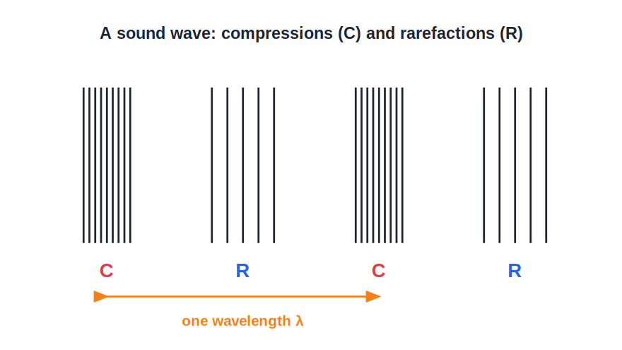
PROPAGATION
How Sound Travels in a Medium
Compressions & rarefactions
• A vibrating source pushes the nearby particles together, making a compression.
• As it moves back it leaves them spread out, making a rarefaction.
• Compressions and rarefactions move outward — a longitudinal wave.
• The particles only vibrate to and fro; they do not travel with the wave.
A longitudinal wave of pressure
Notes:
Sound is a longitudinal pressure wave. Stress that the particles oscillate in place; the disturbance travels.

Slide 7
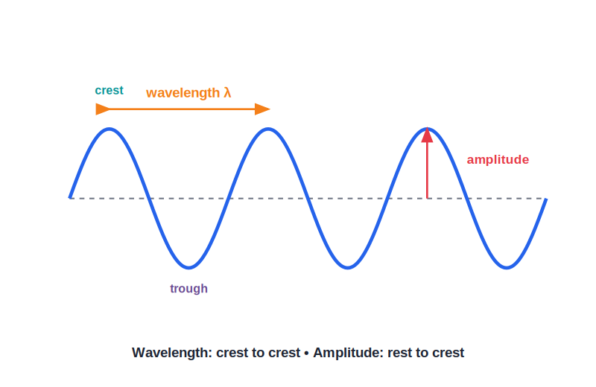
WAVE TERMS
Terms of Wave Motion
λ, f, T and amplitude
• Wavelength (λ): the distance for one complete wave (compression + rarefaction).
• Frequency (f): the number of waves per second, in hertz (Hz).
• Time period (T): the time for one wave; T = 1/f.
• Amplitude: the maximum displacement, which sets the loudness.
Wavelength, amplitude, crest and trough
Notes:
Define each term. T = 1/f is essential. Amplitude → loudness, frequency → pitch.

Slide 8



WAVE TYPES
Longitudinal vs Transverse Waves
Longitudinal
Transverse
Particles vibrate along the direction of travel; made of compressions and rarefactions — e.g. sound.
Particles vibrate at right angles to the travel; made of crests and troughs — e.g. light, water ripples.
Sound is longitudinal
Both carry energy
It needs a medium and travels as pressure variations.
In each, energy moves forward while the particles only oscillate in place.
Notes:
Contrast the two wave types. Sound is longitudinal; light and ripples are transverse. Particles never travel with the wave.

Slide 9
SPEED IN MEDIA
Sound Travels Fastest in Solids
Closer particles → faster sound
• Solids Particles are tightly packed, so a vibration passes on almost at once — fastest (e.g. ~5000 m/s in steel).
• Liquids Particles are close but freer, so sound is slower (~1500 m/s in water).
• Gases Particles are far apart, so sound is slowest (~340 m/s in air).
• The rule The closer the particles, the faster sound travels: solids > liquids > gases.
Notes:
Order and rough values. Closely packed particles pass on the vibration quickly, so solids win.

Slide 10
QUIZ 1
Check Your Understanding
5 questions • think before the answer reveals on the next slide

Slide 11
QUIZ QUESTION
Q1 — Bell in a Jar
As air is pumped out of a jar containing a ringing electric bell, the sound:
Gets louder
Fades away to nothing
A
B
Changes pitch only
Stays the same
C
D

Slide 12
ANSWER REVEALED
Q1 — Bell in a Jar
As air is pumped out of a jar containing a ringing electric bell, the sound:
Gets louder
Fades away to nothing
A
✓
Changes pitch only
Stays the same
C
D
WHY
Removing the air takes away the medium that carries the sound. With fewer and fewer particles to pass on the vibration, the sound fades — proving sound needs a material medium.

Slide 13
QUIZ QUESTION
Q2 — Particles Move?
As a sound wave passes through air, the air particles:
Travel along with the wave to your ear
Vibrate to and fro about fixed positions
A
B
Stay completely still
Move only upward
C
D

Slide 14
ANSWER REVEALED
Q2 — Particles Move?
As a sound wave passes through air, the air particles:
Travel along with the wave to your ear
Vibrate to and fro about fixed positions
A
✓
Stay completely still
Move only upward
C
D
WHY
In a longitudinal wave the particles merely oscillate back and forth; it is the disturbance (compressions and rarefactions) that travels, not the particles themselves.

Slide 15
QUIZ QUESTION
Q3 — Time Period
A sound wave has a frequency of 250 Hz. Its time period is:
250 s
0.004 s
A
B
0.04 s
2.5 s
C
D

Slide 16
ANSWER REVEALED
Q3 — Time Period
A sound wave has a frequency of 250 Hz. Its time period is:
250 s
0.004 s
A
✓
0.04 s
2.5 s
C
D
WHY
T = 1/f = 1/250 = 0.004 s. The time period is just the reciprocal of the frequency.

Slide 17
QUIZ QUESTION
Q4 — Fastest Medium
Sound travels fastest through:
Air
Water
A
B
Steel
A vacuum
C
D

Slide 18
ANSWER REVEALED
Q4 — Fastest Medium
Sound travels fastest through:
Air
Water
A
B
Steel
A vacuum
✓
D
WHY
Sound is fastest in solids, where the tightly packed particles pass the vibration on quickly; slower in liquids, slowest in gases, and impossible in a vacuum.

Slide 19
QUIZ QUESTION
Q5 — Which Is Longitudinal?
In which wave do the particles of the medium vibrate along the same direction as the wave travels?
A water ripple
A light wave
A
B
A sound wave
All transverse waves
C
D

Slide 20
ANSWER REVEALED
Q5 — Which Is Longitudinal?
In which wave do the particles of the medium vibrate along the same direction as the wave travels?
A water ripple
A light wave
A
B
A sound wave
All transverse waves
✓
D
WHY
Sound is a longitudinal wave — its particles oscillate back and forth along the direction of travel, forming compressions and rarefactions. Light and ripples are transverse.

Slide 21
PART 2
The Wave Equation
2
Linking speed, frequency and wavelength

Slide 22
V = F Λ
Speed, Frequency and Wavelength
The speed of a wave equals its frequency multiplied by its wavelength.
v = f × λ
• v is the wave speed, f the frequency, λ the wavelength.
• In a given medium the speed is fixed, so a higher frequency means a shorter wavelength.
• It applies to all waves, including sound and light.
Notes:
v = fλ is the central equation. In one medium v is constant, so f and λ trade off.

Slide 23
WORKED EXAMPLE
Using v = f λ
Problem. A sound wave of frequency 170 Hz travels through air at 340 m/s. Find its wavelength.
v = f × λ → λ = v / f
λ = 340 / 170
λ = 2 m
Answer: Wavelength = 2 m
Notes:
Rearrange v = fλ for λ. A 170 Hz note has a 2 m wavelength in air.

Slide 24
WORKED EXAMPLE
Finding the Frequency
Problem. Ripples on water travel at 0.5 m/s with a wavelength of 0.1 m. Find their frequency.
v = f × λ → f = v / λ
f = 0.5 / 0.1
f = 5 Hz
Answer: Frequency = 5 Hz
Notes:
Same equation, different unknown. Reinforces that v = fλ works for any wave.

Slide 25

LOUDNESS & PITCH
What Amplitude and Frequency Decide
Amplitude → loudness
Frequency → pitch
A bigger amplitude carries more energy and sounds louder.
A higher frequency sounds higher in pitch.
Independent
Energy
A sound can be loud and low, or soft and high.
Loud sounds transfer more energy to the ear.
Notes:
Keep amplitude (loudness) and frequency (pitch) separate — a frequent confusion.

Slide 26
WRAP UP
Quick Recap
✓ Production — all sound comes from a vibrating source
✓ Medium — sound needs a medium; fastest in solids
✓ Propagation — longitudinal wave of compressions & rarefactions
✓ Terms — wavelength, frequency, time period (T = 1/f), amplitude
✓ Wave equation — v = f λ
✓ Loudness & pitch — amplitude → loudness; frequency → pitch
Notes:
Rapid recap; v = fλ and T = 1/f are the must-know relations.

Slide 27
QUIZ 2
Final Check — The Wave Equation
5 questions • think before the answer reveals on the next slide

Slide 28
QUIZ QUESTION
Q1 — Find the Wavelength
A tuning fork of frequency 512 Hz sounds in air where the speed of sound is 340 m/s. Its wavelength is about:
0.66 m
1.5 m
A
B
174 m
0.0015 m
C
D

Slide 29
ANSWER REVEALED
Q1 — Find the Wavelength
A tuning fork of frequency 512 Hz sounds in air where the speed of sound is 340 m/s. Its wavelength is about:
0.66 m
1.5 m
✓
B
174 m
0.0015 m
C
D
WHY
λ = v/f = 340/512 ≈ 0.66 m. A higher-frequency note has a shorter wavelength.

Slide 30
QUIZ QUESTION
Q2 — Higher Note
In the same air, a higher-pitched note compared with a lower one has a:
Greater speed
Shorter wavelength
A
B
Larger amplitude
Longer time period
C
D

Slide 31
ANSWER REVEALED
Q2 — Higher Note
In the same air, a higher-pitched note compared with a lower one has a:
Greater speed
Shorter wavelength
A
✓
Larger amplitude
Longer time period
C
D
WHY
The speed of sound in the air is fixed, so by v = fλ a higher frequency must have a shorter wavelength.

Slide 32
QUIZ QUESTION
Q3 — Same Medium
Two sounds of different frequencies travel through the same air. They have the same:
Wavelength
Speed
A
B
Pitch
Time period
C
D

Slide 33
ANSWER REVEALED
Q3 — Same Medium
Two sounds of different frequencies travel through the same air. They have the same:
Wavelength
Speed
A
✓
Pitch
Time period
C
D
WHY
All sounds travel at the same speed in a given medium. They can differ in frequency and wavelength, but v stays the same — so their speeds are equal.

Slide 34
QUIZ QUESTION
Q4 — Louder Sound
Striking a drum harder makes a louder sound because it increases the wave's:
Frequency
Speed
A
B
Amplitude
Wavelength
C
D

Slide 35
ANSWER REVEALED
Q4 — Louder Sound
Striking a drum harder makes a louder sound because it increases the wave's:
Frequency
Speed
A
B
Amplitude
Wavelength
✓
D
WHY
A harder hit makes the drum skin vibrate with a larger amplitude. Greater amplitude carries more energy and is heard as a louder sound; the pitch is unchanged.

Slide 36
QUIZ QUESTION
Q5 — Period and Frequency
A wave has a time period of 0.02 s. Its frequency is:
0.02 Hz
20 Hz
A
B
50 Hz
500 Hz
C
D

Slide 37
ANSWER REVEALED
Q5 — Period and Frequency
A wave has a time period of 0.02 s. Its frequency is:
0.02 Hz
20 Hz
A
B
50 Hz
500 Hz
✓
D
WHY
f = 1/T = 1/0.02 = 50 Hz. Frequency and time period are reciprocals of each other.

Slide 38
Sound on the Move
Vibrations become travelling waves of pressure — and v = f λ ties their speed, pitch and wavelength together.

