Slide 1
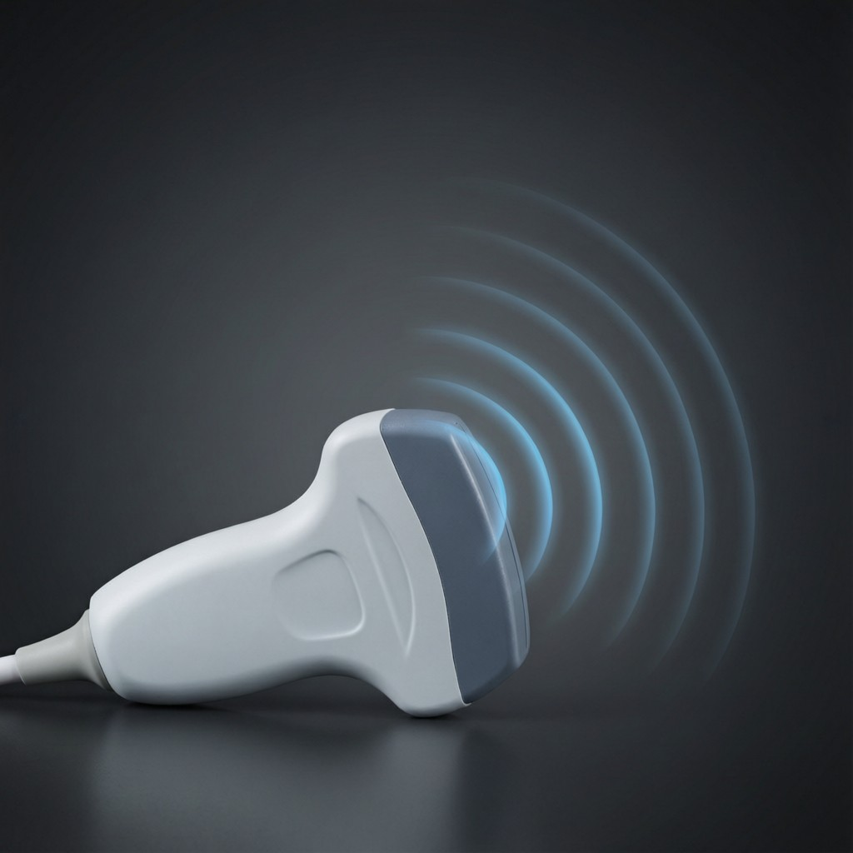
ICSE • CLASS 9 • SOUND
Speed of Sound & Ultrasound
What changes the speed • Sound vs light • Measuring the speed • Ultrasound

Slide 2
INTRODUCTION
Learning Objectives
1
List the factors that affect the speed of sound in a gas
2
List the factors that do NOT affect it
3
Compare the speed of sound with the speed of light
4
Describe how the speed of sound in air is measured
5
Distinguish infrasonic, sonic and ultrasonic sounds
6
State the uses of ultrasound
Notes:
Open by previewing these objectives so students know what they should be able to do by the end of the session.

Slide 3
PART 1
The Speed of Sound
1
What does — and does not — change it

Slide 4


AFFECTS SPEED
Factors That Affect the Speed in a Gas
Temperature
Humidity
Sound travels faster in warmer air (about 0.6 m/s faster per °C).
Sound travels faster in moist (humid) air than in dry air.
Nature of the gas
Wind
It travels faster in a lighter, less dense gas.
Wind blowing toward the listener adds to the apparent speed.
Notes:
Speed of sound in a gas rises with temperature and humidity, and in lighter gases. These are commonly examined.

Slide 5

DOES NOT AFFECT
Factors That Do NOT Affect the Speed
Pressure
Loudness (amplitude)
Changing the pressure of a gas (at fixed temperature) does not change the speed.
A loud and a soft sound travel at the same speed.
Frequency / pitch
Wavelength
High and low notes travel at the same speed — or music would arrive jumbled.
Follows frequency; it does not change the speed in a given gas.
Notes:
Crucial list: pressure, loudness, frequency and wavelength do NOT change the speed. The 'music not jumbled' argument is memorable.

Slide 6
SOUND VS LIGHT
Sound Compared With Light
Light travels almost a million times faster than sound, which is why we see distant events before we hear them.
v(light) = 3 × 10⁸ m/s ≫ v(sound) ≈ 340 m/s
• We see lightning before we hear the thunder.
• Light can travel through a vacuum; sound cannot.
• Light is a transverse wave; sound is longitudinal.
Notes:
The huge speed gap explains the lightning-then-thunder delay. Also contrast medium and wave type.

Slide 7
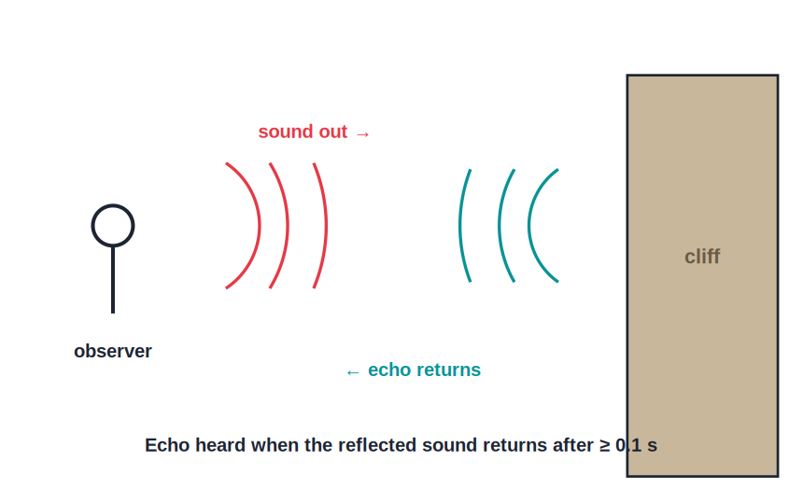
MEASURE
Measuring the Speed of Sound (Echo Method)
v = 2d / t
• Stand a measured distance d from a large wall.
• Clap and measure the time t for the echo to return.
• The sound travels 2d (to the wall and back) in time t.
• Speed of sound v = 2d / t — repeat and average.
Time the echo from a distant wall
Notes:
The echo method: remember 2d for the round trip and average several readings to reduce error.

Slide 8
QUIZ 1
Check Your Understanding
5 questions • think before the answer reveals on the next slide

Slide 9
QUIZ QUESTION
Q1 — Hot Day
On a hot afternoon compared with a cold morning, the speed of sound in the air is:
Lower
Higher
A
B
Unchanged
Zero
C
D

Slide 10
ANSWER REVEALED
Q1 — Hot Day
On a hot afternoon compared with a cold morning, the speed of sound in the air is:
Lower
Higher
A
✓
Unchanged
Zero
C
D
WHY
Sound travels faster in warmer air — roughly 0.6 m/s faster for each degree Celsius rise — because the particles move and collide more rapidly.

Slide 11
QUIZ QUESTION
Q2 — No Effect
Which of these does NOT change the speed of sound in a gas?
Temperature
Humidity
A
B
Pressure (at constant temperature)
The type of gas
C
D

Slide 12
ANSWER REVEALED
Q2 — No Effect
Which of these does NOT change the speed of sound in a gas?
Temperature
Humidity
A
B
Pressure (at constant temperature)
The type of gas
✓
D
WHY
At a fixed temperature, changing a gas's pressure does not alter the speed of sound, because density changes in proportion. Temperature, humidity and the gas itself do affect it.

Slide 13
QUIZ QUESTION
Q3 — Thunder Delay
You see a flash of lightning and hear the thunder 3 seconds later. This delay occurs because:
Thunder happens after lightning
Light travels far faster than sound
A
B
Sound is louder than light
The storm is moving
C
D

Slide 14
ANSWER REVEALED
Q3 — Thunder Delay
You see a flash of lightning and hear the thunder 3 seconds later. This delay occurs because:
Thunder happens after lightning
Light travels far faster than sound
A
✓
Sound is louder than light
The storm is moving
C
D
WHY
Light reaches you almost instantly, but sound at ~340 m/s takes time to arrive. The 3 s gap is the time the thunder's sound needs to cover the distance.

Slide 15
QUIZ QUESTION
Q4 — Echo Distance
An echo from a cliff returns in 2 s when the speed of sound is 340 m/s. The cliff is:
680 m away
340 m away
A
B
170 m away
1020 m away
C
D

Slide 16
ANSWER REVEALED
Q4 — Echo Distance
An echo from a cliff returns in 2 s when the speed of sound is 340 m/s. The cliff is:
680 m away
340 m away
A
✓
170 m away
1020 m away
C
D
WHY
The sound travels 2d = 340 × 2 = 680 m for the round trip, so the cliff is 680 / 2 = 340 m away.

Slide 17
QUIZ QUESTION
Q5 — Humid Air
Sound travels slightly faster on a humid day than on a dry day because moist air is:
Denser
Slightly less dense than dry air
A
B
Hotter
At higher pressure
C
D

Slide 18
ANSWER REVEALED
Q5 — Humid Air
Sound travels slightly faster on a humid day than on a dry day because moist air is:
Denser
Slightly less dense than dry air
A
✓
Hotter
At higher pressure
C
D
WHY
Water vapour is lighter than the nitrogen and oxygen it replaces, so humid air is a little less dense — and sound travels faster in a less dense gas.

Slide 19



REFLECTION & ECHO
Reflection of Sound and the Echo
Sound reflects
Echo
Sound bounces off hard surfaces, obeying the same laws as light (angle in = angle out).
A reflected sound heard separately from the original is an echo.
Condition
Uses
The reflector must be far enough that the echo returns at least 0.1 s later (about 17 m away).
Echoes are used in SONAR and depth-sounding, and to measure the speed of sound.
Notes:
Sound reflects like light; a distinct echo needs the reflector ≥ ~17 m away (0.1 s gap). Basis of the echo method and SONAR.

Slide 20
CHARACTERISTICS
Characteristics of a Musical Sound
Loudness
Pitch
Set by the amplitude — a bigger vibration sounds louder.
Set by the frequency — a higher frequency sounds higher-pitched.
Quality (timbre)
Musical note vs noise
Lets us tell two instruments apart even at the same pitch and loudness.
A note has a regular, pleasant waveform; noise is irregular and jarring.
Notes:
The three characteristics — loudness, pitch, quality — plus the music-vs-noise distinction.

Slide 21
PART 2
Infrasound, Ultrasound & Uses
2
Sounds beyond our hearing

Slide 22
RANGE
Infrasonic, Sonic and Ultrasonic
Audible (sonic)
Infrasonic
Frequencies we can hear: about 20 Hz to 20,000 Hz.
Below 20 Hz — too low to hear; from earthquakes and large animals like elephants.
Ultrasonic
With age
Above 20,000 Hz — too high to hear; produced and heard by bats and dolphins.
The upper limit of human hearing drops as we grow older.
Notes:
The three ranges around the 20 Hz–20 kHz audible band. Infrasonic below, ultrasonic above.

Slide 23
ULTRASOUND
Uses of Ultrasound
High-frequency sound at work
• Medical scans Ultrasound builds images of a baby or internal organs safely.
• SONAR Ships find the depth of the sea and locate shoals or wrecks.
• Cleaning Ultrasonic vibrations clean delicate items like jewellery and instruments.
• Flaw detection Reveals hidden cracks inside metal castings and welds.
Notes:
Ultrasound's short wavelength gives fine detail and a narrow beam — ideal for imaging, SONAR, cleaning and testing.

Slide 24

WHY ULTRASOUND
Why Ultrasound Is So Useful
Narrow beam
Fine detail
Its short wavelength can be sent as a focused, directed beam.
Short wavelengths resolve small features in scans and tests.
Harmless
Echoes
At the levels used, it does not damage living tissue like X-rays can.
It reflects clearly off boundaries, so echoes can be timed and imaged.
Notes:
The advantages flow from the short wavelength: directed beam, fine detail, plus it is non-ionising and safe.

Slide 25
WRAP UP
Quick Recap
✓ Affects speed — temperature, humidity, the gas itself, wind
✓ No effect — pressure, loudness, frequency, wavelength
✓ Sound vs light — light ≈ 3 × 10⁸ m/s ≫ sound ≈ 340 m/s
✓ Measuring speed — echo method, v = 2d / t
✓ Ranges — infrasonic < 20 Hz < audible < 20 kHz < ultrasonic
✓ Ultrasound uses — scans, SONAR, cleaning, flaw detection
Notes:
Rapid recap; the affects/does-not-affect lists and ultrasound uses are the key exam points.

Slide 26
QUIZ 2
Final Check — Speed & Ultrasound
5 questions • think before the answer reveals on the next slide

Slide 27
QUIZ QUESTION
Q1 — Bat Navigation
A bat finds insects in the dark by emitting and listening for:
Infrasound
Ultrasound
A
B
Visible light
Radio waves
C
D

Slide 28
ANSWER REVEALED
Q1 — Bat Navigation
A bat finds insects in the dark by emitting and listening for:
Infrasound
Ultrasound
A
✓
Visible light
Radio waves
C
D
WHY
Bats emit ultrasonic squeaks (above 20,000 Hz) and listen for the echoes to locate insects and obstacles — echolocation using ultrasound.

Slide 29
QUIZ QUESTION
Q2 — Why Not X-rays?
Ultrasound is preferred over X-rays for scanning an unborn baby because ultrasound:
Is cheaper only
Does not harm living tissue at the levels used
A
B
Travels faster
Is visible
C
D

Slide 30
ANSWER REVEALED
Q2 — Why Not X-rays?
Ultrasound is preferred over X-rays for scanning an unborn baby because ultrasound:
Is cheaper only
Does not harm living tissue at the levels used
A
✓
Travels faster
Is visible
C
D
WHY
Ultrasound is non-ionising, so at scanning levels it is safe for the baby and mother — unlike X-rays, which can damage living cells.

Slide 31
QUIZ QUESTION
Q3 — Music Arrives Together
We know that all frequencies of sound travel at the same speed in air because, otherwise, a distant band's music would:
Be louder
Arrive jumbled, with high and low notes out of step
A
B
Travel faster
Not be heard at all
C
D

Slide 32
ANSWER REVEALED
Q3 — Music Arrives Together
We know that all frequencies of sound travel at the same speed in air because, otherwise, a distant band's music would:
Be louder
Arrive jumbled, with high and low notes out of step
A
✓
Travel faster
Not be heard at all
C
D
WHY
If high and low notes travelled at different speeds, they would reach a distant listener at different times and the tune would be scrambled. Since music stays in tune, all frequencies share one speed.

Slide 33
QUIZ QUESTION
Q4 — Infrasonic
A sound of frequency 10 Hz is:
Audible
Infrasonic (below hearing)
A
B
Ultrasonic (above hearing)
The loudest possible
C
D

Slide 34
ANSWER REVEALED
Q4 — Infrasonic
A sound of frequency 10 Hz is:
Audible
Infrasonic (below hearing)
A
✓
Ultrasonic (above hearing)
The loudest possible
C
D
WHY
10 Hz is below the 20 Hz lower limit of human hearing, so it is infrasonic — the kind of low rumble produced by earthquakes.

Slide 35
QUIZ QUESTION
Q5 — SONAR Depth
A ship's SONAR pulse returns from the seabed in 0.5 s. If sound travels at 1500 m/s in water, the depth is:
750 m
375 m
A
B
3000 m
1500 m
C
D

Slide 36
ANSWER REVEALED
Q5 — SONAR Depth
A ship's SONAR pulse returns from the seabed in 0.5 s. If sound travels at 1500 m/s in water, the depth is:
750 m
375 m
A
✓
3000 m
1500 m
C
D
WHY
Total path = 1500 × 0.5 = 750 m for the round trip, so the depth is 750 / 2 = 375 m. Always halve the echo distance.

Slide 37
Beyond What We Can Hear
From a clap's echo to a baby's first scan, understanding the speed and range of sound puts it to work for us.

