Slide 1
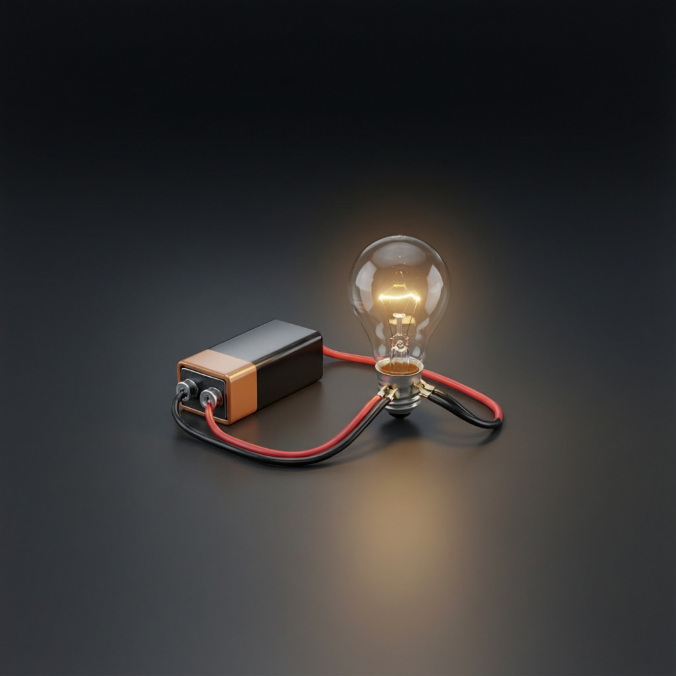
ICSE • CLASS 9 • ELECTRICITY
Electric Current & Circuits
Sources of current • Circuit symbols • Simple circuits • Conductors & insulators

Slide 2
INTRODUCTION
Learning Objectives
1
Name sources of direct current
2
Define electric current and its unit
3
Recognise the standard circuit symbols
4
Draw and describe a simple electric circuit
5
Distinguish conductors from insulators
6
Distinguish open from closed circuits
Notes:
Open by previewing these objectives so students know what they should be able to do by the end of the session.

Slide 3
PART 1
Current, Sources & Symbols
1
What current is and how we draw circuits

Slide 4
CURRENT
Electric Current
An electric current is a flow of electric charge through a conductor.
Current I = charge Q / time t (unit: ampere, A)
• It is driven round a circuit by a source such as a cell.
• Measured by an ammeter, connected in series.
• A steady current in one direction is direct current (DC).
Notes:
Define current as flowing charge, I = Q/t, measured in amperes by an ammeter in series.

Slide 5



SOURCES
Sources of Direct Current
Cells & batteries
DC generator (dynamo)
Convert chemical energy into electrical energy (e.g. a torch cell).
Converts mechanical energy into a direct current.
Solar cells
Always one direction
Convert sunlight directly into a direct current.
All these give direct current — it flows steadily one way.
Notes:
Sources of DC: cells, dynamos, solar cells. DC always flows in one direction, unlike AC.

Slide 6
CELL TYPES
Primary and Secondary Cells
Primary cell
Secondary cell
Gives current from a chemical reaction that cannot be reversed — used up and thrown away (e.g. a dry cell).
Can be recharged by passing current back through it (e.g. a car battery, a phone battery).
Primary example
Secondary example
The torch dry cell — cheap and convenient but not rechargeable.
The lead-acid accumulator — stores charge and is reused many times.
Notes:
Primary = single-use (dry cell); secondary = rechargeable (accumulator/phone battery). A common Class 9 distinction.

Slide 7

DC VS AC
Direct and Alternating Current
Direct current (DC)
Alternating current (AC)
Flows steadily in one direction — from cells, batteries and solar cells.
Reverses direction many times each second — supplied by the mains.
Mains in India
Which for what
AC at 50 hertz — it changes direction 100 times a second.
DC suits electronics and torches; AC is easy to transmit over long distances.
Notes:
DC (one direction, cells) vs AC (reversing, mains). Indian mains is 50 Hz AC.

Slide 8
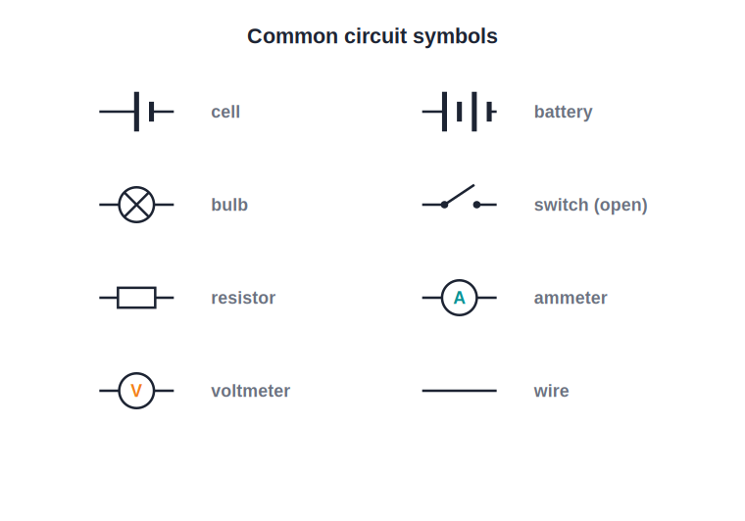
SYMBOLS
Symbols Used in Circuit Diagrams
A common language for circuits
• Circuits are drawn using simple, standard symbols.
• A cell, a battery, a bulb, a switch, a resistor, an ammeter and a voltmeter each have their own symbol.
• Wires are shown as straight lines joining the components.
• Using symbols makes circuits quick to draw and easy to understand.
Standard symbols for circuit components
Notes:
Go through each symbol. Students must be able to read and draw these accurately.

Slide 9
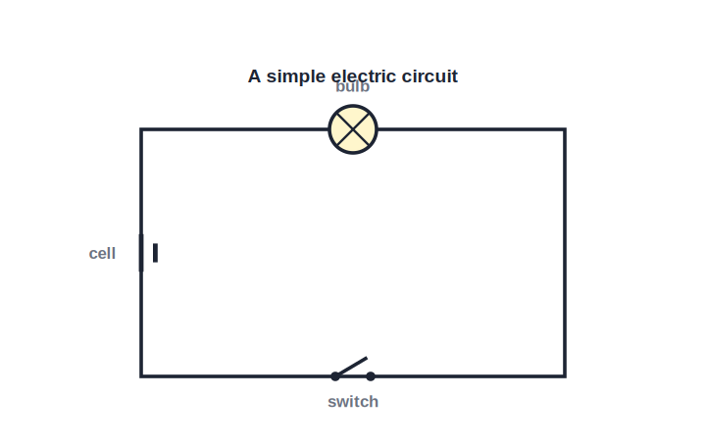
SIMPLE CIRCUIT
A Simple Electric Circuit
Cell, switch, bulb, wires
• A simple circuit has a source (cell), connecting wires, a switch and a device (bulb).
• When the switch is closed, current flows and the bulb lights.
• The current leaves the cell, passes through the bulb and returns to the cell.
• It must be a complete, unbroken loop for current to flow.
A complete loop lights the bulb
Notes:
Trace the loop. Emphasise a complete path is essential — leads into open/closed circuits.

Slide 10



EFFECTS
What an Electric Current Can Do
Heating effect
Lighting effect
Current heats a wire — used in heaters, irons and filament bulbs.
It makes filaments and LEDs glow to give light.
Magnetic effect
Chemical effect
A current creates a magnetic field — used in electromagnets and motors.
It can drive chemical changes, as in electroplating and charging cells.
Notes:
The main effects of a current: heating, lighting, magnetic and chemical. Each underlies everyday devices.

Slide 11
QUIZ 1
Check Your Understanding
5 questions • think before the answer reveals on the next slide

Slide 12
QUIZ QUESTION
Q1 — What Is Current?
An electric current is best described as a:
Build-up of charge at a point
Flow of electric charge through a conductor
A
B
Type of magnet
Form of light
C
D

Slide 13
ANSWER REVEALED
Q1 — What Is Current?
An electric current is best described as a:
Build-up of charge at a point
Flow of electric charge through a conductor
A
✓
Type of magnet
Form of light
C
D
WHY
Current is moving charge. In a metal wire it is a flow of electrons driven round the circuit by the cell, measured in amperes.

Slide 14
QUIZ QUESTION
Q2 — Measuring Current
To measure the current in a circuit, an ammeter is connected:
In parallel with the bulb
In series, in the main circuit
A
B
Across the cell only
Outside the circuit
C
D

Slide 15
ANSWER REVEALED
Q2 — Measuring Current
To measure the current in a circuit, an ammeter is connected:
In parallel with the bulb
In series, in the main circuit
A
✓
Across the cell only
Outside the circuit
C
D
WHY
An ammeter must carry the whole current it measures, so it is connected in series — in the line of the circuit, not across a component.

Slide 16
QUIZ QUESTION
Q3 — DC Source
Which of these is NOT a source of direct current?
A torch cell
A solar cell
A
B
A car battery
The mains socket at home
C
D

Slide 17
ANSWER REVEALED
Q3 — DC Source
Which of these is NOT a source of direct current?
A torch cell
A solar cell
A
B
A car battery
The mains socket at home
C
✓
WHY
Cells, batteries and solar cells all give direct current. The household mains supplies alternating current (AC), which reverses direction many times a second.

Slide 18
QUIZ QUESTION
Q4 — Read the Symbol
In a circuit diagram, a small circle with a cross inside it represents a:
Cell
Switch
A
B
Bulb (lamp)
Resistor
C
D

Slide 19
ANSWER REVEALED
Q4 — Read the Symbol
In a circuit diagram, a small circle with a cross inside it represents a:
Cell
Switch
A
B
Bulb (lamp)
Resistor
✓
D
WHY
The crossed circle is the standard symbol for a lamp or bulb. A cell is two parallel lines of unequal length, and a resistor is a rectangle.

Slide 20
QUIZ QUESTION
Q5 — Electromagnet
An electromagnet works because an electric current produces a:
Heating effect only
Magnetic effect
A
B
Chemical effect
Lighting effect
C
D

Slide 21
ANSWER REVEALED
Q5 — Electromagnet
An electromagnet works because an electric current produces a:
Heating effect only
Magnetic effect
A
✓
Chemical effect
Lighting effect
C
D
WHY
A current flowing through a coil creates a magnetic field — the magnetic effect of current. This is what makes an electromagnet (and electric motors) work.

Slide 22
PART 2
Conductors, Insulators & Circuits
2
What carries current, and complete vs broken loops

Slide 23
CONDUCTORS
Conductors and Insulators
Conductors
Insulators
Let current pass easily — they have free electrons (e.g. copper, silver, aluminium).
Block current — they have almost no free electrons (e.g. rubber, glass, plastic).
In a wire
Special cases
A copper core carries the current; a plastic sheath keeps it in and us safe.
Some materials (semiconductors) lie in between.
Notes:
Free electrons distinguish conductors from insulators. Link to the copper-core/plastic-sheath of everyday wires.

Slide 24

OPEN VS CLOSED
Open and Closed Circuits
Closed circuit
Open circuit
An unbroken loop — current flows and the bulb lights.
A break somewhere (switch off or a loose wire) — no current flows.
The switch
Fault finding
A switch simply opens or closes the circuit to turn a device off or on.
A blown bulb or broken wire leaves the circuit open and dark.
Notes:
Closed = complete = current flows; open = broken = no current. The switch is just a controlled break.

Slide 25
CLOSED CIRCUIT
Why the Loop Must Be Complete
No complete loop, no current
• One unbroken path Charge can only flow round a continuous conducting loop.
• Any break stops it A single gap anywhere stops the current everywhere.
• The switch decides Closing the switch completes the loop; opening it breaks the loop.
• Same current throughout In a single loop the same current passes through every part.
Notes:
Reinforce that current needs a complete path; one break stops the whole circuit.

Slide 26
WRAP UP
Quick Recap
✓ Current — flow of charge; I = Q/t; unit ampere; ammeter in series
✓ DC sources — cells, batteries, dynamos, solar cells
✓ Symbols — standard symbols for cell, bulb, switch, meters
✓ Simple circuit — source + wires + switch + device in a loop
✓ Conductors/insulators — free electrons let current pass or not
✓ Open/closed — complete loop flows; a break stops the current
Notes:
Rapid recap; the symbols and the open/closed-circuit idea are key.

Slide 27
QUIZ 2
Final Check — Circuits
5 questions • think before the answer reveals on the next slide

Slide 28
QUIZ QUESTION
Q1 — Bulb Won't Light
A torch bulb does not light when the switch is on. The most likely reason is:
Too much current
A break somewhere, leaving the circuit open
A
B
The wires are too short
The bulb is a conductor
C
D

Slide 29
ANSWER REVEALED
Q1 — Bulb Won't Light
A torch bulb does not light when the switch is on. The most likely reason is:
Too much current
A break somewhere, leaving the circuit open
A
✓
The wires are too short
The bulb is a conductor
C
D
WHY
If the bulb stays dark with the switch on, the loop is not complete — perhaps a flat cell, a blown filament or a loose wire has left the circuit open.

Slide 30
QUIZ QUESTION
Q2 — Best Conductor
Which material would you choose to carry the current in a wire?
Rubber
Glass
A
B
Copper
Plastic
C
D

Slide 31
ANSWER REVEALED
Q2 — Best Conductor
Which material would you choose to carry the current in a wire?
Rubber
Glass
A
B
Copper
Plastic
✓
D
WHY
Copper is an excellent conductor with many free electrons and is affordable, so it is used for the current-carrying core of wires. Rubber, glass and plastic are insulators.

Slide 32
QUIZ QUESTION
Q3 — Job of a Switch
A switch in a circuit works by:
Storing charge
Opening or closing the conducting loop
A
B
Producing current
Measuring voltage
C
D

Slide 33
ANSWER REVEALED
Q3 — Job of a Switch
A switch in a circuit works by:
Storing charge
Opening or closing the conducting loop
A
✓
Producing current
Measuring voltage
C
D
WHY
A switch is simply a controlled break: closing it completes the loop so current flows, and opening it breaks the loop so the device turns off.

Slide 34
QUIZ QUESTION
Q4 — Plastic Coating
The plastic coating around an electric wire is there to:
Help it conduct better
Insulate the wire, keeping current in and us safe
A
B
Make it heavier
Store charge
C
D

Slide 35
ANSWER REVEALED
Q4 — Plastic Coating
The plastic coating around an electric wire is there to:
Help it conduct better
Insulate the wire, keeping current in and us safe
A
✓
Make it heavier
Store charge
C
D
WHY
Plastic is an insulator. The coating stops the current escaping the copper core and protects us from electric shock if we touch the wire.

Slide 36
QUIZ QUESTION
Q5 — Same Current
In a simple single-loop circuit, the current in the wire near the cell compared with the current in the bulb is:
Larger
Smaller
A
B
Exactly the same
Zero
C
D

Slide 37
ANSWER REVEALED
Q5 — Same Current
In a simple single-loop circuit, the current in the wire near the cell compared with the current in the bulb is:
Larger
Smaller
A
B
Exactly the same
Zero
✓
D
WHY
In a single unbroken loop there is only one path, so the same current flows through every part — the cell, the wires and the bulb all carry it equally.

Slide 38
Completing the Circuit
A source, a loop and a switch — the simple ingredients behind every electric device you use.

