Slide 1
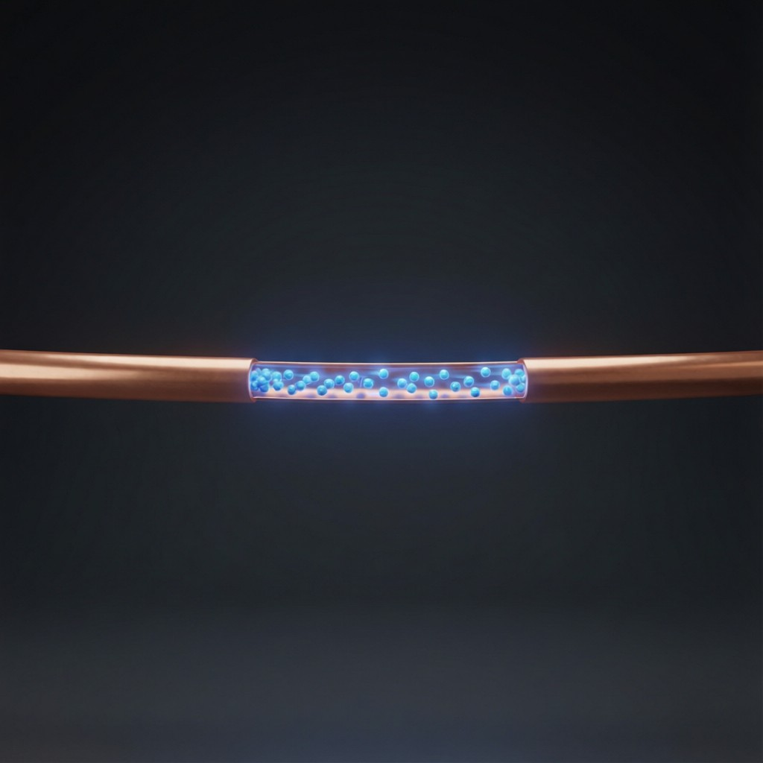
ICSE • CLASS 9 • ELECTRICITY
Electron Flow & Resistance
Flow of electrons • Direction of current • Resistance • Using energy efficiently

Slide 2
INTRODUCTION
Learning Objectives
1
Describe how electrons flow in a conductor
2
Distinguish electron flow from conventional current direction
3
Relate current to the work done by the source
4
Explain electrical resistance
5
List ways to use electrical energy efficiently
6
Appreciate social initiatives to save energy
Notes:
Open by previewing these objectives so students know what they should be able to do by the end of the session.

Slide 3
PART 1
Electron Flow & Current Direction
1
What really moves, and which way we say it goes

Slide 4
ELECTRON FLOW
Flow of Electrons in a Conductor
Free electrons on the move
• Free electrons A metal has loosely held free electrons that can drift through it.
• The cell drives them The cell's energy pushes these electrons round the circuit.
• From − to + Electrons flow from the negative terminal, through the circuit, to the positive terminal.
• This drift is the current The steady drift of electrons constitutes the electric current.
Notes:
Electrons (negative) drift from − to + through the external circuit, driven by the cell. This drift IS the current.

Slide 5
DIRECTION
Direction of the Electric Current
By convention, the direction of the current is taken to be the direction in which positive charge would flow — opposite to the electron flow.
• Conventional current: from + to − in the external circuit.
• Electron flow: from − to +, the opposite way.
• This convention was fixed before the electron was discovered.
Notes:
Conventional current (+ to −) is opposite to electron flow (− to +). A historical convention students must know.

Slide 6
POTENTIAL DIFFERENCE
Potential Difference (Voltage)
The potential difference between two points is the work done in moving unit charge from one point to the other.
V = work done / charge = W / Q (unit: volt, V)
• It is the 'push' a cell gives to drive current round a circuit.
• Measured with a voltmeter, connected in parallel (across a component).
• 1 volt means 1 joule of energy is given to each coulomb of charge.
Notes:
Introduce p.d. as energy per unit charge (V = W/Q), measured by a voltmeter in parallel. The 'push' driving the current.

Slide 7
WORK & ENERGY
Current, Work and Energy
As charge flows round a circuit, the cell does work on it, and that energy is delivered to the components.
Work done W = V × Q (volts × coulombs = joules)
• The cell converts chemical energy into electrical energy.
• The bulb converts electrical energy into light and heat.
• Energy is transferred, not created or destroyed.
Notes:
The source does work moving charge (W = VQ). Energy is transferred from cell to components and transformed.

Slide 8
QUIZ 1
Check Your Understanding
5 questions • think before the answer reveals on the next slide

Slide 9
QUIZ QUESTION
Q1 — What Moves?
In a copper wire carrying a current, the particles that actually move are the:
Protons
Free electrons
A
B
Whole atoms
Neutrons
C
D

Slide 10
ANSWER REVEALED
Q1 — What Moves?
In a copper wire carrying a current, the particles that actually move are the:
Protons
Free electrons
A
✓
Whole atoms
Neutrons
C
D
WHY
Only the loosely held free electrons drift through the metal lattice. The positive ions stay fixed in place, so the current in a wire is a flow of electrons.

Slide 11
QUIZ QUESTION
Q2 — Which Direction?
In the wires outside the cell, the conventional current flows from the:
Negative to the positive terminal, like the electrons
Positive to the negative terminal, opposite to the electrons
A
B
Middle outward
It does not flow
C
D

Slide 12
ANSWER REVEALED
Q2 — Which Direction?
In the wires outside the cell, the conventional current flows from the:
Negative to the positive terminal, like the electrons
Positive to the negative terminal, opposite to the electrons
A
✓
Middle outward
It does not flow
C
D
WHY
Conventional current is defined as the direction positive charge would move: from + to − in the external circuit — the opposite of the actual electron flow.

Slide 13
QUIZ QUESTION
Q3 — Energy Change in a Bulb
In a glowing bulb, electrical energy is mainly changed into:
Sound and chemical energy
Light and heat
A
B
Magnetic energy only
Nuclear energy
C
D

Slide 14
ANSWER REVEALED
Q3 — Energy Change in a Bulb
In a glowing bulb, electrical energy is mainly changed into:
Sound and chemical energy
Light and heat
A
✓
Magnetic energy only
Nuclear energy
C
D
WHY
The current heats the filament until it glows, converting electrical energy into light and heat — an energy transformation, with energy conserved overall.

Slide 15
QUIZ QUESTION
Q4 — Cell's Job
The cell in a circuit provides the energy to:
Create electrons
Do work pushing charge around the circuit
A
B
Destroy current
Cool the wires
C
D

Slide 16
ANSWER REVEALED
Q4 — Cell's Job
The cell in a circuit provides the energy to:
Create electrons
Do work pushing charge around the circuit
A
✓
Destroy current
Cool the wires
C
D
WHY
The cell converts its chemical energy into electrical energy, doing work to drive the charge round the loop and deliver energy to the components.

Slide 17
QUIZ QUESTION
Q5 — Energy Transformation
In a torch, the overall energy change is from:
Light → chemical → electrical
Chemical (cell) → electrical → light and heat
A
B
Electrical → chemical → sound
Heat → light → chemical
C
D

Slide 18
ANSWER REVEALED
Q5 — Energy Transformation
In a torch, the overall energy change is from:
Light → chemical → electrical
Chemical (cell) → electrical → light and heat
A
✓
Electrical → chemical → sound
Heat → light → chemical
C
D
WHY
The cell's chemical energy becomes electrical energy, which the bulb then converts into light and heat — a chain of energy transformations with energy conserved throughout.

Slide 19
PART 2
Resistance & Saving Energy
2
Opposition to current, and using energy wisely

Slide 20
RESISTANCE
Electrical Resistance
Resistance is the opposition that a conductor offers to the flow of current through it.
More resistance → less current for the same voltage
• It arises as moving electrons collide with the atoms of the conductor.
• Good conductors have low resistance; poor conductors have high resistance.
• A long, thin wire resists more than a short, thick one.
• The unit of resistance is the ohm (Ω).
Notes:
Resistance opposes current, from electron-atom collisions. Introduce the ohm and the length/thickness dependence simply.

Slide 21



WHAT AFFECTS R
What Affects a Wire's Resistance
Length
Thickness
A longer wire has more resistance.
A thicker (greater area) wire has less resistance.
Material
Temperature
Different materials resist differently — copper resists less than iron.
For metals, resistance increases as the wire gets hotter.
Notes:
The factors affecting resistance: length, thickness, material and temperature — a Class 9 introduction to the idea.

Slide 22

GROUPING CELLS
Joining Cells in a Battery
In series
In parallel
Cells joined + to − add their voltages, giving a higher total voltage.
Like cells joined + to + and − to − keep the same voltage but last longer.
A battery
Choosing
Two or more cells joined together form a battery.
Series for more voltage; parallel to supply current for longer.
Notes:
Cells in series add voltage; in parallel they keep the voltage but supply current longer. Several cells make a battery.

Slide 23


EFFICIENT USE
Using Electrical Energy Efficiently
Switch off
LED lighting
Turn off lights, fans and chargers when not in use.
LEDs give the same light for far less electricity than old bulbs.
Star ratings
Maintain appliances
Choose appliances with high energy-efficiency ratings.
Clean, well-kept appliances waste less energy.
Notes:
Practical efficiency steps. Saving energy lowers bills and conserves fuel and the environment.

Slide 24
SOCIAL INITIATIVES
Saving Energy Together
Awareness drives
Efficiency labels
Campaigns encourage people to save electricity.
Star-rating labels help buyers choose efficient appliances.
Public lighting
Renewables
Switching streetlights to LEDs saves large amounts of power.
Communities adopt solar power to reduce demand on the grid.
Notes:
Energy saving is also a social effort: awareness, labelling, efficient public lighting and renewables.

Slide 25
WRAP UP
Quick Recap
✓ Electron flow — free electrons drift from − to +
✓ Conventional current — taken from + to −, opposite to electrons
✓ Work — the cell does work W = V × Q on the charge
✓ Resistance — opposition to current; unit ohm; from collisions
✓ Efficient use — switch off, use LEDs, choose efficient appliances
✓ Social effort — awareness, labels, public LED lighting, renewables
Notes:
Rapid recap; electron vs conventional direction and resistance are the key ideas.

Slide 26
QUIZ 2
Final Check — Electrons & Resistance
5 questions • think before the answer reveals on the next slide

Slide 27
QUIZ QUESTION
Q1 — Higher Resistance
Which wire of the same material has the greater resistance?
A short, thick wire
A long, thin wire
A
B
They are equal
A coiled wire only
C
D

Slide 28
ANSWER REVEALED
Q1 — Higher Resistance
Which wire of the same material has the greater resistance?
A short, thick wire
A long, thin wire
A
✓
They are equal
A coiled wire only
C
D
WHY
Resistance increases with length and decreases with thickness, so a long, thin wire offers the most opposition to the current.

Slide 29
QUIZ QUESTION
Q2 — Why Wires Warm
A wire carrying a current becomes slightly warm because the moving electrons:
Create new energy
Collide with the atoms of the wire, giving up energy as heat
A
B
Slow down and stop
Turn into heat
C
D

Slide 30
ANSWER REVEALED
Q2 — Why Wires Warm
A wire carrying a current becomes slightly warm because the moving electrons:
Create new energy
Collide with the atoms of the wire, giving up energy as heat
A
✓
Slow down and stop
Turn into heat
C
D
WHY
As electrons drift through the wire they repeatedly collide with its atoms, transferring energy that appears as heat — the resistance of the wire.

Slide 31
QUIZ QUESTION
Q3 — Save the Most
Replacing all the old filament bulbs in a house with LEDs will:
Increase the bill
Give similar light using much less electricity
A
B
Make the rooms darker
Use more current
C
D

Slide 32
ANSWER REVEALED
Q3 — Save the Most
Replacing all the old filament bulbs in a house with LEDs will:
Increase the bill
Give similar light using much less electricity
A
✓
Make the rooms darker
Use more current
C
D
WHY
LEDs convert far more of the electrical energy into light and waste much less as heat, so they provide the same brightness while using a fraction of the power.

Slide 33
QUIZ QUESTION
Q4 — Electron Direction
Inside the connecting wires of a torch, the electrons actually move:
From the + terminal to the − terminal
From the − terminal to the + terminal
A
B
In no particular direction
Round in tiny circles
C
D

Slide 34
ANSWER REVEALED
Q4 — Electron Direction
Inside the connecting wires of a torch, the electrons actually move:
From the + terminal to the − terminal
From the − terminal to the + terminal
A
✓
In no particular direction
Round in tiny circles
C
D
WHY
Electrons are pushed out of the negative terminal, through the circuit, and back to the positive terminal — opposite to the conventional current direction.

Slide 35
QUIZ QUESTION
Q5 — Star Rating
When buying a refrigerator, choosing one with a higher star rating means it:
Looks better
Uses less electricity for the same job
A
B
Is bigger
Runs hotter
C
D

Slide 36
ANSWER REVEALED
Q5 — Star Rating
When buying a refrigerator, choosing one with a higher star rating means it:
Looks better
Uses less electricity for the same job
A
✓
Is bigger
Runs hotter
C
D
WHY
Star ratings show energy efficiency: more stars means the appliance does the same work using less electrical energy, saving power and money.

Slide 37
Electrons at Work
Drifting electrons, a little resistance and wise use — the small ideas that power and conserve our world.

