Slide 1
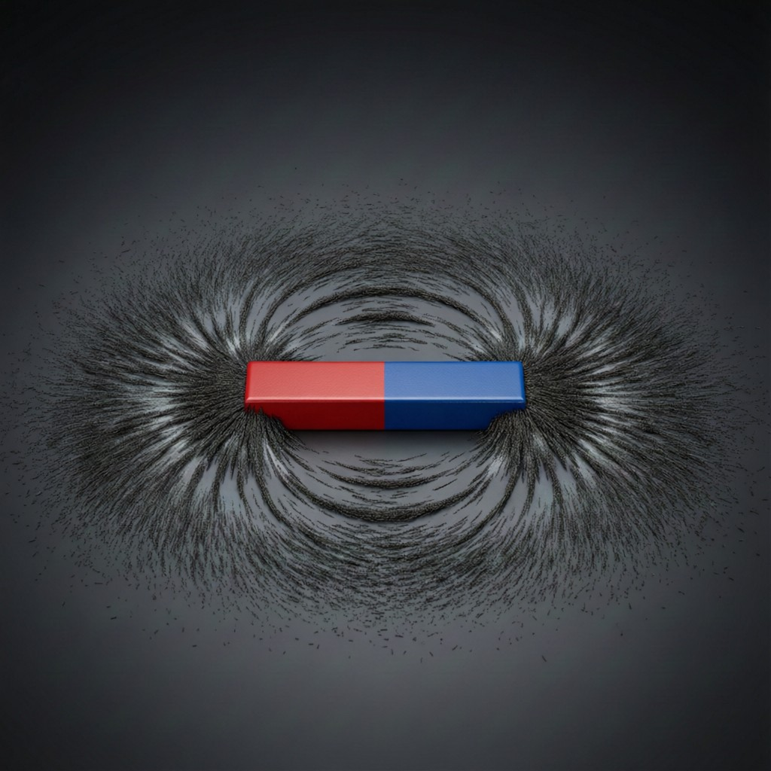
ICSE • CLASS 9 • MAGNETISM
Magnetic Fields
Magnets & induced magnetism • Magnetic field lines • Properties • The Earth's field

Slide 2
INTRODUCTION
Learning Objectives
1
Recall the basic properties of magnets
2
Explain induced magnetism
3
Describe magnetic field lines
4
State the properties of magnetic field lines
5
Describe the Earth's magnetic field
6
Plot the uniform field lines of the Earth
Notes:
Open by previewing these objectives so students know what they should be able to do by the end of the session.

Slide 3
PART 1
Magnets & Induced Magnetism
1
Poles, forces and how magnetism is induced

Slide 4


BASICS
Basic Properties of Magnets
Two poles
Poles in pairs
Every magnet has a north and a south pole.
Poles always occur in pairs — you cannot get a single pole.
Attraction & repulsion
Directive property
Like poles repel; unlike poles attract.
A freely suspended magnet sets itself north–south.
Notes:
Recap the fundamental magnet properties. The directive property (points N–S) leads to the compass and Earth's field.

Slide 5
MATERIALS
Magnetic and Non-Magnetic Materials
Magnetic materials
Non-magnetic
Attracted by a magnet — iron, cobalt, nickel and steel.
Not attracted — wood, plastic, copper, glass and aluminium.
Soft magnetic
Hard magnetic
Soft iron magnetises and demagnetises easily — used in electromagnets.
Steel keeps its magnetism — used for permanent magnets.
Notes:
Sort materials into magnetic vs non-magnetic, and soft (iron) vs hard (steel) magnetic materials.

Slide 6
INDUCED MAGNETISM
Induced Magnetism
Magnetism without contact
• What it is A magnetic material becomes a magnet when placed near a magnet, without touching it.
• Temporary Soft iron loses this induced magnetism as soon as the magnet is removed.
• Nearer pole The induced pole nearest the magnet is always opposite to it, so attraction results.
• Why iron sticks Pins cling to a magnet because each becomes a tiny induced magnet.
Notes:
Induced magnetism explains why unmagnetised iron is attracted: it temporarily becomes a magnet with an opposite near-pole.

Slide 7
MOLECULAR THEORY
The Molecular Theory of Magnetism
Magnets made of tiny magnets
• Tiny molecular magnets Every molecule of a magnetic material is itself a tiny magnet.
• Unmagnetised Normally these point in all directions, so their effects cancel out.
• Magnetised In a magnet they line up the same way, adding together to give net poles.
• It explains Why breaking a magnet gives two magnets, and why heating or hammering (jumbling them) demagnetises it.
Notes:
The molecular/domain theory: aligned molecular magnets give magnetism. Explains induced magnetism, breaking, and demagnetisation by heat/hammering.

Slide 8
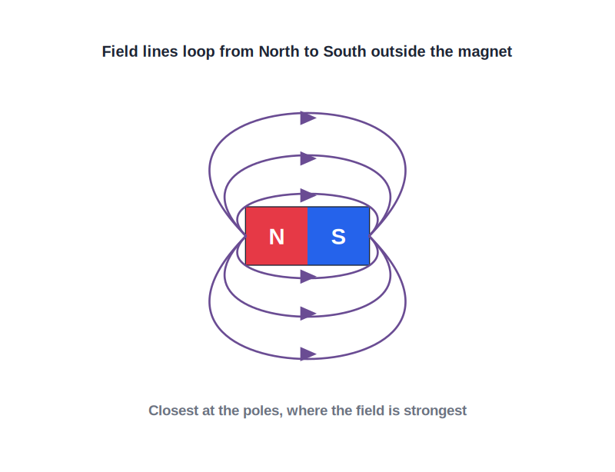
FIELD LINES
Magnetic Field Lines
Picturing the field
• A magnetic field is the region around a magnet where its force can be felt.
• We picture it using magnetic field lines.
• Outside the magnet, the lines run from the North pole to the South pole.
• Where the lines are crowded the field is strong; where they are spread out it is weak.
Lines run from N to S outside the magnet
Notes:
Field lines visualise the field. Direction N→S outside; spacing shows strength.

Slide 9
PROPERTIES
Properties of Magnetic Field Lines
Direction
Never cross
Run from North to South outside, and South to North inside the magnet.
Two field lines never intersect.
Closed loops
Spacing = strength
Each line is a continuous closed loop.
Closer lines mean a stronger field; they are densest at the poles.
Notes:
The four standard properties. 'Never cross' and 'closed loops' are commonly asked.

Slide 10
QUIZ 1
Check Your Understanding
5 questions • think before the answer reveals on the next slide

Slide 11
QUIZ QUESTION
Q1 — Sure Test
The surest test that a bar of steel is a magnet is that it:
Attracts iron
Repels one end of a known magnet
A
B
Is shiny
Is heavy
C
D

Slide 12
ANSWER REVEALED
Q1 — Sure Test
The surest test that a bar of steel is a magnet is that it:
Attracts iron
Repels one end of a known magnet
A
✓
Is shiny
Is heavy
C
D
WHY
Attraction can happen with ordinary iron too (by induction). Only a magnet can REPEL another magnet, so repulsion is the sure test of magnetism.

Slide 13
QUIZ QUESTION
Q2 — Pin on a Magnet
An iron pin clings to a magnet and a second pin then clings to the first. This shows:
The pins are already magnets
Induced magnetism — each pin becomes a temporary magnet
A
B
The magnet is losing strength
The pins are glued
C
D

Slide 14
ANSWER REVEALED
Q2 — Pin on a Magnet
An iron pin clings to a magnet and a second pin then clings to the first. This shows:
The pins are already magnets
Induced magnetism — each pin becomes a temporary magnet
A
✓
The magnet is losing strength
The pins are glued
C
D
WHY
The magnet induces magnetism in the first pin, which in turn induces it in the second. Each becomes a temporary magnet, so they cling in a chain.

Slide 15
QUIZ QUESTION
Q3 — Field Lines Cross?
Two magnetic field lines can never cross because at the crossing point the field would have:
Zero strength
Two directions at once, which is impossible
A
B
Too many poles
Infinite strength
C
D

Slide 16
ANSWER REVEALED
Q3 — Field Lines Cross?
Two magnetic field lines can never cross because at the crossing point the field would have:
Zero strength
Two directions at once, which is impossible
A
✓
Too many poles
Infinite strength
C
D
WHY
A field line shows the field's direction at each point. If two crossed, the field would point two ways at once there — impossible — so lines never intersect.

Slide 17
QUIZ QUESTION
Q4 — Strongest Field
On a field-line diagram, the magnetic field is strongest where the lines are:
Furthest apart
Closest together
A
B
Straight
Coloured
C
D

Slide 18
ANSWER REVEALED
Q4 — Strongest Field
On a field-line diagram, the magnetic field is strongest where the lines are:
Furthest apart
Closest together
A
✓
Straight
Coloured
C
D
WHY
Crowded (closely spaced) field lines indicate a strong field. That is why the lines bunch up at the poles, where the field is strongest.

Slide 19
QUIZ QUESTION
Q5 — Not Magnetic
Which of these materials is NOT attracted by a magnet?
Iron
Cobalt
A
B
Nickel
Copper
C
D

Slide 20
ANSWER REVEALED
Q5 — Not Magnetic
Which of these materials is NOT attracted by a magnet?
Iron
Cobalt
A
B
Nickel
Copper
C
✓
WHY
Iron, cobalt and nickel are magnetic materials, attracted by a magnet. Copper, like wood and plastic, is non-magnetic and is not attracted.

Slide 21
PART 2
The Earth's Magnetic Field
2
Why a compass points north

Slide 22
EARTH'S FIELD
The Earth as a Magnet
A planet-sized bar magnet
• A giant magnet The Earth behaves as if it has a huge bar magnet inside it.
• Compass points north A freely suspended magnet (compass) aligns with the Earth's field, pointing north–south.
• Poles are opposite The Earth's magnetic south pole lies near the geographic North — which is why a compass north is attracted to it.
• Uses Compasses guide ships, aircraft and hikers.
Notes:
The Earth acts like a bar magnet; the compass aligns with its field. Note the magnetic-geographic pole swap.

Slide 23
UNIFORM FIELD
Plotting the Earth's Uniform Field
Over a small area, the Earth's magnetic field is nearly uniform — the same strength and direction everywhere.
• Plot it with a compass on paper, marking the needle direction at many points.
• The field lines come out parallel and equally spaced.
• Parallel, evenly spaced lines are the signature of a uniform field.
Notes:
A uniform field = parallel, evenly spaced lines. The Earth's field is uniform over a small region.

Slide 24
MAGNETIC VS GEOGRAPHIC
Two Kinds of North
Geographic north
Magnetic north
The direction of the Earth's axis (true north).
The direction a compass needle points.
Declination
They differ
The small angle between them at a place.
Magnetic north and true north are not exactly the same direction.
Notes:
Distinguish geographic (true) north from magnetic north; the angle between is the declination.

Slide 25
WRAP UP
Quick Recap
✓ Magnet basics — two poles; like repel, unlike attract; points N–S
✓ Induced magnetism — iron becomes a temporary magnet near a magnet
✓ Field lines — run N→S outside; show field direction and strength
✓ Properties — never cross; closed loops; closest at the poles
✓ Earth's field — Earth acts like a bar magnet; compass aligns N–S
✓ Uniform field — parallel, equally spaced lines
Notes:
Rapid recap; field-line properties and the Earth's field are the key points.

Slide 26
QUIZ 2
Final Check — Fields & the Earth
5 questions • think before the answer reveals on the next slide

Slide 27
QUIZ QUESTION
Q1 — Compass Needle
A compass needle points north because it:
Is attracted to the Sun
Aligns itself with the Earth's magnetic field
A
B
Is heavier at one end
Repels all metals
C
D

Slide 28
ANSWER REVEALED
Q1 — Compass Needle
A compass needle points north because it:
Is attracted to the Sun
Aligns itself with the Earth's magnetic field
A
✓
Is heavier at one end
Repels all metals
C
D
WHY
The compass needle is a tiny magnet free to turn. It lines up with the Earth's magnetic field, coming to rest pointing north–south.

Slide 29
QUIZ QUESTION
Q2 — Uniform Field
Parallel, equally spaced magnetic field lines represent a field that is:
Getting stronger
Uniform (same everywhere)
A
B
Zero
Circular
C
D

Slide 30
ANSWER REVEALED
Q2 — Uniform Field
Parallel, equally spaced magnetic field lines represent a field that is:
Getting stronger
Uniform (same everywhere)
A
✓
Zero
Circular
C
D
WHY
When field lines are parallel and evenly spaced, the field has the same strength and direction at every point — a uniform field, like the Earth's over a small area.

Slide 31
QUIZ QUESTION
Q3 — Single Pole?
Breaking a bar magnet in half produces:
One N pole and one S pole separately
Two complete magnets, each with N and S poles
A
B
A magnet with no poles
A non-magnet
C
D

Slide 32
ANSWER REVEALED
Q3 — Single Pole?
Breaking a bar magnet in half produces:
One N pole and one S pole separately
Two complete magnets, each with N and S poles
A
✓
A magnet with no poles
A non-magnet
C
D
WHY
Poles always exist in pairs. Cutting a magnet simply makes two smaller magnets, each with its own north and south pole — you can never isolate a single pole.

Slide 33
QUIZ QUESTION
Q4 — Inside the Magnet
Inside a bar magnet, the field lines run from:
North to South
South to North
A
B
They stop at the surface
In circles
C
D

Slide 34
ANSWER REVEALED
Q4 — Inside the Magnet
Inside a bar magnet, the field lines run from:
North to South
South to North
A
✓
They stop at the surface
In circles
C
D
WHY
Field lines are closed loops. Outside the magnet they go N→S, and inside the magnet they continue from S→N to complete each loop.

Slide 35
QUIZ QUESTION
Q5 — Two Norths
The angle between the geographic north and the magnetic north at a place is called the:
Latitude
Magnetic declination
A
B
Longitude
Field strength
C
D

Slide 36
ANSWER REVEALED
Q5 — Two Norths
The angle between the geographic north and the magnetic north at a place is called the:
Latitude
Magnetic declination
A
✓
Longitude
Field strength
C
D
WHY
Declination is the small angle between true (geographic) north and the direction a compass points (magnetic north) at a given place.

Slide 37
Fields All Around
From a fridge magnet to the whole planet, invisible magnetic fields shape the space around every magnet.

