Slide 1
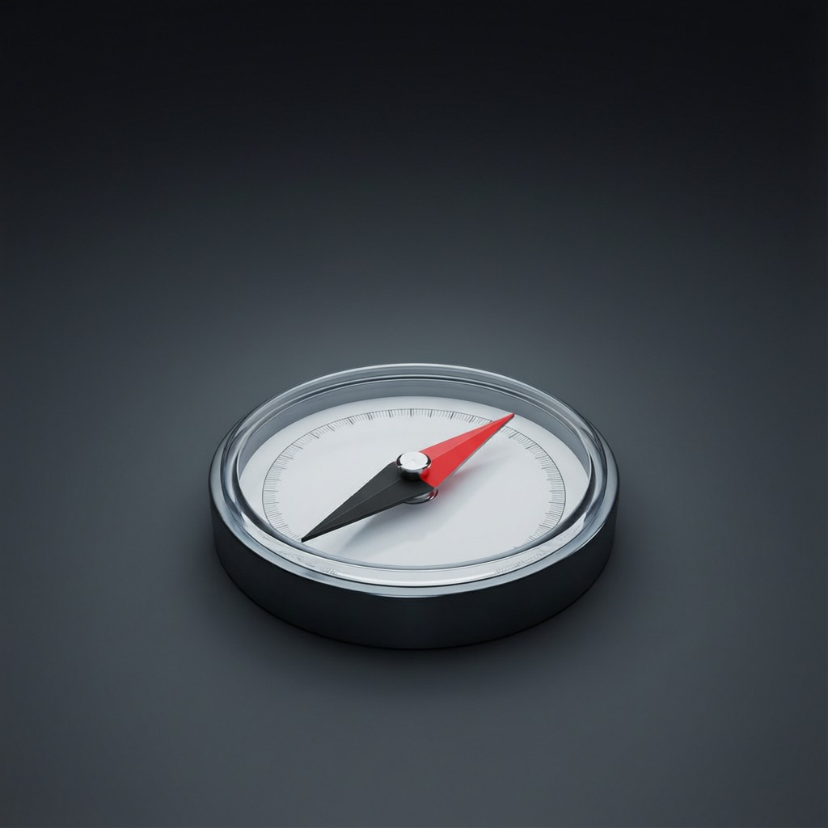
ICSE • CLASS 9 • MAGNETISM
Plotting Fields & Electromagnets
Plotting a magnet's field • Neutral points • Electromagnets • Uses

Slide 2
INTRODUCTION
Learning Objectives
1
Plot the non-uniform field of a strong bar magnet
2
Explain what a neutral point is
3
Describe an electromagnet
4
Compare an electromagnet with a permanent magnet
5
State the advantages of an electromagnet
6
List the uses of electromagnets
Notes:
Open by previewing these objectives so students know what they should be able to do by the end of the session.

Slide 3
PART 1
Plotting Fields & Neutral Points
1
Mapping a magnet's field with a compass

Slide 4
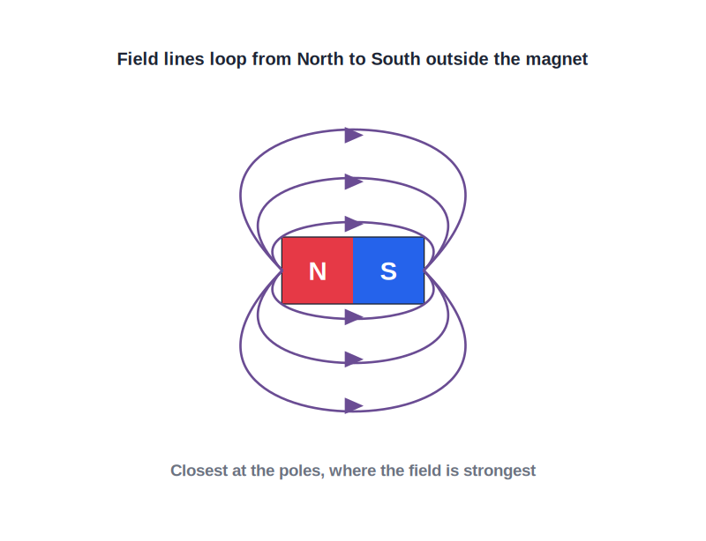
PLOTTING
Plotting a Bar Magnet's Field
Following the compass
• Place a bar magnet on paper and mark its outline.
• Put a plotting compass near one pole and mark the two ends of the needle.
• Move the compass so its tail sits on the last dot; repeat to trace a line.
• Joining the dots gives a curved field line; the field is non-uniform (it varies in strength and direction).
Curved lines: a non-uniform field
Notes:
The compass plotting method traces field lines. A bar magnet's field is non-uniform — curved, unevenly spaced lines.

Slide 5
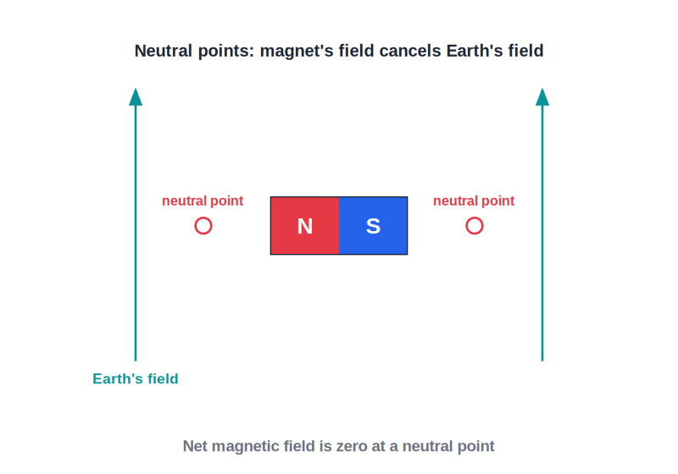
NEUTRAL POINTS
Neutral Points
Where the field is zero
• A neutral point is where the magnet's field exactly cancels the Earth's field.
• The net magnetic field there is zero.
• A compass placed at a neutral point can point in any direction.
• Their position depends on how the magnet is laid relative to north.
The magnet's field cancels the Earth's field
Notes:
At a neutral point the magnet's field and the Earth's field are equal and opposite, so they cancel to zero.

Slide 6
WHERE
Where Neutral Points Appear
Position depends on the magnet's setting
• N pointing north With the magnet's N pole toward geographic north, the neutral points lie to the east and west (on the equatorial line).
• N pointing south With the N pole toward the south, the neutral points lie on the axis, beyond the poles.
• Always in pairs Neutral points occur symmetrically, one on each side.
• Field is zero A plotting compass there is not deflected in any particular direction.
Notes:
The two cases (N to north vs N to south) move the neutral points from the sides to the axis — a classic ICSE point.

Slide 7



MAKING MAGNETS
Ways to Make a Magnet
Stroking
Electrical method
Rub a steel bar repeatedly with one pole of a magnet, always in the same direction.
Pass a direct current through a coil wound on the steel bar (the strongest method).
Induction
Demagnetising
Place a magnetic material near a magnet to magnetise it temporarily.
Heating, hammering or an alternating current can remove magnetism.
Notes:
Methods of making (and destroying) magnets. The electrical method using a DC coil is the most effective.

Slide 8
QUIZ 1
Check Your Understanding
5 questions • think before the answer reveals on the next slide

Slide 9
QUIZ QUESTION
Q1 — Neutral Point
At a neutral point near a bar magnet, the total magnetic field is:
Very strong
Zero
A
B
Always pointing north
Twice the Earth's field
C
D

Slide 10
ANSWER REVEALED
Q1 — Neutral Point
At a neutral point near a bar magnet, the total magnetic field is:
Very strong
Zero
A
✓
Always pointing north
Twice the Earth's field
C
D
WHY
A neutral point is where the magnet's field and the Earth's field are equal in size but opposite in direction, so they cancel and the net field is zero.

Slide 11
QUIZ QUESTION
Q2 — Compass There
A plotting compass placed exactly at a neutral point will:
Point firmly north
Point firmly south
A
B
Rest in no definite direction
Spin forever
C
D

Slide 12
ANSWER REVEALED
Q2 — Compass There
A plotting compass placed exactly at a neutral point will:
Point firmly north
Point firmly south
A
B
Rest in no definite direction
Spin forever
✓
D
WHY
With no net field to align to, the compass needle has nothing to turn it, so it can settle pointing any way — the test for a neutral point.

Slide 13
QUIZ QUESTION
Q3 — Non-Uniform
The field lines plotted around a single bar magnet are curved and unevenly spaced, showing the field is:
Uniform
Non-uniform
A
B
Zero everywhere
Straight
C
D

Slide 14
ANSWER REVEALED
Q3 — Non-Uniform
The field lines plotted around a single bar magnet are curved and unevenly spaced, showing the field is:
Uniform
Non-uniform
A
✓
Zero everywhere
Straight
C
D
WHY
Curved lines that crowd near the poles and spread out further away show that the field changes in both strength and direction — a non-uniform field.

Slide 15
QUIZ QUESTION
Q4 — Plotting Tool
The instrument used to plot the field lines of a magnet on paper is a:
Voltmeter
Plotting compass
A
B
Thermometer
Ammeter
C
D

Slide 16
ANSWER REVEALED
Q4 — Plotting Tool
The instrument used to plot the field lines of a magnet on paper is a:
Voltmeter
Plotting compass
A
✓
Thermometer
Ammeter
C
D
WHY
A small plotting compass shows the field's direction at each point; moving it step by step and joining the marks traces out the field lines.

Slide 17
QUIZ QUESTION
Q5 — Strongest Method
The most effective way to make a strong permanent magnet from a steel bar is to:
Stroke it once with a magnet
Pass a direct current through a coil wound around it
A
B
Leave it in sunlight
Hammer it repeatedly
C
D

Slide 18
ANSWER REVEALED
Q5 — Strongest Method
The most effective way to make a strong permanent magnet from a steel bar is to:
Stroke it once with a magnet
Pass a direct current through a coil wound around it
A
✓
Leave it in sunlight
Hammer it repeatedly
C
D
WHY
The electrical method — winding a coil round the steel and passing a direct current — magnetises it strongly and uniformly, far better than a few strokes. Hammering would actually demagnetise it.

Slide 19
PART 2
Electromagnets
2
Magnets you can switch on and off

Slide 20
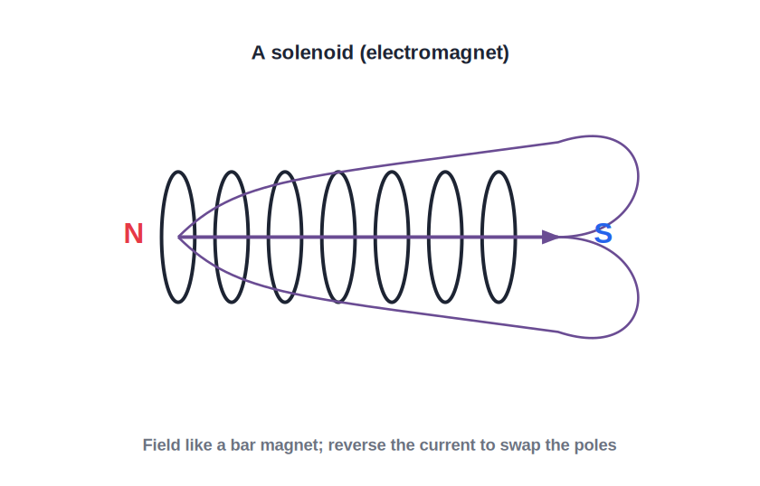
ELECTROMAGNET
The Electromagnet
A switchable magnet
• A current-carrying coil (solenoid) behaves like a bar magnet.
• Winding the coil on a soft-iron core makes a strong electromagnet.
• It is a magnet only while the current flows.
• Stronger with more current, more turns and a soft-iron core.
A coil + soft-iron core = electromagnet
Notes:
An electromagnet is a solenoid with a soft-iron core. Strength rises with current, turns and the core.

Slide 21

ELECTRO VS PERMANENT
Electromagnet vs Permanent Magnet
Switchable
Adjustable
An electromagnet can be turned on and off; a permanent magnet is always magnetic.
Its strength changes with the current; a permanent magnet's is fixed.
Reversible poles
Very strong
Reversing the current swaps its poles.
It can be made far stronger than a permanent magnet.
Notes:
The advantages of an electromagnet: switchable, adjustable, reversible, can be very strong.

Slide 22
USES
Uses of Electromagnets
Lifting cranes
Electric bell
Switch on to lift scrap iron, off to drop it.
Repeatedly pulls a clapper to strike the gong.
Relays & motors
Loudspeakers & maglev
Switch large circuits and drive electric motors.
Make sound, and lift maglev trains.
Notes:
Uses exploit switchable, controllable magnetism. The lifting crane and electric bell are the classic examples.

Slide 23

CARE OF MAGNETS
Storing and Caring for Permanent Magnets
They weaken
Use keepers
Rough handling, heating, hammering and stray fields gradually weaken a magnet.
Store bar magnets in pairs with soft-iron 'keepers' across their ends.
Unlike poles together
Why it helps
Lay the pair with unlike poles adjacent, joined by the keepers.
The keepers form closed loops for the field, keeping the molecular magnets aligned.
Notes:
Care of magnets: avoid heat/shock; store in pairs with soft-iron keepers across unlike poles to preserve magnetism.

Slide 24
WRAP UP
Quick Recap
✓ Plotting — use a plotting compass to trace field lines
✓ Bar magnet field — non-uniform: curved, unevenly spaced lines
✓ Neutral point — magnet's field cancels Earth's; net field zero
✓ Electromagnet — solenoid + soft-iron core; switchable
✓ Vs permanent — switchable, adjustable, reversible, very strong
✓ Uses — cranes, electric bell, relays, motors, loudspeakers
Notes:
Rapid recap; neutral points and the electromagnet advantages are the key points.

Slide 25
QUIZ 2
Final Check — Electromagnets
5 questions • think before the answer reveals on the next slide

Slide 26
QUIZ QUESTION
Q1 — Why Soft Iron?
An electromagnet's core is made of soft iron rather than steel because soft iron:
Stays magnetic permanently
Loses its magnetism as soon as the current stops
A
B
Conducts electricity better
Is lighter
C
D

Slide 27
ANSWER REVEALED
Q1 — Why Soft Iron?
An electromagnet's core is made of soft iron rather than steel because soft iron:
Stays magnetic permanently
Loses its magnetism as soon as the current stops
A
✓
Conducts electricity better
Is lighter
C
D
WHY
Soft iron magnetises and demagnetises easily, so the electromagnet can be switched off. Steel would keep its magnetism and could not be turned off.

Slide 28
QUIZ QUESTION
Q2 — Make It Stronger
Which change would NOT strengthen an electromagnet?
More turns on the coil
A larger current
A
B
A soft-iron core
Using a wooden core instead of iron
C
D

Slide 29
ANSWER REVEALED
Q2 — Make It Stronger
Which change would NOT strengthen an electromagnet?
More turns on the coil
A larger current
A
B
A soft-iron core
Using a wooden core instead of iron
C
✓
WHY
Wood is non-magnetic and adds nothing. An electromagnet is made stronger by more turns, a larger current and a soft-iron core.

Slide 30
QUIZ QUESTION
Q3 — Scrapyard Crane
A scrapyard prefers an electromagnet to a permanent magnet for moving iron because it can:
Never be switched off
Be switched off to release the load
A
B
Work without electricity
Lift plastic too
C
D

Slide 31
ANSWER REVEALED
Q3 — Scrapyard Crane
A scrapyard prefers an electromagnet to a permanent magnet for moving iron because it can:
Never be switched off
Be switched off to release the load
A
✓
Work without electricity
Lift plastic too
C
D
WHY
The crane grabs the scrap when the current is on and drops it when the current is switched off — control a permanent magnet could never provide.

Slide 32
QUIZ QUESTION
Q4 — Reverse Current
Reversing the current through an electromagnet:
Switches it off
Swaps its north and south poles
A
B
Doubles its strength
Has no effect
C
D

Slide 33
ANSWER REVEALED
Q4 — Reverse Current
Reversing the current through an electromagnet:
Switches it off
Swaps its north and south poles
A
✓
Doubles its strength
Has no effect
C
D
WHY
The poles of an electromagnet depend on the current's direction. Reversing the current reverses the field, so the north and south ends interchange.

Slide 34
QUIZ QUESTION
Q5 — Which Is Stronger Controllable
Compared with an ordinary permanent magnet, an electromagnet's strength is:
Always fixed
Adjustable by changing the current
A
B
Always weaker
Impossible to change
C
D

Slide 35
ANSWER REVEALED
Q5 — Which Is Stronger Controllable
Compared with an ordinary permanent magnet, an electromagnet's strength is:
Always fixed
Adjustable by changing the current
A
✓
Always weaker
Impossible to change
C
D
WHY
An electromagnet's strength can be increased or decreased simply by changing the current through its coil — a permanent magnet's strength cannot be adjusted.

Slide 36
Magnetism on Demand
Wind a coil, add a current, and you have a magnet you can switch, strengthen and reverse at will.

