Slide 1
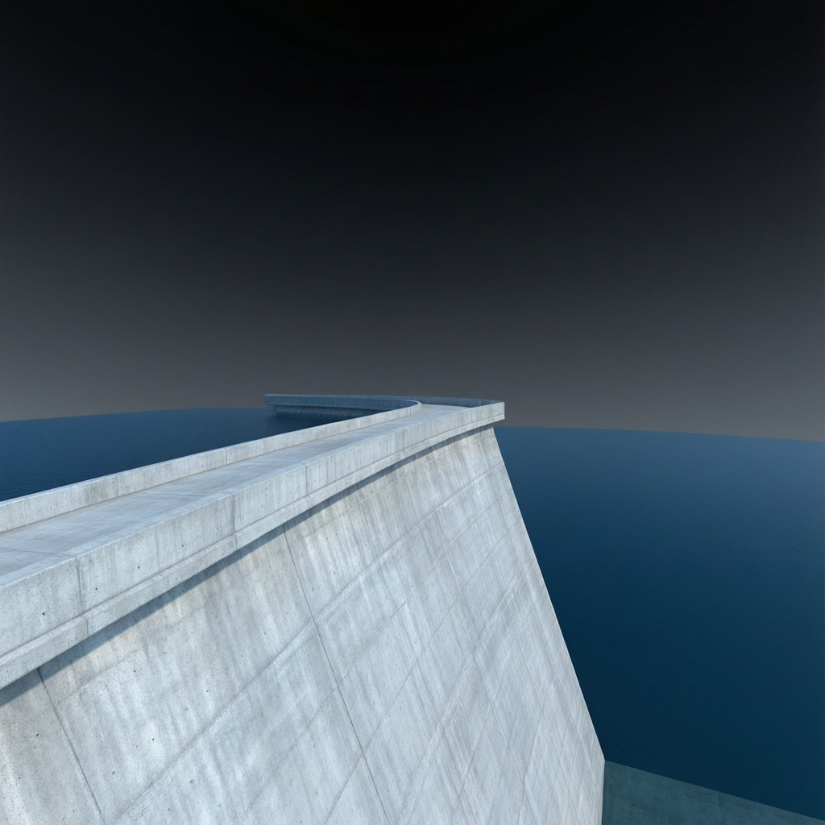
ICSE • CLASS 9 • FLUIDS
Pressure in Fluids
Thrust & pressure • Pressure in a liquid • Laws of liquid pressure • Pascal's law

Slide 2
INTRODUCTION
Learning Objectives
1
Distinguish thrust from pressure
2
Use the relation pressure = thrust / area
3
Find the pressure due to a liquid column (P = h ρ g)
4
State the laws of liquid pressure
5
Explain everyday consequences of liquid pressure
6
State Pascal's law and its applications
Notes:
Open by previewing these objectives so students know what they should be able to do by the end of the session.

Slide 3
PART 1
Thrust & Pressure in Liquids
1
How liquids press on their surroundings

Slide 4
THRUST & PRESSURE
Thrust and Pressure
Thrust is the total force acting normally on a surface; pressure is the thrust acting on each unit of area.
Pressure = Thrust / Area (unit: pascal, Pa)
• Thrust is a force, measured in newtons (N).
• 1 pascal = 1 newton per square metre (N/m²).
• The same force gives more pressure on a smaller area — why a sharp knife cuts well.
Notes:
Separate thrust (force) from pressure (force per area). The sharp-knife / camel-foot examples make area intuitive.

Slide 5
WORKED EXAMPLE
Pressure From a Force
Problem. A box exerts a thrust of 600 N on the floor through a base area of 1.5 m². Find the pressure on the floor.
Pressure = Thrust / Area
Pressure = 600 / 1.5
Pressure = 400 Pa
Answer: Pressure = 400 Pa
Notes:
Straight substitution. Note how a smaller base area would raise the pressure for the same weight.

Slide 6
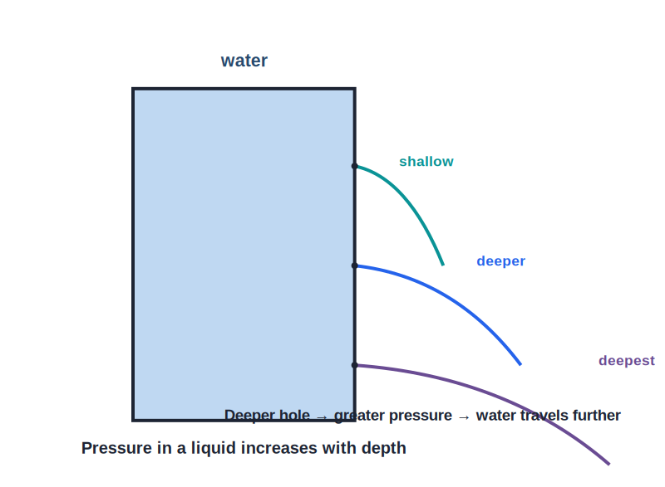
LIQUID COLUMN
Pressure in a Liquid
P = h ρ g
• A liquid exerts pressure because of its weight.
• The pressure at a depth h is P = h ρ g (depth × density × g).
• So pressure increases with depth — deeper water presses harder.
• It does not depend on the area or shape of the container.
Deeper holes squirt water further
Notes:
Derive P = hρg from the weight of the column. Stress it depends on depth and density, not on the container's shape.

Slide 7



LAWS
Laws of Liquid Pressure
Increases with depth
Same at the same depth
The deeper you go, the greater the pressure.
At a given depth the pressure is the same in all directions.
Acts in all directions
Depends on density
A liquid presses sideways and upwards, not just downwards.
A denser liquid exerts more pressure at the same depth.
Notes:
The four laws. The 'all directions' and 'same at same depth' points are commonly tested.

Slide 8
TOTAL PRESSURE
Total Pressure at a Depth
The total pressure at a depth in an open liquid is the atmospheric pressure pushing on the surface plus the pressure of the liquid column.
P_total = P_atmospheric + h ρ g
• The liquid column adds hρg to the air pressure above it.
• The deeper the point, the larger the hρg term.
• If only the liquid's own pressure is wanted, use just h ρ g.
Notes:
Distinguish gauge pressure (hρg) from total/absolute pressure (atmospheric + hρg). Exam questions specify which they want.

Slide 9

OWN LEVEL
Liquids Find Their Own Level
Communicating vessels
Why
Liquid poured into connected vessels settles at the same height in each.
At the joining level the pressure must be equal, and equal pressure means equal height (same liquid).
Whatever the shape
Everyday use
It is true however wide, narrow or tilted each vessel is.
Water-level tubes, canal locks and a spirit level all rely on this.
Notes:
Communicating vessels: a liquid reaches the same level everywhere because pressure balances at a common depth.

Slide 10
CONSEQUENCES
Consequences of Liquid Pressure
Thick dam walls
Deep-sea diving
Dams are built much thicker at the bottom to withstand the greater pressure there.
Divers need strong suits because pressure grows rapidly with depth.
Water tank height
Holes in a can
An overhead tank gives more pressure (and flow) the higher it is placed.
Water spurts farthest from the lowest hole in a tin.
Notes:
Each consequence follows from 'pressure increases with depth'. The dam wall is the classic exam example.

Slide 11
ALL DIRECTIONS
Liquids Press in Every Direction
Pressure has no preferred direction
• Sideways too A liquid pushes outward on the walls of its container, not just downward — water spurts sideways from a hole.
• Upward as well Liquid pressure also acts upward, which is why objects feel an upthrust.
• Equal at one depth At a given depth the pressure is the same in all directions.
• Free surface stays level Because pressure balances, the surface of a still liquid is always horizontal.
Notes:
Reinforce that liquid pressure acts in all directions — leads naturally to upthrust in the next chapter.

Slide 12
QUIZ 1
Check Your Understanding
5 questions • think before the answer reveals on the next slide

Slide 13
QUIZ QUESTION
Q1 — Sharp Knife
A sharp knife cuts more easily than a blunt one because, for the same force, the sharp edge gives:
Less pressure (larger area)
More pressure (smaller area)
A
B
Less thrust
More thrust
C
D

Slide 14
ANSWER REVEALED
Q1 — Sharp Knife
A sharp knife cuts more easily than a blunt one because, for the same force, the sharp edge gives:
Less pressure (larger area)
More pressure (smaller area)
A
✓
Less thrust
More thrust
C
D
WHY
Pressure = thrust / area. A sharp edge has a very small contact area, so the same force produces a much greater pressure, letting it cut.

Slide 15
QUIZ QUESTION
Q2 — Dam Design
The wall of a dam is made much thicker at its base than at the top because the water pressure:
Is greatest at the top
Increases with depth, so it is greatest at the bottom
A
B
Is the same everywhere
Acts only sideways
C
D

Slide 16
ANSWER REVEALED
Q2 — Dam Design
The wall of a dam is made much thicker at its base than at the top because the water pressure:
Is greatest at the top
Increases with depth, so it is greatest at the bottom
A
✓
Is the same everywhere
Acts only sideways
C
D
WHY
Liquid pressure rises with depth (P = hρg), so the base of the dam must resist the greatest pressure — hence it is built thickest there.

Slide 17
QUIZ QUESTION
Q3 — Which Depth?
Two tanks hold water. The pressure at the bottom depends on:
The width of the tank
The total amount of water
A
B
The depth of the water (and its density)
The shape of the tank
C
D

Slide 18
ANSWER REVEALED
Q3 — Which Depth?
Two tanks hold water. The pressure at the bottom depends on:
The width of the tank
The total amount of water
A
B
The depth of the water (and its density)
The shape of the tank
✓
D
WHY
Liquid pressure depends only on depth, density and g — not on the shape, width or total volume. Two differently shaped tanks filled to the same depth have the same bottom pressure.

Slide 19
QUIZ QUESTION
Q4 — Find the Pressure
The pressure due to a 2 m column of water (ρ = 1000 kg/m³, g = 10 m/s²) is:
200 Pa
2000 Pa
A
B
20,000 Pa
5000 Pa
C
D

Slide 20
ANSWER REVEALED
Q4 — Find the Pressure
The pressure due to a 2 m column of water (ρ = 1000 kg/m³, g = 10 m/s²) is:
200 Pa
2000 Pa
A
B
20,000 Pa
5000 Pa
✓
D
WHY
P = h ρ g = 2 × 1000 × 10 = 20,000 Pa. Multiply depth, density and g.

Slide 21
QUIZ QUESTION
Q5 — Same Level
A liquid is poured into a set of connected tubes of different widths and shapes. The liquid settles so that:
It is highest in the narrowest tube
It reaches the same level in every tube
A
B
It is highest in the widest tube
Each tube has a different level
C
D

Slide 22
ANSWER REVEALED
Q5 — Same Level
A liquid is poured into a set of connected tubes of different widths and shapes. The liquid settles so that:
It is highest in the narrowest tube
It reaches the same level in every tube
A
✓
It is highest in the widest tube
Each tube has a different level
C
D
WHY
In communicating vessels the pressure must balance at the joining level, so the same liquid stands at the same height in each — regardless of the tubes' shapes or widths.

Slide 23
PART 2
Pascal's Law
2
How pressure is transmitted through liquids

Slide 24
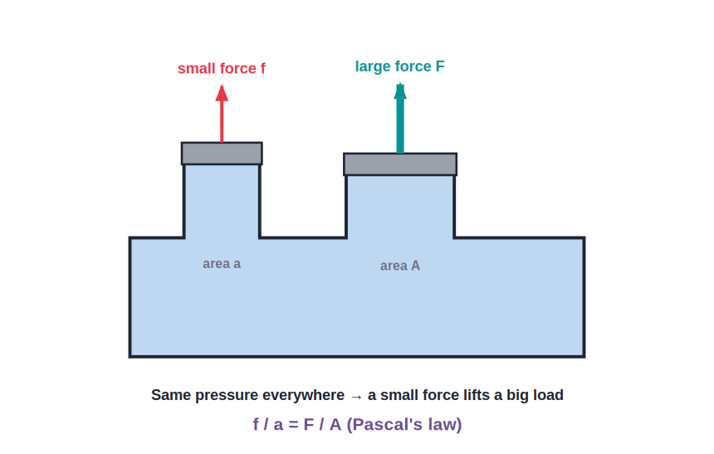
PASCAL'S LAW
Transmission of Pressure
f / a = F / A
• Pascal's law: pressure applied to an enclosed liquid is transmitted equally to every part of it.
• So a small force on a small piston can balance a large force on a large piston.
• The pressure (f/a) is the same as (F/A) throughout the liquid.
• This multiplies force — the basis of all hydraulic machines.
A small force lifts a big load
Notes:
State Pascal's law. The force is multiplied by the ratio of piston areas — hydraulics trade distance for force.

Slide 25
WORKED EXAMPLE
Hydraulic Force Multiplier
Problem. In a hydraulic press a force of 50 N acts on a piston of area 0.01 m². The large piston has area 0.5 m². Find the force it can exert.
f / a = F / A → F = f × A / a
F = 50 × 0.5 / 0.01
F = 2500 N
Answer: F = 2500 N — the force is multiplied 50 times
Notes:
The area ratio (0.5/0.01 = 50) is the force multiplier. Great for showing the power of hydraulics.

Slide 26
APPLICATIONS
Applications of Pascal's Law
Hydraulic press
Hydraulic brakes
Compresses bales, moulds metal and presses oil from seeds.
A light push on the brake pedal presses the brake pads on all wheels.
Hydraulic lift / jack
Excavators
Lifts cars and heavy loads with a small effort.
Hydraulic arms move huge buckets of earth.
Notes:
Each device transmits pressure to multiply force. Brakes and the car jack are the everyday examples.

Slide 27
WRAP UP
Quick Recap
✓ Thrust vs pressure — thrust is force; pressure = thrust / area (Pa)
✓ Liquid pressure — P = h ρ g; increases with depth
✓ Laws — acts in all directions; same at the same depth
✓ Consequences — thick dam walls, deep-sea pressure
✓ Pascal's law — pressure is transmitted equally; f/a = F/A
✓ Applications — hydraulic press, brakes, lift and jack
Notes:
Rapid recap; P = hρg and Pascal's law are the key results.

Slide 28
QUIZ 2
Final Check — Pascal & Hydraulics
5 questions • think before the answer reveals on the next slide

Slide 29
QUIZ QUESTION
Q1 — Pascal's Law
Pascal's law states that pressure applied to an enclosed liquid is:
Lost as heat
Transmitted equally to every part of the liquid
A
B
Greatest near the piston
Reduced with distance
C
D

Slide 30
ANSWER REVEALED
Q1 — Pascal's Law
Pascal's law states that pressure applied to an enclosed liquid is:
Lost as heat
Transmitted equally to every part of the liquid
A
✓
Greatest near the piston
Reduced with distance
C
D
WHY
An enclosed liquid passes on the applied pressure undiminished to all points. This equal transmission is what hydraulic machines rely on.

Slide 31
QUIZ QUESTION
Q2 — Force Multiplier
A hydraulic lift has pistons of area 2 cm² and 100 cm². A force of 20 N on the small piston can lift a load of:
20 N
100 N
A
B
1000 N
400 N
C
D

Slide 32
ANSWER REVEALED
Q2 — Force Multiplier
A hydraulic lift has pistons of area 2 cm² and 100 cm². A force of 20 N on the small piston can lift a load of:
20 N
100 N
A
B
1000 N
400 N
✓
D
WHY
F = f × A/a = 20 × 100/2 = 1000 N. The area ratio of 50 multiplies the force 50 times.

Slide 33
QUIZ QUESTION
Q3 — Brakes
When you press a car's brake pedal, the braking force reaches all the wheels because the brake fluid:
Evaporates
Transmits the pressure equally to each wheel cylinder
A
B
Heats up
Freezes
C
D

Slide 34
ANSWER REVEALED
Q3 — Brakes
When you press a car's brake pedal, the braking force reaches all the wheels because the brake fluid:
Evaporates
Transmits the pressure equally to each wheel cylinder
A
✓
Heats up
Freezes
C
D
WHY
The enclosed brake fluid obeys Pascal's law, carrying the pressure from the pedal equally to the cylinders at every wheel so they brake together.

Slide 35
QUIZ QUESTION
Q4 — No Free Lunch
A hydraulic jack multiplies force 50 times. To lift the load, the small piston must move:
The same distance as the load
50 times further than the load rises
A
B
50 times less than the load
It does not move
C
D

Slide 36
ANSWER REVEALED
Q4 — No Free Lunch
A hydraulic jack multiplies force 50 times. To lift the load, the small piston must move:
The same distance as the load
50 times further than the load rises
A
✓
50 times less than the load
It does not move
C
D
WHY
Energy is conserved: gaining 50× the force costs 50× the distance. The small piston moves a long way to raise the load a little — work in equals work out.

Slide 37
QUIZ QUESTION
Q5 — Same Liquid Level
An enclosed hydraulic system is filled with oil rather than air because a liquid:
Is lighter
Is almost incompressible, so it transmits pressure without being squashed
A
B
Is cheaper
Flows faster
C
D

Slide 38
ANSWER REVEALED
Q5 — Same Liquid Level
An enclosed hydraulic system is filled with oil rather than air because a liquid:
Is lighter
Is almost incompressible, so it transmits pressure without being squashed
A
✓
Is cheaper
Flows faster
C
D
WHY
A liquid barely compresses, so applied pressure is passed on at once. A gas would simply compress, absorbing the effort instead of transmitting it.

Slide 39
The Power of Pressure
From a dam wall to a car's brakes, understanding fluid pressure lets us hold back oceans and multiply force at will.

