Slide 1

ICSE • CLASS 9 • FLUIDS
Atmospheric Pressure
Hydraulic machines • Atmospheric pressure • The barometer • Pressure & altitude

Slide 2
INTRODUCTION
Learning Objectives
1
Give examples of hydraulic machines
2
Explain what atmospheric pressure is
3
Describe demonstrations of atmospheric pressure
4
List everyday consequences of atmospheric pressure
5
Describe how a barometer measures atmospheric pressure
6
Explain how pressure varies with altitude
Notes:
Open by previewing these objectives so students know what they should be able to do by the end of the session.

Slide 3
PART 1
Hydraulic Machines & the Atmosphere
1
Multiplying force, and the ocean of air above us

Slide 4
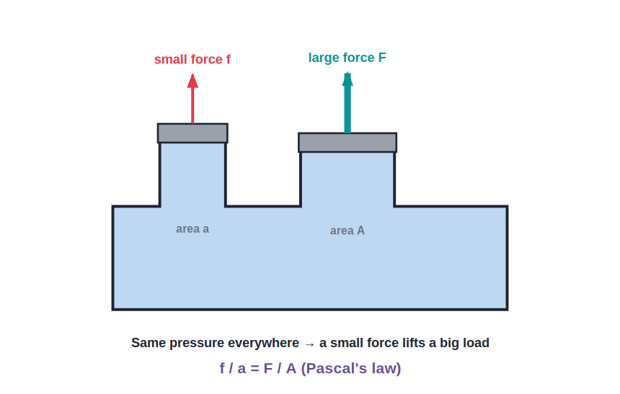
HYDRAULICS
Hydraulic Machines
Force multipliers
• Hydraulic machines use Pascal's law to multiply force.
• A small force on a small piston produces a large force on a large piston.
• Examples: hydraulic press, car brakes, jacks and excavators.
• They trade a long movement of the small piston for a large force on the load.
A small effort raises a heavy load
Notes:
Recap hydraulics from the previous lesson as the lead-in, then move to the atmosphere.

Slide 5
ATMOSPHERIC PRESSURE
Atmospheric Pressure
The atmosphere is a deep ocean of air whose weight presses on everything — this is atmospheric pressure.
Normal value ≈ 1.013 × 10⁵ Pa (≈ 76 cm of mercury)
• It acts in all directions, like any fluid pressure.
• We do not feel it because it is balanced by the pressure inside our bodies.
• It decreases as we go up, where there is less air above.
Notes:
Air has weight, so it presses on us. We don't feel it because internal pressure balances it.

Slide 6


DEMONSTRATIONS
Showing Atmospheric Pressure Exists
Crushing can
Magdeburg hemispheres
Steam is boiled in a can, then it is sealed and cooled — the air pressure outside crushes it.
Two evacuated hemispheres cannot be pulled apart, held by air pressure.
Water in a glass
Rubber sucker
A card holds water in an inverted glass — air pressure pushes up on the card.
Squeeze out the air and atmospheric pressure holds the sucker to the wall.
Notes:
Classic demonstrations. Each works because air pressure pushes from outside when the inside pressure is reduced.

Slide 7
CONSEQUENCES
Atmospheric Pressure in Daily Life
Drinking straw
Syringe
Sucking lowers the pressure inside; air pressure pushes the drink up the straw.
Pulling the plunger lets atmospheric pressure push liquid in.
Dropper
Pumps
Releasing the bulb lets air pressure push liquid up into it.
Lift and force pumps move water using pressure differences.
Notes:
Everyday uses. Stress the pattern: reduce pressure on one side, and atmospheric pressure does the pushing.

Slide 8
UNITS
Ways of Stating Atmospheric Pressure
One pressure, several units
• Pascal (Pa) The SI unit; normal atmospheric pressure ≈ 1.013 × 10⁵ Pa.
• Centimetres of mercury Normal pressure supports 76 cm (760 mm) of mercury.
• Atmosphere (atm) 1 atm is the average sea-level pressure.
• Bar / millibar Weather maps often use millibars; 1 bar ≈ 10⁵ Pa.
Notes:
Connect the units students will meet: pascals, cm of mercury, atmospheres and millibars on weather maps.

Slide 9
QUIZ 1
Check Your Understanding
5 questions • think before the answer reveals on the next slide

Slide 10
QUIZ QUESTION
Q1 — The Straw
When you drink through a straw, the drink rises because:
You pull the liquid up with suction force
Lowering the pressure inside lets atmospheric pressure push the drink up
A
B
The straw heats the liquid
Gravity pushes it up
C
D

Slide 11
ANSWER REVEALED
Q1 — The Straw
When you drink through a straw, the drink rises because:
You pull the liquid up with suction force
Lowering the pressure inside lets atmospheric pressure push the drink up
A
✓
The straw heats the liquid
Gravity pushes it up
C
D
WHY
Sucking removes air from the straw, lowering the pressure inside. The greater atmospheric pressure on the drink's surface then pushes the liquid up the straw.

Slide 12
QUIZ QUESTION
Q2 — Crushing Can
A sealed can with a little steam inside is cooled and suddenly crumples because:
The steam expands
The steam condenses, lowering the inside pressure so the atmosphere crushes it
A
B
The metal shrinks a lot
Water freezes inside
C
D

Slide 13
ANSWER REVEALED
Q2 — Crushing Can
A sealed can with a little steam inside is cooled and suddenly crumples because:
The steam expands
The steam condenses, lowering the inside pressure so the atmosphere crushes it
A
✓
The metal shrinks a lot
Water freezes inside
C
D
WHY
Cooling condenses the steam, drastically lowering the pressure inside the can. The unbalanced atmospheric pressure outside then crushes it.

Slide 14
QUIZ QUESTION
Q3 — Why No Squash?
We are not crushed by the huge atmospheric pressure on us because:
Our skin is very strong
The pressure of fluids inside our bodies balances it
A
B
Atmospheric pressure is actually small
We are too light
C
D

Slide 15
ANSWER REVEALED
Q3 — Why No Squash?
We are not crushed by the huge atmospheric pressure on us because:
Our skin is very strong
The pressure of fluids inside our bodies balances it
A
✓
Atmospheric pressure is actually small
We are too light
C
D
WHY
The pressure of the blood and fluids inside our bodies pushes outward with equal force, balancing the atmospheric pressure pushing in — so there is no net squeezing.

Slide 16
QUIZ QUESTION
Q4 — Hydraulic Recap
Hydraulic machines are able to multiply force because they use:
Atmospheric pressure
Pascal's law — equal transmission of pressure in a liquid
A
B
The weight of air
Magnetism
C
D

Slide 17
ANSWER REVEALED
Q4 — Hydraulic Recap
Hydraulic machines are able to multiply force because they use:
Atmospheric pressure
Pascal's law — equal transmission of pressure in a liquid
A
✓
The weight of air
Magnetism
C
D
WHY
Hydraulics rely on a liquid transmitting pressure equally (Pascal's law); the larger output piston then turns that pressure into a much larger force.

Slide 18
QUIZ QUESTION
Q5 — Sucker on Glass
A rubber sucker sticks firmly to a smooth wall because:
Glue on the sucker holds it
Squeezing out the air lets atmospheric pressure hold it on
A
B
It is magnetic
The wall pulls it
C
D

Slide 19
ANSWER REVEALED
Q5 — Sucker on Glass
A rubber sucker sticks firmly to a smooth wall because:
Glue on the sucker holds it
Squeezing out the air lets atmospheric pressure hold it on
A
✓
It is magnetic
The wall pulls it
C
D
WHY
Pressing the sucker drives out the air behind it. With little pressure inside, the full atmospheric pressure outside presses it against the wall and holds it there.

Slide 20
PART 2
Measuring Atmospheric Pressure
2
The barometer, altitude and the weather

Slide 21
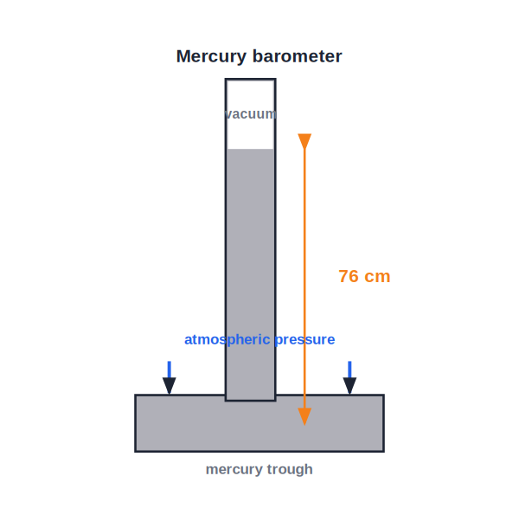
BAROMETER
The Mercury Barometer
76 cm of mercury
• A barometer measures atmospheric pressure.
• Atmospheric pressure supports a column of mercury about 76 cm high in a sealed tube.
• Above the mercury is a vacuum (the Torricellian vacuum).
• Mercury is used because it is very dense — water would need a 10 m tube!
Atmospheric pressure supports the column
Notes:
Explain the balance: atmospheric pressure on the trough equals the pressure of the 76 cm mercury column. Mercury's density keeps it compact.

Slide 22
MANOMETER
The Manometer — Measuring Gas Pressure
A U-tube pressure gauge
• What it is A simple U-tube containing a liquid, used to measure the pressure of an enclosed gas.
• How it reads The gas pushes the liquid down one arm; the difference in levels gives the pressure.
• Above atmospheric If the gas arm is lower, the gas pressure is greater than the atmosphere by hρg.
• Below atmospheric If the gas arm is higher, the gas pressure is less than the atmosphere.
Notes:
The manometer compares an enclosed gas pressure with the atmosphere via the difference in liquid levels (hρg).

Slide 23
ALTITUDE
Pressure and Altitude
Less air above means less pressure
• Falls with height Atmospheric pressure decreases as you go higher — there is less air above.
• On mountains Climbers carry oxygen because the thin air has low pressure.
• Aircraft cabins Planes are pressurised because the outside pressure is very low at altitude.
• Boiling point Water boils below 100°C high up, where pressure is lower.
Notes:
Pressure drops with altitude. Link to oxygen on mountains and lower boiling points high up.

Slide 24
WEATHER & ALTIMETER
Using the Barometer
Weather forecasting
Altimeter
A rising barometer suggests fair weather; a falling one warns of storms or rain.
An aneroid barometer marked in height measures altitude in aircraft.
Aneroid barometer
Sudden drop
A compact, liquid-free barometer used for portability.
A sharp fall in pressure often means a storm is coming.
Notes:
A barometer does double duty: forecasting weather (pressure trends) and, as an altimeter, measuring height.

Slide 25
WRAP UP
Quick Recap
✓ Hydraulic machines — use Pascal's law to multiply force
✓ Atmospheric pressure — the weight of the air; ≈ 10⁵ Pa
✓ Demonstrations — crushing can, Magdeburg hemispheres
✓ Consequences — straws, syringes, droppers, pumps
✓ Barometer — atmospheric pressure supports 76 cm of mercury
✓ Altitude — pressure falls with height; barometers forecast weather
Notes:
Rapid recap; the barometer and the altitude relationship are the key points.

Slide 26
QUIZ 2
Final Check — Atmosphere & Barometer
5 questions • think before the answer reveals on the next slide

Slide 27
QUIZ QUESTION
Q1 — Why Mercury?
A barometer uses mercury rather than water because mercury:
Is cheaper
Is far denser, so the column is a manageable 76 cm instead of about 10 m
A
B
Is colourless
Boils easily
C
D

Slide 28
ANSWER REVEALED
Q1 — Why Mercury?
A barometer uses mercury rather than water because mercury:
Is cheaper
Is far denser, so the column is a manageable 76 cm instead of about 10 m
A
✓
Is colourless
Boils easily
C
D
WHY
Because mercury is about 13.6 times denser than water, atmospheric pressure supports only 76 cm of it. A water barometer would need a tube over 10 m tall.

Slide 29
QUIZ QUESTION
Q2 — On a Mountain
As a climber goes higher up a mountain, the reading on a barometer they carry will:
Increase
Decrease
A
B
Stay exactly the same
Drop to zero immediately
C
D

Slide 30
ANSWER REVEALED
Q2 — On a Mountain
As a climber goes higher up a mountain, the reading on a barometer they carry will:
Increase
Decrease
A
✓
Stay exactly the same
Drop to zero immediately
C
D
WHY
There is less air above at greater heights, so atmospheric pressure — and the barometer reading — falls steadily as the climber ascends.

Slide 31
QUIZ QUESTION
Q3 — Falling Barometer
A barometer reading that is falling quickly usually indicates:
Fair, dry weather ahead
An approaching storm or rain
A
B
A rise in temperature only
No change in weather
C
D

Slide 32
ANSWER REVEALED
Q3 — Falling Barometer
A barometer reading that is falling quickly usually indicates:
Fair, dry weather ahead
An approaching storm or rain
A
✓
A rise in temperature only
No change in weather
C
D
WHY
Low and falling pressure is associated with unsettled, stormy weather, which is why a dropping barometer is taken as a warning of rain.

Slide 33
QUIZ QUESTION
Q4 — Above the Mercury
The space above the mercury in a barometer tube contains:
Air
Water vapour
A
B
A vacuum
More mercury
C
D

Slide 34
ANSWER REVEALED
Q4 — Above the Mercury
The space above the mercury in a barometer tube contains:
Air
Water vapour
A
B
A vacuum
More mercury
✓
D
WHY
The tube is filled and inverted so that no air can enter, leaving a vacuum (the Torricellian vacuum) above the mercury. Any air there would push the column down and spoil the reading.

Slide 35
QUIZ QUESTION
Q5 — Altimeter
An aircraft's altimeter is really a barometer because altitude can be found from:
The temperature
How atmospheric pressure decreases with height
A
B
The speed of the plane
The Earth's magnetism
C
D

Slide 36
ANSWER REVEALED
Q5 — Altimeter
An aircraft's altimeter is really a barometer because altitude can be found from:
The temperature
How atmospheric pressure decreases with height
A
✓
The speed of the plane
The Earth's magnetism
C
D
WHY
Since atmospheric pressure falls in a known way as you climb, a barometer scaled in metres (an altimeter) can read off the aircraft's altitude from the pressure.

Slide 37
An Ocean of Air
We live at the bottom of a sea of air — measuring its pressure lets us forecast storms and fly safely above the clouds.

