Slide 1
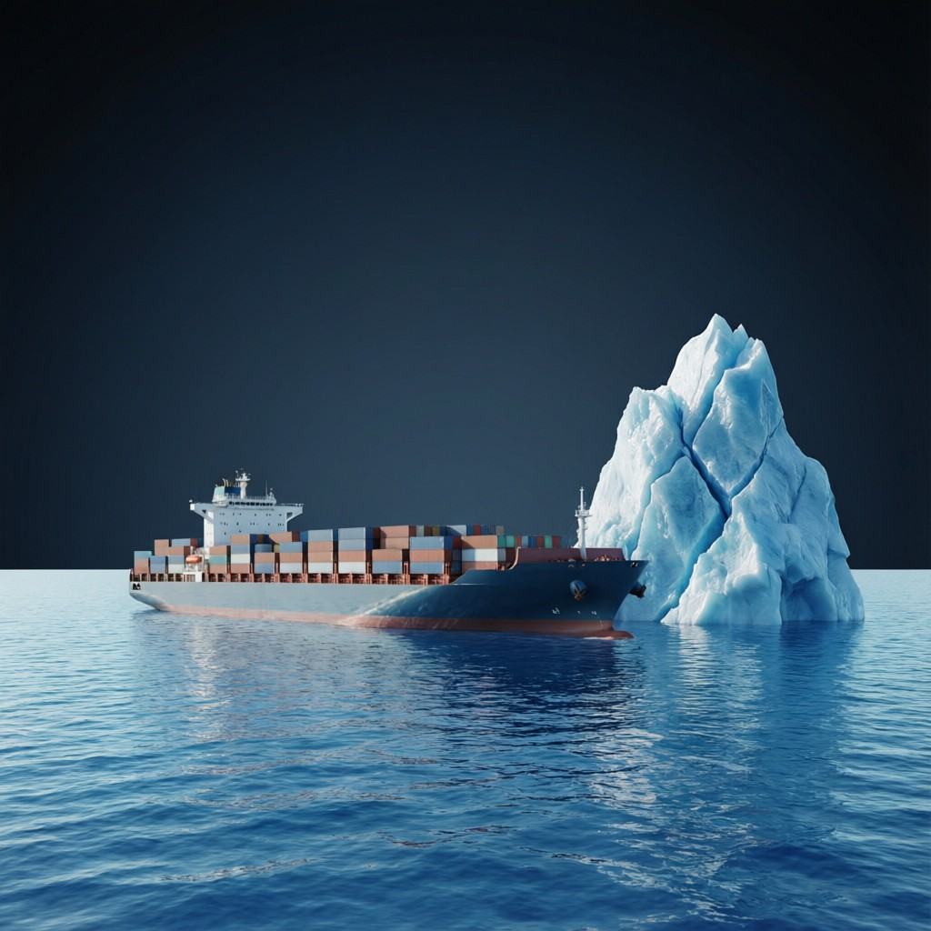
ICSE • CLASS 9 • FLUIDS
Upthrust & Archimedes
Buoyancy & upthrust • Why upthrust acts • Archimedes' principle • Float or sink

Slide 2
INTRODUCTION
Learning Objectives
1
Define buoyancy and upthrust
2
State the characteristic properties of upthrust
3
Explain why a liquid exerts an upthrust
4
State that upthrust equals the weight of displaced liquid
5
State and verify Archimedes' principle
6
Predict whether a body will float or sink
Notes:
Open by previewing these objectives so students know what they should be able to do by the end of the session.

Slide 3
PART 1
Buoyancy & Upthrust
1
The upward push of a fluid

Slide 4
UPTHRUST
Buoyancy and Upthrust
When a body is placed in a fluid, the fluid exerts an upward force on it called the upthrust or buoyant force.
• This is why objects feel lighter in water.
• It acts vertically upward through the centre of the displaced fluid.
• It is the reason ships float and balloons rise.
Notes:
Define upthrust as the upward push of a fluid. The 'lighter in water' experience is the hook.

Slide 5
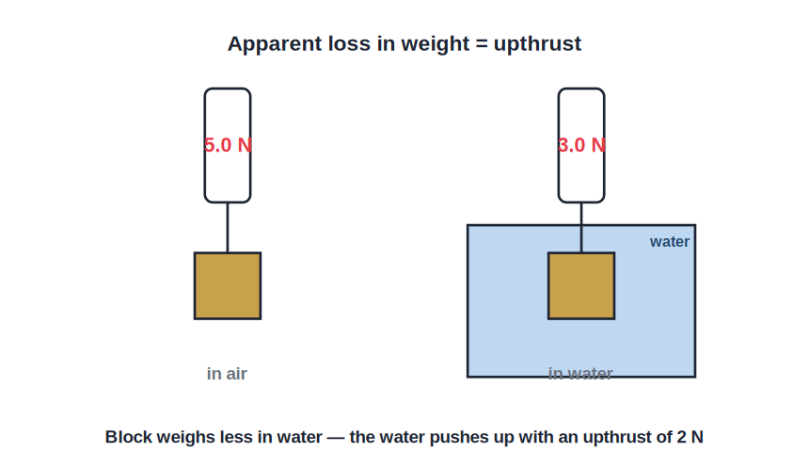
APPARENT WEIGHT
Apparent Loss of Weight
Weight lost = upthrust
• A body weighed in water reads less on a spring balance than in air.
• The apparent loss of weight equals the upthrust on the body.
• Example: 5 N in air but 3 N in water means a 2 N upthrust.
• The upthrust does not depend on the weight of the body — only on the fluid it displaces.
The balance reads less in water
Notes:
The apparent-weight-loss experiment defines and measures upthrust directly.

Slide 6

PROPERTIES
Characteristic Properties of Upthrust
Acts upward
More in denser fluids
Always vertically upward, opposite to the weight.
A denser fluid exerts a greater upthrust.
Depends on volume submerged
Independent of the body
More of the body submerged means more liquid displaced and more upthrust.
It does not depend on the body's own weight or material, only on the fluid displaced.
Notes:
The key properties. Upthrust depends on the fluid and the submerged volume, NOT on the object's weight.

Slide 7
WHY IT HAPPENS
Why a Fluid Exerts an Upthrust
A pressure difference top to bottom
• Pressure rises with depth The bottom of a submerged body is deeper than its top.
• Bigger push from below So the upward pressure on the base exceeds the downward pressure on the top.
• Net upward force This pressure difference gives a net upward force — the upthrust.
• Sideways cancels The sideways pressures on the body cancel out.
Notes:
The cause: greater pressure on the lower surface than the upper one. This pressure difference IS the upthrust.

Slide 8
WORKED EXAMPLE
Upthrust From Displaced Water
Problem. A body completely immersed in water displaces 250 cm³ of water. Find the upthrust on it. (density of water = 1 g/cm³, g = 10 m/s²)
Mass of water displaced = volume × density = 250 × 1 = 250 g = 0.25 kg
Weight of displaced water = m g = 0.25 × 10 = 2.5 N
Upthrust = weight of displaced water
Answer: Upthrust = 2.5 N
Notes:
Upthrust = weight of displaced water. Convert grams to kg before using g = 10.

Slide 9

BUOYANCY AROUND US
Buoyancy in Everyday Life
Swimming
Lifting in water
Water's upthrust supports much of our weight, so we feel light in a pool.
A heavy stone is easy to lift underwater but heavy once out of it.
Fish
Life jackets
Fish adjust a gas-filled swim bladder to rise or sink.
Filled with low-density material, they increase upthrust and keep us afloat.
Notes:
Relatable buoyancy examples to cement the concept before the quiz.

Slide 10
QUIZ 1
Check Your Understanding
4 questions • think before the answer reveals on the next slide

Slide 11
QUIZ QUESTION
Q1 — Lighter in Water
A stone weighs 8 N in air and 5 N when fully immersed in water. The upthrust on the stone is:
13 N
8 N
A
B
3 N
5 N
C
D

Slide 12
ANSWER REVEALED
Q1 — Lighter in Water
A stone weighs 8 N in air and 5 N when fully immersed in water. The upthrust on the stone is:
13 N
8 N
A
B
3 N
5 N
✓
D
WHY
Upthrust = apparent loss of weight = weight in air − weight in water = 8 − 5 = 3 N.

Slide 13
QUIZ QUESTION
Q2 — Why Upthrust?
A fluid pushes a submerged object upward because the pressure on the object is:
The same all over
Greater on the bottom (deeper) than on the top
A
B
Greater on the top
Only sideways
C
D

Slide 14
ANSWER REVEALED
Q2 — Why Upthrust?
A fluid pushes a submerged object upward because the pressure on the object is:
The same all over
Greater on the bottom (deeper) than on the top
A
✓
Greater on the top
Only sideways
C
D
WHY
Pressure increases with depth, so the upward push on the lower face is greater than the downward push on the upper face. This difference is the upthrust.

Slide 15
QUIZ QUESTION
Q3 — Denser Liquid
The same metal block is immersed fully first in water and then in a denser salt solution. The upthrust is:
Greater in water
Greater in the salt solution
A
B
The same in both
Zero in both
C
D

Slide 16
ANSWER REVEALED
Q3 — Denser Liquid
The same metal block is immersed fully first in water and then in a denser salt solution. The upthrust is:
Greater in water
Greater in the salt solution
A
✓
The same in both
Zero in both
C
D
WHY
Fully immersed, the block displaces the same volume in each, but the denser salt solution weighs more for that volume — so it exerts a greater upthrust.

Slide 17
QUIZ QUESTION
Q4 — Half Submerged
As a block is lowered further into water, the upthrust on it:
Decreases
Increases until it is fully submerged, then stays constant
A
B
Stays the same throughout
Becomes zero
C
D

Slide 18
ANSWER REVEALED
Q4 — Half Submerged
As a block is lowered further into water, the upthrust on it:
Decreases
Increases until it is fully submerged, then stays constant
A
✓
Stays the same throughout
Becomes zero
C
D
WHY
Upthrust depends on the volume of liquid displaced. As more of the block goes under, it displaces more water and the upthrust grows — until it is fully submerged, after which it no longer changes.

Slide 19
THREE CASES
Sink, Float or Hang Submerged
Weight > max upthrust
Weight = upthrust submerged
The body sinks (its density is greater than the fluid's).
The body floats fully submerged at any depth (densities equal).
Weight < max upthrust
The deciding factor
The body rises and floats partly out (its density is less than the fluid's).
Compare the body's density with the fluid's density.
Notes:
Three outcomes set by the density comparison: denser sinks, equal stays submerged, lighter floats partly out.

Slide 20
PART 2
Archimedes' Principle
2
Exactly how much upthrust?

Slide 21
ARCHIMEDES
Archimedes' Principle
When a body is wholly or partly immersed in a fluid, it experiences an upthrust equal to the weight of the fluid it displaces.
Upthrust = weight of the displaced fluid
• This puts an exact value on the upthrust.
• Displace more fluid → feel more upthrust.
• It explains floating, sinking and the apparent loss of weight.
Notes:
Archimedes' principle quantifies upthrust. Everything about floating and sinking follows from it.

Slide 22
VERIFICATION
Verifying Archimedes' Principle
The overflow-can experiment
• Weigh a solid in air using a spring balance.
• Lower it into an overflow (eureka) can full to the spout, catching the overflow.
• Note the new (smaller) reading while it is immersed.
• Weigh the water that overflowed.
• The loss in weight equals the weight of the displaced water — Archimedes' principle confirmed.
Notes:
Walk through the eureka-can experiment showing loss of weight = weight of displaced water.

Slide 23
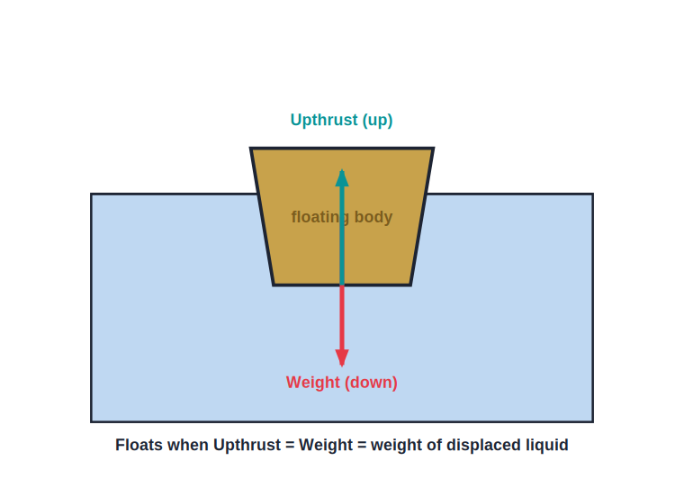
FLOAT OR SINK
Float or Sink?
Weight vs upthrust
• Compare the weight of the body with the maximum upthrust (when fully submerged).
• If the upthrust can equal the weight, the body floats.
• If the weight is greater than the largest possible upthrust, it sinks.
• A body floats if its average density is less than the fluid's.
Floats when upthrust can balance the weight
Notes:
The float/sink rule via density: lighter-than-fluid floats, denser sinks. Leads into density next lesson.

Slide 24
WRAP UP
Quick Recap
✓ Upthrust — the upward (buoyant) force a fluid exerts
✓ Apparent loss — weight in air − weight in fluid = upthrust
✓ Cause — greater pressure on the lower face than the upper face
✓ Archimedes — upthrust = weight of fluid displaced
✓ Verification — eureka can: loss of weight = weight of overflow
✓ Float/sink — floats if average density < fluid density
Notes:
Rapid recap; Archimedes' principle is the central result.

Slide 25
QUIZ 2
Final Check — Archimedes
6 questions • think before the answer reveals on the next slide

Slide 26
QUIZ QUESTION
Q1 — How Much Upthrust?
A body displaces 200 g of water when immersed. The upthrust on it equals the weight of:
200 g of the body
200 g of water
A
B
The whole body
The container
C
D

Slide 27
ANSWER REVEALED
Q1 — How Much Upthrust?
A body displaces 200 g of water when immersed. The upthrust on it equals the weight of:
200 g of the body
200 g of water
A
✓
The whole body
The container
C
D
WHY
By Archimedes' principle the upthrust equals the weight of the displaced fluid — here, the weight of 200 g of water.

Slide 28
QUIZ QUESTION
Q2 — Eureka Can
In the overflow-can experiment, the weight of water collected from the spout is found to equal the:
Weight of the body in air
Apparent loss in weight of the body
A
B
Weight of the can
Volume of the body
C
D

Slide 29
ANSWER REVEALED
Q2 — Eureka Can
In the overflow-can experiment, the weight of water collected from the spout is found to equal the:
Weight of the body in air
Apparent loss in weight of the body
A
✓
Weight of the can
Volume of the body
C
D
WHY
The water pushed out weighs exactly the same as the apparent loss in the body's weight — a direct confirmation of Archimedes' principle.

Slide 30
QUIZ QUESTION
Q3 — Iron vs Ship
A solid lump of iron sinks, yet a ship made of iron floats. This is because the ship:
Is lighter than the iron lump
Is hollow, so it displaces a large weight of water for its weight
A
B
Is made of special iron
Has an engine
C
D

Slide 31
ANSWER REVEALED
Q3 — Iron vs Ship
A solid lump of iron sinks, yet a ship made of iron floats. This is because the ship:
Is lighter than the iron lump
Is hollow, so it displaces a large weight of water for its weight
A
✓
Is made of special iron
Has an engine
C
D
WHY
The ship's hollow shape lets it push aside a large volume — and hence weight — of water. When that displaced weight equals the ship's weight, the upthrust balances it and the ship floats.

Slide 32
QUIZ QUESTION
Q4 — Same Volume
A block of wood and a block of iron have the same volume and are fully submerged in water. The upthrust on them is:
Greater on the iron
Greater on the wood
A
B
The same on both
Zero on the wood
C
D

Slide 33
ANSWER REVEALED
Q4 — Same Volume
A block of wood and a block of iron have the same volume and are fully submerged in water. The upthrust on them is:
Greater on the iron
Greater on the wood
A
B
The same on both
Zero on the wood
✓
D
WHY
Fully submerged, both displace the same volume of water, so Archimedes' principle gives them the same upthrust — even though the iron is far heavier and will sink.

Slide 34
QUIZ QUESTION
Q5 — Floating Balance
A wooden block floats at rest on water. The upthrust on it is:
Greater than its weight
Less than its weight
A
B
Exactly equal to its weight
Zero
C
D

Slide 35
ANSWER REVEALED
Q5 — Floating Balance
A wooden block floats at rest on water. The upthrust on it is:
Greater than its weight
Less than its weight
A
B
Exactly equal to its weight
Zero
✓
D
WHY
A floating body is in equilibrium, so the upward upthrust must exactly balance its downward weight — it sinks just far enough to displace its own weight of water.

Slide 36
QUIZ QUESTION
Q6 — Will It Stay Submerged?
A sealed ball has exactly the same density as water. Released under the surface, it will:
Shoot to the surface
Sink to the bottom
A
B
Stay floating at whatever depth it is left (fully submerged)
Dissolve
C
D

Slide 37
ANSWER REVEALED
Q6 — Will It Stay Submerged?
A sealed ball has exactly the same density as water. Released under the surface, it will:
Shoot to the surface
Sink to the bottom
A
B
Stay floating at whatever depth it is left (fully submerged)
Dissolve
✓
D
WHY
When a body's density equals the fluid's, its weight exactly equals the upthrust while fully submerged. The forces balance at any depth, so it neither rises nor sinks.

Slide 38
Why Ships Float
Archimedes' principle — upthrust equals the weight of fluid displaced — explains everything from a floating cork to a steel ship.

