Slide 1
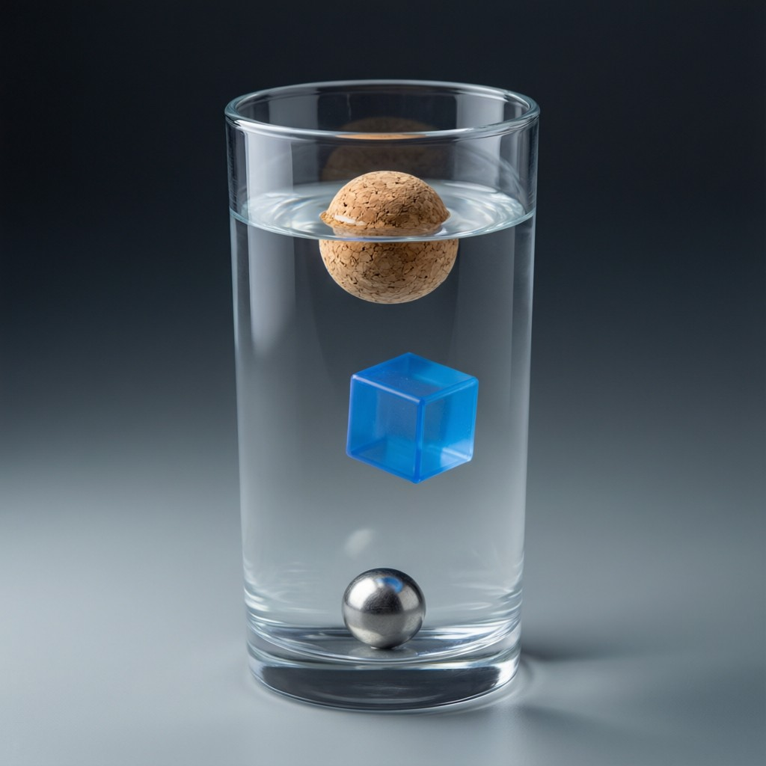
ICSE • CLASS 9 • FLUIDS
Density & Floatation
Density • Relative density • Measuring R.D. • The principle of floatation

Slide 2
INTRODUCTION
Learning Objectives
1
Define density and its units
2
Define relative density
3
Determine the relative density of a solid
4
Determine the relative density of a liquid
5
State the principle of floatation
6
Explain everyday applications of floatation
Notes:
Open by previewing these objectives so students know what they should be able to do by the end of the session.

Slide 3
PART 1
Density & Relative Density
1
How heavy a material is for its size

Slide 4
DENSITY
Density
Density is the mass of a substance per unit volume.
Density = mass / volume (unit: kg/m³ or g/cm³)
• Water has a density of 1000 kg/m³ (1 g/cm³).
• A denser material packs more mass into the same volume.
• Density decides whether a material sinks or floats in a fluid.
Notes:
Define density = mass/volume. Water's value (1 g/cm³) is the reference everything is compared with.

Slide 5
WORKED EXAMPLE
Calculating Density
Problem. A metal block has a mass of 270 g and a volume of 100 cm³. Find its density.
Density = mass / volume
Density = 270 / 100
Density = 2.7 g/cm³
Answer: Density = 2.7 g/cm³ (this is aluminium)
Notes:
Simple substitution. 2.7 g/cm³ identifies aluminium — link density to identifying materials.

Slide 6
RELATIVE DENSITY
Relative Density
Relative density (R.D.) compares the density of a substance with the density of water.
R.D. = density of substance / density of water
• It is a pure ratio, so it has no unit.
• R.D. = mass of substance / mass of an equal volume of water.
• R.D. greater than 1 sinks in water; less than 1 floats.
Notes:
Relative density is a unitless ratio against water. >1 sinks, <1 floats — a quick float/sink test.

Slide 7
R.D. OF A SOLID
Finding the R.D. of a Solid
Using the apparent loss of weight
• Weigh the solid in air (W₁).
• Weigh it again fully immersed in water (W₂).
• The loss in weight (W₁ − W₂) equals the weight of water displaced.
• R.D. = weight in air / loss of weight in water = W₁ / (W₁ − W₂).
Notes:
The R.D. of a solid comes straight from Archimedes: weight in air over the loss of weight in water.

Slide 8
WORKED EXAMPLE
Relative Density of a Solid
Problem. A piece of metal weighs 60 gf in air and 40 gf when fully immersed in water. Find its relative density.
Loss of weight in water = 60 − 40 = 20 gf
R.D. = weight in air / loss of weight in water
R.D. = 60 / 20 = 3
Answer: Relative density = 3 (no unit)
Notes:
Apply R.D. = weight in air / loss in water. The answer is a pure number, three times as dense as water.

Slide 9
R.D. OF A LIQUID
Finding the R.D. of a Liquid
Comparing losses of weight
• Take a solid that sinks in both the liquid and water.
• Find its loss of weight in the liquid and its loss of weight in water.
• R.D. of liquid = loss of weight in liquid / loss of weight in water.
• Because the same solid displaces the same volume in each.
Notes:
For a liquid's R.D., compare the upthrust (loss of weight) it gives with that of water on the same solid.

Slide 10
QUIZ 1
Check Your Understanding
4 questions • think before the answer reveals on the next slide

Slide 11
QUIZ QUESTION
Q1 — Will It Float?
A material has a relative density of 0.8. Placed in water, it will:
Sink to the bottom
Float with part above the surface
A
B
Dissolve
Stay fully submerged in the middle
C
D

Slide 12
ANSWER REVEALED
Q1 — Will It Float?
A material has a relative density of 0.8. Placed in water, it will:
Sink to the bottom
Float with part above the surface
A
✓
Dissolve
Stay fully submerged in the middle
C
D
WHY
R.D. less than 1 means the material is less dense than water, so it floats — sinking just enough to displace its own weight, with the rest above the surface.

Slide 13
QUIZ QUESTION
Q2 — Find R.D.
A solid weighs 50 N in air and 40 N in water. Its relative density is:
0.8
1.25
A
B
5
10
C
D

Slide 14
ANSWER REVEALED
Q2 — Find R.D.
A solid weighs 50 N in air and 40 N in water. Its relative density is:
0.8
1.25
A
B
5
10
✓
D
WHY
R.D. = weight in air / loss of weight = 50 / (50 − 40) = 50/10 = 5. The solid is five times as dense as water.

Slide 15
QUIZ QUESTION
Q3 — No Units
Relative density has no unit because it is:
A very small number
A ratio of two densities
A
B
Measured in kg/m³
Always equal to 1
C
D

Slide 16
ANSWER REVEALED
Q3 — No Units
Relative density has no unit because it is:
A very small number
A ratio of two densities
A
✓
Measured in kg/m³
Always equal to 1
C
D
WHY
R.D. compares a substance's density with water's density. Dividing one density by another cancels the units, leaving a pure number.

Slide 17
QUIZ QUESTION
Q4 — Densest Sinks
Three liquids that do not mix settle in layers in a jar. The liquid at the very bottom has the:
Lowest density
Highest density
A
B
Least mass
Largest volume
C
D

Slide 18
ANSWER REVEALED
Q4 — Densest Sinks
Three liquids that do not mix settle in layers in a jar. The liquid at the very bottom has the:
Lowest density
Highest density
A
✓
Least mass
Largest volume
C
D
WHY
The densest liquid sinks below the others, so the bottom layer is always the one with the greatest density.

Slide 19
PART 2
The Principle of Floatation
2
When and how things float

Slide 20
FLOATATION
The Principle of Floatation
A floating body displaces a weight of fluid exactly equal to its own weight.
Weight of body = weight of fluid displaced
• A body floats when it can displace its own weight of fluid before being fully submerged.
• It floats higher in a denser fluid (less of it submerged).
• This is a special case of Archimedes' principle for a floating body.
Notes:
The floatation principle: a floating body displaces its own weight of fluid. Denser fluid → floats higher.

Slide 21
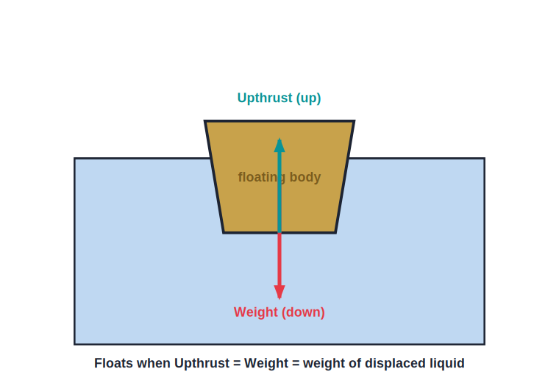
FORCES
Balanced Forces on a Floating Body
Weight = Upthrust
• A floating body is in equilibrium: two forces balance.
• Its weight acts downward through its centre of gravity.
• The upthrust acts upward and equals the weight.
• It sinks only until the displaced fluid weighs as much as the body.
Equilibrium of a floating body
Notes:
Two balanced forces: weight down, upthrust up. The body settles at the depth where they are equal.

Slide 22
HOW MUCH SUBMERGED
Fraction of a Floating Body Submerged
The fraction of a floating body that lies below the surface equals the ratio of its density to the fluid's density.
submerged fraction = ρ(body) / ρ(fluid)
• Ice (ρ ≈ 0.9) in water floats with about 0.9 of it submerged.
• A body of density 0.6 g/cm³ floats with 60% under water.
• It follows directly from weight = weight of displaced fluid.
Notes:
Submerged fraction = density ratio. This explains the iceberg and lets students predict how high a body floats.

Slide 23
WORKED EXAMPLE
Fraction of Wood Submerged
Problem. A block of wood of density 0.6 g/cm³ floats in water (1.0 g/cm³). What fraction of its volume is under water?
submerged fraction = ρ(wood) / ρ(water)
= 0.6 / 1.0
= 0.6
Answer: 0.6 (60%) of the block is below the surface; 40% shows above
Notes:
Apply submerged fraction = density ratio. 60% under, 40% above — a quick check on floatation.

Slide 24
LIGHT SOLID
R.D. of a Solid Lighter Than Water
The sinker method
• The problem A solid that floats cannot simply be weighed fully immersed — it will not stay under.
• Use a sinker Attach a heavy sinker so the solid is dragged fully under water.
• Weigh in stages Find the loss of weight with only the sinker immersed, then with both immersed.
• Get the R.D. The extra loss of weight is the upthrust on the solid alone, giving its R.D.
Notes:
For a solid lighter than water, a sinker keeps it submerged; the extra loss of weight gives the upthrust on the solid alone.

Slide 25

APPLICATIONS
Applications of Floatation
Ships
Submarines
A steel ship is hollow, so it displaces a huge weight of water and floats.
Fill tanks with water to dive (sink), empty them with air to surface.
Hydrometer
Hot-air balloons
A floating instrument that measures the density of a liquid by how deep it sinks.
Float in air because the hot air inside is less dense than the cool air outside.
Notes:
Each application uses floatation. The submarine's ballast tanks and the hydrometer are commonly examined.

Slide 26
WRAP UP
Quick Recap
✓ Density — mass / volume; water is 1 g/cm³
✓ Relative density — density ÷ density of water; no unit
✓ R.D. of solid — weight in air / loss of weight in water
✓ R.D. of liquid — loss in liquid / loss in water (same solid)
✓ Floatation — a floating body displaces its own weight of fluid
✓ Applications — ships, submarines, hydrometer, balloons
Notes:
Rapid recap; the floatation principle and the R.D. formulae are the key results.

Slide 27
QUIZ 2
Final Check — Density & Floatation
5 questions • think before the answer reveals on the next slide

Slide 28
QUIZ QUESTION
Q1 — Floating Weight
A boat of weight 5000 N floats on a lake. The weight of water it displaces is:
Less than 5000 N
Exactly 5000 N
A
B
More than 5000 N
Zero
C
D

Slide 29
ANSWER REVEALED
Q1 — Floating Weight
A boat of weight 5000 N floats on a lake. The weight of water it displaces is:
Less than 5000 N
Exactly 5000 N
A
✓
More than 5000 N
Zero
C
D
WHY
By the principle of floatation a floating body displaces a weight of fluid equal to its own weight — so the boat displaces exactly 5000 N of water.

Slide 30
QUIZ QUESTION
Q2 — Sea vs River
A ship floats slightly higher in the sea than in a river because sea water is:
Less dense
Denser, so less of the ship needs to be submerged
A
B
Colder
Saltier but lighter
C
D

Slide 31
ANSWER REVEALED
Q2 — Sea vs River
A ship floats slightly higher in the sea than in a river because sea water is:
Less dense
Denser, so less of the ship needs to be submerged
A
✓
Colder
Saltier but lighter
C
D
WHY
Sea water is denser than river water, so a smaller submerged volume displaces the ship's weight. The ship therefore rides a little higher in the sea.

Slide 32
QUIZ QUESTION
Q3 — Submarine Dives
A submarine dives by:
Becoming lighter
Letting water into its ballast tanks to increase its weight
A
B
Pumping in air
Speeding up
C
D

Slide 33
ANSWER REVEALED
Q3 — Submarine Dives
A submarine dives by:
Becoming lighter
Letting water into its ballast tanks to increase its weight
A
✓
Pumping in air
Speeding up
C
D
WHY
Flooding the tanks increases the submarine's weight beyond the upthrust, so it sinks. To surface, compressed air pushes the water out, making it lighter again.

Slide 34
QUIZ QUESTION
Q4 — Hydrometer
A hydrometer floats deeper in liquid A than in liquid B. This shows that liquid A is:
Denser than B
Less dense than B
A
B
The same as B
Not a liquid
C
D

Slide 35
ANSWER REVEALED
Q4 — Hydrometer
A hydrometer floats deeper in liquid A than in liquid B. This shows that liquid A is:
Denser than B
Less dense than B
A
✓
The same as B
Not a liquid
C
D
WHY
A hydrometer sinks further in a less dense liquid (which gives less upthrust per unit volume). Sinking deeper in A means A is the lower-density liquid.

Slide 36
QUIZ QUESTION
Q5 — Iceberg
About nine-tenths of an iceberg lies below the water surface because the density of ice (0.9 g/cm³) is:
Much less than water
Just below that of water, so most of it must submerge to displace its weight
A
B
Greater than water
Equal to water
C
D

Slide 37
ANSWER REVEALED
Q5 — Iceberg
About nine-tenths of an iceberg lies below the water surface because the density of ice (0.9 g/cm³) is:
Much less than water
Just below that of water, so most of it must submerge to displace its weight
A
✓
Greater than water
Equal to water
C
D
WHY
Ice is only slightly less dense than water (0.9 vs 1.0), so it must sink until about 90% is underwater to displace a weight of water equal to its own — leaving just a tenth showing.

Slide 38
Float, Sink, or Sail
Density and the principle of floatation decide whether something bobs like a cork or sinks like a stone.

