Slide 1
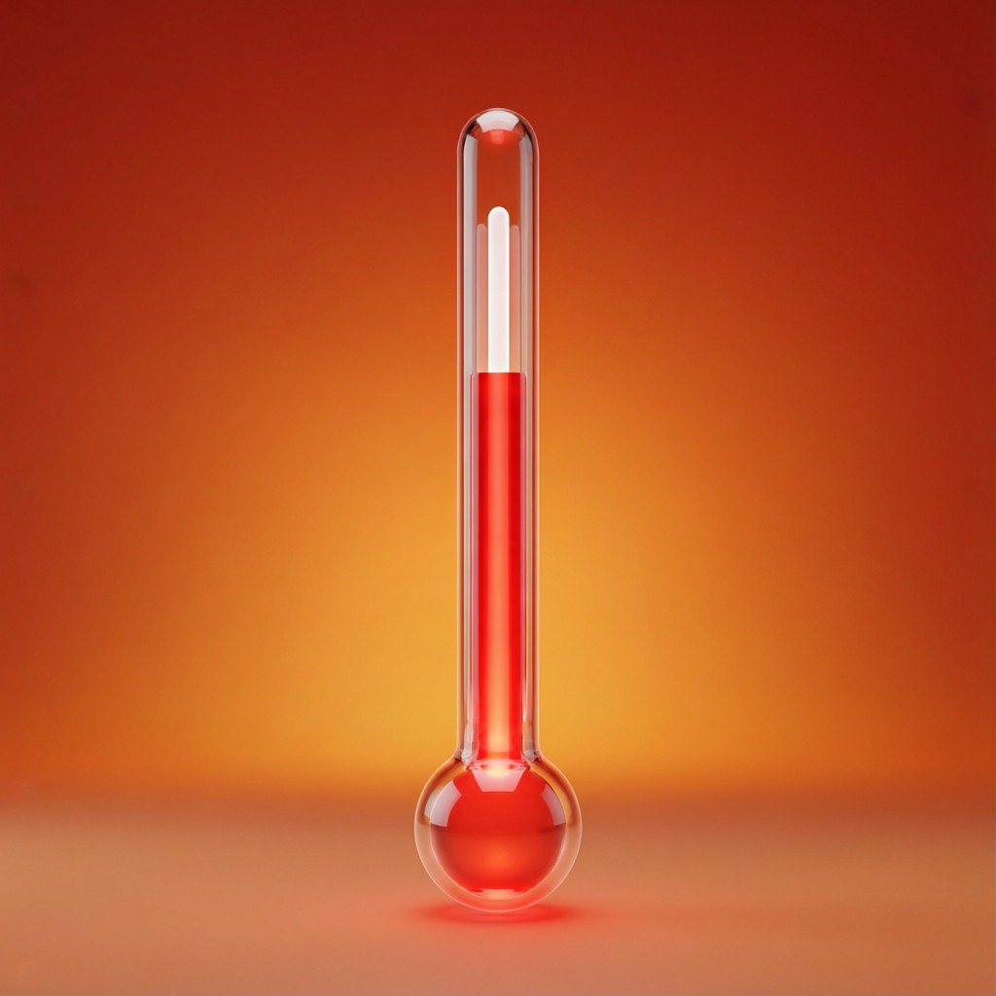
ICSE • CLASS 9 • HEAT
Heat, Temperature & Expansion
Heat vs temperature • Thermal expansion • Anomalous expansion of water • Energy flow

Slide 2
INTRODUCTION
Learning Objectives
1
Distinguish heat from temperature
2
Describe thermal expansion of solids, liquids and gases
3
Explain the anomalous expansion of water
4
Describe Hope's experiment
5
State the consequences of water's anomalous expansion
6
Outline the flow of energy in an ecosystem
Notes:
Open by previewing these objectives so students know what they should be able to do by the end of the session.

Slide 3
PART 1
Heat, Temperature & Expansion
1
Energy on the move, and what it does to matter

Slide 4



TWO IDEAS
Heat vs Temperature
Heat
Temperature
A form of energy that flows from a hotter to a colder body; measured in joules.
The degree of hotness that decides the direction of heat flow; measured in °C or K.
Total vs average
Different things
Heat is total thermal energy; temperature is the average energy per molecule.
A bucket of warm water holds more heat than a spark, though the spark is hotter.
Notes:
Separate heat (energy) from temperature (hotness). The bucket-vs-spark example is the clearest.

Slide 5

EXPANSION
Thermal Expansion
Solids
Liquids
Expand the least on heating; rails and bridges are given gaps to allow for it.
Expand more than solids; the basis of liquid-in-glass thermometers.
Gases
Why it happens
Expand the most of all for the same temperature rise.
Heating makes molecules vibrate more and move further apart.
Notes:
Order of expansion: gases > liquids > solids. Heating increases molecular separation.

Slide 6
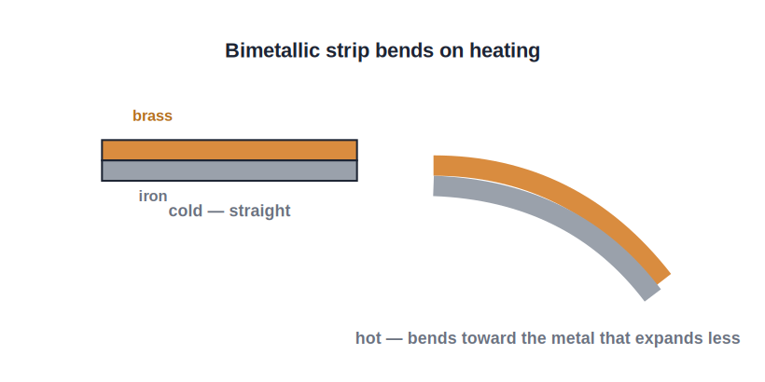
APPLICATIONS
Using and Allowing for Expansion
The bimetallic strip
• A bimetallic strip bends on heating because two metals expand by different amounts.
• It is used in thermostats to switch heating circuits on and off.
• Gaps are left between railway lines and in bridges to allow for expansion.
• Overhead wires are strung loosely so they do not snap when they contract in winter.
Two metals expand differently, so the strip bends
Notes:
The bimetallic strip is the key application — bending from unequal expansion runs thermostats.

Slide 7
USE & CARE
Expansion: Where It Helps and Where It Harms
Shrink-fitting
Thermostats
A hot metal rim or ring is slipped on, then grips tightly as it cools and contracts.
A bimetallic strip bends with temperature to switch an iron or heater on and off.
Bridges & rails
Pipes & wires
Expansion gaps and roller supports stop them buckling in hot weather.
Loops in pipes and slack in wires allow for expansion and contraction.
Notes:
Expansion is both useful (shrink-fitting, thermostats) and a hazard to design around (bridges, rails, pipes).

Slide 8
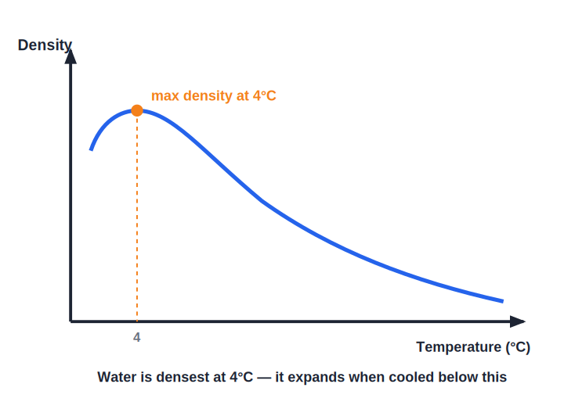
ANOMALOUS WATER
The Anomalous Expansion of Water
Densest at 4°C
• Most substances expand steadily as they are heated.
• Water is unusual: between 0°C and 4°C it CONTRACTS as it warms.
• Above 4°C it expands normally.
• So water has its maximum density at 4°C.
Water contracts from 0°C to 4°C, then expands
Notes:
Water's odd behaviour: densest at 4°C. This single fact explains why ice floats and ponds freeze top-down.

Slide 9
HOPE'S EXPERIMENT
Hope's Experiment
Demonstrating maximum density at 4°C
• The setup A tall jar of water is surrounded at the middle by a freezing mixture.
• Two thermometers One near the top and one near the bottom of the jar.
• What is seen The bottom cools to 4°C first; later the top cools to 0°C and freezes.
• What it proves Water at 4°C is densest and sinks, so freezing starts at the top.
Notes:
Hope's experiment proves water is densest at 4°C: the 4°C water sinks, and ice forms at the top.

Slide 10
QUIZ 1
Check Your Understanding
5 questions • think before the answer reveals on the next slide

Slide 11
QUIZ QUESTION
Q1 — Hotter or More Heat
A mug of tea at 80°C and a bucket of water at 40°C — which holds more heat energy?
The tea
The bucket of water
A
B
Both the same
Neither holds heat
C
D

Slide 12
ANSWER REVEALED
Q1 — Hotter or More Heat
A mug of tea at 80°C and a bucket of water at 40°C — which holds more heat energy?
The tea
The bucket of water
A
✓
Both the same
Neither holds heat
C
D
WHY
Temperature tells you how hot something is, but heat depends also on mass. The large mass of bucket water stores more thermal energy than the small, hotter mug of tea.

Slide 13
QUIZ QUESTION
Q2 — Gaps in Rails
Small gaps are left between sections of railway line so that, on a hot day, the rails can:
Contract safely
Expand without buckling
A
B
Conduct electricity
Stay cool
C
D

Slide 14
ANSWER REVEALED
Q2 — Gaps in Rails
Small gaps are left between sections of railway line so that, on a hot day, the rails can:
Contract safely
Expand without buckling
A
✓
Conduct electricity
Stay cool
C
D
WHY
Metals expand when heated. The gaps give the rails room to lengthen on a hot day; without them the rails would push against each other and buckle.

Slide 15
QUIZ QUESTION
Q3 — Densest Water
Water has its maximum density at a temperature of:
0°C
4°C
A
B
10°C
100°C
C
D

Slide 16
ANSWER REVEALED
Q3 — Densest Water
Water has its maximum density at a temperature of:
0°C
4°C
A
✓
10°C
100°C
C
D
WHY
Because water contracts from 0°C up to 4°C and then expands, it is at its densest at 4°C — the heart of its anomalous behaviour.

Slide 17
QUIZ QUESTION
Q4 — Bimetallic Strip
A bimetallic strip is able to bend when heated because the two metals have different:
Colours
Amounts of expansion
A
B
Masses
Melting points
C
D

Slide 18
ANSWER REVEALED
Q4 — Bimetallic Strip
A bimetallic strip is able to bend when heated because the two metals have different:
Colours
Amounts of expansion
A
✓
Masses
Melting points
C
D
WHY
The two bonded metals expand by different amounts for the same temperature rise. The one that expands more forces the strip to curve toward the other — used in thermostats.

Slide 19
QUIZ QUESTION
Q5 — Which Expands Most?
For the same rise in temperature, which expands the most?
A solid
A liquid
A
B
A gas
All the same
C
D

Slide 20
ANSWER REVEALED
Q5 — Which Expands Most?
For the same rise in temperature, which expands the most?
A solid
A liquid
A
B
A gas
All the same
✓
D
WHY
Gases expand far more than liquids, and liquids more than solids, for the same temperature rise — because gas molecules are free to move much further apart.

Slide 21
PART 2
Consequences & Energy Flow
2
Why ponds freeze from the top, and how energy moves

Slide 22
CONSEQUENCES
Consequences of Anomalous Expansion
Ice floats
Ponds freeze top-down
Ice is less dense than water, so it floats on the surface.
A layer of ice forms on top while water below stays liquid.
Aquatic life survives
Pipes burst
The ice insulates the water beneath, so fish live through winter.
Water expanding as it freezes can crack water pipes.
Notes:
All follow from water being densest at 4°C and ice being less dense. Life under ice is the headline consequence.

Slide 23
ENERGY FLOW
Energy Flow in an Ecosystem
Sun → plants → animals
• The Sun Almost all energy on Earth comes from the Sun.
• Producers Green plants capture solar energy by photosynthesis.
• Consumers Animals get energy by eating plants or other animals.
• One-way flow Energy flows from the Sun → producers → consumers, and only about 10% passes to each next level.
Notes:
Energy flows one way through food chains, with large losses at each step — the 10% rule.

Slide 24
THERMODYNAMICS
Energy Is Conserved but Degrades
Conservation and degradation
• First law Energy can be transformed but never created or destroyed.
• Always transforming In every process energy changes form, e.g. food energy → movement + heat.
• Degradation At each change some energy spreads out as low-grade heat that cannot be fully reused.
• Why it matters This is why no machine is 100% efficient.
Notes:
First law: energy is conserved. But it degrades to useless heat, limiting efficiency — links to energy degradation in lesson 3.

Slide 25
WRAP UP
Quick Recap
✓ Heat vs temperature — energy that flows vs degree of hotness
✓ Expansion — gases > liquids > solids; allowed for in rails/bridges
✓ Anomalous water — contracts 0–4°C; densest at 4°C
✓ Hope's experiment — shows water is densest at 4°C
✓ Consequences — ice floats; ponds freeze top-down; life survives
✓ Energy flow — Sun → producers → consumers; energy degrades
Notes:
Rapid recap; anomalous expansion and its consequences are the exam favourites.

Slide 26
QUIZ 2
Final Check — Water & Energy
5 questions • think before the answer reveals on the next slide

Slide 27
QUIZ QUESTION
Q1 — Frozen Pond
Fish survive in a pond whose surface has frozen because:
Ice sinks and warms the bottom
Ice floats on top and insulates the liquid water below
A
B
Fish do not need oxygen
The whole pond turns solid
C
D

Slide 28
ANSWER REVEALED
Q1 — Frozen Pond
Fish survive in a pond whose surface has frozen because:
Ice sinks and warms the bottom
Ice floats on top and insulates the liquid water below
A
✓
Fish do not need oxygen
The whole pond turns solid
C
D
WHY
Because ice is less dense it floats, and this surface layer insulates the water beneath. That water stays liquid (around 4°C), letting fish survive the winter.

Slide 29
QUIZ QUESTION
Q2 — Cooling Water
A beaker of water at 10°C is cooled. As its temperature falls toward 4°C, the water:
Expands
Contracts and becomes denser
A
B
Boils
Stays the same volume
C
D

Slide 30
ANSWER REVEALED
Q2 — Cooling Water
A beaker of water at 10°C is cooled. As its temperature falls toward 4°C, the water:
Expands
Contracts and becomes denser
A
✓
Boils
Stays the same volume
C
D
WHY
From 10°C down to 4°C water behaves normally, contracting as it cools and reaching maximum density at 4°C. Only below 4°C does it start to expand again.

Slide 31
QUIZ QUESTION
Q3 — Energy Loss
Only about 10% of the energy at one level of a food chain reaches the next level. The rest is mostly:
Created anew
Lost as heat and used in life processes
A
B
Stored forever
Turned into matter
C
D

Slide 32
ANSWER REVEALED
Q3 — Energy Loss
Only about 10% of the energy at one level of a food chain reaches the next level. The rest is mostly:
Created anew
Lost as heat and used in life processes
A
✓
Stored forever
Turned into matter
C
D
WHY
Most energy is used up in respiration, movement and staying warm, escaping as low-grade heat. Only a small fraction is stored and passed on — hence short food chains.

Slide 33
QUIZ QUESTION
Q4 — No 100% Machine
No machine can be 100% efficient because, in every energy change, some energy:
Is destroyed
Degrades into low-grade heat that cannot be fully reused
A
B
Turns into mass
Disappears completely
C
D

Slide 34
ANSWER REVEALED
Q4 — No 100% Machine
No machine can be 100% efficient because, in every energy change, some energy:
Is destroyed
Degrades into low-grade heat that cannot be fully reused
A
✓
Turns into mass
Disappears completely
C
D
WHY
Energy is conserved, but at each transformation some of it spreads out as low-grade heat that cannot all be recovered. This degradation caps the efficiency of every machine.

Slide 35
QUIZ QUESTION
Q5 — Burst Pipe
Water pipes can burst in freezing weather because water:
Contracts as it freezes
Expands as it freezes
A
B
Evaporates
Gets heavier
C
D

Slide 36
ANSWER REVEALED
Q5 — Burst Pipe
Water pipes can burst in freezing weather because water:
Contracts as it freezes
Expands as it freezes
A
✓
Evaporates
Gets heavier
C
D
WHY
Unlike most liquids, water expands on freezing. Confined in a pipe, the growing ice pushes outward with great force and can split the pipe.

Slide 37
Heat, Water and Energy
Water's strange expansion keeps fish alive under the ice — and every joule of energy, though conserved, slowly degrades to heat.

