Slide 1
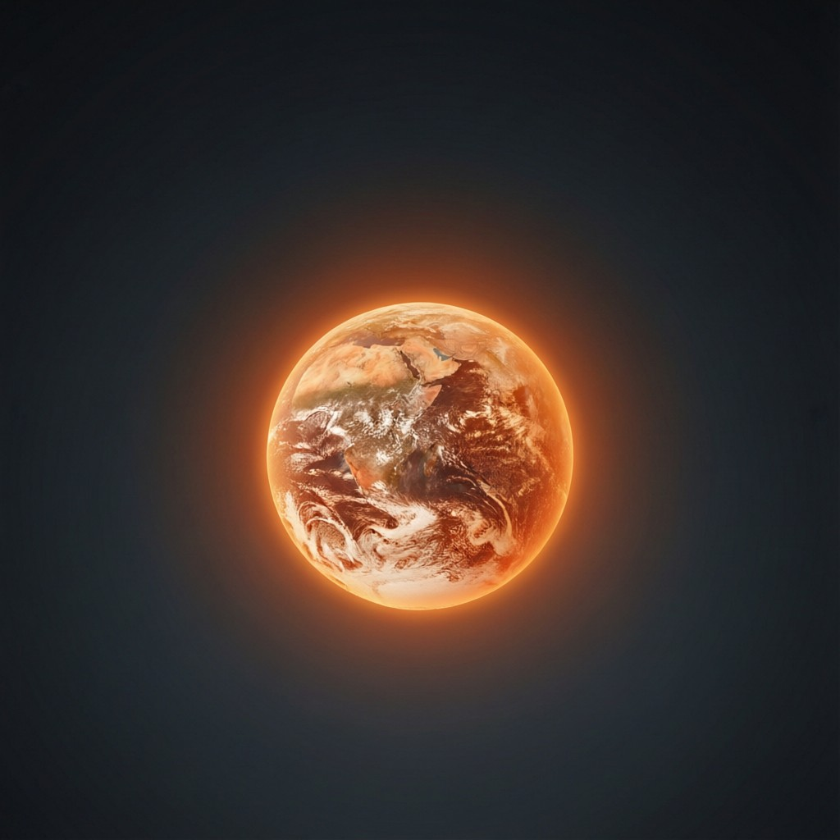
ICSE • CLASS 9 • ENERGY
Energy & the Environment
Wind, water & nuclear energy • Energy degradation • Greenhouse effect • Global warming

Slide 2
INTRODUCTION
Learning Objectives
1
Describe how wind and water energy generate electricity
2
Outline how nuclear energy is produced
3
Explain energy degradation
4
Explain the greenhouse effect
5
Describe the causes and effects of global warming
6
Suggest ways to reduce global warming
Notes:
Open by previewing these objectives so students know what they should be able to do by the end of the session.

Slide 3
PART 1
Wind, Water & Nuclear Energy
1
Three more ways to generate power

Slide 4


WIND
Wind Energy
How it works
Wind farms
Moving air turns the blades of a wind turbine, which drives a generator.
Many turbines together form a wind farm.
Clean & renewable
Limitation
It burns no fuel and produces no pollution.
It works only where winds are strong and steady.
Notes:
Wind turns turbines to make electricity — clean but dependent on the wind.

Slide 5

WATER
Water (Hydro) Energy
Hydroelectricity
Tidal energy
Water stored behind a dam falls and spins turbines to make electricity.
The rise and fall of tides drives generators.
Renewable
Big projects
The water cycle constantly replenishes the supply.
Dams are costly to build and affect local environments.
Notes:
Hydro uses falling/tidal water. Renewable and powerful, but dams have environmental costs.

Slide 6
NUCLEAR
Nuclear Energy
Energy from the atom
• Nuclear fission Splitting heavy atoms (like uranium) releases an enormous amount of energy.
• In a reactor The heat boils water to steam, which spins turbines to generate electricity.
• Very concentrated A tiny amount of fuel yields a huge amount of energy.
• The drawback It produces dangerous radioactive waste that must be stored safely.
Notes:
Nuclear fission releases vast energy from little fuel, but radioactive waste is the major problem.

Slide 7
FUSION VS FISSION
Two Kinds of Nuclear Energy
Splitting vs joining nuclei
• Fission A heavy nucleus (uranium) splits into lighter ones, releasing energy — used in today's reactors.
• Fusion Light nuclei (hydrogen) join to form a heavier one, releasing even more energy — this powers the Sun.
• Fuel and waste Fission needs rare uranium and leaves radioactive waste; fusion's fuel (hydrogen) is abundant and cleaner.
• The challenge Controlled fusion needs enormous temperatures and is still being developed on Earth.
Notes:
Distinguish fission (splitting, used now) from fusion (joining, powers the Sun, future clean energy).

Slide 8
DEGRADATION
Energy Degradation
Each time energy is used or changed, some of it turns into low-grade heat that spreads out and cannot be usefully recovered.
• Energy is conserved in total, but its usefulness falls.
• High-grade energy (electricity, fuel) degrades to low-grade heat.
• This is why we must keep finding fresh energy sources.
Notes:
Energy degradation: total energy is conserved but its quality falls to useless heat. Motivates conservation.

Slide 9
CONVENTIONAL VS NOT
Conventional and Non-Conventional Sources
Conventional
Non-conventional
Long-used sources: coal, petroleum, natural gas and hydroelectricity.
Newer, renewable sources: solar, wind, tidal, geothermal and biogas.
Why the shift
Best mix
Conventional fossil fuels are finite and polluting; non-conventional ones are cleaner.
A reliable supply combines several sources to suit the location.
Notes:
Clarify the conventional vs non-conventional terms, which the syllabus uses alongside renewable/non-renewable.

Slide 10
QUIZ 1
Check Your Understanding
5 questions • think before the answer reveals on the next slide

Slide 11
QUIZ QUESTION
Q1 — Turbine Power
Wind, hydro and most other power stations make electricity by ultimately:
Burning the wind
Turning a generator with a spinning turbine
A
B
Using solar cells
Splitting water
C
D

Slide 12
ANSWER REVEALED
Q1 — Turbine Power
Wind, hydro and most other power stations make electricity by ultimately:
Burning the wind
Turning a generator with a spinning turbine
A
✓
Using solar cells
Splitting water
C
D
WHY
Whether driven by wind, falling water or steam, the common step is a turbine spinning a generator — turning motion into electricity by electromagnetic induction.

Slide 13
QUIZ QUESTION
Q2 — Tiny Fuel, Huge Energy
A very small mass of fuel releasing an enormous amount of energy is characteristic of:
Wind energy
Nuclear energy
A
B
Solar heating
Burning wood
C
D

Slide 14
ANSWER REVEALED
Q2 — Tiny Fuel, Huge Energy
A very small mass of fuel releasing an enormous amount of energy is characteristic of:
Wind energy
Nuclear energy
A
✓
Solar heating
Burning wood
C
D
WHY
Nuclear fission releases millions of times more energy per kilogram than burning fuel, so a tiny amount of uranium yields a huge amount of energy.

Slide 15
QUIZ QUESTION
Q3 — Nuclear Drawback
The main disadvantage of nuclear power is:
It uses too much fuel
It produces dangerous radioactive waste
A
B
It needs strong winds
It only works at night
C
D

Slide 16
ANSWER REVEALED
Q3 — Nuclear Drawback
The main disadvantage of nuclear power is:
It uses too much fuel
It produces dangerous radioactive waste
A
✓
It needs strong winds
It only works at night
C
D
WHY
Nuclear reactors leave behind radioactive waste that stays hazardous for a very long time and must be stored with great care — its biggest drawback.

Slide 17
QUIZ QUESTION
Q4 — Degraded Energy
When energy 'degrades', it changes into:
High-grade electricity
Low-grade heat that cannot be fully reused
A
B
New fuel
Pure light
C
D

Slide 18
ANSWER REVEALED
Q4 — Degraded Energy
When energy 'degrades', it changes into:
High-grade electricity
Low-grade heat that cannot be fully reused
A
✓
New fuel
Pure light
C
D
WHY
Degradation turns useful, concentrated energy into spread-out low-grade heat. The energy still exists but can no longer do much useful work.

Slide 19
QUIZ QUESTION
Q5 — Hydro vs Nuclear
Which pair correctly matches the source to its description?
Hydro — splits atoms; Nuclear — uses falling water
Hydro — uses falling water; Nuclear — splits atoms
A
B
Both split atoms
Both burn coal
C
D

Slide 20
ANSWER REVEALED
Q5 — Hydro vs Nuclear
Which pair correctly matches the source to its description?
Hydro — splits atoms; Nuclear — uses falling water
Hydro — uses falling water; Nuclear — splits atoms
A
✓
Both split atoms
Both burn coal
C
D
WHY
Hydroelectricity uses falling water to spin turbines, while nuclear power releases energy by splitting (fissioning) heavy atoms such as uranium.

Slide 21
PART 2
Greenhouse Effect & Global Warming
2
How our energy use is changing the climate

Slide 22
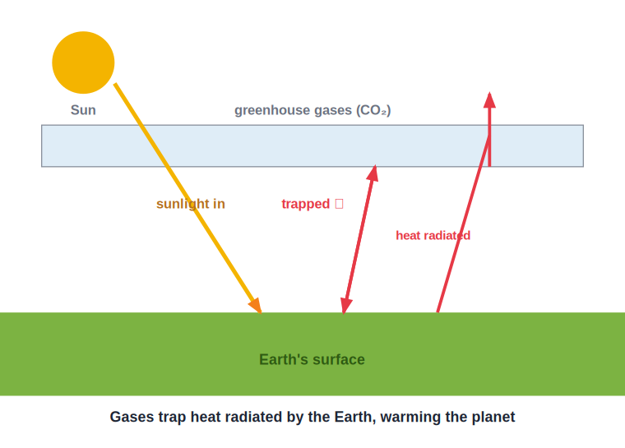
GREENHOUSE
The Greenhouse Effect
Heat trapped by gases
• Sunlight passes through the atmosphere and warms the Earth's surface.
• The warm Earth radiates heat (infrared) back outward.
• Greenhouse gases like carbon dioxide trap some of this heat in the atmosphere.
• This natural warming keeps Earth habitable — but too much of it is harmful.
Greenhouse gases trap outgoing heat
Notes:
The greenhouse effect: gases trap re-radiated heat. Natural and necessary, but enhanced by our emissions.

Slide 23
GLOBAL WARMING
Global Warming
An enhanced greenhouse effect
• The cause Burning fossil fuels adds extra carbon dioxide, strengthening the greenhouse effect.
• Rising temperatures Average global temperatures are slowly rising.
• Melting ice Glaciers and polar ice melt, raising sea levels.
• Climate change More extreme weather — floods, droughts and storms.
Notes:
Extra CO2 from fossil fuels enhances warming, melting ice and disrupting the climate.

Slide 24

SOLUTIONS
Ways to Reduce Global Warming
Use renewables
Save energy
Switch from fossil fuels to solar, wind and hydro.
Use less electricity and fuel, and choose efficient appliances.
Plant trees
Less, reuse, recycle
Trees absorb carbon dioxide from the air.
Cut waste and pollution from manufacturing and transport.
Notes:
Solutions centre on cutting CO2: renewables, efficiency, afforestation and reducing waste.

Slide 25
WRAP UP
Quick Recap
✓ Wind & water — spin turbines to generate clean electricity
✓ Nuclear — fission gives huge energy but radioactive waste
✓ Degradation — useful energy turns to low-grade heat
✓ Greenhouse effect — gases trap re-radiated heat; natural but enhanced
✓ Global warming — extra CO2 → rising temperatures, melting ice
✓ Solutions — renewables, efficiency, trees, reduce waste
Notes:
Rapid recap; the greenhouse effect and ways to cut warming are the key points.

Slide 26
QUIZ 2
Final Check — Climate
5 questions • think before the answer reveals on the next slide

Slide 27
QUIZ QUESTION
Q1 — Main Greenhouse Gas
The greenhouse gas most increased by burning fossil fuels is:
Oxygen
Nitrogen
A
B
Carbon dioxide
Hydrogen
C
D

Slide 28
ANSWER REVEALED
Q1 — Main Greenhouse Gas
The greenhouse gas most increased by burning fossil fuels is:
Oxygen
Nitrogen
A
B
Carbon dioxide
Hydrogen
✓
D
WHY
Burning coal, oil and gas releases large amounts of carbon dioxide, the chief greenhouse gas responsible for the enhanced warming of the planet.

Slide 29
QUIZ QUESTION
Q2 — How It Warms
Greenhouse gases warm the Earth by:
Blocking sunlight from entering
Letting sunlight in but trapping the heat radiated back out
A
B
Cooling the surface
Producing their own light
C
D

Slide 30
ANSWER REVEALED
Q2 — How It Warms
Greenhouse gases warm the Earth by:
Blocking sunlight from entering
Letting sunlight in but trapping the heat radiated back out
A
✓
Cooling the surface
Producing their own light
C
D
WHY
Sunlight passes through the atmosphere and warms the ground. The Earth re-radiates infrared heat, which greenhouse gases absorb and trap — warming the planet.

Slide 31
QUIZ QUESTION
Q3 — Rising Seas
A major consequence of global warming is rising sea levels, caused mainly by:
More rainfall
Melting glaciers and polar ice plus expanding warmer water
A
B
Less evaporation
Stronger winds
C
D

Slide 32
ANSWER REVEALED
Q3 — Rising Seas
A major consequence of global warming is rising sea levels, caused mainly by:
More rainfall
Melting glaciers and polar ice plus expanding warmer water
A
✓
Less evaporation
Stronger winds
C
D
WHY
Warming melts land ice into the oceans, and warmer water expands slightly — together raising sea levels and threatening low-lying coasts.

Slide 33
QUIZ QUESTION
Q4 — Best Action
Which action would most directly reduce global warming?
Running more coal plants
Replacing fossil-fuel power with solar and wind
A
B
Cutting down forests
Using more petrol cars
C
D

Slide 34
ANSWER REVEALED
Q4 — Best Action
Which action would most directly reduce global warming?
Running more coal plants
Replacing fossil-fuel power with solar and wind
A
✓
Cutting down forests
Using more petrol cars
C
D
WHY
Solar and wind generate electricity without releasing carbon dioxide, so switching to them directly cuts the emissions driving global warming.

Slide 35
QUIZ QUESTION
Q5 — Trees Help
Planting trees helps fight global warming because trees:
Release carbon dioxide
Absorb carbon dioxide from the air during photosynthesis
A
B
Reflect all sunlight
Produce methane
C
D

Slide 36
ANSWER REVEALED
Q5 — Trees Help
Planting trees helps fight global warming because trees:
Release carbon dioxide
Absorb carbon dioxide from the air during photosynthesis
A
✓
Reflect all sunlight
Produce methane
C
D
WHY
Growing trees take in carbon dioxide and lock the carbon into wood, lowering the amount of this greenhouse gas in the atmosphere.

Slide 37
Energy and Our Planet
The way we make and use energy shapes the climate — choosing clean sources protects the Earth for the future.

