Slide 1
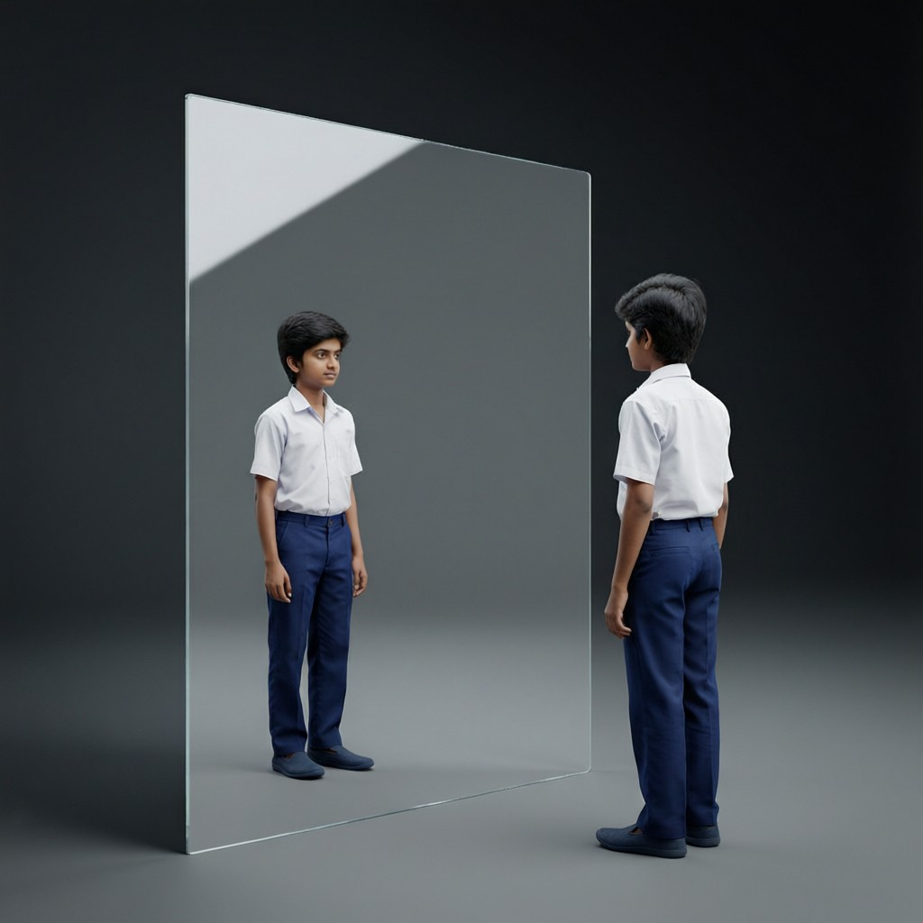
ICSE • CLASS 9 • LIGHT
Reflection of Light
Laws of reflection • Plane-mirror images • Lateral inversion • Images in inclined mirrors

Slide 2
INTRODUCTION
Learning Objectives
1
Define reflection and the terms used to describe it
2
Distinguish regular from irregular reflection
3
State and verify the laws of reflection
4
Describe the image formed by a plane mirror
5
Explain lateral inversion
6
Find the number of images formed by two inclined mirrors
Notes:
Open by previewing these objectives so students know what they should be able to do by the end of the session.

Slide 3
PART 1
Reflection & the Laws
1
How light bounces off a surface

Slide 4
TERMS
Reflection — the Key Terms
The vocabulary of reflection
• Reflection the bouncing back of light when it strikes a surface.
• Incident & reflected ray the ray going to, and the ray coming back from, the surface.
• Normal the line drawn at 90° to the surface at the point of incidence.
• Angle of incidence (i) & reflection (r) measured between the rays and the normal.
Notes:
Define each term against a diagram. Angles are always from the normal, never the surface.

Slide 5




TYPES
Regular vs Irregular Reflection
Regular reflection
Irregular (diffuse)
From a smooth, polished surface like a mirror — parallel rays stay parallel.
From a rough surface like paper — parallel rays scatter in all directions.
Why we see objects
Same laws
Diffuse reflection from objects sends light to our eyes from every angle.
Both kinds still obey the laws of reflection at each tiny point.
Notes:
Regular = mirror (clear image); irregular = paper (no image, but lets us see things). Both obey the laws locally.

Slide 6
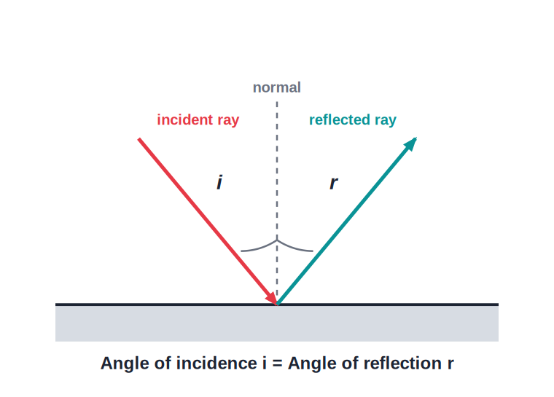
LAWS
The Laws of Reflection
i = r
• Law 1: the angle of incidence equals the angle of reflection (i = r).
• Law 2: the incident ray, the reflected ray and the normal all lie in the same plane.
• Both angles are measured from the normal.
• They hold for every reflecting surface, flat or curved.
Angle of incidence = angle of reflection
Notes:
State both laws. The equality i = r is the workhorse for all reflection problems.

Slide 7
VERIFICATION
Verifying the Laws of Reflection
The pin-and-protractor method
• Fix a plane mirror upright on a sheet of paper and draw the normal.
• Shine a ray of light (or use pins) at the mirror at a chosen angle.
• Mark the incident and reflected rays and measure i and r with a protractor.
• Repeat for several angles — each time i = r, confirming the first law.
Notes:
Standard practical: measure i and r for several angles and show they are equal.

Slide 8
ROTATING MIRROR
When the Mirror Turns
If the mirror is rotated while the incident ray is kept fixed, the reflected ray turns through twice that angle.
mirror rotates by θ → reflected ray rotates by 2θ
• Turning the mirror by θ increases the angle of incidence by θ.
• The angle of reflection also increases by θ, so the reflected ray swings by 2θ.
• This is used in the optical lever and in moving-mirror galvanometers.
Notes:
A favourite ICSE result: for a fixed incident ray, rotating the mirror by θ turns the reflected ray by 2θ. Basis of the optical lever.

Slide 9
QUIZ 1
Check Your Understanding
5 questions • think before the answer reveals on the next slide

Slide 10
QUIZ QUESTION
Q1 — Angle of Reflection
A ray strikes a mirror so that it makes an angle of 30° with the mirror surface. The angle of reflection is:
30°
60°
A
B
90°
15°
C
D

Slide 11
ANSWER REVEALED
Q1 — Angle of Reflection
A ray strikes a mirror so that it makes an angle of 30° with the mirror surface. The angle of reflection is:
30°
60°
A
✓
90°
15°
C
D
WHY
Angles are measured from the normal, not the surface. If the ray is 30° from the surface, the angle of incidence is 90 − 30 = 60°, and the angle of reflection equals it: 60°.

Slide 12
QUIZ QUESTION
Q2 — Why See Paper?
We can see a sheet of white paper from any direction because it produces:
Regular reflection
Irregular (diffuse) reflection
A
B
No reflection
Refraction
C
D

Slide 13
ANSWER REVEALED
Q2 — Why See Paper?
We can see a sheet of white paper from any direction because it produces:
Regular reflection
Irregular (diffuse) reflection
A
✓
No reflection
Refraction
C
D
WHY
The rough surface of paper scatters light in all directions (diffuse reflection), so some reaches your eye wherever you stand — unlike a mirror's regular reflection.

Slide 14
QUIZ QUESTION
Q3 — Normal Incidence
A ray of light strikes a plane mirror along the normal (i = 0°). It is reflected:
At 90°
Straight back along the same path
A
B
Along the mirror
Not at all
C
D

Slide 15
ANSWER REVEALED
Q3 — Normal Incidence
A ray of light strikes a plane mirror along the normal (i = 0°). It is reflected:
At 90°
Straight back along the same path
A
✓
Along the mirror
Not at all
C
D
WHY
With i = 0°, the law i = r gives r = 0° too, so the ray returns straight back along its original path — normal incidence.

Slide 16
QUIZ QUESTION
Q4 — Both Rays
According to the second law of reflection, the incident ray, reflected ray and normal all lie:
In different planes
In the same plane
A
B
On the mirror
Parallel to each other
C
D

Slide 17
ANSWER REVEALED
Q4 — Both Rays
According to the second law of reflection, the incident ray, reflected ray and normal all lie:
In different planes
In the same plane
A
✓
On the mirror
Parallel to each other
C
D
WHY
The second law states that the incident ray, the reflected ray and the normal at the point of incidence are all in one plane.

Slide 18
QUIZ QUESTION
Q5 — Turn the Mirror
A fixed ray of light strikes a mirror. If the mirror is rotated by 10°, the reflected ray turns by:
5°
10°
A
B
20°
0°
C
D

Slide 19
ANSWER REVEALED
Q5 — Turn the Mirror
A fixed ray of light strikes a mirror. If the mirror is rotated by 10°, the reflected ray turns by:
5°
10°
A
B
20°
0°
✓
D
WHY
For a fixed incident ray, rotating the mirror by an angle turns the reflected ray by twice that angle. So a 10° turn of the mirror swings the reflected ray by 20°.

Slide 20
PART 2
Plane-Mirror Images
2
What a flat mirror does to light

Slide 21
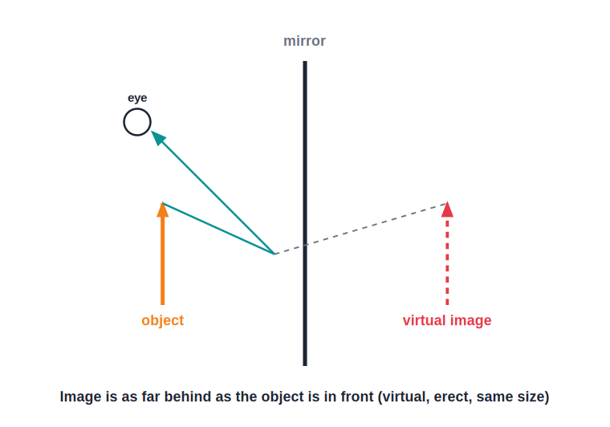
IMAGE
Image in a Plane Mirror
Virtual, erect, same size
• Light from the object reflects off the mirror into the eye.
• The brain traces the rays back to form a virtual image behind the mirror.
• The image is as far behind the mirror as the object is in front.
• It is virtual, erect and the same size as the object.
Image is as far behind as the object is in front
Notes:
The four characteristics: virtual, erect, same size, as far behind. Plus laterally inverted (next slide).

Slide 22
CHARACTERISTICS
Characteristics of the Image
Virtual
Erect
Cannot be caught on a screen; it only appears to be behind the mirror.
The right way up, same as the object.
Same size
Laterally inverted
Exactly as large as the object.
Left and right are swapped over.
Notes:
List all characteristics. Lateral inversion is the one students most often forget.

Slide 23
LATERAL INVERSION
Lateral Inversion
Why left and right swap
• What it is The sideways swapping of left and right in a mirror image.
• Your right hand Looks like the image's left hand.
• AMBULANCE Written reversed on the front of the vehicle so it reads correctly in a driver's mirror.
• Clock in a mirror Appears to run anticlockwise.
Notes:
Lateral inversion: left↔right. The AMBULANCE lettering is the classic real-world example.

Slide 24
INCLINED MIRRORS
Images in Two Inclined Mirrors
Two plane mirrors placed at an angle θ form several images of an object between them.
Number of images n = (360° / θ) − 1
• At 90°, n = 360/90 − 1 = 3 images.
• At 60°, n = 360/60 − 1 = 5 images.
• Parallel mirrors (θ = 0°) form infinitely many images.
• Used in the kaleidoscope and the periscope.
Notes:
The inclined-mirror formula is a signature ICSE result. Drill 90°→3 and 60°→5, and parallel→infinite.

Slide 25
USES
Uses of Plane Mirrors
Looking glass
Periscope
The everyday mirror for seeing ourselves.
Two parallel mirrors at 45° let us see over walls or from a submarine.
Kaleidoscope
Instruments
Inclined mirrors make colourful, symmetric patterns.
Used in solar cookers and to read fine scales (galvanometers).
Notes:
Real uses of plane mirrors. The periscope (parallel mirrors) and kaleidoscope (inclined mirrors) tie back to the chapter.

Slide 26
WRAP UP
Quick Recap
✓ Reflection — light bounces back; angles measured from the normal
✓ Regular vs irregular — smooth mirror vs rough paper
✓ Laws — i = r; incident, reflected & normal in one plane
✓ Plane-mirror image — virtual, erect, same size, as far behind
✓ Lateral inversion — left and right are swapped
✓ Inclined mirrors — n = 360/θ − 1; parallel → infinite
Notes:
Rapid recap; i = r and the inclined-mirror formula are the key exam points.

Slide 27
QUIZ 2
Final Check — Plane Mirrors
5 questions • think before the answer reveals on the next slide

Slide 28
QUIZ QUESTION
Q1 — Step Back
You stand 1 m in front of a plane mirror. The distance between you and your image is:
1 m
0.5 m
A
B
2 m
4 m
C
D

Slide 29
ANSWER REVEALED
Q1 — Step Back
You stand 1 m in front of a plane mirror. The distance between you and your image is:
1 m
0.5 m
A
B
2 m
4 m
✓
D
WHY
The image is as far behind the mirror as you are in front — 1 m behind. So you and your image are 1 + 1 = 2 m apart.

Slide 30
QUIZ QUESTION
Q2 — Walk Toward It
You walk toward a plane mirror at 1 m/s. Your image approaches you at:
1 m/s
0.5 m/s
A
B
2 m/s
It stays still
C
D

Slide 31
ANSWER REVEALED
Q2 — Walk Toward It
You walk toward a plane mirror at 1 m/s. Your image approaches you at:
1 m/s
0.5 m/s
A
B
2 m/s
It stays still
✓
D
WHY
As you move 1 m closer, the image also moves 1 m closer (staying level with you behind the glass). So the gap between you closes at 1 + 1 = 2 m/s.

Slide 32
QUIZ QUESTION
Q3 — AMBULANCE
The word AMBULANCE is painted reversed on the front of the vehicle so that:
It looks decorative
It reads correctly in the rear-view mirror of the car ahead
A
B
It is harder to read
It glows at night
C
D

Slide 33
ANSWER REVEALED
Q3 — AMBULANCE
The word AMBULANCE is painted reversed on the front of the vehicle so that:
It looks decorative
It reads correctly in the rear-view mirror of the car ahead
A
✓
It is harder to read
It glows at night
C
D
WHY
A driver ahead sees the ambulance in their mirror, which laterally inverts it. Writing it reversed means the mirror image appears the right way round and is easy to read.

Slide 34
QUIZ QUESTION
Q4 — Right Angle Mirrors
Two plane mirrors are placed at 90° to each other. The number of images of an object between them is:
1
2
A
B
3
Infinite
C
D

Slide 35
ANSWER REVEALED
Q4 — Right Angle Mirrors
Two plane mirrors are placed at 90° to each other. The number of images of an object between them is:
1
2
A
B
3
Infinite
✓
D
WHY
Using n = 360/θ − 1 with θ = 90°: n = 360/90 − 1 = 4 − 1 = 3 images.

Slide 36
QUIZ QUESTION
Q5 — Barber's Mirrors
Why do two parallel mirrors in a barber's shop show a seemingly endless row of images?
The light speeds up
θ = 0°, so n = 360/θ − 1 is infinite
A
B
The mirrors are curved
The light changes colour
C
D

Slide 37
ANSWER REVEALED
Q5 — Barber's Mirrors
Why do two parallel mirrors in a barber's shop show a seemingly endless row of images?
The light speeds up
θ = 0°, so n = 360/θ − 1 is infinite
A
✓
The mirrors are curved
The light changes colour
C
D
WHY
For parallel mirrors the angle between them is zero, and 360/0 is infinite. Each mirror keeps re-reflecting the other's image, giving an endless series.

Slide 38
Mirror, Mirror
From i = r to a barber's endless reflections, the simple laws of reflection explain every image in a flat mirror.

