Slide 1
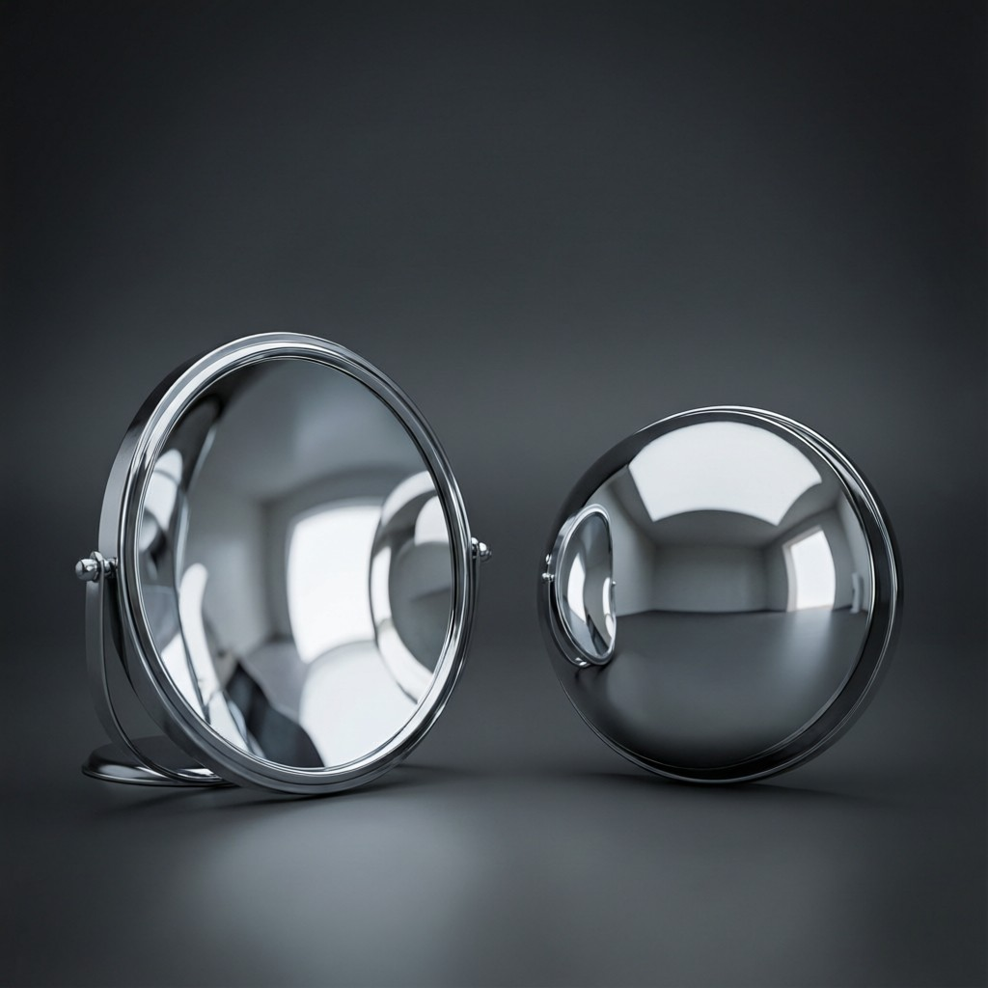
ICSE • CLASS 9 • LIGHT
Spherical Mirrors
Concave & convex mirrors • Focus & focal length • Ray diagrams • Uses

Slide 2
INTRODUCTION
Learning Objectives
1
Identify concave and convex spherical mirrors
2
Define the terms used for spherical mirrors
3
Relate focal length to radius of curvature (f = R/2)
4
Use the convenient rays to construct ray diagrams
5
Describe images formed by concave and convex mirrors
6
State the uses of concave and convex mirrors
Notes:
Open by previewing these objectives so students know what they should be able to do by the end of the session.

Slide 3
PART 1
Spherical Mirrors & Their Terms
1
Curved reflecting surfaces

Slide 4



TWO TYPES
Concave and Convex Mirrors
Spherical mirror
Concave
A mirror that is part of a hollow sphere.
Reflecting surface curves inward; it converges light (a converging mirror).
Convex
Everywhere
Reflecting surface bulges outward; it diverges light (a diverging mirror).
Shaving and make-up mirrors are concave; vehicle rear-view mirrors are convex.
Notes:
Concave = caves in, converges; convex = bulges out, diverges. Anchor each with a real mirror.

Slide 5
TERMS
Terms for a Spherical Mirror
Pole, centre, focus, focal length
• Pole (P) the centre of the mirror's reflecting surface.
• Centre of curvature (C) the centre of the sphere the mirror is part of.
• Radius of curvature (R) the radius of that sphere (distance PC).
• Principal focus (F) where rays parallel to the axis meet (or appear to).
• Focal length (f) the distance from the pole to the focus, PF.
Notes:
Define each term against a diagram. These feed straight into the ray diagrams and f = R/2.

Slide 6
MORE TERMS
Principal Axis, Aperture & the Normal
Principal axis
Aperture
The straight line through the pole P and the centre of curvature C.
The width of the mirror — the part that actually reflects light.
Normal at a point
Small aperture
The line joining that point to the centre of curvature C.
We assume a small aperture so the rays focus sharply at a single point.
Notes:
Round out the terms: principal axis (P–C line), aperture (mirror width), and that the normal at any point passes through C.

Slide 7
F = R/2
Focus and Focal Length
For a spherical mirror, the principal focus lies exactly halfway between the pole and the centre of curvature.
focal length f = R / 2
• Rays parallel to the principal axis converge at F (concave) or appear to come from F (convex).
• So the focal length is half the radius of curvature.
• A more sharply curved mirror has a shorter focal length.
Notes:
f = R/2 is a key relation. Concave focus is real; convex focus is virtual (behind the mirror).

Slide 8

RAY RULES
Convenient Rays for Ray Diagrams
Parallel ray
Focal ray
A ray parallel to the axis reflects through the focus F.
A ray through F reflects back parallel to the axis.
Central-of-curvature ray
Two are enough
A ray through C hits the mirror normally and returns along itself.
Any two of these locate the image; the third is a check.
Notes:
The standard rays for mirror ray diagrams. Two rays fix the image position.

Slide 9
WORKED EXAMPLE
Focal Length and Radius
Problem. A concave mirror forms a sharp image of a distant tree on a screen 15 cm from the mirror. Find its radius of curvature.
A distant object focuses at the principal focus, so f = 15 cm
f = R / 2 → R = 2 f
R = 2 × 15 = 30 cm
Answer: Radius of curvature R = 30 cm
Notes:
A distant object images at F, so the screen distance is f. Then R = 2f. A neat way to find R experimentally.

Slide 10
QUIZ 1
Check Your Understanding
5 questions • think before the answer reveals on the next slide

Slide 11
QUIZ QUESTION
Q1 — Which Converges?
Which spherical mirror converges a parallel beam of light to a real focus?
Convex mirror
Concave mirror
A
B
Plane mirror
Neither
C
D

Slide 12
ANSWER REVEALED
Q1 — Which Converges?
Which spherical mirror converges a parallel beam of light to a real focus?
Convex mirror
Concave mirror
A
✓
Plane mirror
Neither
C
D
WHY
A concave mirror curves inward and brings parallel rays together at a real focus in front of it — a converging mirror. A convex mirror spreads them out.

Slide 13
QUIZ QUESTION
Q2 — Focal Length
A concave mirror has a radius of curvature of 40 cm. Its focal length is:
80 cm
40 cm
A
B
20 cm
10 cm
C
D

Slide 14
ANSWER REVEALED
Q2 — Focal Length
A concave mirror has a radius of curvature of 40 cm. Its focal length is:
80 cm
40 cm
A
B
20 cm
10 cm
✓
D
WHY
f = R/2 = 40/2 = 20 cm. The focus lies halfway between the pole and the centre of curvature.

Slide 15
QUIZ QUESTION
Q3 — Centre Ray
A ray of light passing through the centre of curvature of a concave mirror, after reflection:
Passes through the focus
Returns along the same path
A
B
Goes parallel to the axis
Is not reflected
C
D

Slide 16
ANSWER REVEALED
Q3 — Centre Ray
A ray of light passing through the centre of curvature of a concave mirror, after reflection:
Passes through the focus
Returns along the same path
A
✓
Goes parallel to the axis
Is not reflected
C
D
WHY
A ray through C strikes the mirror along the normal (i = 0°), so it reflects straight back on itself.

Slide 17
QUIZ QUESTION
Q4 — Convex Focus
The principal focus of a convex mirror is:
Real, in front of the mirror
Virtual, behind the mirror
A
B
At the pole
At infinity
C
D

Slide 18
ANSWER REVEALED
Q4 — Convex Focus
The principal focus of a convex mirror is:
Real, in front of the mirror
Virtual, behind the mirror
A
✓
At the pole
At infinity
C
D
WHY
A convex mirror diverges parallel rays; they only appear to come from a point behind the mirror, so its focus is virtual.

Slide 19
QUIZ QUESTION
Q5 — Same-Size Image
An object placed at the centre of curvature of a concave mirror gives an image that is the same size as the object. The image is at:
The focus F
The pole P
A
B
The centre of curvature C
Infinity
C
D

Slide 20
ANSWER REVEALED
Q5 — Same-Size Image
An object placed at the centre of curvature of a concave mirror gives an image that is the same size as the object. The image is at:
The focus F
The pole P
A
B
The centre of curvature C
Infinity
✓
D
WHY
With the object at C, the rays return to C, forming a real, inverted image of the same size right at the centre of curvature.

Slide 21
PART 2
Images and Uses
2
What curved mirrors do, and where we use them

Slide 22
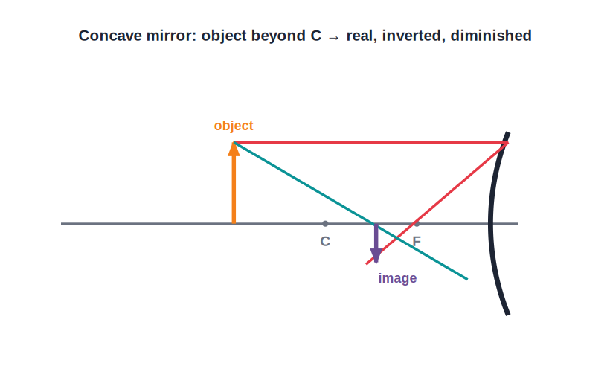
CONCAVE IMAGES
Images in a Concave Mirror
Depends on object position
• The image depends on where the object is placed.
• Object beyond C: real, inverted and diminished.
• Object between F and C: real, inverted and magnified.
• Object between F and the pole: virtual, erect and magnified.
Object beyond C → real, inverted, diminished
Notes:
Concave mirror images change with object position — real & inverted for far objects, virtual & magnified when close (within F).

Slide 23
CONCAVE TABLE
Concave Mirror: All Object Positions
At infinity / beyond C
At C
Image at F or between F and C — real, inverted, diminished (used in a reflecting telescope).
Image at C — real, inverted, the same size as the object.
Between C and F
At F / within F
Image beyond C — real, inverted, magnified (a projector).
At F the image is at infinity; within F it is virtual, erect and magnified (a shaving mirror).
Notes:
The full set of concave-mirror cases. Note the cross-over: within F the image becomes virtual, erect and magnified.

Slide 24
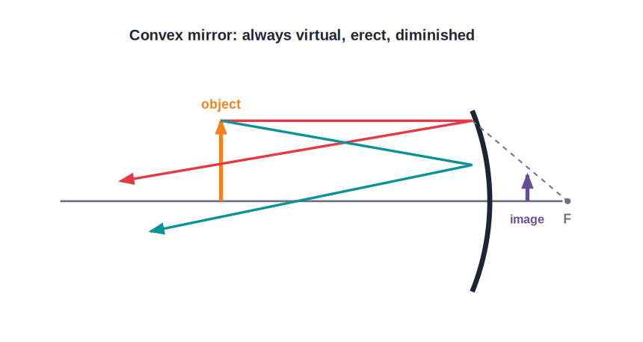
CONVEX IMAGES
Images in a Convex Mirror
Always virtual, erect, diminished
• A convex mirror always forms the same kind of image.
• The image is virtual, erect and diminished.
• It lies behind the mirror, between the pole and F.
• Because the image is small, a convex mirror gives a wide field of view.
A wide field of view in a small mirror
Notes:
Convex mirror: always virtual, erect, diminished, with a wide view — why it is used for rear-view and security mirrors.

Slide 25
USES
Uses of Curved Mirrors
Concave — shaving/make-up
Concave — reflectors
Held close, it gives a magnified, erect image of the face.
In torches, headlights and search-lights to throw a parallel beam.
Convex — rear-view
Convex — security
In vehicles for a wide field of view behind.
In shops and at blind corners to watch a large area.
Notes:
Match mirror to use: concave magnifies/focuses; convex gives a wide view. The dentist's mirror and solar concentrator are also concave.

Slide 26
DISTINCTION
Plane vs Concave vs Convex
Plane
Concave
Image always virtual, erect, same size.
Image real or virtual, depending on object position; can magnify.
Convex
Quick test
Image always virtual, erect, diminished; wide view.
Look in it: concave can magnify, convex always makes things smaller.
Notes:
Side-by-side comparison of the three mirror types — a common summary question.

Slide 27
WRAP UP
Quick Recap
✓ Spherical mirrors — concave converges, convex diverges
✓ Terms — pole, centre of curvature, focus, focal length
✓ f = R/2 — focus is halfway to the centre of curvature
✓ Ray rules — parallel→F, through F→parallel, through C→back
✓ Images — concave varies with position; convex always virtual/diminished
✓ Uses — concave: shaving, headlights; convex: rear-view, security
Notes:
Rapid recap; f = R/2 and the concave image cases are the key exam points.

Slide 28
QUIZ 2
Final Check — Spherical Mirrors
5 questions • think before the answer reveals on the next slide

Slide 29
QUIZ QUESTION
Q1 — Rear-View Choice
A convex mirror is used as a vehicle's rear-view mirror mainly because it:
Magnifies the traffic
Gives an erect image and a wide field of view
A
B
Shows a real image
Reverses the image
C
D

Slide 30
ANSWER REVEALED
Q1 — Rear-View Choice
A convex mirror is used as a vehicle's rear-view mirror mainly because it:
Magnifies the traffic
Gives an erect image and a wide field of view
A
✓
Shows a real image
Reverses the image
C
D
WHY
A convex mirror always forms a small, erect (right-way-up) image and covers a wide area behind, letting the driver see much more traffic at a glance.

Slide 31
QUIZ QUESTION
Q2 — Shaving Mirror
To see an enlarged, erect image of your face, you should use a concave mirror with your face:
Beyond C
At C
A
B
Between the focus and the mirror
At the focus
C
D

Slide 32
ANSWER REVEALED
Q2 — Shaving Mirror
To see an enlarged, erect image of your face, you should use a concave mirror with your face:
Beyond C
At C
A
B
Between the focus and the mirror
At the focus
✓
D
WHY
When the object (face) is closer than the focus of a concave mirror, the image is virtual, erect and magnified — exactly what a shaving or make-up mirror needs.

Slide 33
QUIZ QUESTION
Q3 — Headlight
A car headlight places its bulb at the focus of a concave reflector so that the reflected light:
Spreads out widely
Comes out as a strong parallel beam
A
B
Forms an image of the bulb
Is dimmed
C
D

Slide 34
ANSWER REVEALED
Q3 — Headlight
A car headlight places its bulb at the focus of a concave reflector so that the reflected light:
Spreads out widely
Comes out as a strong parallel beam
A
✓
Forms an image of the bulb
Is dimmed
C
D
WHY
Rays from a source at the focus of a concave mirror reflect parallel to the axis, producing the powerful straight beam a headlight needs.

Slide 35
QUIZ QUESTION
Q4 — Object at C
An object placed at the centre of curvature of a concave mirror forms an image that is:
Virtual and magnified
Real, inverted and the same size, at C
A
B
Diminished and erect
At infinity
C
D

Slide 36
ANSWER REVEALED
Q4 — Object at C
An object placed at the centre of curvature of a concave mirror forms an image that is:
Virtual and magnified
Real, inverted and the same size, at C
A
✓
Diminished and erect
At infinity
C
D
WHY
With the object at C, the concave mirror forms a real, inverted image of the same size, also located at C.

Slide 37
QUIZ QUESTION
Q5 — Identify the Mirror
Looking into a mirror, you always see a small, upright image of yourself, however far away you stand. The mirror is:
Plane
Concave
A
B
Convex
Cannot be decided
C
D

Slide 38
ANSWER REVEALED
Q5 — Identify the Mirror
Looking into a mirror, you always see a small, upright image of yourself, however far away you stand. The mirror is:
Plane
Concave
A
B
Convex
Cannot be decided
✓
D
WHY
Only a convex mirror gives an image that is always erect AND diminished for every object distance. A plane mirror keeps the same size; a concave one can magnify or invert.

Slide 39
Curved Mirrors, Curved Light
Concave mirrors gather light to a focus; convex mirrors spread the view — geometry doing useful work.

