Slide 1
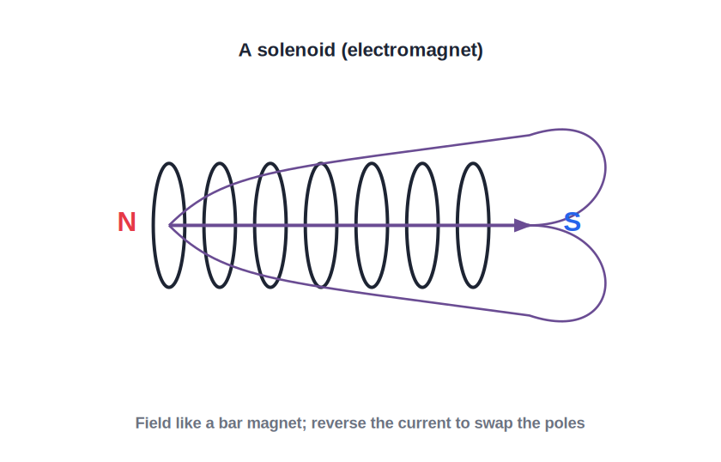
ICSE • CLASS 10 • MAGNETISM
Magnetic Effect of Current
Oersted's experiment • Field of a wire, loop & solenoid • The electromagnet

Slide 2
INTRODUCTION
Learning Objectives
1
Describe Oersted's experiment linking current and magnetism
2
Draw the magnetic field around a straight current-carrying wire
3
Use the right-hand thumb rule for field direction
4
Describe the field of a current loop and a solenoid
5
Explain how an electromagnet is made and strengthened
6
Compare an electromagnet with a permanent magnet
Notes:
Open by previewing these objectives so students know what they should be able to do by the end of the session.

Slide 3
PART 1
Current Makes Magnetism
1
Oersted's discovery and the field of a wire

Slide 4
OERSTED
Oersted's Experiment
Electricity and magnetism are linked
• The discovery A compass needle near a wire deflects when a current flows through the wire.
• What it shows An electric current produces a magnetic field around it.
• Reverse the current The needle deflects the other way — the field direction reverses too.
• No current, no effect Switch the current off and the needle returns to north.
Notes:
Oersted's chance discovery: current creates magnetism. The needle deflection and its reversal are the key observations.

Slide 5
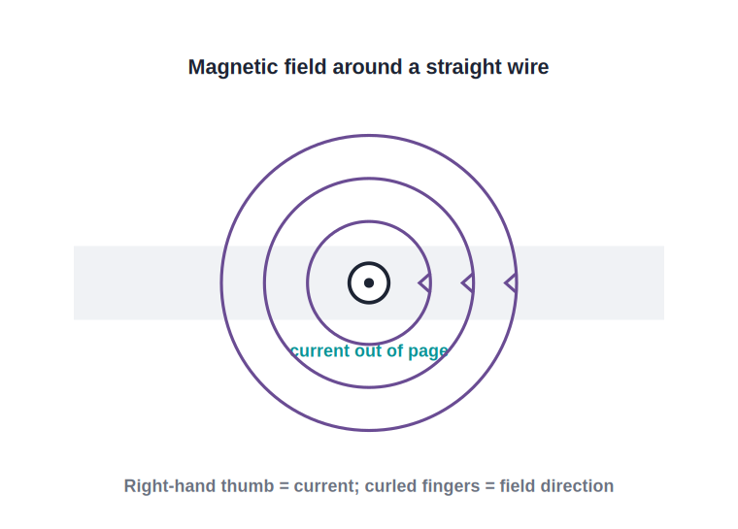
STRAIGHT WIRE
Field Around a Straight Wire
Circular field lines
• The magnetic field lines form concentric circles around the wire.
• The field is stronger close to the wire and weakens with distance.
• Right-hand thumb rule: thumb points along the current, curled fingers show the field direction.
• Reversing the current reverses the direction of the field lines.
Right-hand thumb rule gives the direction
Notes:
Field = concentric circles. Demonstrate the right-hand rule with your own hand; reversal flips the circles.

Slide 6
CURRENT LOOP
Field Due to a Circular Loop
Bending the wire concentrates the field
• Each part adds up Every bit of the loop circles a field; inside the loop they all add together.
• Straight through the centre The field at the centre is perpendicular to the plane of the loop.
• Like a tiny magnet One face of the loop acts as a north pole, the other as a south pole.
• More turns, stronger Many turns side by side make the field much stronger.
Notes:
A loop concentrates the field through its centre, behaving like a small magnet — the stepping stone to the solenoid.

Slide 7
SOLENOID
The Solenoid
A coil that acts like a bar magnet
• A solenoid is a long coil of many turns of insulated wire.
• When current flows, its field is just like that of a bar magnet, with a N and a S pole.
• The field inside is strong and nearly uniform.
• Reversing the current swaps the north and south poles.
Reverse the current to swap the poles
Notes:
Solenoid = many loops = bar-magnet field. Strong uniform field inside; poles reverse with the current.

Slide 8
WHICH END IS NORTH?
The Clock (End) Rule for a Solenoid
Anticlockwise → N, clockwise → S
• Look at an end View the current flowing in the end face of the solenoid.
• Anticlockwise = North If the current looks anticlockwise, that face is a North pole.
• Clockwise = South If it looks clockwise, that face is a South pole.
• Reverse to swap Reversing the current swaps the sense, and so the poles.
Notes:
The clock/end rule fixes which face is N or S. Pair it with the right-hand rule for the field direction.

Slide 9
ELECTROMAGNET
Making an Electromagnet
Put a soft-iron core inside a solenoid and it becomes a powerful, switchable magnet — an electromagnet.
• The soft-iron core greatly increases the strength of the field.
• Stronger with more turns, more current, and a soft-iron core.
• It is a magnet only while the current flows.
Notes:
Electromagnet = solenoid + soft-iron core. Strength depends on turns, current and the core.

Slide 10
STRENGTH
What Makes an Electromagnet Stronger
Current, turns and core
• More current A larger current through the coil gives a stronger magnetic field.
• More turns Packing in more turns of wire increases the field.
• Soft-iron core A soft-iron core multiplies the strength many times over.
• Shorter / closer Bringing the turns closer together concentrates the field.
Notes:
The three controllable factors: current, number of turns and the core. These are common one-mark answers.

Slide 11


CHOOSING THE CORE
Soft Iron vs Steel
Soft iron — temporary
Steel — permanent
Magnetises strongly but loses it at once when the current stops — ideal for electromagnets.
Magnetises less easily but keeps its magnetism — used for permanent magnets.
Electromagnet core
Why not steel
Always soft iron, so the magnet can be switched off.
A steel core would stay magnetised, so the device could not be turned off.
Notes:
Soft iron = temporary (electromagnet core); steel = permanent magnet. The switch-off requirement decides the choice.

Slide 12

ELECTRO VS PERMANENT
Electromagnet vs Permanent Magnet
Switchable
Adjustable strength
An electromagnet can be turned on and off; a permanent magnet is always magnetic.
Its strength can be changed by varying the current; a permanent magnet's cannot.
Reversible poles
Very strong
Its poles can be reversed by reversing the current.
It can be made far stronger than an ordinary permanent magnet.
Notes:
The four advantages of an electromagnet: switchable, adjustable, reversible, and can be very strong.

Slide 13
QUIZ 1
Check Your Understanding
5 questions • think before the answer reveals on the next slide

Slide 14
QUIZ QUESTION
Q1 — Oersted
A compass placed under a straight wire deflects only when:
The wire is made of iron
A current flows through the wire
A
B
The wire is very long
The compass is heated
C
D

Slide 15
ANSWER REVEALED
Q1 — Oersted
A compass placed under a straight wire deflects only when:
The wire is made of iron
A current flows through the wire
A
✓
The wire is very long
The compass is heated
C
D
WHY
Oersted showed that a current produces a magnetic field. With no current there is no field, so the needle stays pointing north; switch the current on and it deflects.

Slide 16
QUIZ QUESTION
Q2 — Reverse It
If the current in a solenoid is reversed, its magnetic poles:
Disappear
Stay the same
A
B
Swap over (N becomes S)
Become stronger
C
D

Slide 17
ANSWER REVEALED
Q2 — Reverse It
If the current in a solenoid is reversed, its magnetic poles:
Disappear
Stay the same
A
B
Swap over (N becomes S)
Become stronger
✓
D
WHY
The direction of the field follows the current. Reversing the current reverses the field, so the north and south ends of the solenoid interchange.

Slide 18
QUIZ QUESTION
Q3 — Stronger Magnet
Which change would NOT make an electromagnet stronger?
Increasing the current
Adding more turns of wire
A
B
Using a soft-iron core
Using a wooden core instead of iron
C
D

Slide 19
ANSWER REVEALED
Q3 — Stronger Magnet
Which change would NOT make an electromagnet stronger?
Increasing the current
Adding more turns of wire
A
B
Using a soft-iron core
Using a wooden core instead of iron
C
✓
WHY
Wood is non-magnetic, so it adds nothing — far weaker than soft iron. Strength is increased by more current, more turns and a soft-iron core.

Slide 20
QUIZ QUESTION
Q4 — Why Soft Iron?
An electromagnet uses a soft-iron core rather than steel because soft iron:
Stays magnetised permanently
Loses its magnetism as soon as the current stops, so the magnet can be switched off
A
B
Is a good conductor
Is lighter
C
D

Slide 21
ANSWER REVEALED
Q4 — Why Soft Iron?
An electromagnet uses a soft-iron core rather than steel because soft iron:
Stays magnetised permanently
Loses its magnetism as soon as the current stops, so the magnet can be switched off
A
✓
Is a good conductor
Is lighter
C
D
WHY
Soft iron magnetises and demagnetises easily, so the electromagnet works only while current flows. Steel would keep its magnetism and could not be switched off.

Slide 22
QUIZ QUESTION
Q5 — Name the Pole
Looking at one end of a solenoid, the current appears to flow anticlockwise. That end is a:
South pole
North pole
A
B
Neutral point
Not a pole at all
C
D

Slide 23
ANSWER REVEALED
Q5 — Name the Pole
Looking at one end of a solenoid, the current appears to flow anticlockwise. That end is a:
South pole
North pole
A
✓
Neutral point
Not a pole at all
C
D
WHY
By the clock rule, an anticlockwise current (as seen from that end) marks a North pole; a clockwise current marks a South pole. Reversing the current would swap them.

Slide 24
PART 2
Using Electromagnets
2
From scrapyards to doorbells

Slide 25

USES
Uses of Electromagnets
Lifting magnets
Electric bell
Cranes in scrapyards lift and drop heavy iron by switching the magnet on and off.
An electromagnet repeatedly pulls a clapper to strike the gong.
Relays
Loudspeakers
A small current's electromagnet switches on a much larger circuit.
A changing current in a coil moves a cone to make sound.
Notes:
Each use exploits the switchable, controllable magnetism. The lifting magnet and electric bell are the classic examples.

Slide 26
ELECTRIC BELL
How an Electric Bell Works
A make-and-break circuit
• Pressing the switch completes the circuit and the electromagnet is energised.
• It attracts the soft-iron armature, so the hammer strikes the gong.
• This movement breaks the circuit at a contact, switching the magnet off.
• A spring pulls the armature back, the contact remakes, and the cycle repeats rapidly.
Notes:
The make-and-break action is the heart of the bell: the magnet switches itself off as the hammer moves, then on again.

Slide 27
WRAP UP
Quick Recap
✓ Oersted — a current produces a magnetic field
✓ Straight wire — circular field lines; right-hand thumb rule
✓ Loop & solenoid — concentrate the field; solenoid acts like a bar magnet
✓ Electromagnet — solenoid + soft-iron core; switchable and strong
✓ Advantages — switchable, adjustable, reversible, very strong
✓ Uses — lifting magnets, electric bell, relays, loudspeakers
Notes:
Rapid recap; the right-hand rule and the electromagnet advantages are the key recall items.

Slide 28
QUIZ 2
Final Check — Fields & Electromagnets
5 questions • think before the answer reveals on the next slide

Slide 29
QUIZ QUESTION
Q1 — Field Shape
The magnetic field lines around a long straight current-carrying wire are:
Straight lines along the wire
Concentric circles around the wire
A
B
Radial lines pointing outward
There is no field
C
D

Slide 30
ANSWER REVEALED
Q1 — Field Shape
The magnetic field lines around a long straight current-carrying wire are:
Straight lines along the wire
Concentric circles around the wire
A
✓
Radial lines pointing outward
There is no field
C
D
WHY
The field circles the wire. Closer to the wire the circles are tighter (stronger field); the right-hand thumb rule gives their direction.

Slide 31
QUIZ QUESTION
Q2 — Scrapyard Crane
A scrapyard uses an electromagnet rather than a permanent magnet to move cars mainly because it can:
Never lose strength
Be switched off to drop the load
A
B
Work without electricity
Lift wood and plastic too
C
D

Slide 32
ANSWER REVEALED
Q2 — Scrapyard Crane
A scrapyard uses an electromagnet rather than a permanent magnet to move cars mainly because it can:
Never lose strength
Be switched off to drop the load
A
✓
Work without electricity
Lift wood and plastic too
C
D
WHY
The whole point is control: turn the current on to grab the scrap and off to release it. A permanent magnet could never let go.

Slide 33
QUIZ QUESTION
Q3 — Doorbell Buzz
An electric bell rings continuously while the button is pressed because the circuit:
Stays permanently closed
Repeatedly makes and breaks itself as the hammer moves
A
B
Has no electromagnet
Uses a permanent magnet
C
D

Slide 34
ANSWER REVEALED
Q3 — Doorbell Buzz
An electric bell rings continuously while the button is pressed because the circuit:
Stays permanently closed
Repeatedly makes and breaks itself as the hammer moves
A
✓
Has no electromagnet
Uses a permanent magnet
C
D
WHY
As the armature is attracted, it breaks the contact and the magnet switches off; a spring returns it, remaking the contact. This rapid make-and-break keeps the hammer striking.

Slide 35
QUIZ QUESTION
Q4 — More Turns
Doubling the number of turns on a solenoid (same current) makes its magnetic field:
Weaker
Stronger
A
B
Reverse direction
Disappear
C
D

Slide 36
ANSWER REVEALED
Q4 — More Turns
Doubling the number of turns on a solenoid (same current) makes its magnetic field:
Weaker
Stronger
A
✓
Reverse direction
Disappear
C
D
WHY
More turns means more current loops adding their fields together, so the solenoid's magnetic field becomes stronger.

Slide 37
QUIZ QUESTION
Q5 — Compass Test
A solenoid hangs freely and comes to rest pointing north–south. This proves the solenoid:
Is made of iron
Behaves like a bar magnet with N and S poles
A
B
Carries no current
Is an insulator
C
D

Slide 38
ANSWER REVEALED
Q5 — Compass Test
A solenoid hangs freely and comes to rest pointing north–south. This proves the solenoid:
Is made of iron
Behaves like a bar magnet with N and S poles
A
✓
Carries no current
Is an insulator
C
D
WHY
Only a magnet aligns itself north–south in the Earth's field. Since the current-carrying solenoid does so, it must have north and south poles like a bar magnet.

Slide 39
Electricity That Magnetises
A simple coil and a current give us magnets we can switch, tune and reverse at will.

