Slide 1
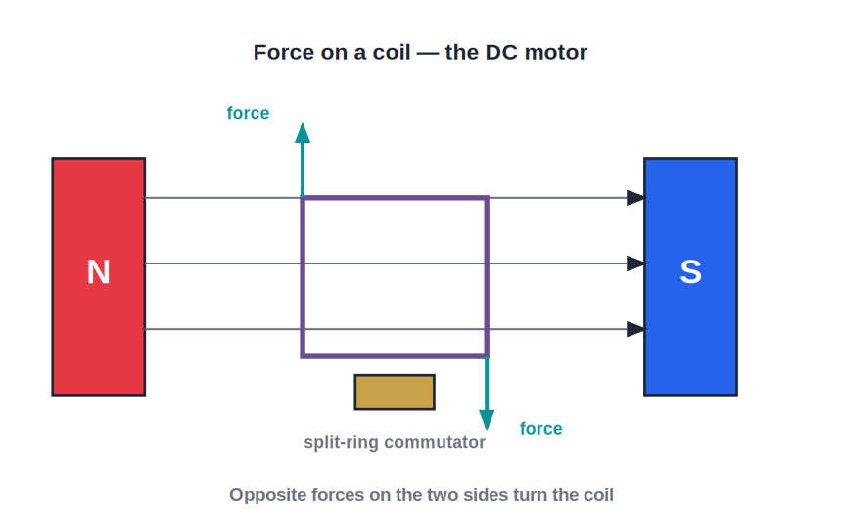
ICSE • CLASS 10 • MAGNETISM
Motors & Induction
Force on a conductor • The DC motor • Electromagnetic induction • Generators

Slide 2
INTRODUCTION
Learning Objectives
1
State the force on a current-carrying conductor in a field
2
Apply Fleming's left-hand rule
3
Explain how a simple DC motor works
4
Describe electromagnetic induction
5
State Faraday's laws of electromagnetic induction
6
Outline how a generator and a transformer work
Notes:
Open by previewing these objectives so students know what they should be able to do by the end of the session.

Slide 3
PART 1
The Motor Effect
1
When a current feels a force in a magnetic field

Slide 4
MOTOR EFFECT
Force on a Conductor
Current + field → force
• A current-carrying conductor placed in a magnetic field experiences a force.
• The force is largest when the conductor is at right angles to the field.
• It is bigger for a stronger field, a larger current or a longer conductor.
• Reversing the current — or the field — reverses the direction of the force.
Opposite forces on the two sides of the coil
Notes:
The motor effect. Force depends on field, current and length, and is maximum at 90°. This drives the motor.

Slide 5
FLEMING
Fleming's Left-Hand Rule
Fleming's left-hand rule gives the direction of the force on the conductor.
• Hold the thumb, first finger and second finger of the left hand at right angles.
• First finger → Field, seCond finger → Current, thuMb → Motion (force).
• Use it for motors — anything that is made to move.
Notes:
Teach the mnemonic: First=Field, seCond=Current, thuMb=Motion. Left hand for motors.

Slide 6
DC MOTOR
The Simple DC Motor
Turning electricity into motion
• A rectangular coil sits between the poles of a magnet.
• Current flows in opposite directions along the two sides, so they feel opposite forces.
• This pair of forces makes the coil rotate.
• A split-ring commutator reverses the current every half turn, keeping it spinning the same way.
The commutator keeps the rotation going one way
Notes:
The commutator is the crucial part — it flips the current each half turn so the coil keeps turning continuously.

Slide 7



STRONGER TURNING
Increasing the Turning Effect of a Motor
More current
Stronger magnet
A larger current in the coil gives a bigger force on each side.
A more powerful field increases the force.
More turns
Larger coil area
More turns on the coil multiply the total force.
A bigger coil gives the forces a longer arm, increasing the turning effect.
Notes:
Four ways to make a motor turn more strongly: current, field, turns and coil area — all increase the couple on the coil.

Slide 8
QUIZ 1
Check Your Understanding
5 questions • think before the answer reveals on the next slide

Slide 9
QUIZ QUESTION
Q1 — Which Hand?
To find the direction in which a motor's coil is pushed, you use:
Fleming's right-hand rule
Fleming's left-hand rule
A
B
The right-hand thumb rule
Ohm's law
C
D

Slide 10
ANSWER REVEALED
Q1 — Which Hand?
To find the direction in which a motor's coil is pushed, you use:
Fleming's right-hand rule
Fleming's left-hand rule
A
✓
The right-hand thumb rule
Ohm's law
C
D
WHY
The left-hand rule gives the direction of force (motion) on a current in a field — used for motors. The right-hand rule is for induced currents in generators.

Slide 11
QUIZ QUESTION
Q2 — No Force
A current-carrying wire lies exactly parallel to the magnetic field. The force on it is:
Maximum
Zero
A
B
Half the maximum
Reversed
C
D

Slide 12
ANSWER REVEALED
Q2 — No Force
A current-carrying wire lies exactly parallel to the magnetic field. The force on it is:
Maximum
Zero
A
✓
Half the maximum
Reversed
C
D
WHY
The motor effect is greatest when the wire is at 90° to the field and zero when it lies along the field. Parallel to the field, there is no force.

Slide 13
QUIZ QUESTION
Q3 — Reverse Both
In a motor, both the current AND the magnetic field are reversed at the same time. The coil now turns:
The opposite way
The same way as before
A
B
Twice as fast
It stops
C
D

Slide 14
ANSWER REVEALED
Q3 — Reverse Both
In a motor, both the current AND the magnetic field are reversed at the same time. The coil now turns:
The opposite way
The same way as before
A
✓
Twice as fast
It stops
C
D
WHY
Reversing the current alone, or the field alone, flips the force. Reversing both flips it twice — back to the original direction — so the coil turns the same way.

Slide 15
QUIZ QUESTION
Q4 — Commutator's Job
The split-ring commutator in a DC motor is needed to:
Increase the voltage
Reverse the current in the coil every half turn so it keeps rotating one way
A
B
Stop the coil
Cool the motor
C
D

Slide 16
ANSWER REVEALED
Q4 — Commutator's Job
The split-ring commutator in a DC motor is needed to:
Increase the voltage
Reverse the current in the coil every half turn so it keeps rotating one way
A
✓
Stop the coil
Cool the motor
C
D
WHY
Without it, the coil would stop after a half turn. The commutator flips the current direction at just the right moment so the forces keep driving the coil the same way round.

Slide 17
QUIZ QUESTION
Q5 — Speed It Up
Which change would make a simple DC motor spin faster?
Using a weaker magnet
Increasing the current through the coil
A
B
Using fewer turns on the coil
Removing the commutator
C
D

Slide 18
ANSWER REVEALED
Q5 — Speed It Up
Which change would make a simple DC motor spin faster?
Using a weaker magnet
Increasing the current through the coil
A
✓
Using fewer turns on the coil
Removing the commutator
C
D
WHY
A larger current means a bigger force on each side of the coil, turning it more strongly and faster. A stronger magnet or more turns would help too; a weaker magnet or fewer turns would slow it.

Slide 19
PART 2
Electromagnetic Induction
2
Magnetism making electricity

Slide 20
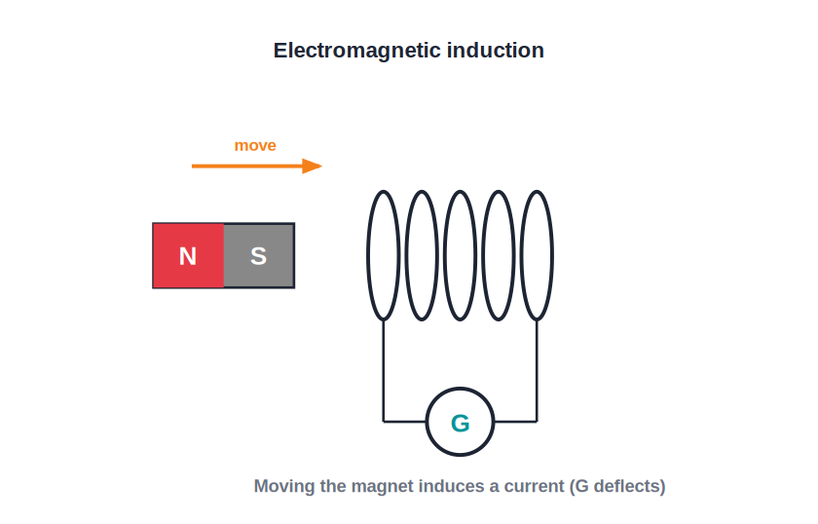
INDUCTION
Electromagnetic Induction
A changing field makes a current
• Moving a magnet into or out of a coil makes a current flow in the coil.
• No battery is needed — the changing magnetic field 'induces' the current.
• A galvanometer deflects, showing the induced current.
• Stop moving the magnet and the current stops — only a change induces it.
Move the magnet → the galvanometer deflects
Notes:
Induction is the reverse of the motor effect. Key word: CHANGE. A stationary magnet induces nothing.

Slide 21
FARADAY
Faraday's Laws of Induction
Faraday summarised electromagnetic induction in two laws.
• First law: an EMF is induced whenever the magnetic field through a coil changes.
• Second law: the size of the induced EMF is greater when the field changes faster.
• More turns, a stronger magnet and faster movement all increase the induced EMF.
Notes:
Faraday: a change of field induces an EMF; faster change (or more turns) gives a bigger EMF.

Slide 22

BIGGER EMF
How to Increase the Induced Current
Move faster
More turns
A quicker change of the magnetic field induces a larger EMF.
A coil with more turns gives a bigger induced EMF.
Stronger magnet
No movement, no EMF
A more powerful magnet increases the change in field.
If nothing changes, no current is induced.
Notes:
The factors that increase induced EMF — all are about a bigger or faster change of field.

Slide 23
LENZ'S LAW
Lenz's Law — the Direction of Induced Current
The induced current always flows in the direction that opposes the change causing it.
• Push a N-pole into a coil and the near face becomes a N-pole to repel it.
• Pull it away and that face becomes a S-pole to attract it back.
• This opposition is why work must be done to generate electricity — it follows from conservation of energy.
Notes:
Lenz's law gives the direction: the induced current always opposes the change. It is energy conservation in action.

Slide 24
FLEMING (RIGHT)
Fleming's Right-Hand Rule
For induction (generators) we use the RIGHT hand to find the direction of the induced current.
• Hold thumb, first finger and second finger of the RIGHT hand at right angles.
• First finger → Field, thuMb → Motion, seCond finger → induced Current.
• Left hand for motors (force); right hand for generators (induced current).
Notes:
Pair this with the left-hand rule: left = motor (force), right = generator (induced current). A frequent point of confusion.

Slide 25
GENERATORS
AC and DC Generators
AC generator
Slip rings
A coil spun in a magnetic field induces an alternating current — how power stations make electricity.
Two slip rings connect the spinning coil to the circuit, delivering AC.
DC generator
Parts
Replacing the slip rings with a split-ring commutator gives a current that flows one way (DC).
A coil (armature), a field magnet, slip rings or a commutator, and carbon brushes.
Notes:
AC generator uses slip rings; a split-ring commutator turns it into a DC generator. Same induction principle.

Slide 26
TRANSFORMER
The Transformer and Its Turns Ratio
A transformer changes an alternating voltage using two coils wound on a common soft-iron core.
Vs / Vp = Ns / Np (ideal: Vp Ip = Vs Is)
• More turns on the secondary (Ns > Np) → step-up transformer (higher voltage).
• Fewer turns on the secondary → step-down transformer.
• An ideal transformer conserves power, so a higher voltage means a smaller current.
Notes:
Turns ratio sets the voltage ratio. In an ideal transformer power in = power out, so stepping voltage up steps current down.

Slide 27
WORKED EXAMPLE
Transformer Turns Ratio
Problem. A transformer steps 230 V down to 23 V. If the primary has 2000 turns, how many turns has the secondary?
Vs / Vp = Ns / Np → Ns = Np × (Vs / Vp)
Ns = 2000 × (23 / 230)
Ns = 2000 × 0.1 = 200 turns
Answer: The secondary has 200 turns (a step-down transformer)
Notes:
Apply the turns ratio. Fewer secondary turns (200 < 2000) confirm it is step-down.

Slide 28
REAL TRANSFORMERS
Energy Losses and Their Cure
Copper loss
Iron (eddy) loss
Heat in the coils' resistance — reduced by thick, low-resistance windings.
Currents induced in the core — reduced by using a laminated core.
Hysteresis loss
Why transmit high
Energy used repeatedly re-magnetising the core — reduced with soft iron.
Step-up at the station and step-down near homes keeps current (and I²R loss) low along the lines.
Notes:
Real transformers lose some energy (copper, eddy, hysteresis). Laminated soft-iron cores and thick wire cut the losses.

Slide 29
WRAP UP
Quick Recap
✓ Motor effect — current in a field feels a force
✓ Fleming's left hand — Field, Current, Motion — for motors
✓ DC motor — opposite forces turn a coil; commutator keeps it going
✓ Induction — a changing field induces a current — no battery
✓ Faraday — EMF appears on change; faster change → bigger EMF
✓ Generator & transformer — make AC, and step voltage up or down
Notes:
Rapid recap; contrast the motor effect (left hand) with induction (right hand / generators).

Slide 30
QUIZ 2
Final Check — Induction & Machines
5 questions • think before the answer reveals on the next slide

Slide 31
QUIZ QUESTION
Q1 — Make It Deflect
A bar magnet is held still inside a coil connected to a galvanometer. The galvanometer reads zero because:
The magnet is too weak
There is no change in the magnetic field, so no EMF is induced
A
B
The coil has too few turns
The wire is broken
C
D

Slide 32
ANSWER REVEALED
Q1 — Make It Deflect
A bar magnet is held still inside a coil connected to a galvanometer. The galvanometer reads zero because:
The magnet is too weak
There is no change in the magnetic field, so no EMF is induced
A
✓
The coil has too few turns
The wire is broken
C
D
WHY
Induction needs a CHANGING field. A motionless magnet gives a steady field through the coil, so nothing is induced. Move it and the needle springs to life.

Slide 33
QUIZ QUESTION
Q2 — Bigger Kick
Which would give the largest deflection on the galvanometer?
Pushing a weak magnet in slowly
Pushing a strong magnet in quickly
A
B
Holding a strong magnet still
Removing the coil
C
D

Slide 34
ANSWER REVEALED
Q2 — Bigger Kick
Which would give the largest deflection on the galvanometer?
Pushing a weak magnet in slowly
Pushing a strong magnet in quickly
A
✓
Holding a strong magnet still
Removing the coil
C
D
WHY
The induced EMF grows with a stronger magnet and a faster change. A strong magnet moved quickly maximises both, giving the biggest deflection.

Slide 35
QUIZ QUESTION
Q3 — Motor or Generator?
A device that converts electrical energy into motion is a motor. A device that converts motion into electrical energy is a:
Transformer
Generator
A
B
Resistor
Fuse
C
D

Slide 36
ANSWER REVEALED
Q3 — Motor or Generator?
A device that converts electrical energy into motion is a motor. A device that converts motion into electrical energy is a:
Transformer
Generator
A
✓
Resistor
Fuse
C
D
WHY
A generator does the reverse of a motor: spinning a coil in a field induces a current, turning mechanical motion into electrical energy.

Slide 37
QUIZ QUESTION
Q4 — Transformer Needs AC
A transformer works only with alternating current because it relies on:
A steady current
A continually changing magnetic field to induce a voltage in the second coil
A
B
A permanent magnet
A commutator
C
D

Slide 38
ANSWER REVEALED
Q4 — Transformer Needs AC
A transformer works only with alternating current because it relies on:
A steady current
A continually changing magnetic field to induce a voltage in the second coil
A
✓
A permanent magnet
A commutator
C
D
WHY
Induction needs change. AC constantly changes, so it keeps the field through the second coil changing and a voltage is induced. A steady DC current would induce nothing.

Slide 39
QUIZ QUESTION
Q5 — Step Up
A transformer has more turns on its output (secondary) coil than on its input. It will:
Step the voltage down
Step the voltage up
A
B
Leave the voltage unchanged
Stop the current
C
D

Slide 40
ANSWER REVEALED
Q5 — Step Up
A transformer has more turns on its output (secondary) coil than on its input. It will:
Step the voltage down
Step the voltage up
A
✓
Leave the voltage unchanged
Stop the current
C
D
WHY
The voltage shares out in proportion to the turns. More turns on the secondary than the primary means a higher output voltage — a step-up transformer.

Slide 41
Motion and Electricity, Two Ways
A current in a field moves a motor; a moving magnet powers a city — electromagnetism runs the modern world.

