Slide 1
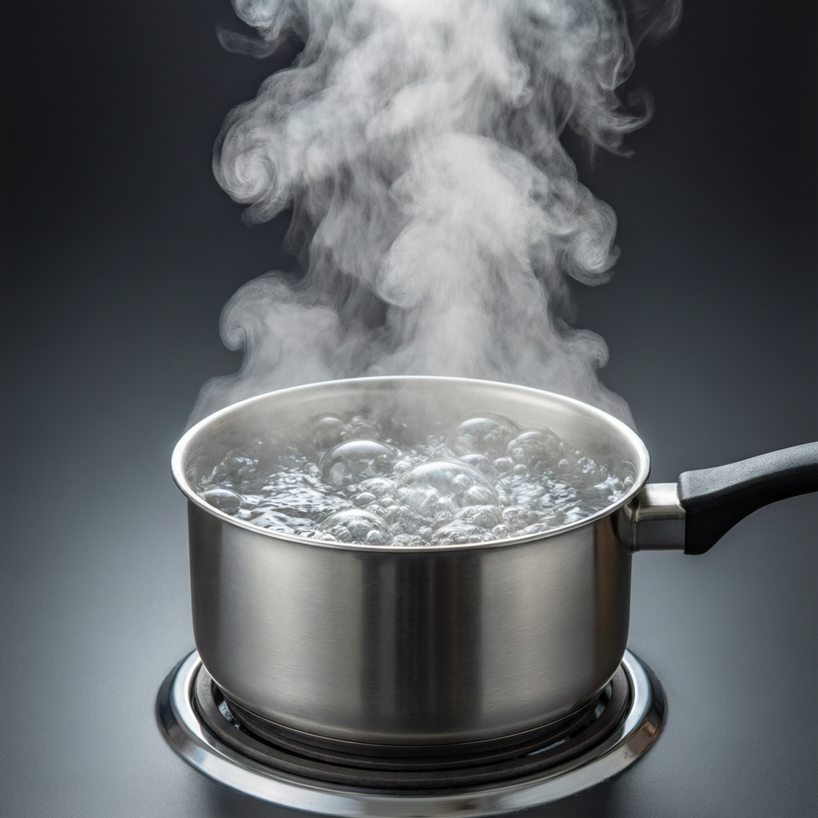
ICSE • CLASS 10 • HEAT
Heat & Specific Heat Capacity
Heat vs temperature • Heat capacity • Specific heat capacity • Q = m c ΔT

Slide 2
INTRODUCTION
Learning Objectives
1
Distinguish heat from temperature
2
List the factors that decide the heat absorbed by a body
3
Define heat (thermal) capacity
4
Define specific heat capacity and its unit
5
Distinguish heat capacity from specific heat capacity
6
Use the relation Q = m c ΔT
Notes:
Open by previewing these objectives so students know what they should be able to do by the end of the session.

Slide 3
PART 1
Heat and Temperature
1
Two different ideas that are often confused

Slide 4



TWO IDEAS
Heat vs Temperature
Heat
Temperature
A form of energy that flows from a hotter body to a colder one. Measured in joules.
How hot or cold a body is — what decides the direction of heat flow. Measured in °C or K.
Energy vs degree
A big example
Heat is total thermal energy; temperature is the average energy per molecule.
A bucket of warm water holds more heat than a red-hot spark, though the spark is hotter.
Notes:
The bucket-vs-spark example is the clearest way to separate heat (total energy) from temperature (degree of hotness).

Slide 5
QUANTITY OF HEAT
What Decides the Heat Absorbed
The heat needed to warm a body depends on its mass, the material, and the temperature rise.
Q = m c ΔT
• m = mass, c = specific heat capacity, ΔT = temperature change.
• More mass or a bigger temperature rise needs more heat.
• Different materials need different amounts of heat (different c).
Notes:
Introduce Q = mcΔT and name each term. Everything in this chapter is built on this relation.

Slide 6

DIFFERENCE
Heat and Temperature Compared
Heat flows
Temperature decides direction
Heat is energy on the move from hot to cold.
Heat always flows from higher to lower temperature.
Units
Measured by
Heat in joules (J); temperature in °C or kelvin (K).
Heat by a calorimeter; temperature by a thermometer.
Notes:
Reinforce the distinction with units and instruments. Temperature difference, not heat content, drives the flow.

Slide 7
HEAT CAPACITY
Heat (Thermal) Capacity
The heat capacity of a body is the heat needed to raise its temperature by 1°C (or 1 K).
Heat capacity = Q / ΔT = m c (unit: J/°C)
• It depends on both the mass and the material of the body.
• A large body has a large heat capacity.
• Unit: joule per degree Celsius (J/°C) or J/K.
Notes:
Heat capacity is for the whole body (depends on mass). Contrast with specific heat capacity next.

Slide 8
WATER EQUIVALENT
Water Equivalent of a Body
The water equivalent of a body is the mass of water that would need the same heat as the body for the same rise in temperature.
W = m c / c_water (unit: kg or g)
• It equals the body's heat capacity expressed as a mass of water.
• A body and its water equivalent have the same heat capacity.
• Used to allow for the heat absorbed by a calorimeter itself.
Notes:
Water equivalent converts a body's heat capacity into an equivalent mass of water — handy in calorimeter calculations.

Slide 9
QUIZ 1
Check Your Understanding
5 questions • think before the answer reveals on the next slide

Slide 10
QUIZ QUESTION
Q1 — Hotter or More Heat?
A cup of tea at 90°C and a bath of water at 40°C. Which statement is correct?
The tea contains more heat energy
The bath contains more heat energy, though the tea is hotter
A
B
Both contain the same heat
Temperature equals heat
C
D

Slide 11
ANSWER REVEALED
Q1 — Hotter or More Heat?
A cup of tea at 90°C and a bath of water at 40°C. Which statement is correct?
The tea contains more heat energy
The bath contains more heat energy, though the tea is hotter
A
✓
Both contain the same heat
Temperature equals heat
C
D
WHY
Temperature tells you how hot something is; heat depends also on mass. The large mass of bath water stores far more thermal energy than the small, hotter cup of tea.

Slide 12
QUIZ QUESTION
Q2 — Direction of Flow
Two bodies are placed in contact. Heat flows from one to the other until:
Their masses are equal
Their heat capacities are equal
A
B
They reach the same temperature
All heat is destroyed
C
D

Slide 13
ANSWER REVEALED
Q2 — Direction of Flow
Two bodies are placed in contact. Heat flows from one to the other until:
Their masses are equal
Their heat capacities are equal
A
B
They reach the same temperature
All heat is destroyed
✓
D
WHY
Heat flows from the hotter to the colder body. It stops when both are at the same temperature — thermal equilibrium — whatever their masses.

Slide 14
QUIZ QUESTION
Q3 — More Heat Needed
Which needs the MOST heat to warm it by 10°C? (water has a high specific heat capacity)
1 kg of water
1 kg of iron
A
B
1 kg of copper
1 kg of sand
C
D

Slide 15
ANSWER REVEALED
Q3 — More Heat Needed
Which needs the MOST heat to warm it by 10°C? (water has a high specific heat capacity)
1 kg of water
1 kg of iron
✓
B
1 kg of copper
1 kg of sand
C
D
WHY
For equal masses and equal temperature rise, Q = mcΔT means the substance with the largest c needs the most heat. Water's specific heat capacity is far higher than metals or sand.

Slide 16
QUIZ QUESTION
Q4 — Units
The SI unit in which heat energy is measured is the:
Degree Celsius
Kelvin
A
B
Joule
Watt
C
D

Slide 17
ANSWER REVEALED
Q4 — Units
The SI unit in which heat energy is measured is the:
Degree Celsius
Kelvin
A
B
Joule
Watt
✓
D
WHY
Heat is a form of energy, so it is measured in joules. Degree Celsius and kelvin are units of temperature, and the watt is a unit of power.

Slide 18
QUIZ QUESTION
Q5 — Water Equivalent
A calorimeter has a heat capacity of 84 J/°C. Its water equivalent is (c_water = 4200 J/kg°C):
0.02 kg
0.05 kg
A
B
0.2 kg
2 kg
C
D

Slide 19
ANSWER REVEALED
Q5 — Water Equivalent
A calorimeter has a heat capacity of 84 J/°C. Its water equivalent is (c_water = 4200 J/kg°C):
0.02 kg
0.05 kg
✓
B
0.2 kg
2 kg
C
D
WHY
Water equivalent = heat capacity / c_water = 84 / 4200 = 0.02 kg (20 g). This mass of water would absorb the same heat per degree as the calorimeter.

Slide 20
PART 2
Specific Heat Capacity
2
The heat 'fingerprint' of a material

Slide 21
SPECIFIC HEAT
Specific Heat Capacity
The specific heat capacity of a substance is the heat needed to raise the temperature of 1 kg of it by 1°C.
c = Q / (m ΔT) (unit: J / kg °C)
• It is a property of the material, not the size of the body.
• Water has a very high value: 4200 J/kg °C.
• Metals have low values, so they heat up and cool down quickly.
Notes:
Specific heat capacity is PER kilogram — a material property. Water's high value is the headline fact.

Slide 22
DISTINCTION
Heat Capacity vs Specific Heat Capacity
Heat capacity
Specific heat capacity
For the whole body; depends on mass; unit J/°C.
Per kilogram; a material property; unit J/kg°C.
Linked by mass
Example
Heat capacity = mass × specific heat capacity.
2 kg of water: c = 4200 J/kg°C, but heat capacity = 8400 J/°C.
Notes:
The key link: heat capacity = m × c. One is for the object, the other for the material.

Slide 23
VALUES
Specific Heat Capacities to Know
Water stands out
• Water 4200 J/kg°C — unusually high; stores a lot of heat.
• Ice about 2100 J/kg°C — roughly half that of water.
• Aluminium about 900 J/kg°C.
• Iron / steel about 450–500 J/kg°C — heats up quickly.
• Copper about 390 J/kg°C — among the lowest.
Notes:
Students should remember water = 4200. Metals are roughly ten-times smaller, hence quick to heat and cool.

Slide 24
WORKED EXAMPLE
Using Q = m c ΔT
Problem. How much heat is needed to raise the temperature of 2 kg of water from 20°C to 70°C? (c_water = 4200 J/kg°C)
Q = m c ΔT
ΔT = 70 − 20 = 50°C
Q = 2 × 4200 × 50
Q = 420,000 J = 420 kJ
Answer: Q = 420,000 J (420 kJ)
Notes:
Find ΔT first, then substitute. Encourage a kJ answer for a sense of scale.

Slide 25
WORKED EXAMPLE
Finding the Temperature Rise
Problem. 5000 J of heat is given to 0.5 kg of aluminium (c = 900 J/kg°C). Find its temperature rise.
Q = m c ΔT → ΔT = Q / (m c)
ΔT = 5000 / (0.5 × 900)
ΔT = 5000 / 450 ≈ 11.1°C
Answer: Temperature rise ≈ 11.1°C
Notes:
Rearrange for ΔT. Note the same heat would warm metals far more than water, because c is smaller.

Slide 26
WRAP UP
Quick Recap
✓ Heat — energy that flows from hot to cold; measured in joules
✓ Temperature — degree of hotness; decides the direction of flow
✓ Q = m c ΔT — heat depends on mass, material and temperature change
✓ Heat capacity — Q/ΔT for the whole body; unit J/°C
✓ Specific heat capacity — per kg material property; unit J/kg°C
✓ Water — very high c = 4200 J/kg°C
Notes:
Rapid recap; Q = mcΔT and the heat-capacity vs specific-heat distinction are the exam essentials.

Slide 27
QUIZ 2
Final Check — Specific Heat
5 questions • think before the answer reveals on the next slide

Slide 28
QUIZ QUESTION
Q1 — Heat Needed
The heat required to raise 3 kg of water by 10°C is (c = 4200 J/kg°C):
12,600 J
42,000 J
A
B
126,000 J
1260 J
C
D

Slide 29
ANSWER REVEALED
Q1 — Heat Needed
The heat required to raise 3 kg of water by 10°C is (c = 4200 J/kg°C):
12,600 J
42,000 J
A
B
126,000 J
1260 J
✓
D
WHY
Q = mcΔT = 3 × 4200 × 10 = 126,000 J. Keep mass, c and ΔT in the right places.

Slide 30
QUIZ QUESTION
Q2 — Quick to Heat
Why does a metal spoon in hot soup become hot far quicker than the soup took to heat up?
Metal has a very high specific heat capacity
Metal has a low specific heat capacity, so little heat raises its temperature a lot
A
B
Metal makes its own heat
Soup is colder than the spoon
C
D

Slide 31
ANSWER REVEALED
Q2 — Quick to Heat
Why does a metal spoon in hot soup become hot far quicker than the soup took to heat up?
Metal has a very high specific heat capacity
Metal has a low specific heat capacity, so little heat raises its temperature a lot
A
✓
Metal makes its own heat
Soup is colder than the spoon
C
D
WHY
A small c means only a little heat is needed to raise the metal's temperature sharply. Water's high c is why the soup took much longer to warm.

Slide 32
QUIZ QUESTION
Q3 — Heat Capacity
The heat capacity of 4 kg of a substance of specific heat capacity 500 J/kg°C is:
125 J/°C
2000 J/°C
A
B
504 J/°C
0.008 J/°C
C
D

Slide 33
ANSWER REVEALED
Q3 — Heat Capacity
The heat capacity of 4 kg of a substance of specific heat capacity 500 J/kg°C is:
125 J/°C
2000 J/°C
A
✓
504 J/°C
0.008 J/°C
C
D
WHY
Heat capacity = mass × specific heat capacity = 4 × 500 = 2000 J/°C. It is the heat needed to warm the whole 4 kg by 1°C.

Slide 34
QUIZ QUESTION
Q4 — Coastal Climate
Places near the sea have milder weather than inland places mainly because water:
Reflects sunlight
Has a high specific heat capacity, so it warms and cools slowly
A
B
Is always cold
Has no specific heat
C
D

Slide 35
ANSWER REVEALED
Q4 — Coastal Climate
Places near the sea have milder weather than inland places mainly because water:
Reflects sunlight
Has a high specific heat capacity, so it warms and cools slowly
A
✓
Is always cold
Has no specific heat
C
D
WHY
The sea stores huge amounts of heat without large temperature swings, moderating the temperature of nearby land — warmer winters and cooler summers.

Slide 36
QUIZ QUESTION
Q5 — Same Heat, Bigger Rise
Equal masses of water and oil are given the same amount of heat. The oil (lower c) will show a:
Smaller temperature rise
Greater temperature rise
A
B
Equal temperature rise
Fall in temperature
C
D

Slide 37
ANSWER REVEALED
Q5 — Same Heat, Bigger Rise
Equal masses of water and oil are given the same amount of heat. The oil (lower c) will show a:
Smaller temperature rise
Greater temperature rise
A
✓
Equal temperature rise
Fall in temperature
C
D
WHY
For the same heat and mass, ΔT = Q/(mc) is larger when c is smaller. Oil's lower specific heat capacity means it heats up more than water for the same energy.

Slide 38
The Energy It Takes to Warm Things
Q = m c ΔT — three letters that explain everything from a kettle to the climate by the sea.

