Slide 1
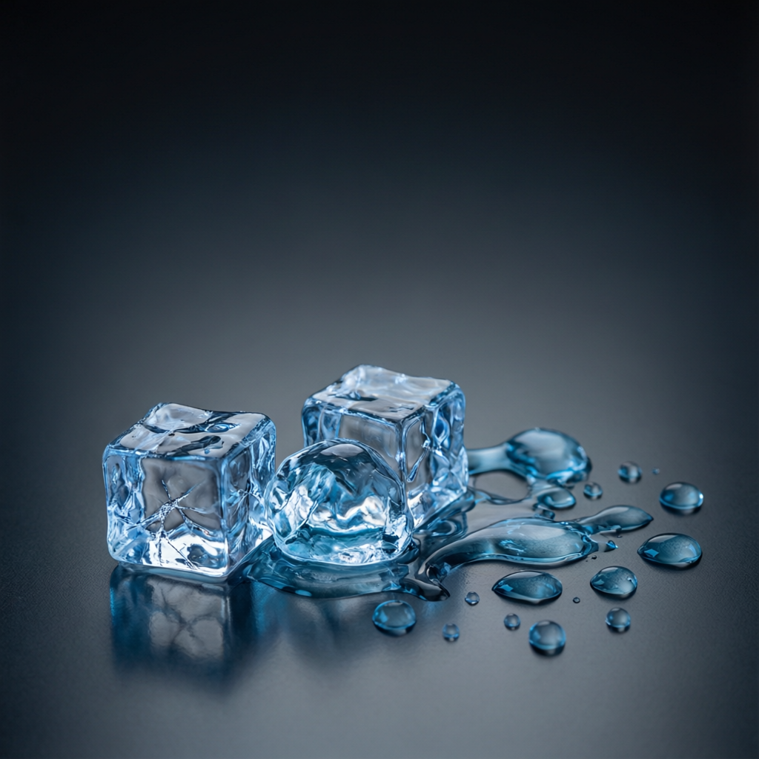
ICSE • CLASS 10 • HEAT
Calorimetry & Melting
The calorimeter • Method of mixtures • Change of phase • Melting & fusion

Slide 2
INTRODUCTION
Learning Objectives
1
Describe a calorimeter and its use
2
State the principle of the method of mixtures
3
Solve mixing problems using heat lost = heat gained
4
List consequences of water's high specific heat capacity
5
Describe the change of phase from solid to liquid
6
Explain the anomalous expansion of water on freezing
Notes:
Open by previewing these objectives so students know what they should be able to do by the end of the session.

Slide 3
PART 1
Measuring Heat: Method of Mixtures
1
Using a calorimeter to find specific heat

Slide 4
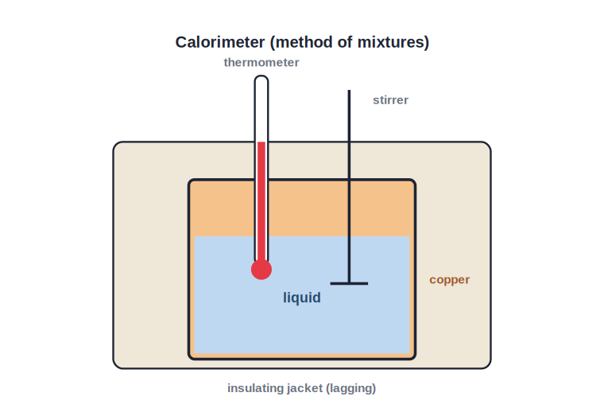
CALORIMETER
The Calorimeter
Copper vessel, stirrer, thermometer
• A calorimeter is a copper vessel used to measure quantities of heat.
• Copper is used because of its low specific heat capacity and good conduction.
• It has a stirrer to share heat evenly and a thermometer to read the temperature.
• An insulating jacket reduces heat loss to the surroundings.
Lagging cuts heat loss to the surroundings
Notes:
Explain each part and why copper is chosen. The insulation matters for accurate results.

Slide 5
METHOD OF MIXTURES
Principle of the Method of Mixtures
When a hot body is mixed with a cold one and no heat escapes, the heat lost by the hot body equals the heat gained by the cold one.
Heat lost by hot body = Heat gained by cold body
• This is just the conservation of energy applied to heat.
• Each side is calculated as Q = m c ΔT.
• It lets us find an unknown specific heat or final temperature.
Notes:
The core principle: heat lost = heat gained. Set the two mcΔT expressions equal and solve.

Slide 6
WORKED EXAMPLE
Method of Mixtures
Problem. 0.2 kg of water at 80°C is mixed with 0.3 kg of water at 20°C. Find the final temperature. (c cancels)
Heat lost by hot water = Heat gained by cold water
0.2 × c × (80 − T) = 0.3 × c × (T − 20)
0.2(80 − T) = 0.3(T − 20) → 16 − 0.2T = 0.3T − 6
22 = 0.5T → T = 44°C
Answer: Final temperature = 44°C
Notes:
Because both are water, c cancels. Set heat lost = heat gained and solve for T. Check: 44°C lies between 20 and 80.

Slide 7
WORKED EXAMPLE
Specific Heat by Mixtures
Problem. 0.2 kg of a hot metal at 100°C is dropped into 0.3 kg of water at 20°C. The mixture settles at 25°C. Find the metal's specific heat capacity. (c_water = 4200 J/kg°C; ignore the calorimeter)
Heat gained by water = 0.3 × 4200 × (25 − 20) = 6300 J
Heat lost by metal = 0.2 × c × (100 − 25) = 15 c
Heat lost = heat gained: 15 c = 6300
c = 6300 / 15 = 420 J/kg°C
Answer: Specific heat capacity of the metal = 420 J/kg°C
Notes:
Classic 'find c by mixtures' problem: equate heat lost by the metal to heat gained by the water and solve for c.

Slide 8
PRECAUTIONS
Getting an Accurate Result
Sources of error and their cure
• Lag the calorimeter Insulation reduces heat lost to the surroundings.
• Stir gently So the temperature is uniform before each reading.
• Allow for the calorimeter Include its water equivalent in the heat-gained side.
• Small temperature gap Keeping it close to room temperature limits heat exchange with the air.
Notes:
The main error is heat loss to surroundings. Lagging, stirring, and allowing for the calorimeter improve accuracy.

Slide 9



WATER'S HIGH C
Consequences of Water's High Specific Heat
Coolant
Mild coastal climate
Water carries away a lot of heat, so it cools car engines and machinery.
The sea warms and cools slowly, moderating nearby weather.
Hot-water bottles
Body temperature
Water stores a lot of heat and releases it slowly to keep us warm.
The water in our bodies helps keep our temperature steady.
Notes:
All these follow from water needing lots of heat to change temperature. Coolant and climate are the favourites.

Slide 10

EXAMPLES
High and Low Heat Capacity
Water — high
Sand — lower
Stores lots of heat; used in hot-water bottles and cooling systems.
Heats up and cools down quickly — beaches are hot by day, cold at night.
Land vs sea
Metals — low
Land (lower capacity) heats faster than the sea, driving sea breezes.
A metal pan heats almost at once; the water in it takes much longer.
Notes:
Contrast high (water) and low (sand, metals) heat capacity with everyday effects like sea breezes and beach sand.

Slide 11
QUIZ 1
Check Your Understanding
5 questions • think before the answer reveals on the next slide

Slide 12
QUIZ QUESTION
Q1 — Why Copper?
A calorimeter is made of copper mainly because copper has:
A high specific heat capacity
A low specific heat capacity and conducts heat well
A
B
A shiny colour
A high melting point
C
D

Slide 13
ANSWER REVEALED
Q1 — Why Copper?
A calorimeter is made of copper mainly because copper has:
A high specific heat capacity
A low specific heat capacity and conducts heat well
A
✓
A shiny colour
A high melting point
C
D
WHY
A low specific heat capacity means the calorimeter itself absorbs little heat, and good conduction lets it quickly share the temperature — both improve the accuracy of measurements.

Slide 14
QUIZ QUESTION
Q2 — Heat Balance
When a hot metal is dropped into cold water in an ideal (perfectly insulated) calorimeter:
The water loses heat to the metal
Heat lost by the metal equals heat gained by the water
A
B
Both gain heat
No heat moves
C
D

Slide 15
ANSWER REVEALED
Q2 — Heat Balance
When a hot metal is dropped into cold water in an ideal (perfectly insulated) calorimeter:
The water loses heat to the metal
Heat lost by the metal equals heat gained by the water
A
✓
Both gain heat
No heat moves
C
D
WHY
With no heat escaping, energy is conserved: every joule the hot metal loses is gained by the cooler water until both reach the same temperature.

Slide 16
QUIZ QUESTION
Q3 — Final Temperature
Equal masses of water at 30°C and 50°C are mixed. The final temperature will be:
30°C
40°C
A
B
50°C
80°C
C
D

Slide 17
ANSWER REVEALED
Q3 — Final Temperature
Equal masses of water at 30°C and 50°C are mixed. The final temperature will be:
30°C
40°C
A
✓
50°C
80°C
C
D
WHY
For equal masses of the same liquid, the final temperature is simply the average: (30 + 50)/2 = 40°C. Heat lost by the hotter equals heat gained by the cooler.

Slide 18
QUIZ QUESTION
Q4 — Engine Coolant
Water is used as a coolant in car engines because it:
Boils very easily
Can absorb a large amount of heat for a small temperature rise
A
B
Is a metal
Freezes quickly
C
D

Slide 19
ANSWER REVEALED
Q4 — Engine Coolant
Water is used as a coolant in car engines because it:
Boils very easily
Can absorb a large amount of heat for a small temperature rise
A
✓
Is a metal
Freezes quickly
C
D
WHY
Water's high specific heat capacity lets it carry away a great deal of engine heat while warming only modestly, making it an excellent coolant.

Slide 20
QUIZ QUESTION
Q5 — Sea Breeze
During the day a cool breeze blows from the sea to the land because the land:
Has a higher specific heat capacity than the sea
Heats up faster than the sea, so warm air rises over it and cool sea air flows in
A
B
Is colder than the sea
Reflects more sunlight
C
D

Slide 21
ANSWER REVEALED
Q5 — Sea Breeze
During the day a cool breeze blows from the sea to the land because the land:
Has a higher specific heat capacity than the sea
Heats up faster than the sea, so warm air rises over it and cool sea air flows in
A
✓
Is colder than the sea
Reflects more sunlight
C
D
WHY
Land has a lower heat capacity, so it warms quickly in the Sun. The hot air above it rises, and cooler air from over the slower-warming sea flows in to replace it — the sea breeze.

Slide 22
PART 2
Change of Phase: Melting
2
Solid to liquid, and water's odd behaviour

Slide 23
CHANGE OF PHASE
Solid, Liquid, Gas
Heating can change the state
• Change of phase Matter can change between solid, liquid and gas states when heated or cooled.
• Melting Solid → liquid, at the melting point.
• Constant temperature During melting the temperature stays the same even as heat is added.
• Where the heat goes The heat breaks the bonds holding the solid together — latent heat.
Notes:
Set up phase change. The key surprise: temperature is constant during melting; heat goes into breaking bonds.

Slide 24
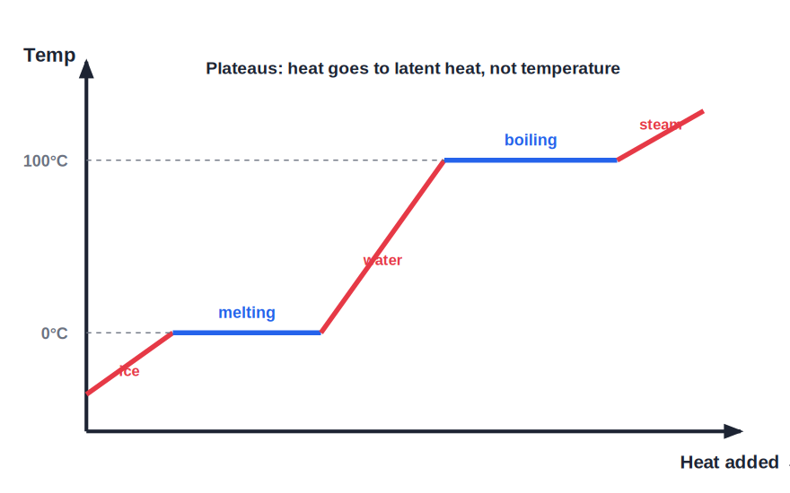
HEATING CURVE
Heating Curve of Ice
A flat step at the melting point
• Heat ice and its temperature rises until it reaches 0°C.
• At 0°C the temperature stays constant while the ice melts — a flat plateau.
• All the heat supplied then goes to melting, not to raising temperature.
• Once melted, the water's temperature rises again.
Temperature is constant while ice melts
Notes:
Read the first plateau of the curve. Stress the flat part: added heat melts the ice without warming it.

Slide 25
ANOMALOUS WATER
Water Expands When It Freezes
The anomalous expansion of water
• Most substances shrink Almost all liquids contract when they solidify.
• Water is different Water expands as it freezes, so ice is less dense than water.
• Ice floats Because ice is less dense, it floats on water.
• Life under ice A floating ice layer insulates the water below, letting fish survive a frozen winter.
Notes:
Water's expansion on freezing is unusual and vital — floating ice protects aquatic life. Also why pipes burst in winter.

Slide 26
WRAP UP
Quick Recap
✓ Calorimeter — copper vessel + stirrer + thermometer + lagging
✓ Method of mixtures — heat lost by hot = heat gained by cold
✓ Water's high c — coolant, mild climates, steady body temperature
✓ Melting — solid → liquid at constant temperature
✓ Heating curve — flat plateau while ice melts
✓ Anomalous water — expands on freezing, so ice floats
Notes:
Rapid recap; method of mixtures and the melting plateau are the key ideas.

Slide 27
QUIZ 2
Final Check — Mixing & Melting
5 questions • think before the answer reveals on the next slide

Slide 28
QUIZ QUESTION
Q1 — Where Did Heat Go?
While ice is melting at 0°C, heat is still being supplied, yet the thermometer reading does not change. The heat is being used to:
Raise the temperature
Break the bonds and change ice to water
A
B
Cool the surroundings
Create new ice
C
D

Slide 29
ANSWER REVEALED
Q1 — Where Did Heat Go?
While ice is melting at 0°C, heat is still being supplied, yet the thermometer reading does not change. The heat is being used to:
Raise the temperature
Break the bonds and change ice to water
A
✓
Cool the surroundings
Create new ice
C
D
WHY
During melting the supplied heat (latent heat) goes into separating the molecules of the solid, not into raising the temperature — so the reading stays at 0°C until all the ice has melted.

Slide 30
QUIZ QUESTION
Q2 — Mixing Unequal
0.1 kg of water at 90°C is added to 0.4 kg of water at 15°C. The final temperature is closest to:
52°C
30°C
A
B
75°C
15°C
C
D

Slide 31
ANSWER REVEALED
Q2 — Mixing Unequal
0.1 kg of water at 90°C is added to 0.4 kg of water at 15°C. The final temperature is closest to:
52°C
30°C
A
✓
75°C
15°C
C
D
WHY
Heat lost = heat gained: 0.1(90 − T) = 0.4(T − 15). So 9 − 0.1T = 0.4T − 6, giving 0.5T = 15, T = 30°C. The larger cold mass pulls the result down toward 15°C.

Slide 32
QUIZ QUESTION
Q3 — Frozen Pond
Fish survive in a pond that freezes over because:
Ice sinks and warms the bottom
Ice floats and insulates the water below, which stays liquid
A
B
Fish do not need water
The whole pond freezes solid
C
D

Slide 33
ANSWER REVEALED
Q3 — Frozen Pond
Fish survive in a pond that freezes over because:
Ice sinks and warms the bottom
Ice floats and insulates the water below, which stays liquid
A
✓
Fish do not need water
The whole pond freezes solid
C
D
WHY
Water expands on freezing, so the ice is less dense and floats. This ice layer insulates the water beneath, which remains liquid and lets fish survive the winter.

Slide 34
QUIZ QUESTION
Q4 — Burst Pipes
Water pipes sometimes burst in very cold weather because water:
Contracts when it freezes
Expands when it freezes, pushing the pipe apart
A
B
Evaporates in the pipe
Becomes heavier
C
D

Slide 35
ANSWER REVEALED
Q4 — Burst Pipes
Water pipes sometimes burst in very cold weather because water:
Contracts when it freezes
Expands when it freezes, pushing the pipe apart
A
✓
Evaporates in the pipe
Becomes heavier
C
D
WHY
Unlike most liquids, water expands as it turns to ice. Trapped in a pipe, the expanding ice exerts a large force that can crack or burst the pipe.

Slide 36
QUIZ QUESTION
Q5 — Stirrer's Job
Why does a calorimeter have a stirrer?
To add heat
To spread the heat evenly so the thermometer reads the true temperature
A
B
To cool the water
To measure mass
C
D

Slide 37
ANSWER REVEALED
Q5 — Stirrer's Job
Why does a calorimeter have a stirrer?
To add heat
To spread the heat evenly so the thermometer reads the true temperature
A
✓
To cool the water
To measure mass
C
D
WHY
Stirring mixes the contents so the temperature is uniform throughout. Then the thermometer reads the genuine common temperature, improving accuracy.

Slide 38
Heat That Hides in a Change of State
From mixing hot and cold to melting ice — energy is always conserved, even when the thermometer stands still.

