Slide 1
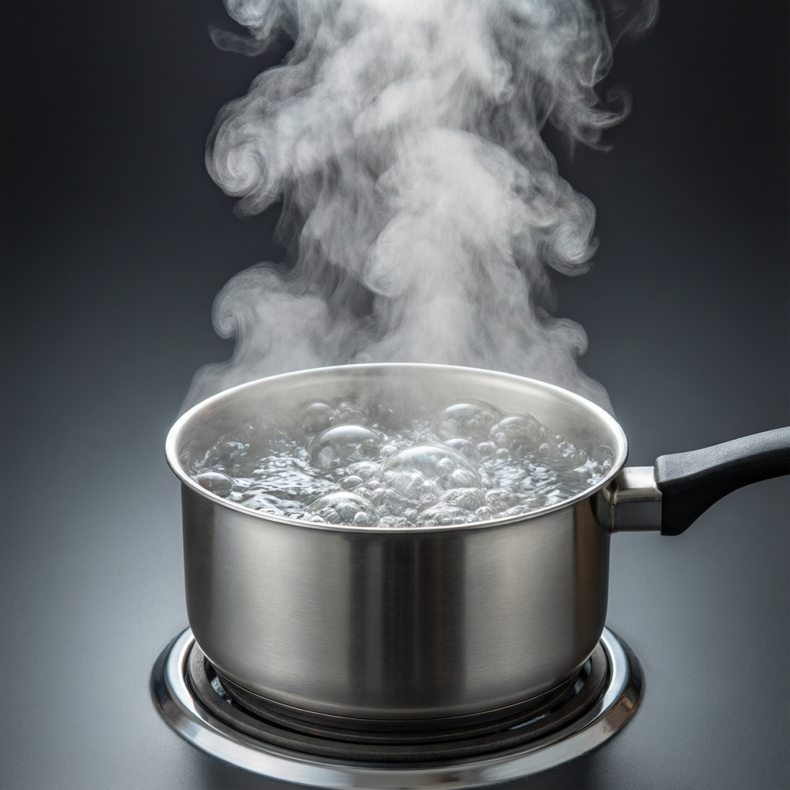
ICSE • CLASS 10 • HEAT
Boiling & Latent Heat
Boiling • Effect of pressure & impurities • Latent heat • Specific latent heat

Slide 2
INTRODUCTION
Learning Objectives
1
Describe boiling and read the heating curve of water
2
Explain the effect of pressure on melting and boiling points
3
Explain the effect of impurities on melting and boiling points
4
Define latent heat and specific latent heat
5
Explain latent heat using the kinetic (molecular) model
6
State consequences of water's high latent heat of fusion
Notes:
Open by previewing these objectives so students know what they should be able to do by the end of the session.

Slide 3
PART 1
Boiling, Pressure & Impurities
1
What changes the melting and boiling points

Slide 4
BOILING
Vaporisation and Boiling
Boiling is the rapid change of a liquid into vapour throughout the liquid, at a fixed temperature called the boiling point.
• For water at normal pressure the boiling point is 100°C.
• During boiling the temperature stays constant though heat is supplied.
• The heat supplied becomes the latent heat of vaporisation.
Notes:
Boiling happens at a fixed temperature, constant while heat is added. Distinguish from evaporation (surface, any temperature).

Slide 5
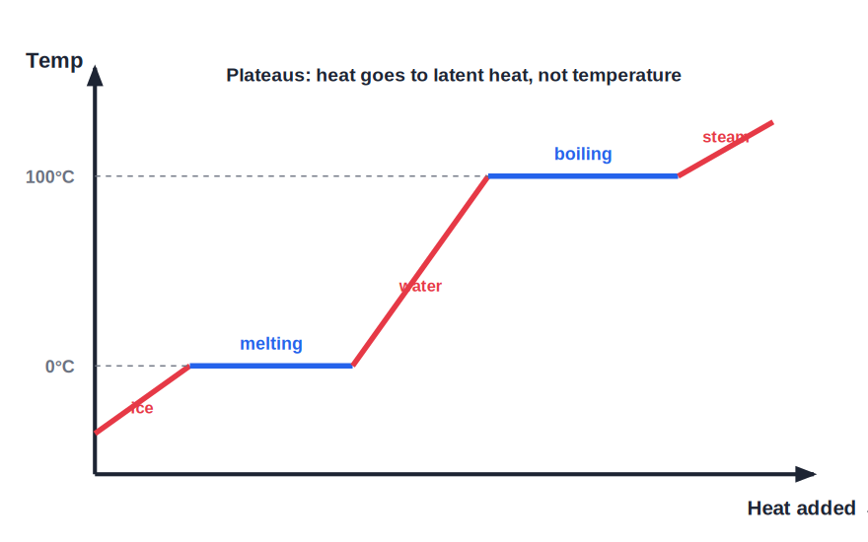
HEATING CURVE
Heating Curve of Water
Two plateaus: melting and boiling
• Heating water raises its temperature until it reaches 100°C.
• At 100°C the temperature stays constant while the water boils — a second plateau.
• All the heat then goes into turning water into steam.
• The two flat steps (melting and boiling) are where latent heat is absorbed.
Temperature is constant while water boils
Notes:
Show both plateaus. The flat sections are latent-heat regions — temperature constant, heat still flowing in.

Slide 6


EVAPORATION
Evaporation and the Cooling It Causes
What it is
Causes cooling
The slow change of a liquid to vapour from its surface, at any temperature.
The fastest molecules escape, so the liquid left behind cools down.
Faster when…
Everyday cooling
Higher temperature, larger surface area, dry moving air all speed it up.
Sweating, earthen pots and wet-cloth coolers all use evaporative cooling.
Notes:
Evaporation: surface-only, any temperature, removes the fastest molecules and so cools. List the factors that speed it up.

Slide 7
PRESSURE
Effect of Pressure
Pressure changes the change-points
• Boiling point rises with pressure Higher pressure makes water boil above 100°C — used in a pressure cooker to cook faster.
• Boiling point falls with low pressure On a high mountain, lower pressure makes water boil below 100°C, so food cooks slowly.
• Melting point of ice falls with pressure Extra pressure lowers the melting point of ice slightly.
• Regelation Ice can melt under pressure and re-freeze when the pressure is removed.
Notes:
Pressure raises the boiling point (cooker) but lowers the melting point of ice (regelation). Mountain cooking is a great example.

Slide 8
IMPURITIES
Effect of Impurities
Impurities widen the liquid range
• Lower the melting point Salt sprinkled on icy roads makes the ice melt below 0°C.
• Raise the boiling point Dissolving salt makes water boil above 100°C.
• Why salt on roads It keeps water liquid below 0°C, clearing ice in winter.
• Antifreeze Added to car radiators to stop the water freezing in cold weather.
Notes:
Impurities lower the melting point and raise the boiling point — salt on roads and antifreeze are the standard examples.

Slide 9
QUIZ 1
Check Your Understanding
5 questions • think before the answer reveals on the next slide

Slide 10
QUIZ QUESTION
Q1 — Pressure Cooker
Food cooks faster in a pressure cooker because the raised pressure inside:
Lowers the boiling point of water
Raises the boiling point, so the water and steam are hotter
A
B
Removes all the water
Cools the food
C
D

Slide 11
ANSWER REVEALED
Q1 — Pressure Cooker
Food cooks faster in a pressure cooker because the raised pressure inside:
Lowers the boiling point of water
Raises the boiling point, so the water and steam are hotter
A
✓
Removes all the water
Cools the food
C
D
WHY
Higher pressure pushes the boiling point above 100°C, so the water and steam reach a higher temperature and cook the food more quickly.

Slide 12
QUIZ QUESTION
Q2 — Mountain Tea
On a high mountain, water boils at about 90°C. As a result:
Tea is hotter than usual
Food takes longer to cook because the water is not as hot
A
B
Water cannot boil at all
The boiling point is unchanged
C
D

Slide 13
ANSWER REVEALED
Q2 — Mountain Tea
On a high mountain, water boils at about 90°C. As a result:
Tea is hotter than usual
Food takes longer to cook because the water is not as hot
A
✓
Water cannot boil at all
The boiling point is unchanged
C
D
WHY
Lower air pressure at altitude lowers the boiling point, so the boiling water is cooler than 100°C and cooks food more slowly.

Slide 14
QUIZ QUESTION
Q3 — Salt on Roads
Salt is spread on icy roads in winter because it:
Raises the melting point of ice
Lowers the melting point, so the ice melts below 0°C
A
B
Makes the ice harder
Warms the road
C
D

Slide 15
ANSWER REVEALED
Q3 — Salt on Roads
Salt is spread on icy roads in winter because it:
Raises the melting point of ice
Lowers the melting point, so the ice melts below 0°C
A
✓
Makes the ice harder
Warms the road
C
D
WHY
Salt is an impurity that lowers the melting point of ice, so it melts even when the temperature is a little below 0°C, clearing the road.

Slide 16
QUIZ QUESTION
Q4 — Boiling vs Evaporation
Which is true of boiling but NOT of evaporation?
It happens only at the surface
It occurs at any temperature
A
B
It happens throughout the liquid at a fixed temperature
It cools the liquid
C
D

Slide 17
ANSWER REVEALED
Q4 — Boiling vs Evaporation
Which is true of boiling but NOT of evaporation?
It happens only at the surface
It occurs at any temperature
A
B
It happens throughout the liquid at a fixed temperature
It cools the liquid
✓
D
WHY
Boiling occurs all through the liquid at one fixed temperature (the boiling point). Evaporation happens only at the surface and at any temperature.

Slide 18
QUIZ QUESTION
Q5 — Cooler in Earthen Pot
Water stays cool in a porous earthen pot because water seeping to the outside:
Boils away
Evaporates, taking heat from the water inside
A
B
Freezes
Absorbs sunlight
C
D

Slide 19
ANSWER REVEALED
Q5 — Cooler in Earthen Pot
Water stays cool in a porous earthen pot because water seeping to the outside:
Boils away
Evaporates, taking heat from the water inside
A
✓
Freezes
Absorbs sunlight
C
D
WHY
Water oozing through the pores evaporates from the surface, and the fastest molecules carry energy away. This draws heat from the water within, keeping it cool — evaporative cooling.

Slide 20
PART 2
Latent Heat
2
The hidden heat of a change of state

Slide 21
LATENT HEAT
Latent Heat
Latent heat is the heat absorbed or released during a change of state, WITHOUT any change in temperature.
Q = m L (L = specific latent heat, J/kg)
• 'Latent' means hidden — the heat is stored in changing the state, not raising the temperature.
• Specific latent heat L is the heat per kilogram for the change of state.
• Fusion = solid↔liquid; vaporisation = liquid↔gas.
Notes:
Latent = hidden heat at constant temperature. Q = mL is the working formula. Define fusion and vaporisation.

Slide 22
VALUES
Specific Latent Heats of Water
Hidden heat per kilogram
• Fusion (melting) L_fusion of ice ≈ 336,000 J/kg (3.36 × 10⁵ J/kg).
• Vaporisation (boiling) L_vap of water ≈ 2,260,000 J/kg (2.26 × 10⁶ J/kg).
• Why so big A lot of energy is needed to fully separate the molecules.
• Q = m L Heat for a change of state = mass × specific latent heat.
Notes:
Students should know the two values. Vaporisation needs far more than fusion — molecules must be fully separated.

Slide 23
KINETIC MODEL
Latent Heat and the Molecular Model
Where the hidden heat goes
• Melting Heat gives molecules enough energy to break free of their fixed positions, so the solid becomes a liquid.
• No temperature rise The energy goes into loosening bonds, not into faster motion, so the temperature is unchanged.
• Boiling Even more energy fully separates the molecules into a gas.
• On cooling The same latent heat is released when a gas condenses or a liquid freezes.
Notes:
Use the molecular picture: latent heat breaks bonds rather than speeding molecules up — hence constant temperature.

Slide 24
WORKED EXAMPLE
Heat to Melt Ice
Problem. How much heat is needed to melt 0.5 kg of ice at 0°C into water at 0°C? (L_fusion = 336,000 J/kg)
Q = m L
Q = 0.5 × 336,000
Q = 168,000 J
Answer: Q = 168,000 J (168 kJ)
Notes:
Pure phase change at 0°C, so use Q = mL only — no mcΔT term because the temperature does not change.

Slide 25
WORKED EXAMPLE
Heat to Boil Water Away
Problem. How much heat turns 0.2 kg of water at 100°C into steam at 100°C? (L_vaporisation = 2.26 × 10⁶ J/kg)
Q = m L
Q = 0.2 × 2.26 × 10⁶
Q = 4.52 × 10⁵ J
Answer: Q = 4.52 × 10⁵ J (452 kJ) — far more than melting the same mass
Notes:
Compare with melting: vaporising the same mass needs about 7 times more heat, because molecules must fully separate.

Slide 26


CONSEQUENCES
Why Water's Latent Heat of Fusion Matters
Ice cools drinks well
Ice keeps food cold
Melting ice absorbs a lot of heat from the drink, cooling it effectively.
It absorbs heat slowly as it melts, keeping an ice-box cold for hours.
Snow melts slowly
Frost protection
The large latent heat means snow and ice take a long time to melt in spring.
Water released onto crops gives out latent heat as it freezes, protecting them from frost.
Notes:
High latent heat of fusion makes ice a powerful, long-lasting coolant and explains slow spring thaws.

Slide 27
WRAP UP
Quick Recap
✓ Boiling — fixed temperature; constant while heat is supplied
✓ Pressure — raises boiling point (cooker), lowers melting point of ice
✓ Impurities — lower the melting point, raise the boiling point
✓ Latent heat — heat for a change of state at constant temperature; Q = m L
✓ Values — fusion 3.36 × 10⁵ J/kg; vaporisation 2.26 × 10⁶ J/kg
✓ Kinetic model — latent heat breaks bonds, not raising temperature
Notes:
Rapid recap; Q = mL and the pressure/impurity effects are the key exam points.

Slide 28
QUIZ 2
Final Check — Latent Heat
5 questions • think before the answer reveals on the next slide

Slide 29
QUIZ QUESTION
Q1 — Worse Burn
Steam at 100°C causes a far worse burn than water at 100°C because the steam:
Is hotter than the water
Releases its large latent heat of vaporisation as it condenses on the skin
A
B
Moves faster
Contains more salt
C
D

Slide 30
ANSWER REVEALED
Q1 — Worse Burn
Steam at 100°C causes a far worse burn than water at 100°C because the steam:
Is hotter than the water
Releases its large latent heat of vaporisation as it condenses on the skin
A
✓
Moves faster
Contains more salt
C
D
WHY
Both are at 100°C, but when steam condenses on the skin it gives up its huge latent heat of vaporisation (2.26 × 10⁶ J/kg) on top of cooling — delivering much more heat than hot water alone.

Slide 31
QUIZ QUESTION
Q2 — Melt the Ice
The heat needed to melt 2 kg of ice at 0°C is (L = 3.36 × 10⁵ J/kg):
1.68 × 10⁵ J
6.72 × 10⁵ J
A
B
3.36 × 10⁵ J
672 J
C
D

Slide 32
ANSWER REVEALED
Q2 — Melt the Ice
The heat needed to melt 2 kg of ice at 0°C is (L = 3.36 × 10⁵ J/kg):
1.68 × 10⁵ J
6.72 × 10⁵ J
A
✓
3.36 × 10⁵ J
672 J
C
D
WHY
Q = mL = 2 × 3.36 × 10⁵ = 6.72 × 10⁵ J. No temperature change, so only the latent-heat term is needed.

Slide 33
QUIZ QUESTION
Q3 — Constant Temperature
While a pure substance is changing state, the heat supplied causes:
A rise in temperature
No change in temperature, only a change of state
A
B
A fall in temperature
The substance to disappear
C
D

Slide 34
ANSWER REVEALED
Q3 — Constant Temperature
While a pure substance is changing state, the heat supplied causes:
A rise in temperature
No change in temperature, only a change of state
A
✓
A fall in temperature
The substance to disappear
C
D
WHY
During a change of state the heat is latent — it goes into rearranging the molecules, not into raising the temperature, so the thermometer reading stays fixed.

Slide 35
QUIZ QUESTION
Q4 — Best Coolant
To cool a drink, 100 g of ice at 0°C works better than 100 g of water at 0°C because the ice:
Is colder
Must first absorb its latent heat of fusion to melt, taking extra heat from the drink
A
B
Is heavier
Floats
C
D

Slide 36
ANSWER REVEALED
Q4 — Best Coolant
To cool a drink, 100 g of ice at 0°C works better than 100 g of water at 0°C because the ice:
Is colder
Must first absorb its latent heat of fusion to melt, taking extra heat from the drink
A
✓
Is heavier
Floats
C
D
WHY
Both start at 0°C, but the ice must absorb a large latent heat to melt before it can warm up. That extra heat is taken from the drink, cooling it much more effectively.

Slide 37
QUIZ QUESTION
Q5 — Sea-Breeze Pressure
Increasing the pressure on a sample of ice will:
Raise its melting point
Lower its melting point slightly so it melts more easily
A
B
Have no effect
Turn it straight to steam
C
D

Slide 38
ANSWER REVEALED
Q5 — Sea-Breeze Pressure
Increasing the pressure on a sample of ice will:
Raise its melting point
Lower its melting point slightly so it melts more easily
A
✓
Have no effect
Turn it straight to steam
C
D
WHY
Unusually, increasing the pressure lowers the melting point of ice (because ice contracts on melting). This is the basis of regelation, where ice melts under pressure and refreezes after.

Slide 39
The Hidden Heat of Change
Latent heat keeps temperatures steady through melting and boiling — the quiet physics behind ice, steam and the weather.

