Slide 1
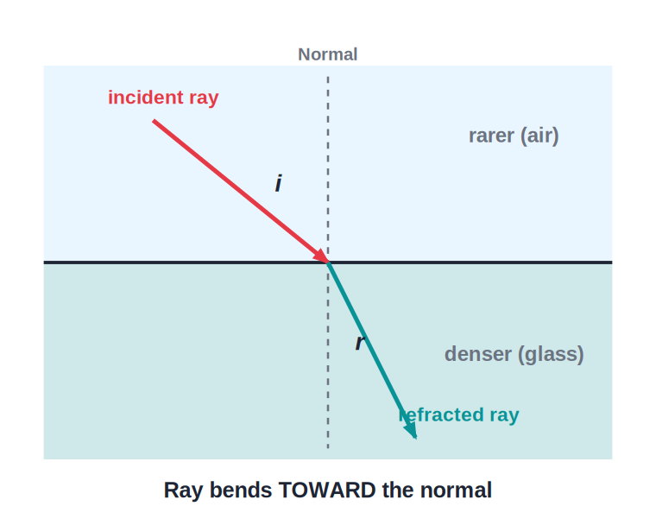
ICSE • CLASS 10 • OPTICS
Refraction of Light
Bending of light at plane surfaces • Laws of refraction • Refractive index • The glass block

Slide 2
INTRODUCTION
Learning Objectives
1
Explain what refraction is and why it happens
2
State and apply the two laws of refraction (Snell's law)
3
Define refractive index and relate it to the speed of light
4
Use n = c / v for the speed of light in a medium
5
Trace a ray through a rectangular glass block
6
Describe lateral displacement and multiple images in thick glass
Notes:
Open by previewing these objectives so students know what they should be able to do by the end of the session.

Slide 3
PART 1
What Refraction Is
1
Bending of light when it changes medium

Slide 4
REFRACTION
What Is Refraction?
Definition
• Refraction is the bending of light as it passes from one transparent medium into another.
• It happens because the speed of light is different in different media.
• The bending takes place only at the boundary (surface) separating the two media.
• A ray entering along the normal does not bend.
Air → glass: ray bends toward the normal
Notes:
Define refraction, then ask students why a straw in a glass of water looks bent. Emphasise the change in speed is the cause, and bending only happens at the surface.

Slide 5

WHICH WAY DOES IT BEND?
The Two Rules of Bending
Rarer → Denser
Denser → Rarer
Going into a denser medium (air → glass), light slows down and bends TOWARD the normal.
Going into a rarer medium (glass → air), light speeds up and bends AWAY from the normal.
Along the normal
At the boundary
A ray that strikes the surface at 90° (along the normal) passes straight through, un-bent.
Bending happens only at the surface; inside a uniform medium the ray travels in a straight line.
Notes:
Drill the toward/away rule — it is the single most tested idea. Use the swimmer-in-mud analogy: the part of the line that enters the denser medium first slows, swinging the ray toward the normal.

Slide 6
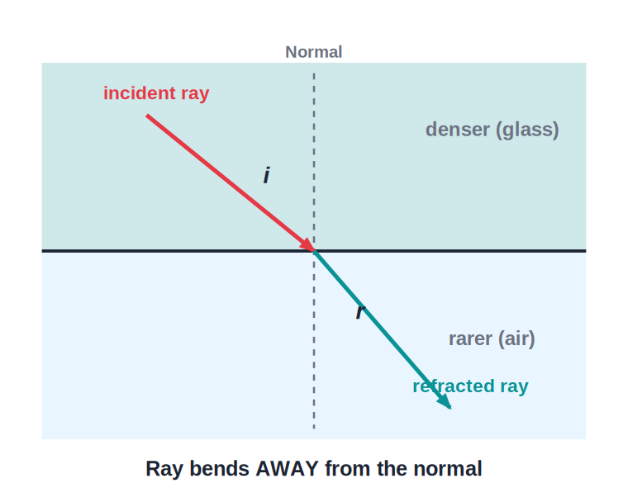
DENSER → RARER
Bending Away From the Normal
Glass → Air
• When light leaves a denser medium for a rarer one it speeds up.
• The refracted ray bends away from the normal.
• So the angle of refraction is larger than the angle of incidence.
• This is exactly the reverse of the air → glass case.
Glass → air: ray bends away from the normal
Notes:
Contrast directly with the previous slide. Stress that the path is reversible — same diagram, arrows flipped.

Slide 7
REFRACTIVE INDEX
Refractive Index (n)
The refractive index of a medium measures how much it bends light — how much it slows light down compared with vacuum.
n = speed of light in vacuum (c) / speed of light in medium (v)
• Refractive index has no unit (it is a ratio).
• A higher n means light travels slower and bends more.
• For air n ≈ 1.0; the denser the medium, the larger n.
• It also equals sin i / sin r (from Snell's law).
Notes:
Define absolute refractive index. Make the link: bigger n → slower light → more bending. Mention n is a pure ratio, hence no unit.

Slide 8
SPEED OF LIGHT
Speed of Light in Different Media
Light slows down in a denser medium
• Vacuum / air c = 3 × 10⁸ m/s — the fastest light can travel.
• Water v ≈ 2.25 × 10⁸ m/s, so n ≈ 1.33.
• Glass v ≈ 2.0 × 10⁸ m/s, so n ≈ 1.5.
• Diamond v ≈ 1.24 × 10⁸ m/s, so n ≈ 2.42 — bends light the most.
• Key relation n = c / v → the smaller the speed v, the larger n.
Notes:
Read the table as a story: as we move to denser media the speed falls and n rises. Diamond's huge n is why it sparkles.

Slide 9
RELATIVE INDEX
Absolute and Relative Refractive Index
The absolute refractive index is measured with respect to vacuum; the relative refractive index compares any two media.
₁n₂ = n₂ / n₁ = v₁ / v₂ = λ₁ / λ₂ = sin i / sin r
• Absolute index of a medium: n = c / v (speed in vacuum ÷ speed in medium).
• Relative index of medium 2 w.r.t. medium 1: ₁n₂ = n₂ / n₁.
• It equals the ratio of speeds v₁/v₂ and of wavelengths λ₁/λ₂ in the two media.
• By reversibility, ₁n₂ × ₂n₁ = 1.
Notes:
Distinguish absolute (w.r.t. vacuum) from relative (between two media). The chain ₁n₂ = n₂/n₁ = v₁/v₂ = λ₁/λ₂ is heavily used in numericals.

Slide 10



WHAT IT DEPENDS ON
Factors Affecting Refractive Index
Nature of the media
Colour / wavelength
It depends on the optical densities of the two media involved.
n is greatest for violet and least for red; it increases as the wavelength decreases.
Temperature
Optical ≠ mass density
Refractive index decreases slightly as the temperature of the medium rises.
'Optically denser' means a higher n — not necessarily more mass: kerosene is optically denser than water yet lighter.
Notes:
Four factors. The colour dependence (violet bends most) underlies dispersion; the optical-vs-mass-density distinction is a classic ICSE trap (kerosene example).

Slide 11
LAWS OF REFRACTION
The Two Laws of Refraction
Snell's law: the ratio of sin i to sin r is constant for a given pair of media.
sin i / sin r = n (a constant)
• Law 1: The incident ray, the refracted ray and the normal at the point of incidence all lie in one plane.
• Law 2 (Snell's law): sin i / sin r = constant = the refractive index of the second medium w.r.t. the first.
• i = angle of incidence, r = angle of refraction, both measured from the normal.
Notes:
State both laws precisely. Snell's law is the workhorse for numericals — make sure angles are taken from the normal, never the surface.

Slide 12
SNELL'S LAW
Reading the Angles
i and r
• Always measure i and r from the normal, not the surface.
• Air → glass: i > r (ray bends toward the normal).
• The constant sin i / sin r is the refractive index n.
• If you know any three of i, r and n you can find the fourth.
Angles of incidence (i) and refraction (r)
Notes:
Point at the diagram: identify the normal first, then i, then r. Common error: measuring from the surface.

Slide 13
WORKED EXAMPLE
Applying Snell's Law
Problem. A ray strikes a glass surface at i = 45°. If the refractive index of glass is 1.5, find sin r (and hence r).
Snell's law: sin i / sin r = n
sin 45° / sin r = 1.5
sin r = sin 45° / 1.5 = 0.707 / 1.5 = 0.471
r = sin⁻¹(0.471) ≈ 28°
Answer: r ≈ 28° (the ray bends toward the normal, as expected)
Notes:
Set up Snell's law, substitute, solve for sin r, then take the inverse sine. Sanity check: r < i because air → glass.

Slide 14
WORKED EXAMPLE
Relative Refractive Index
Problem. Light travels at 2.25 × 10⁸ m/s in water and 2.0 × 10⁸ m/s in glass. Find the refractive index of glass with respect to water.
Relative index: ₁n₂ = v₁ / v₂ (1 = water, 2 = glass)
wn_g = v_water / v_glass
wn_g = (2.25 × 10⁸) / (2.0 × 10⁸)
wn_g = 1.125
Answer: Refractive index of glass w.r.t. water ≈ 1.13 (glass is optically denser than water)
Notes:
Use ₁n₂ = v₁/v₂. The answer > 1 confirms glass is optically denser than water, so light slows going water → glass.

Slide 15
REVERSIBILITY
Principle of Reversibility
Light's path is reversible
• If a ray of light retraces its path, it travels back along exactly the same route.
• Reverse the refracted ray and it comes out along the original incident ray.
• This gives the useful relation: ₁n₂ × ₂n₁ = 1.
• So the refractive index of glass w.r.t. air is the reciprocal of air w.r.t. glass.
Reverse the arrows — the path is unchanged
Notes:
Demonstrate with the diagram by flipping the arrowheads. Introduce the reciprocal relation ₁n₂ = 1 / ₂n₁.

Slide 16
QUIZ 1
Check Your Understanding
5 questions • think before the answer reveals on the next slide

Slide 17
QUIZ QUESTION
Q1 — Crossing a Boundary
A ray of light passes from water (n = 1.33) into glass (n = 1.5). On entering the glass the ray will:
Bend toward the normal and slow down
Bend away from the normal and speed up
A
B
Go straight through without bending
Bend toward the normal and speed up
C
D

Slide 18
ANSWER REVEALED
Q1 — Crossing a Boundary
A ray of light passes from water (n = 1.33) into glass (n = 1.5). On entering the glass the ray will:
Bend toward the normal and slow down
Bend away from the normal and speed up
✓
B
Go straight through without bending
Bend toward the normal and speed up
C
D
WHY
Glass is optically denser than water (higher n), so light slows down on entering it and bends toward the normal — even though neither medium is air. Density, not 'air vs glass', decides the direction of bending.

Slide 19
QUIZ QUESTION
Q2 — What Changes?
When light passes from air into a glass block, which of these does NOT change?
Its speed
Its wavelength
A
B
Its frequency
Its direction
C
D

Slide 20
ANSWER REVEALED
Q2 — What Changes?
When light passes from air into a glass block, which of these does NOT change?
Its speed
Its wavelength
A
B
Its frequency
Its direction
✓
D
WHY
Inside the glass the light slows down and its wavelength shortens, and at the surface its direction changes. Only the frequency (set by the source) stays the same — a common exam trap.

Slide 21
QUIZ QUESTION
Q3 — Comparing Media
Light travels fastest in the medium with the:
Highest refractive index
Lowest refractive index
A
B
Largest angle of refraction
Greatest density
C
D

Slide 22
ANSWER REVEALED
Q3 — Comparing Media
Light travels fastest in the medium with the:
Highest refractive index
Lowest refractive index
A
✓
Largest angle of refraction
Greatest density
C
D
WHY
Since n = c/v, a smaller n means a larger speed v. So light is fastest in the optically rarest medium (lowest n) — for example it travels faster in water than in diamond.

Slide 23
QUIZ QUESTION
Q4 — Relative Index
A ray passes from glass (n = 1.5) into water (n = 1.33). The refractive index of water with respect to glass is about:
1.13
0.89
A
B
1.50
0.75
C
D

Slide 24
ANSWER REVEALED
Q4 — Relative Index
A ray passes from glass (n = 1.5) into water (n = 1.33). The refractive index of water with respect to glass is about:
1.13
0.89
A
✓
1.50
0.75
C
D
WHY
Relative index = n_water / n_glass = 1.33 / 1.5 ≈ 0.89. A value below 1 tells us the second medium (water) is optically rarer than the first (glass), so the ray bends away from the normal.

Slide 25
QUIZ QUESTION
Q5 — Colour and Bending
White light enters a glass block. Which colour is refracted (bent) the most?
Red
Green
A
B
Violet
All bend equally
C
D

Slide 26
ANSWER REVEALED
Q5 — Colour and Bending
White light enters a glass block. Which colour is refracted (bent) the most?
Red
Green
A
B
Violet
All bend equally
✓
D
WHY
Refractive index is greatest for the shortest wavelength, so glass bends violet light most and red least. This unequal bending by colour is exactly what splits white light into a spectrum.

Slide 27
PART 2
Through a Glass Block
2
Lateral shift, experiments and thick-glass images

Slide 28
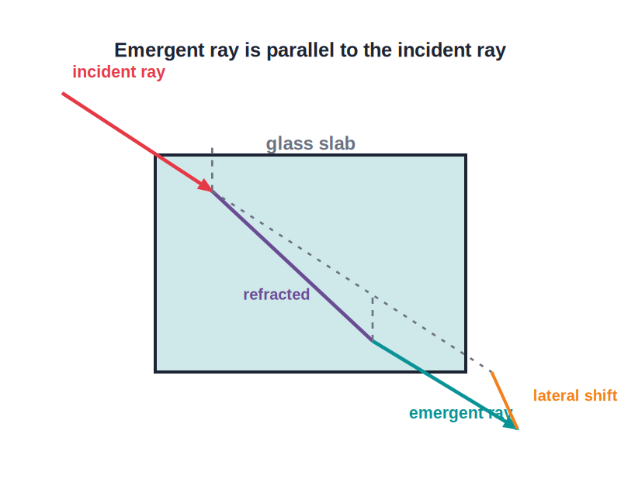
GLASS BLOCK
Through a Rectangular Glass Block
Two refractions
• The ray refracts twice — once entering and once leaving the block.
• At entry (air → glass) it bends toward the normal; at exit (glass → air) it bends away.
• The two surfaces are parallel, so the emergent ray is parallel to the incident ray.
• But the emergent ray is shifted sideways — this is the lateral displacement.
Emergent ray is parallel but shifted sideways
Notes:
Trace the ray surface by surface. The headline result: emergent ray parallel to incident ray, displaced sideways by the lateral shift.

Slide 29

LATERAL SHIFT
What the Lateral Shift Depends On
Thickness
Angle of incidence
A thicker glass block gives a larger lateral displacement.
A larger angle of incidence increases the lateral shift.
Refractive index
Zero shift
A higher refractive index (denser glass) increases the shift.
At normal incidence (i = 0) there is no bending and no lateral displacement.
Notes:
List the three factors that increase lateral shift, then the special case of normal incidence giving zero shift.

Slide 30
EXPERIMENT
Finding the Refractive Index of Glass
Pin-and-tracing method
• Place the glass block on paper and trace its outline.
• Draw a normal and an incident ray; fix two pins on it.
• Looking from the other side, fix two more pins so all four appear in a straight line.
• Remove the block and join the pin marks to draw the emergent ray and the refracted ray inside the block.
• Measure the angles i and r, then compute n = sin i / sin r.
Notes:
Walk through the standard ICSE practical. Emphasise the four-pins-in-a-line condition and that n is found from sin i / sin r.

Slide 31
THICK GLASS
Multiple Images in a Thick Mirror
Several images from one object
• Why it happens A thick glass mirror reflects light at both the front glass surface and the silvered back surface.
• Faint first image A weak image forms by reflection at the front surface of the glass.
• Brightest image The brightest image is formed by the silvered back surface — this is the one we use.
• More faint images Repeated internal reflections create several fainter images behind it.
Notes:
Explain why a thick mirror shows a faint extra image. The brightest is from the silvered back; partial reflections make the rest.

Slide 32

REAL LIFE
Refraction Around Us
Bent straw
Shallow pool
A straw in water looks bent at the surface because light from it refracts on leaving the water.
A pool looks shallower than it is — refraction raises the apparent position of the bottom.
Twinkling stars
Lenses & prisms
Starlight refracts through moving air layers, so stars appear to twinkle.
Spectacles, cameras and prisms all work by refracting light in a controlled way.
Notes:
Connect the physics to everyday sights. Invite students to add their own examples of bent or raised objects in water.

Slide 33
WORKED EXAMPLE
Speed of Light in a Medium
Problem. The refractive index of water is 1.33. Find the speed of light in water. (c = 3 × 10⁸ m/s)
n = c / v → v = c / n
v = (3 × 10⁸) / 1.33
v = 2.256 × 10⁸ m/s
Answer: v ≈ 2.26 × 10⁸ m/s (slower than in air, as expected)
Notes:
Rearrange n = c/v for v. Reinforce that light is slower in the denser medium.

Slide 34
WRAP UP
Quick Recap
✓ Refraction — bending of light when its speed changes between media
✓ Toward / away — to the normal entering denser; away entering rarer
✓ Refractive index — n = c / v = sin i / sin r, no unit
✓ Snell's law — sin i / sin r = constant, angles from the normal
✓ Glass block — emergent ray parallel to incident, shifted sideways
✓ Reversibility — light retraces its path; ₁n₂ × ₂n₁ = 1
Notes:
Rapid recap. Cold-call students to give each result before revealing it.

Slide 35
QUIZ 2
Final Check — Applying It
5 questions • think before the answer reveals on the next slide

Slide 36
QUIZ QUESTION
Q1 — Glass Block
A ray enters a rectangular glass slab at an angle of incidence of 50°. What is the angle of emergence as it leaves the opposite, parallel face?
Less than 50°
Exactly 50°
A
B
More than 50°
It depends on the glass thickness
C
D

Slide 37
ANSWER REVEALED
Q1 — Glass Block
A ray enters a rectangular glass slab at an angle of incidence of 50°. What is the angle of emergence as it leaves the opposite, parallel face?
Less than 50°
Exactly 50°
A
✓
More than 50°
It depends on the glass thickness
C
D
WHY
Because the two faces are parallel, the bending on entering is exactly undone on leaving. The angle of emergence equals the angle of incidence (50°); the ray is only shifted sideways, not rotated. Thickness changes the shift, not the angle.

Slide 38
QUIZ QUESTION
Q2 — Refractive Index
Light travels at 2 × 10⁸ m/s in a medium. Its refractive index is (c = 3 × 10⁸ m/s):
0.67
1.5
A
B
2.0
6 × 10¹⁶
C
D

Slide 39
ANSWER REVEALED
Q2 — Refractive Index
Light travels at 2 × 10⁸ m/s in a medium. Its refractive index is (c = 3 × 10⁸ m/s):
0.67
1.5
A
✓
2.0
6 × 10¹⁶
C
D
WHY
n = c / v = (3 × 10⁸) / (2 × 10⁸) = 1.5. The refractive index is a ratio of speeds, so it has no unit.

Slide 40
QUIZ QUESTION
Q3 — Lateral Shift
The lateral displacement produced by a glass block is zero when the angle of incidence is:
45°
90°
A
B
0° (normal incidence)
60°
C
D

Slide 41
ANSWER REVEALED
Q3 — Lateral Shift
The lateral displacement produced by a glass block is zero when the angle of incidence is:
45°
90°
A
B
0° (normal incidence)
60°
✓
D
WHY
A ray along the normal does not bend, so there is no sideways displacement. Lateral shift increases as the angle of incidence increases.

Slide 42
QUIZ QUESTION
Q4 — Reversibility
If the refractive index of glass with respect to air is 1.5, the refractive index of air with respect to glass is:
1.5
0.67
A
B
2.25
3.0
C
D

Slide 43
ANSWER REVEALED
Q4 — Reversibility
If the refractive index of glass with respect to air is 1.5, the refractive index of air with respect to glass is:
1.5
0.67
A
✓
2.25
3.0
C
D
WHY
By the principle of reversibility, ₁n₂ × ₂n₁ = 1. So air w.r.t. glass = 1 / 1.5 = 0.67.

Slide 44
QUIZ QUESTION
Q5 — Optical vs Mass Density
Kerosene (n ≈ 1.44) floats on water (n ≈ 1.33) yet has a higher refractive index. A ray of light passing from water into kerosene will:
Bend away from the normal and speed up
Bend toward the normal and slow down
A
B
Pass straight through
Be totally internally reflected
C
D

Slide 45
ANSWER REVEALED
Q5 — Optical vs Mass Density
Kerosene (n ≈ 1.44) floats on water (n ≈ 1.33) yet has a higher refractive index. A ray of light passing from water into kerosene will:
Bend away from the normal and speed up
Bend toward the normal and slow down
A
✓
Pass straight through
Be totally internally reflected
C
D
WHY
What decides bending is optical density (refractive index), not mass density. Kerosene has the higher n, so it is optically denser; light entering it slows down and bends toward the normal — even though kerosene is the lighter liquid.

Slide 46
Light Bends — With Rules
Remember: speed change causes bending, measure angles from the normal, and n = c / v = sin i / sin r.

