Slide 1
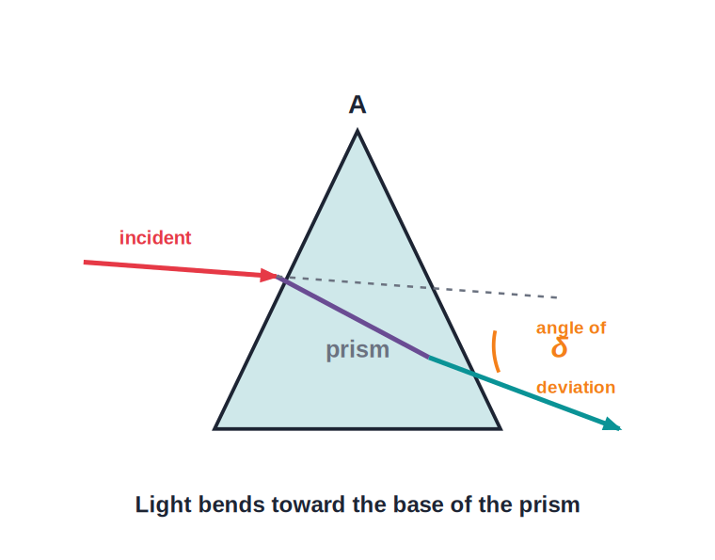
ICSE • CLASS 10 • OPTICS
Refraction — Prisms & T.I.R.
The prism • Real and apparent depth • Critical angle • Total internal reflection

Slide 2
INTRODUCTION
Learning Objectives
1
Trace a ray of light through a triangular prism
2
Define the angle of deviation produced by a prism
3
Distinguish real depth from apparent depth
4
Explain everyday effects of refraction
5
Define the critical angle and relate it to refractive index
6
State the conditions for total internal reflection and its uses
Notes:
Open by previewing these objectives so students know what they should be able to do by the end of the session.

Slide 3
PART 1
The Prism & Apparent Depth
1
Deviation, and why things look raised in water

Slide 4
THE PRISM
Refraction Through a Prism
Angle of deviation
• A prism has two refracting surfaces inclined at an angle A (the angle of the prism).
• Light refracts at both surfaces and bends toward the base of the prism.
• The angle between the incident and emergent directions is the angle of deviation, δ.
• Unlike a glass block, the emergent ray is NOT parallel to the incident ray.
Light bends toward the base; deviation = δ
Notes:
Contrast with the glass block: the surfaces are NOT parallel, so the ray is deviated and emerges in a new direction.

Slide 5
DEVIATION
What Affects the Deviation
Deviation δ depends on three things
• Angle of the prism (A) A larger refracting angle gives more deviation.
• Refractive index A denser prism material deviates light more.
• Angle of incidence Deviation first decreases, reaches a minimum, then increases.
• Minimum deviation At one special angle of incidence the deviation is least — the angle of minimum deviation.
Notes:
Introduce the idea of minimum deviation qualitatively; the full formula is not required, but the U-shaped trend is.

Slide 6
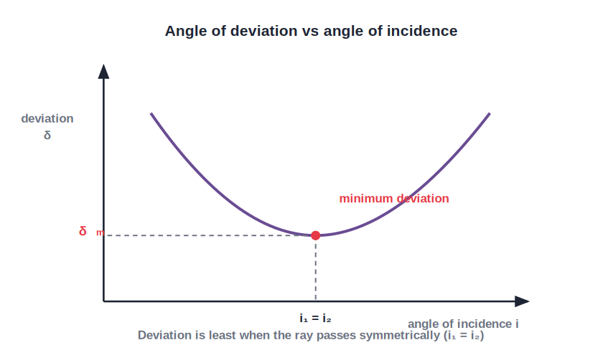
MINIMUM DEVIATION
The i–δ Curve and Minimum Deviation
One least deviation
• Plot the deviation δ against the angle of incidence i.
• As i increases, δ first falls, reaches a least value, then rises again.
• This least value is the angle of minimum deviation, δm.
• At δm the ray passes symmetrically through the prism, so the angle of incidence equals the angle of emergence (i₁ = i₂).
δ is least when the ray passes symmetrically
Notes:
Read the U-shaped graph: a single minimum δm at which i₁ = i₂ and the ray inside runs parallel to the base. Qualitative treatment only.

Slide 7
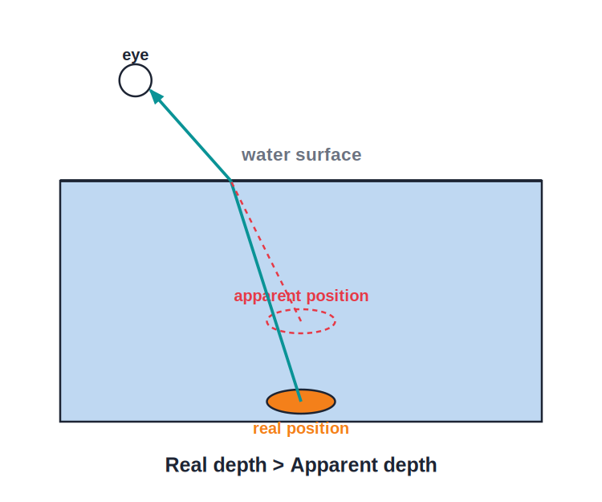
APPARENT DEPTH
Real Depth vs Apparent Depth
Things look raised
• Light from an object under water bends away from the normal as it leaves the water.
• Our eyes trace these rays back in straight lines, so the object looks raised.
• The apparent depth is always less than the real depth.
• Refractive index = real depth / apparent depth.
A coin appears nearer the surface than it is
Notes:
Use the coin-in-a-mug demo. Give the formula n = real depth / apparent depth and note apparent depth is always the smaller one.

Slide 8
WORKED EXAMPLE
Apparent Depth
Problem. A coin lies at the bottom of a tank of water 1.33 m deep. How deep does it appear? (n_water = 1.33)
n = real depth / apparent depth
apparent depth = real depth / n
apparent depth = 1.33 / 1.33 = 1.0 m
Answer: Apparent depth = 1.0 m (the tank looks 0.33 m shallower)
Notes:
Rearrange the depth formula. Stress the answer is smaller than the real depth.

Slide 9
APPARENT SHIFT
How Much an Object is Raised
The upward shift of an object seen through a medium is the difference between its real and apparent depths.
shift = real depth − apparent depth = t (1 − 1/n)
• t is the real depth (thickness) of the medium.
• A larger refractive index n gives a larger upward shift.
• The shift does not depend on the angle when viewed nearly straight down.
Notes:
Derive the shift as real − apparent = t(1 − 1/n). Useful for 'by how much is it raised' numericals.

Slide 10
WORKED EXAMPLE
Apparent Shift of a Coin
Problem. A coin lies at the bottom of a vessel containing water 12 cm deep (n = 1.33). By how much does it appear to be raised?
shift = t (1 − 1/n)
shift = 12 × (1 − 1/1.33)
shift = 12 × (1 − 0.752)
shift = 12 × 0.248 = 2.98 cm
Answer: The coin appears raised by ≈ 3 cm (apparent depth ≈ 9 cm)
Notes:
Apply shift = t(1 − 1/n). Cross-check: apparent depth = 12/1.33 ≈ 9 cm, and 12 − 9 = 3 cm matches.

Slide 11



PRISM VS BLOCK
Prism Compared With a Glass Block
Glass block
Prism
Opposite faces are parallel — the emergent ray is parallel to the incident ray, only shifted sideways.
Faces are inclined at angle A — the emergent ray is deviated into a new direction.
Net bending
Toward
A block gives zero net deviation; a prism gives a definite angle of deviation δ.
A block shifts light sideways; a prism bends light toward its base.
Notes:
Use this side-by-side to cement the difference between parallel faces (block) and inclined faces (prism).

Slide 12

CONSEQUENCES
Everyday Effects of Refraction
Early sunrise
Late sunset
We see the Sun a little before it actually rises, because light bends through the atmosphere.
For the same reason the Sun is seen briefly after it has actually set.
Stars twinkle
Oval Sun at sunset
Light from stars refracts through moving air layers, so their brightness flickers.
Near the horizon the lower edge is lifted more than the upper, so the Sun looks flattened/oval.
Notes:
Each is a consequence of atmospheric or water refraction. The oval/flattened Sun and the lengthening of the day by a few minutes are favourite exam points.

Slide 13
QUIZ 1
Check Your Understanding
5 questions • think before the answer reveals on the next slide

Slide 14
QUIZ QUESTION
Q1 — Prism vs Slab
How does a prism differ from a parallel-sided glass slab in its effect on a ray of light?
Both leave the ray parallel to the incident ray
A prism deviates the ray; a slab only shifts it sideways
A
B
A slab deviates the ray; a prism only shifts it
Neither changes the ray's direction
C
D

Slide 15
ANSWER REVEALED
Q1 — Prism vs Slab
How does a prism differ from a parallel-sided glass slab in its effect on a ray of light?
Both leave the ray parallel to the incident ray
A prism deviates the ray; a slab only shifts it sideways
A
✓
A slab deviates the ray; a prism only shifts it
Neither changes the ray's direction
C
D
WHY
A slab's faces are parallel, so the emergent ray is parallel to the incident ray (just shifted). A prism's faces are inclined, so the ray emerges in a new direction — deviated toward the base by the angle δ.

Slide 16
QUIZ QUESTION
Q2 — Apparent Depth
A fish is 2.0 m below the surface of a pond (n = 1.33). To a person looking straight down, the fish appears to be about how deep?
2.66 m
2.0 m
A
B
1.5 m
1.33 m
C
D

Slide 17
ANSWER REVEALED
Q2 — Apparent Depth
A fish is 2.0 m below the surface of a pond (n = 1.33). To a person looking straight down, the fish appears to be about how deep?
2.66 m
2.0 m
A
B
1.5 m
1.33 m
✓
D
WHY
Apparent depth = real depth / n = 2.0 / 1.33 ≈ 1.5 m. Refraction raises the apparent position, so the fish looks shallower than it really is.

Slide 18
QUIZ QUESTION
Q3 — Atmospheric Refraction
We can see the Sun for a few minutes before it has actually risen above the horizon because:
The Sun moves faster at dawn
Light from the Sun is refracted by the atmosphere
A
B
The Sun is closer at sunrise
Clouds reflect the sunlight
C
D

Slide 19
ANSWER REVEALED
Q3 — Atmospheric Refraction
We can see the Sun for a few minutes before it has actually risen above the horizon because:
The Sun moves faster at dawn
Light from the Sun is refracted by the atmosphere
A
✓
The Sun is closer at sunrise
Clouds reflect the sunlight
C
D
WHY
Air is denser nearer the ground, so sunlight bends as it passes through the atmosphere. This lifts the Sun's apparent position, letting us see it slightly before it actually rises (and after it sets).

Slide 20
QUIZ QUESTION
Q4 — Minimum Deviation
As the angle of incidence on a prism is increased from a small value, the angle of deviation:
Keeps increasing steadily
Keeps decreasing steadily
A
B
First decreases to a minimum, then increases
Stays exactly constant
C
D

Slide 21
ANSWER REVEALED
Q4 — Minimum Deviation
As the angle of incidence on a prism is increased from a small value, the angle of deviation:
Keeps increasing steadily
Keeps decreasing steadily
A
B
First decreases to a minimum, then increases
Stays exactly constant
✓
D
WHY
The i–δ graph is U-shaped: deviation falls to a single least value (the angle of minimum deviation, where i₁ = i₂) and then rises again as i is increased further.

Slide 22
QUIZ QUESTION
Q5 — Raised Coin
A coin lies under 16 cm of water (n = 1.33). By roughly how much does it appear raised when viewed from directly above?
About 1 cm
About 4 cm
A
B
About 8 cm
About 12 cm
C
D

Slide 23
ANSWER REVEALED
Q5 — Raised Coin
A coin lies under 16 cm of water (n = 1.33). By roughly how much does it appear raised when viewed from directly above?
About 1 cm
About 4 cm
A
✓
About 8 cm
About 12 cm
C
D
WHY
Shift = t(1 − 1/n) = 16 × (1 − 1/1.33) = 16 × 0.248 ≈ 4 cm. Equivalently, apparent depth = 16/1.33 ≈ 12 cm, so it is raised by about 4 cm.

Slide 24
PART 2
Critical Angle & T.I.R.
2
When light cannot escape a denser medium

Slide 25
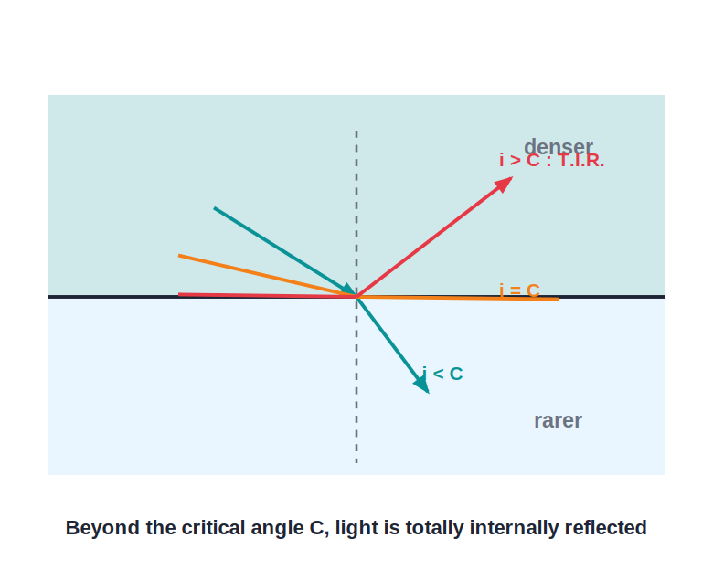
CRITICAL ANGLE
The Critical Angle
Definition of C
• As light goes denser → rarer, it bends away from the normal.
• Increase the angle of incidence and the refracted ray bends more and more toward the surface.
• At the critical angle (C) the refracted ray grazes along the surface (r = 90°).
• Relation: n = 1 / sin C, so a larger n gives a smaller critical angle.
At i = C the refracted ray grazes the surface
Notes:
Build up the critical angle by imagining the angle of incidence growing. Give n = 1/sin C and the values (water ≈ 49°, glass ≈ 42°, diamond ≈ 24°).

Slide 26
T.I.R.
Total Internal Reflection
When light travelling in a denser medium hits the surface at an angle greater than the critical angle, it is completely reflected back into the denser medium.
Condition: denser → rarer AND i > C
• No light is refracted out — the surface acts like a perfect mirror.
• Both conditions must hold: light must go from denser to rarer, and i must exceed the critical angle.
• T.I.R. loses no light, unlike an ordinary mirror.
Notes:
State both conditions clearly. Highlight that T.I.R. is a perfect, loss-free reflection — the basis of its many uses.

Slide 27
T.I.R. VS MIRROR
Total Internal Reflection vs a Plane Mirror
Brightness
No multiple images
T.I.R. reflects 100% of the light; a silvered mirror absorbs a little, so its image is dimmer.
A glass mirror gives faint extra images; T.I.R. gives a single, sharp image.
No tarnishing
Condition
A mirror's silvering can peel or tarnish; a T.I.R. prism surface cannot.
A mirror reflects at any angle; T.I.R. needs denser → rarer and i greater than the critical angle.
Notes:
Direct syllabus comparison. The headline: T.I.R. is total (loss-free, single bright image) whereas a mirror loses some light and can give multiple/faint images.

Slide 28
CRITICAL ANGLE
Critical Angle of Common Media
n = 1 / sin C
• Water n ≈ 1.33, so critical angle C ≈ 49°.
• Ordinary glass n ≈ 1.5, so critical angle C ≈ 42°.
• Dense flint glass n ≈ 1.65, so critical angle C ≈ 37°.
• Diamond n ≈ 2.42, so critical angle C ≈ 24° — the smallest, so light is trapped most easily.
• Rule Larger refractive index → smaller critical angle → easier T.I.R.
Notes:
Have students notice the inverse trend: the denser the medium, the smaller its critical angle, the more readily it traps light.

Slide 29
USES OF T.I.R.
Where Total Internal Reflection Is Used
Optical fibres
Totally reflecting prisms
Light bounces along the fibre by repeated T.I.R., carrying internet and phone signals.
45°–45°–90° prisms turn light through 90° or 180° in periscopes and binoculars.
Mirage
Sparkle of diamond
Hot air near a road bends light by T.I.R., showing a shimmering 'puddle' that is really sky.
Diamond's tiny critical angle (≈ 24°) traps light by repeated T.I.R., making it sparkle.
Notes:
Connect each use back to the two conditions. Optical fibres and the reflecting prism are the most examined.

Slide 30
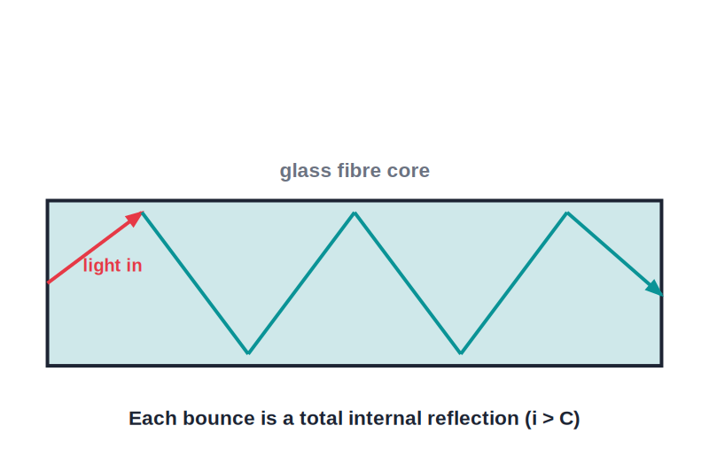
OPTICAL FIBRES
How an Optical Fibre Works
Light trapped by T.I.R.
• A fibre has a glass core surrounded by a cladding of lower refractive index.
• Light enters one end and strikes the core walls beyond the critical angle.
• It undergoes total internal reflection again and again, zig-zagging down the fibre.
• Almost no light escapes, so signals travel long distances with very little loss.
Repeated T.I.R. guides the light along the core
Notes:
Stress the core/cladding refractive-index condition. This is the most important real-world application.

Slide 31
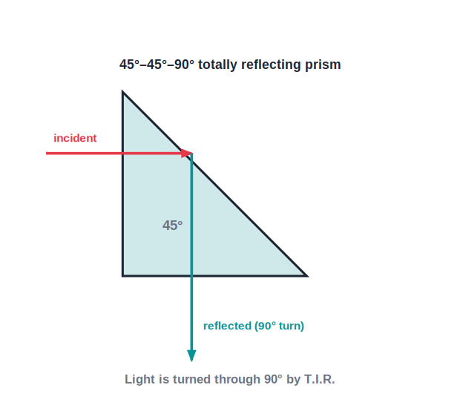
REFLECTING PRISMS
Totally Reflecting Prisms
A perfect mirror from glass
• A 45°–45°–90° glass prism has a critical angle (≈ 42°) smaller than 45°.
• Light hitting the long face at 45° therefore exceeds the critical angle and is totally reflected.
• One reflection turns light through 90°; two reflections turn it through 180°.
• These prisms replace mirrors in periscopes, binoculars and cameras because they lose no light.
45° incidence > critical angle → 90° turn
Notes:
Explain why 45° works: it beats glass's 42° critical angle. Contrast with a silvered mirror, which absorbs some light.

Slide 32
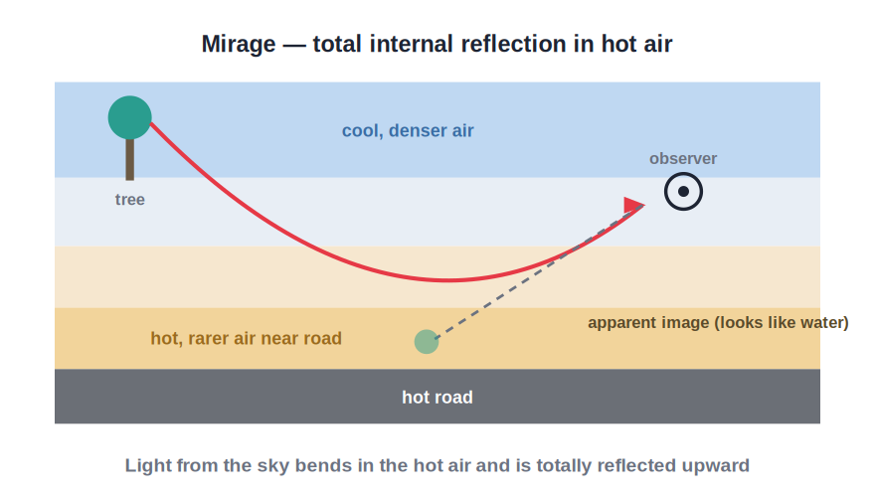
MIRAGE
Why a Mirage Forms
T.I.R. in hot air
• On a hot day the air near the road is hottest and optically rarest; higher layers are cooler and denser.
• Light from the sky bends more and more as it passes down into the rarer air.
• Near the ground it exceeds the critical angle and is totally internally reflected upward.
• The eye traces it back to a shimmering patch that looks like water — a mirage.
Sky light curves up by T.I.R. near the hot road
Notes:
Mirage is T.I.R. in the atmosphere: rarer hot air below, denser cool air above. The 'water' is really an image of the sky. A classic application question.

Slide 33
WORKED EXAMPLE
Critical Angle from Refractive Index
Problem. The refractive index of glass is 1.5. Find its critical angle.
n = 1 / sin C → sin C = 1 / n
sin C = 1 / 1.5 = 0.667
C = sin⁻¹(0.667) ≈ 42°
Answer: Critical angle of glass ≈ 42°
Notes:
Apply n = 1/sin C. Note the result (~42°) is the standard value students should remember for glass.

Slide 34
WRAP UP
Quick Recap
✓ Prism — two inclined faces; light bends toward the base, deviation δ
✓ Apparent depth — n = real depth / apparent depth; things look raised
✓ Consequences — early sunrise, late sunset, twinkling stars
✓ Critical angle — r = 90° at i = C; n = 1 / sin C
✓ T.I.R. — denser → rarer and i > C; perfect, loss-free reflection
✓ Uses — optical fibres, reflecting prisms, mirage, diamond sparkle
Notes:
Rapid recap; cold-call for each result.

Slide 35
QUIZ 2
Final Check — Critical Angle & T.I.R.
5 questions • think before the answer reveals on the next slide

Slide 36
QUIZ QUESTION
Q1 — Will It Escape?
Light inside glass (critical angle 42°) strikes the glass–air surface at 40°. What happens?
It is totally internally reflected
It refracts and passes out into the air
A
B
It travels along the surface
It is absorbed by the glass
C
D

Slide 37
ANSWER REVEALED
Q1 — Will It Escape?
Light inside glass (critical angle 42°) strikes the glass–air surface at 40°. What happens?
It is totally internally reflected
It refracts and passes out into the air
A
✓
It travels along the surface
It is absorbed by the glass
C
D
WHY
40° is less than the critical angle of 42°, so the ray is still refracted out of the glass (bending away from the normal). T.I.R. would only happen if the angle exceeded 42°.

Slide 38
QUIZ QUESTION
Q2 — Diamond vs Glass
A diamond (critical angle ≈ 24°) sparkles more than a glass crystal (critical angle ≈ 42°) because:
Diamond reflects all colours equally
Light meets its surfaces beyond the critical angle more often
A
B
Diamond is a better conductor
Glass absorbs more light
C
D

Slide 39
ANSWER REVEALED
Q2 — Diamond vs Glass
A diamond (critical angle ≈ 24°) sparkles more than a glass crystal (critical angle ≈ 42°) because:
Diamond reflects all colours equally
Light meets its surfaces beyond the critical angle more often
A
✓
Diamond is a better conductor
Glass absorbs more light
C
D
WHY
A smaller critical angle means more rays strike the inner surfaces beyond it and undergo total internal reflection. So diamond traps and bounces light around far more than glass, giving its sparkle.

Slide 40
QUIZ QUESTION
Q3 — Refractive Index
If the critical angle of a medium is 30°, its refractive index is:
0.5
1.5
A
B
2.0
1.0
C
D

Slide 41
ANSWER REVEALED
Q3 — Refractive Index
If the critical angle of a medium is 30°, its refractive index is:
0.5
1.5
A
B
2.0
1.0
✓
D
WHY
n = 1 / sin C = 1 / sin 30° = 1 / 0.5 = 2.0.

Slide 42
QUIZ QUESTION
Q4 — Application
Optical fibres carry light signals mainly by using:
Dispersion
Total internal reflection
A
B
Diffraction
Ordinary reflection
C
D

Slide 43
ANSWER REVEALED
Q4 — Application
Optical fibres carry light signals mainly by using:
Dispersion
Total internal reflection
A
✓
Diffraction
Ordinary reflection
C
D
WHY
Light entering a fibre strikes the walls beyond the critical angle and undergoes repeated T.I.R., travelling along the fibre with almost no loss.

Slide 44
QUIZ QUESTION
Q5 — Prism vs Mirror
A periscope made with totally reflecting prisms gives a brighter, sharper image than one made with plane mirrors because total internal reflection:
Bends light by a larger angle
Reflects all the light with no loss or multiple images
A
B
Splits the light into colours
Works only for red light
C
D

Slide 45
ANSWER REVEALED
Q5 — Prism vs Mirror
A periscope made with totally reflecting prisms gives a brighter, sharper image than one made with plane mirrors because total internal reflection:
Bends light by a larger angle
Reflects all the light with no loss or multiple images
A
✓
Splits the light into colours
Works only for red light
C
D
WHY
A silvered mirror absorbs a little light and can form faint extra images. T.I.R. inside a 45° prism reflects 100% of the light and gives a single sharp image, so the prism periscope is brighter and clearer.

Slide 46
Trapping Light
Beyond the critical angle, light cannot escape — that is how optical fibres carry the world's data.

