Slide 1
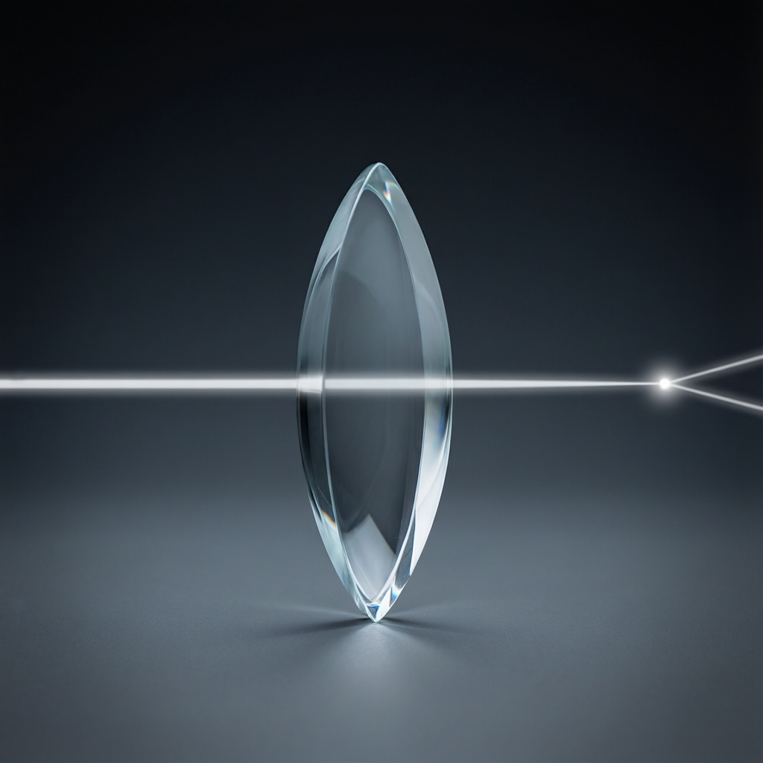
ICSE • CLASS 10 • OPTICS
Refraction Through a Lens
Convex & concave lenses • Principal rays • Image formation in a convex lens

Slide 2
INTRODUCTION
Learning Objectives
1
Identify convex (converging) and concave (diverging) lenses
2
Explain a lens as a set of prisms
3
Define the technical terms: optical centre, focus, focal length
4
State the three rules for drawing ray diagrams
5
Locate images formed by a convex lens for any object position
6
Describe a convex lens used as a magnifying glass
Notes:
Open by previewing these objectives so students know what they should be able to do by the end of the session.

Slide 3
PART 1
Lenses & How They Bend Light
1
Types of lens, key terms and the ray-diagram rules

Slide 4



LENSES
Two Types of Lens
Convex (converging)
Concave (diverging)
Thicker in the middle. It brings parallel rays together to a real focus.
Thinner in the middle. It spreads parallel rays out as if from a virtual focus.
Made of two surfaces
Refraction twice
Each lens is bounded by two spherical (or one flat) refracting surfaces.
Light refracts on entering and on leaving the lens, bending toward the thicker part.
Notes:
Hold up a real convex and concave lens if available. The single rule behind both: light bends toward the thicker part of the glass.

Slide 5
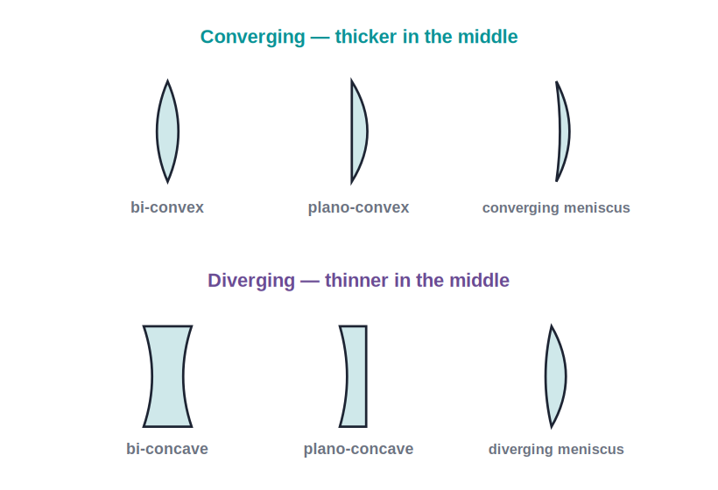
LENS SHAPES
The Six Common Lens Shapes
Converging vs diverging shapes
• Converging lenses are thicker in the middle: bi-convex, plano-convex and the converging meniscus.
• Diverging lenses are thinner in the middle: bi-concave, plano-concave and the diverging meniscus.
• A meniscus lens has one convex and one concave face.
• Whatever the shape, thicker-in-the-middle converges and thinner-in-the-middle diverges.
Six standard lens cross-sections
Notes:
Show all six shapes. The one rule: judge by the middle — thicker converges, thinner diverges, regardless of the exact faces.

Slide 6
REFRACTION
Refraction Through Equi-Convex & Equi-Concave Lenses
Parallel light through the two lens types
• Equi-convex lens Both surfaces bulge outward; a parallel beam converges to a real focus on the far side.
• Equi-concave lens Both surfaces curve inward; a parallel beam spreads out as if from a virtual focus in front.
• Two refractions Light bends once at each surface — toward the normal entering the glass, away from it on leaving.
• Net effect Convex shapes converge light; concave shapes diverge it, no matter the object.
Notes:
Trace a parallel beam through each lens type. Convex → real focus behind; concave → virtual focus in front.

Slide 7
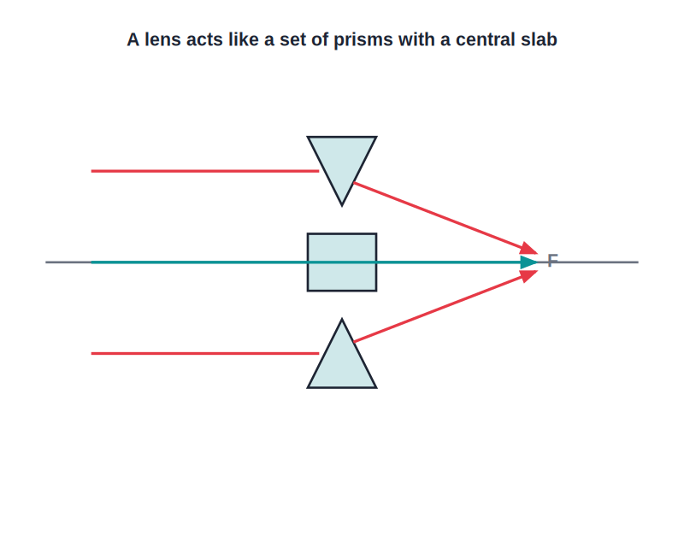
HOW IT WORKS
A Lens Is Like a Set of Prisms
Prism model
• The top and bottom of a convex lens act like prisms with their bases toward the middle.
• Each prism bends light toward its base — i.e. toward the principal axis.
• The central part acts like a glass slab and lets light pass straight through.
• So a convex lens converges parallel rays to a single focus.
Each half bends light toward the axis
Notes:
Use the prism analogy to make convergence intuitive. For a concave lens the prisms point the other way, so light diverges.

Slide 8
KEY TERMS
Terms You Must Know
The vocabulary of lenses
• Optical centre (O) the central point of the lens; a ray through it goes straight on.
• Principal axis the line through the centres of curvature of the two surfaces.
• Principal focus (F) the point where parallel rays meet (convex) or appear to come from (concave).
• Focal length (f) the distance from the optical centre to the principal focus.
• A lens has two foci one on each side, at equal distances, because light can enter from either side.
Notes:
Drill these terms with the diagram. Stress a lens has TWO foci, equally spaced on both sides.

Slide 9
MORE TERMS
Curvature, Aperture & the Two Centres
Centres of curvature
Radii of curvature
the centres of the two spheres whose surfaces form the lens (C₁ and C₂).
the radii of those two spheres (R₁ and R₂); a smaller radius is more sharply curved.
Aperture
Brightness
the effective diameter of the lens through which light passes.
a larger aperture gathers more light, giving a brighter (not bigger) image.
Notes:
Define centre/radius of curvature and aperture. Tie aperture to brightness — sets up the half-covered-lens idea.

Slide 10
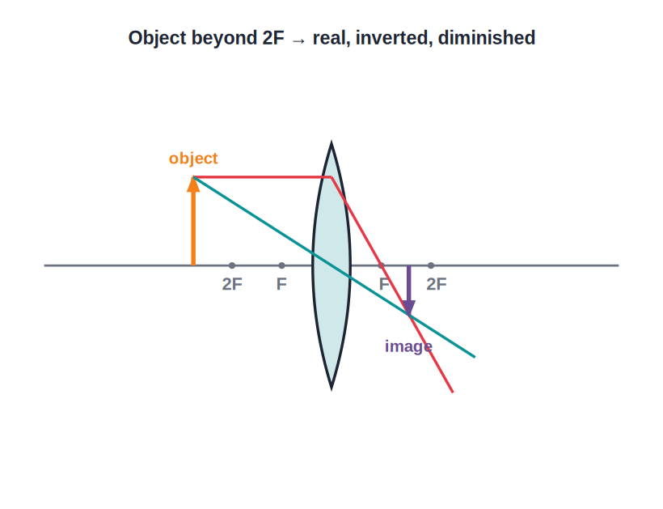
FOCAL LENGTH
Principal Focus & Focal Length
Parallel rays close to the principal axis converge at the principal focus of a convex lens after refraction.
Notes:
Define f via parallel rays. Mention shorter f = more powerful lens (links to power later).

Slide 11
RAY-DIAGRAM RULES
The Three Rules for a Convex Lens
Rule 1 — parallel ray
Rule 2 — central ray
A ray parallel to the axis refracts to pass through the far focus F.
A ray through the optical centre O goes straight on, undeviated.
Rule 3 — focal ray
Where they meet
A ray through the near focus F refracts to emerge parallel to the axis.
Any two of these rays locate the image; the third is a useful check.
Notes:
These three rules build every ray diagram. Students only need two rays to find an image; the third confirms it.

Slide 12
IMAGES
Real vs Virtual Images
Real image
Virtual image
Formed where refracted rays actually meet; can be caught on a screen; always inverted.
Formed where rays only appear to meet; cannot be caught on a screen; always erect.
Convex lens
Concave lens
Gives a real image for objects beyond F, a virtual image for objects within F.
Gives only a virtual, erect, diminished image.
Notes:
Define real vs virtual precisely — the screen test is the clearest way for students to tell them apart.

Slide 13
DEPENDS ON THE MEDIUM
A Lens Depends on the Surrounding Medium
Whether a lens converges or diverges depends on how its refractive index compares with that of the medium around it.
• In air, a convex glass lens is converging because glass is denser than air.
• Placed in a still denser medium, a convex lens can act as a diverging lens.
• An air bubble in water is thicker in the middle yet diverges light — it behaves like a concave lens.
Notes:
Important ICSE subtlety: 'convex = converging' only holds when the lens is optically denser than its surroundings. The air-bubble-in-water example is the classic test.

Slide 14
QUIZ 1
Check Your Understanding
5 questions • think before the answer reveals on the next slide

Slide 15
QUIZ QUESTION
Q1 — Predict the Image
An object is placed 25 cm from a convex lens of focal length 10 cm. Without calculating, what is the image like?
Real, inverted and diminished
Real, inverted and magnified
A
B
Virtual, erect and magnified
No image is formed
C
D

Slide 16
ANSWER REVEALED
Q1 — Predict the Image
An object is placed 25 cm from a convex lens of focal length 10 cm. Without calculating, what is the image like?
Real, inverted and diminished
Real, inverted and magnified
✓
B
Virtual, erect and magnified
No image is formed
C
D
WHY
f = 10 cm, so 2F = 20 cm. The object (25 cm) lies beyond 2F, so the image is real, inverted and diminished — the camera case. Knowing the 2F landmark lets you predict this without any arithmetic.

Slide 17
QUIZ QUESTION
Q2 — Half-Covered Lens
The lower half of a convex lens is covered with black paper. The image of an object will be:
Only the top half of the object
The complete image, but fainter (less bright)
A
B
Only the bottom half of the object
Turned the right way up
C
D

Slide 18
ANSWER REVEALED
Q2 — Half-Covered Lens
The lower half of a convex lens is covered with black paper. The image of an object will be:
Only the top half of the object
The complete image, but fainter (less bright)
A
✓
Only the bottom half of the object
Turned the right way up
C
D
WHY
Every part of the lens collects light from the whole object, so the uncovered half still forms a complete image. With fewer rays reaching it, the image is simply dimmer — a classic conceptual trap.

Slide 19
QUIZ QUESTION
Q3 — Which Lens Bends More?
Two convex lenses are identical in size, but lens X is fatter (more sharply curved) than lens Y. Compared with Y, lens X has a:
Longer focal length
Shorter focal length
A
B
Larger optical centre
Weaker converging power
C
D

Slide 20
ANSWER REVEALED
Q3 — Which Lens Bends More?
Two convex lenses are identical in size, but lens X is fatter (more sharply curved) than lens Y. Compared with Y, lens X has a:
Longer focal length
Shorter focal length
A
✓
Larger optical centre
Weaker converging power
C
D
WHY
A more sharply curved lens bends light more strongly, bringing parallel rays to a focus closer to the lens. So the fatter lens X has a shorter focal length and greater power.

Slide 21
QUIZ QUESTION
Q4 — Place the Object
Where should an object be placed before a convex lens to get a real image larger than the object (as in a projector)?
Beyond 2F
At 2F
A
B
Between F and 2F
Within F
C
D

Slide 22
ANSWER REVEALED
Q4 — Place the Object
Where should an object be placed before a convex lens to get a real image larger than the object (as in a projector)?
Beyond 2F
At 2F
A
B
Between F and 2F
Within F
✓
D
WHY
With the object between F and 2F, the image forms beyond 2F and is real, inverted and magnified — exactly how a projector throws an enlarged picture on the screen.

Slide 23
QUIZ QUESTION
Q5 — Air Bubble
A spherical air bubble inside water is thicker in the middle, yet it makes a parallel beam of light spread out. It behaves like a:
Converging (convex) lens
Diverging (concave) lens
A
B
Plane glass slab
Prism
C
D

Slide 24
ANSWER REVEALED
Q5 — Air Bubble
A spherical air bubble inside water is thicker in the middle, yet it makes a parallel beam of light spread out. It behaves like a:
Converging (convex) lens
Diverging (concave) lens
A
✓
Plane glass slab
Prism
C
D
WHY
The bubble is optically rarer than the surrounding water, so light bends the opposite way to a glass-in-air lens. Despite its convex shape it diverges light — whether a lens converges depends on its index relative to the medium around it.

Slide 25
PART 2
Images in a Convex Lens
2
How the image changes as the object moves

Slide 26
IMAGE FORMATION
Object Beyond 2F
Real, inverted, diminished
• Draw the parallel ray (through F) and the central ray (straight).
• They meet between F and 2F on the other side.
• The image is real, inverted and diminished.
• This is how a camera forms a small picture of a distant scene.
Object beyond 2F → image between F and 2F
Notes:
Walk the two rays on the diagram. Tie the result to a camera making a small real image on the sensor.

Slide 27
IMAGE FORMATION
As the Object Moves In…
The six standard cases
• At infinity Image at F — real, inverted, point-sized.
• Beyond 2F Image between F and 2F — real, inverted, diminished.
• At 2F Image at 2F — real, inverted, same size as the object.
• Between F and 2F Image beyond 2F — real, inverted, magnified (the projector case).
• At F Image at infinity — rays emerge parallel, no image formed.
• Within F Image on the same side — virtual, erect, magnified (the magnifying glass).
Notes:
This table is heavily examined. Have students memorise the trend: as the object comes closer than 2F the image grows and moves away, until within F it becomes virtual and erect.

Slide 28
IMAGE FORMATION
Object Between F and 2F — the Projector
Real, inverted, magnified
• Place the object between F and 2F.
• The image forms beyond 2F on the other side.
• It is real, inverted and magnified.
• A slide projector uses exactly this to throw a large image on the screen.
Object between F and 2F → image beyond 2F
Notes:
Contrast with the camera case: moving the object closer (within 2F) flips the image from diminished to magnified. This is the projector.

Slide 29
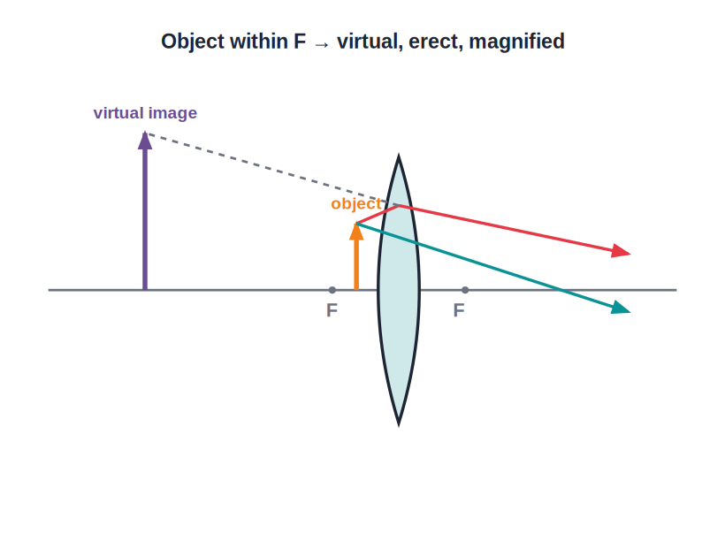
MAGNIFIER
Convex Lens as a Magnifying Glass
Object within F
• Place the object closer than the focal length (within F).
• The refracted rays diverge, so no real image forms.
• Tracing them back gives a virtual, erect, magnified image.
• This is the simple microscope or magnifying glass.
Within F → virtual, erect, magnified image
Notes:
Demonstrate with a real magnifying glass over text. Emphasise the object must be within the focal length.

Slide 30
CONVEX VS CONCAVE
Convex and Concave Lens at a Glance
Shape
Action on light
Convex is thicker in the middle; concave is thinner in the middle.
Convex converges a parallel beam; concave diverges it.
Focus
Typical image
Convex has a real focus; concave has a virtual focus.
Convex can give real or virtual images; concave gives only virtual, erect, diminished images.
Notes:
A clean comparison table — a common 'state the differences' exam question.

Slide 31
IDENTIFY IT
Telling a Convex Lens From a Concave Lens
Simple lab tests
• By touch A convex lens feels thicker at the centre; a concave lens feels thinner at the centre.
• Look through it Convex magnifies nearby print; concave always makes it look smaller.
• Move it over print With a convex lens the letters move opposite to the lens; with a concave lens they move the same way.
• Focus the Sun Only a convex lens can focus sunlight to a tiny bright spot.
Notes:
Practical ways to identify a lens without instruments — useful for the lab and for application questions.

Slide 32

REAL LIFE
Where Convex Lenses Are Used
Camera
Projector
Forms a small real image of the scene on the film/sensor.
Object just beyond F gives a large real image on the screen.
Magnifying glass
Human eye
Object within F gives an enlarged virtual image.
The eye lens focuses a real, inverted image on the retina.
Notes:
Each device is just one row of the image table. Ask students to match each use to an object position.

Slide 33
WRAP UP
Quick Recap
✓ Convex / concave — thicker-middle converges; thinner-middle diverges
✓ Lens = prisms — each half bends light toward the thicker centre
✓ Key terms — optical centre, principal focus, focal length, 2F
✓ Three rules — parallel→F, through O straight, through F→parallel
✓ Convex images — real & inverted beyond F; virtual & erect within F
✓ Magnifier — object within F → virtual, erect, magnified
Notes:
Cold-call the six image cases as a rapid recap.

Slide 34
QUIZ 2
Final Check — Convex Images
5 questions • think before the answer reveals on the next slide

Slide 35
QUIZ QUESTION
Q1 — Camera
To form a small, real, inverted image (as in a camera), the object should be:
Within F
At F
A
B
Between F and 2F
Beyond 2F
C
D

Slide 36
ANSWER REVEALED
Q1 — Camera
To form a small, real, inverted image (as in a camera), the object should be:
Within F
At F
A
B
Between F and 2F
Beyond 2F
C
✓
WHY
When the object is beyond 2F, the image is real, inverted and diminished, formed between F and 2F — exactly what a camera needs.

Slide 37
QUIZ QUESTION
Q2 — Same Size
A convex lens forms an image the same size as the object when the object is placed:
At F
At 2F
A
B
Within F
At infinity
C
D

Slide 38
ANSWER REVEALED
Q2 — Same Size
A convex lens forms an image the same size as the object when the object is placed:
At F
At 2F
A
✓
Within F
At infinity
C
D
WHY
With the object at 2F, the image is also at 2F on the other side — real, inverted and the same size as the object.

Slide 39
QUIZ QUESTION
Q3 — Magnifier
When used as a magnifying glass, a convex lens forms an image that is:
Real and inverted
Virtual, erect and magnified
A
B
Real and diminished
Virtual and diminished
C
D

Slide 40
ANSWER REVEALED
Q3 — Magnifier
When used as a magnifying glass, a convex lens forms an image that is:
Real and inverted
Virtual, erect and magnified
A
✓
Real and diminished
Virtual and diminished
C
D
WHY
With the object within the focal length, the rays diverge and the eye sees a virtual, erect, magnified image on the same side as the object.

Slide 41
QUIZ QUESTION
Q4 — No Image
A convex lens forms no image (rays emerge parallel) when the object is placed:
Beyond 2F
At 2F
A
B
At the focus F
Within F
C
D

Slide 42
ANSWER REVEALED
Q4 — No Image
A convex lens forms no image (rays emerge parallel) when the object is placed:
Beyond 2F
At 2F
A
B
At the focus F
Within F
✓
D
WHY
With the object exactly at F, the refracted rays emerge parallel and meet only at infinity — so no image is formed on a screen.

Slide 43
QUIZ QUESTION
Q5 — Distant Object
The image of a very distant object (the Sun) formed by a convex lens is:
At 2F, the same size
At F, a tiny real inverted image
A
B
Within F, virtual and erect
At infinity
C
D

Slide 44
ANSWER REVEALED
Q5 — Distant Object
The image of a very distant object (the Sun) formed by a convex lens is:
At 2F, the same size
At F, a tiny real inverted image
A
✓
Within F, virtual and erect
At infinity
C
D
WHY
Rays from a far object reach the lens almost parallel, so they converge at the focus. The image is real, inverted and very small — the basis of the distant-object method for finding f.

Slide 45
Convex Lenses Shape Our World
From your eye to a camera — placement decides whether the image is big or small, real or virtual.

