Slide 1
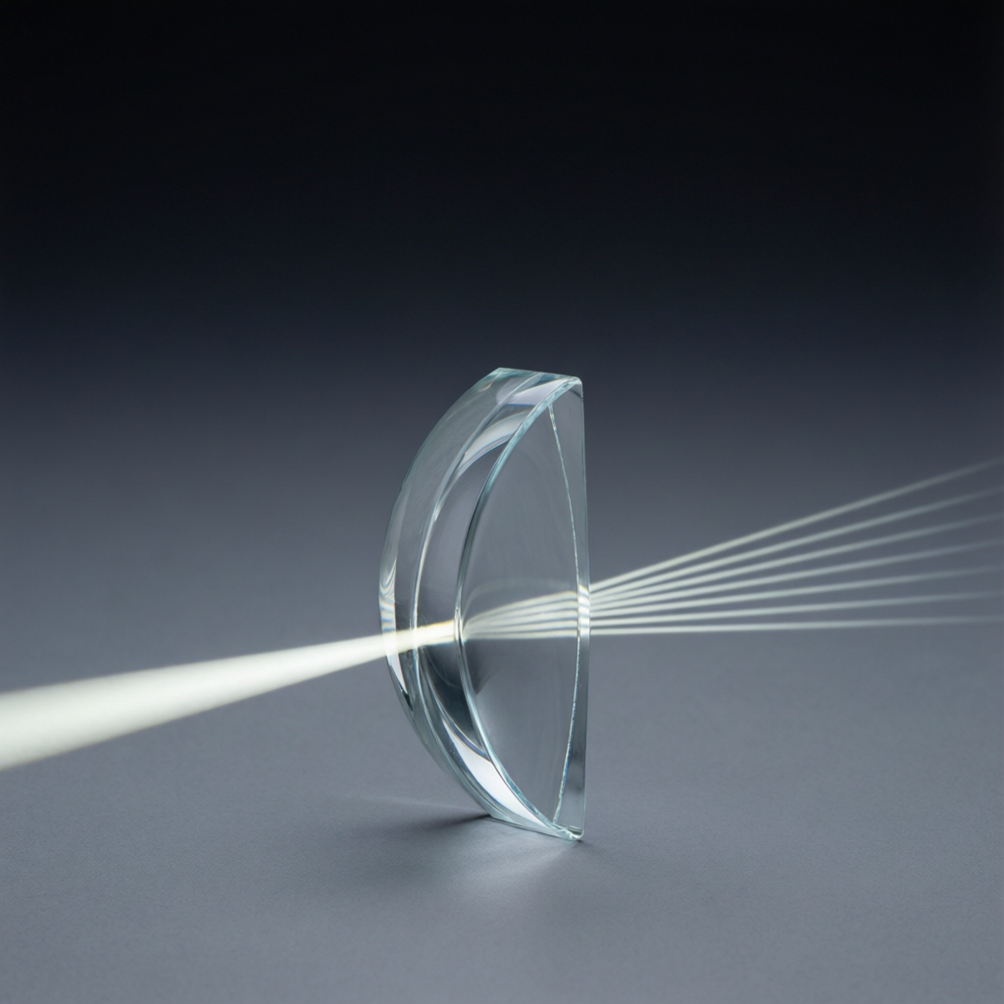
ICSE • CLASS 10 • OPTICS
Lenses — Formula & Power
Concave-lens images • Sign convention • Lens formula • Magnification & power

Slide 2
INTRODUCTION
Learning Objectives
1
Locate the image formed by a concave lens
2
Apply the sign convention for lenses
3
Use the lens formula 1/v − 1/u = 1/f
4
Calculate linear magnification m = v/u = hi/ho
5
Define the power of a lens and its unit, the dioptre
6
Describe how to find the focal length of a convex lens
Notes:
Open by previewing these objectives so students know what they should be able to do by the end of the session.

Slide 3
PART 1
Concave Lens, Sign Convention & Formula
1
The diverging lens and the numbers behind images

Slide 4
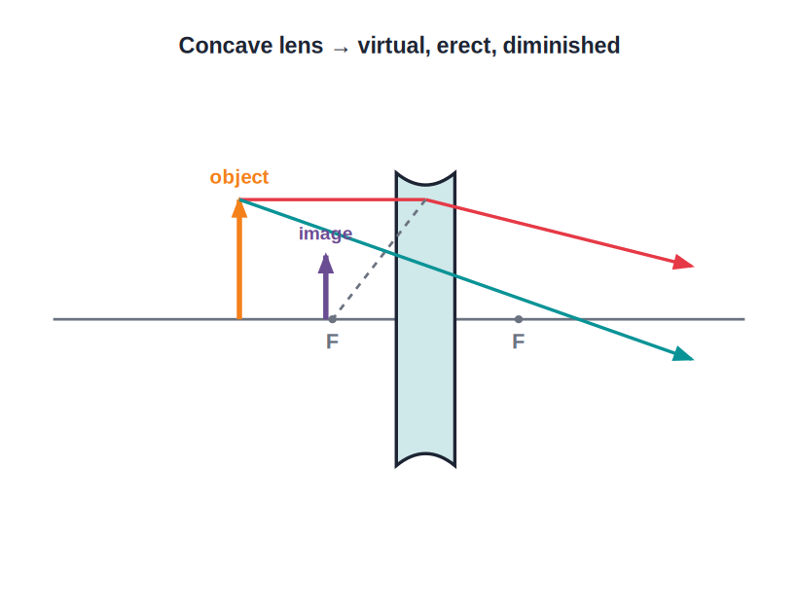
CONCAVE LENS
Image in a Concave Lens
Always virtual & erect
• A concave lens diverges the refracted rays.
• Tracing the rays back, they appear to meet on the same side as the object.
• The image is always virtual, erect and diminished.
• This is true for every position of the object.
Concave lens → virtual, erect, diminished
Notes:
Key point: a concave lens gives the SAME kind of image (virtual, erect, diminished) wherever the object is — much simpler than the convex lens.

Slide 5


CONVEX VS CONCAVE
Telling the Images Apart
Convex
Concave
Image is real & inverted for most positions; virtual & erect only within F.
Image is always virtual, erect and diminished.
On a screen
Quick test
A convex lens can throw a real image on a screen; a concave lens cannot.
Look through it at text: convex can magnify; concave always makes things look smaller.
Notes:
Give the practical 'look through it' test to distinguish the two lenses in the lab.

Slide 6
SIGN CONVENTION
The New Cartesian Sign Convention
Get the signs right before the formula
• All distances are measured from the optical centre O.
• Direction of light distances measured in the direction of the incident light are positive; against it, negative.
• Object distance u is taken negative (object is on the incoming side).
• Convex lens f is positive; a concave lens f is negative.
• Heights above the axis are positive, below the axis negative.
Notes:
Most numerical mistakes come from signs. Drill: u negative, convex f positive, concave f negative.

Slide 7
LENS FORMULA
The Lens Formula
For a thin lens, object distance u, image distance v and focal length f are related by one equation.
1/v − 1/u = 1/f
• Use the sign convention for every quantity.
• Works for both convex and concave lenses.
• Rearrange to find whichever quantity is unknown.
Notes:
State the formula and that the same equation covers both lens types — only the signs differ.

Slide 8
WORKED EXAMPLE
Using the Lens Formula
Problem. An object is placed 30 cm in front of a convex lens of focal length 20 cm. Find the image distance.
Sign convention: u = −30 cm, f = +20 cm
1/v − 1/u = 1/f → 1/v = 1/f + 1/u
1/v = 1/20 + 1/(−30) = 3/60 − 2/60 = 1/60
v = +60 cm
Answer: v = +60 cm — a real image 60 cm beyond the lens
Notes:
Show every sign. The positive v means a real image on the far side. Cross-check with the image table (object between F and 2F → magnified real image beyond 2F).

Slide 9
QUIZ 1
Quick Check — Concave & Formula
5 questions • think before the answer reveals on the next slide

Slide 10
QUIZ QUESTION
Q1 — Moving the Object
An object is slowly moved closer to a concave lens. The image it forms:
Becomes real and inverted
Stays virtual and erect, getting slightly larger but always smaller than the object
A
B
Disappears at the focus
Becomes magnified and inverted
C
D

Slide 11
ANSWER REVEALED
Q1 — Moving the Object
An object is slowly moved closer to a concave lens. The image it forms:
Becomes real and inverted
Stays virtual and erect, getting slightly larger but always smaller than the object
A
✓
Disappears at the focus
Becomes magnified and inverted
C
D
WHY
A concave lens gives a virtual, erect, diminished image for every object position. As the object approaches, the image grows a little but never exceeds the object's size or becomes real.

Slide 12
QUIZ QUESTION
Q2 — Identify the Lens
A lens has a power of −2.5 D. This lens is:
A convex lens of focal length 40 cm
A concave lens of focal length 40 cm
A
B
A convex lens of focal length 25 cm
A concave lens of focal length 25 cm
C
D

Slide 13
ANSWER REVEALED
Q2 — Identify the Lens
A lens has a power of −2.5 D. This lens is:
A convex lens of focal length 40 cm
A concave lens of focal length 40 cm
A
✓
A convex lens of focal length 25 cm
A concave lens of focal length 25 cm
C
D
WHY
P = 1/f, so f = 1/P = 1/(−2.5) = −0.4 m = −40 cm. The negative sign means it is a diverging (concave) lens, and its focal length is 40 cm.

Slide 14
QUIZ QUESTION
Q3 — Lens Formula
The correct lens formula is:
1/v + 1/u = 1/f
1/v − 1/u = 1/f
A
B
1/u − 1/v = 1/f
v − u = f
C
D

Slide 15
ANSWER REVEALED
Q3 — Lens Formula
The correct lens formula is:
1/v + 1/u = 1/f
1/v − 1/u = 1/f
A
✓
1/u − 1/v = 1/f
v − u = f
C
D
WHY
The thin-lens formula is 1/v − 1/u = 1/f, with all quantities carrying their proper signs.

Slide 16
QUIZ QUESTION
Q4 — Virtual & Diminished
An object placed anywhere in front of a lens always gives a virtual, erect, diminished image. The lens must be:
Convex
Concave
A
B
A plane glass slab
A converging meniscus
C
D

Slide 17
ANSWER REVEALED
Q4 — Virtual & Diminished
An object placed anywhere in front of a lens always gives a virtual, erect, diminished image. The lens must be:
Convex
Concave
A
✓
A plane glass slab
A converging meniscus
C
D
WHY
Only a concave (diverging) lens forms a virtual, erect, diminished image for every object position. A convex lens does this only when the object lies within its focal length.

Slide 18
QUIZ QUESTION
Q5 — Combined Power
A +4 D convex lens is held in contact with a −1 D concave lens. The power of the combination is:
+5 D
+3 D
A
B
−3 D
+4 D
C
D

Slide 19
ANSWER REVEALED
Q5 — Combined Power
A +4 D convex lens is held in contact with a −1 D concave lens. The power of the combination is:
+5 D
+3 D
A
✓
−3 D
+4 D
C
D
WHY
Powers in contact add algebraically: P = (+4) + (−1) = +3 D. The combination behaves as a single convex lens of power 3 D.

Slide 20
PART 2
Magnification, Power & Uses
2
Measuring images, lens strength and applications

Slide 21
MAGNIFICATION
Linear Magnification
Magnification tells us how many times bigger (or smaller) the image is compared with the object.
m = height of image / height of object = v / u
• m greater than 1 → image magnified; less than 1 → diminished.
• A negative m means a real, inverted image; positive m means a virtual, erect image.
• It links the image size directly to the distances v and u.
Notes:
Define m two ways (heights and distances). The SIGN of m encodes real/inverted vs virtual/erect.

Slide 22
WORKED EXAMPLE
Magnification From Heights
Problem. A 4 cm tall object placed before a convex lens forms a real image 12 cm tall. Find the magnification and the image height's meaning.
m = height of image / height of object
m = h_i / h_o = 12 / 4
|m| = 3 (image is 3× the object)
real & inverted, so we write m = −3
Answer: m = −3 : the image is three times as tall, real and inverted
Notes:
Use m = h_i/h_o. For a real image we attach a negative sign (inverted). Magnitude 3 means three times taller.

Slide 23
WORKED EXAMPLE
Finding the Magnification
Problem. For the previous lens, u = −30 cm and v = +60 cm. Find the magnification and describe the image.
m = v / u = (+60) / (−30)
m = −2
|m| = 2 → image is twice the object's size
negative sign → image is real and inverted
Answer: m = −2 : a real, inverted image, magnified 2×
Notes:
Connect the negative sign to 'real and inverted'. Magnitude 2 means twice as tall.

Slide 24
POWER
Power of a Lens
The power of a lens measures how strongly it converges or diverges light — the shorter the focal length, the greater the power.
P = 1 / f (in metres) unit: dioptre (D)
• f must be in metres; P is in dioptres (D).
• A convex lens has positive power; a concave lens has negative power.
• Example: f = 50 cm = 0.5 m → P = 1/0.5 = +2 D.
Notes:
Stress f in METRES. Power is just the reciprocal; sign follows the lens type.

Slide 25
WORKED EXAMPLE
Calculating Power
Problem. Find the power of a concave lens of focal length 25 cm.
Sign convention: f = −25 cm = −0.25 m
P = 1 / f = 1 / (−0.25)
P = −4 D
Answer: P = −4 D (negative, because it is a diverging lens)
Notes:
Convert to metres first, keep the negative sign for the concave lens.

Slide 26
COMBINING LENSES
Power of Lenses in Contact
When two thin lenses are placed in contact, their powers simply add — taking each sign into account.
P = P₁ + P₂ (1/f = 1/f₁ + 1/f₂)
• Add the powers with their proper signs (+ for convex, − for concave).
• The combination acts as a single lens of power P.
• This is how opticians build a lens of any required power.
Notes:
Powers in contact add algebraically. Watch the signs — a convex and concave together can partly cancel.

Slide 27
WORKED EXAMPLE
Combining Two Lenses
Problem. A convex lens of power +5 D is placed in contact with a concave lens of power −2 D. Find the power and focal length of the combination.
P = P₁ + P₂ = (+5) + (−2)
P = +3 D
f = 1 / P = 1 / 3 m
f = 0.33 m = 33.3 cm
Answer: P = +3 D, f ≈ +33 cm — the pair acts as one convex lens
Notes:
Add powers algebraically (+5 − 2 = +3 D). The positive result means the combination is still converging.

Slide 28
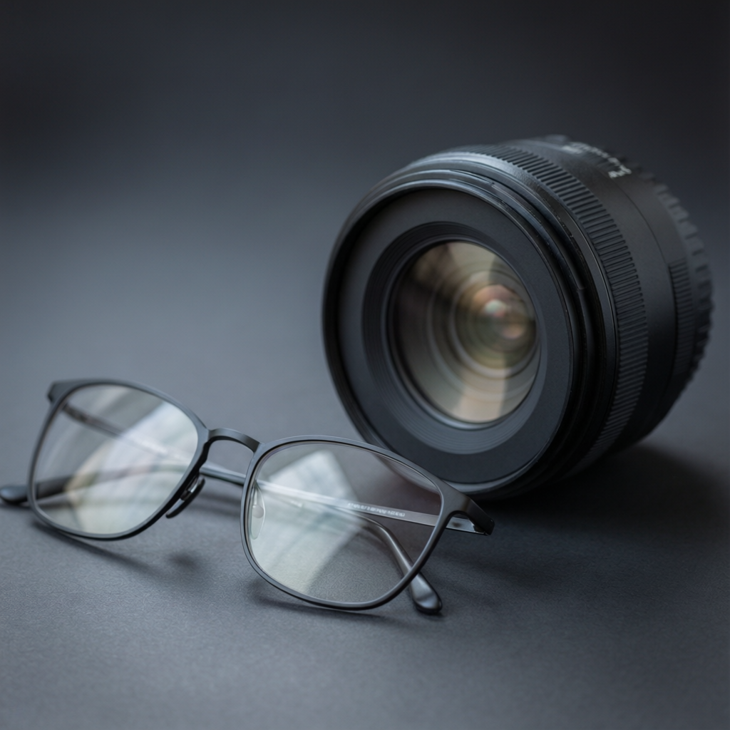
APPLICATIONS
Lenses Around Us
Everyday optics
• Spectacles correct short sight (concave) and long sight (convex).
• Cameras and the eye use convex lenses to form real images.
• Microscopes and telescopes combine lenses to magnify.
• Projectors and magnifying glasses enlarge what we see.
Eyeglasses and camera lenses in daily life
Notes:
Link lens power and type to real corrective lenses: concave for myopia, convex for hypermetropia.

Slide 29

EYE DEFECTS
Correcting Vision With Lenses
Short sight (myopia)
Long sight (hypermetropia)
The eye over-converges; distant objects focus in front of the retina. Corrected with a concave lens.
The eye under-converges; near objects focus behind the retina. Corrected with a convex lens.
Concave = negative power
Convex = positive power
Diverges light slightly before it enters the eye.
Adds converging power to help the eye focus near objects.
Notes:
A favourite application question. Match the defect to the corrective lens and its sign of power.

Slide 30

CONCAVE USES
Where Concave Lenses Are Used
Spectacles for myopia
Door viewer (peephole)
A concave lens of the right negative power corrects short sight.
Gives a wide, erect, diminished view of the area outside the door.
In instruments
Laser/beam spreading
Used with convex lenses to widen the field of view and reduce defects.
Spreads a narrow beam out over a larger area.
Notes:
Concave lenses are less common than convex; the peephole and myopia spectacles are the standard examples.

Slide 31
EXPERIMENT
Finding the Focal Length of a Convex Lens
Distant-object method
• Point the lens at a distant object (a far window or tree).
• Move a white screen behind the lens until a sharp image forms.
• The object is effectively at infinity, so the image forms at F.
• Measure the distance from the lens to the screen.
• That distance is the focal length of the convex lens.
Notes:
A quick, classic ICSE practical. Works because rays from a far object are nearly parallel, so they focus at F.

Slide 32
WRAP UP
Quick Recap
✓ Concave lens — always virtual, erect, diminished image
✓ Sign convention — u negative; convex f positive, concave f negative
✓ Lens formula — 1/v − 1/u = 1/f
✓ Magnification — m = v/u = hi/ho; sign gives real/virtual
✓ Power — P = 1/f (metres), unit dioptre; sign follows lens type
✓ Focal length — distant-object method: image of far object forms at F
Notes:
Rapid recap; cold-call the formulae and their sign rules.

Slide 33
QUIZ 2
Final Check — Numbers & Power
5 questions • think before the answer reveals on the next slide

Slide 34
QUIZ QUESTION
Q1 — Power Unit
The SI unit of the power of a lens is the:
Watt
Dioptre
A
B
Metre
Newton
C
D

Slide 35
ANSWER REVEALED
Q1 — Power Unit
The SI unit of the power of a lens is the:
Watt
Dioptre
A
✓
Metre
Newton
C
D
WHY
Power P = 1/f with f in metres, so its unit is the dioptre (D). 1 D is the power of a lens of focal length 1 metre.

Slide 36
QUIZ QUESTION
Q2 — Power Value
A convex lens has a focal length of 20 cm. Its power is:
+0.2 D
+5 D
A
B
−5 D
+20 D
C
D

Slide 37
ANSWER REVEALED
Q2 — Power Value
A convex lens has a focal length of 20 cm. Its power is:
+0.2 D
+5 D
A
✓
−5 D
+20 D
C
D
WHY
f = 20 cm = 0.2 m, so P = 1/0.2 = +5 D. It is positive because the lens is convex (converging).

Slide 38
QUIZ QUESTION
Q3 — Magnification Sign
A lens produces a magnification of m = −3. The image is:
Virtual and erect
Real and inverted
A
B
Virtual and diminished
Same size as object
C
D

Slide 39
ANSWER REVEALED
Q3 — Magnification Sign
A lens produces a magnification of m = −3. The image is:
Virtual and erect
Real and inverted
A
✓
Virtual and diminished
Same size as object
C
D
WHY
A negative magnification means a real, inverted image; the magnitude 3 means it is three times the object's size.

Slide 40
QUIZ QUESTION
Q4 — Lens Formula
An object at u = −15 cm gives an image at v = +30 cm. The focal length is:
+10 cm
+45 cm
A
B
−10 cm
+30 cm
C
D

Slide 41
ANSWER REVEALED
Q4 — Lens Formula
An object at u = −15 cm gives an image at v = +30 cm. The focal length is:
+10 cm
+45 cm
✓
B
−10 cm
+30 cm
C
D
WHY
1/f = 1/v − 1/u = 1/30 − 1/(−15) = 1/30 + 2/30 = 3/30 = 1/10, so f = +10 cm (a convex lens).

Slide 42
QUIZ QUESTION
Q5 — Eye Defect
Short sight (myopia) is corrected by using a:
Convex lens
Concave lens
A
B
Plane mirror
Prism
C
D

Slide 43
ANSWER REVEALED
Q5 — Eye Defect
Short sight (myopia) is corrected by using a:
Convex lens
Concave lens
A
✓
Plane mirror
Prism
C
D
WHY
A short-sighted eye over-converges light, so distant objects focus in front of the retina. A concave (diverging) lens of negative power corrects this.

Slide 44
From Eyeglasses to Telescopes
Sign convention, the lens formula and power turn lenses from magic into measurable physics.

