Slide 1
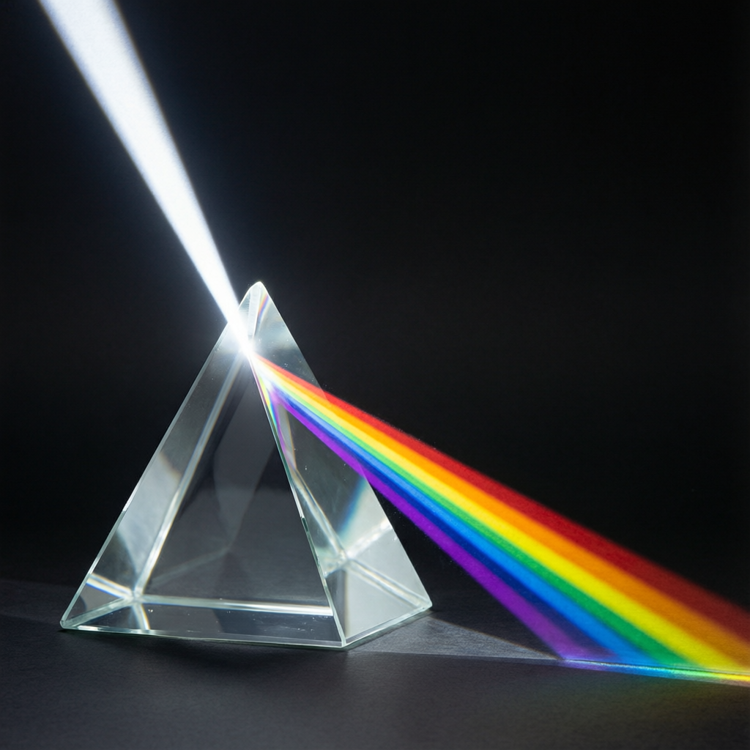
ICSE • CLASS 10 • OPTICS
Spectrum & Dispersion
Deviation by a prism • Dispersion of white light • The electromagnetic spectrum

Slide 2
INTRODUCTION
Learning Objectives
1
Describe the deviation produced by a triangular prism
2
Explain the dispersion of white light into a spectrum
3
Recall the seven colours and their wavelength/frequency order
4
Explain why violet deviates more than red
5
List the members of the electromagnetic spectrum in order
6
Use the wave relation c = f λ
Notes:
Open by previewing these objectives so students know what they should be able to do by the end of the session.

Slide 3
PART 1
Dispersion of White Light
1
How a prism splits white light into colours

Slide 4
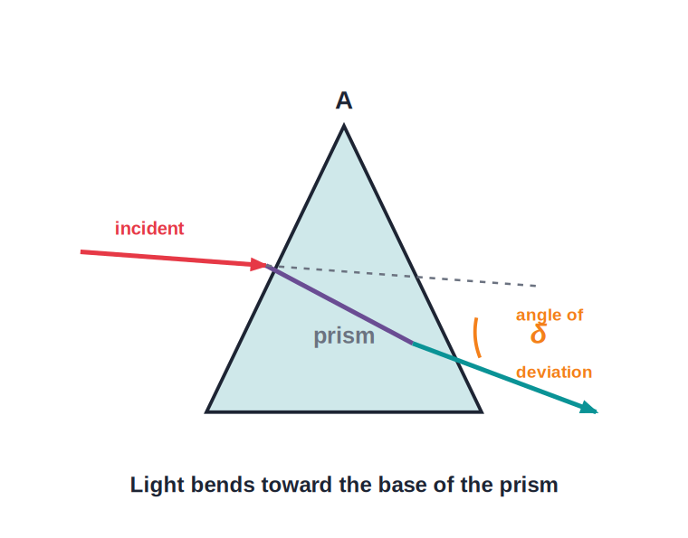
DEVIATION
Deviation by a Prism
Angle of deviation
• A prism has two refracting surfaces inclined at the angle of the prism, A.
• Light refracts at both faces and bends toward the base.
• The angle between the incident and emergent directions is the angle of deviation, δ.
• Different colours are deviated by different amounts — the key to dispersion.
Light bends toward the base of the prism
Notes:
Recall deviation from the refraction chapter, then set up the idea that deviation depends on colour — leading into dispersion.

Slide 5
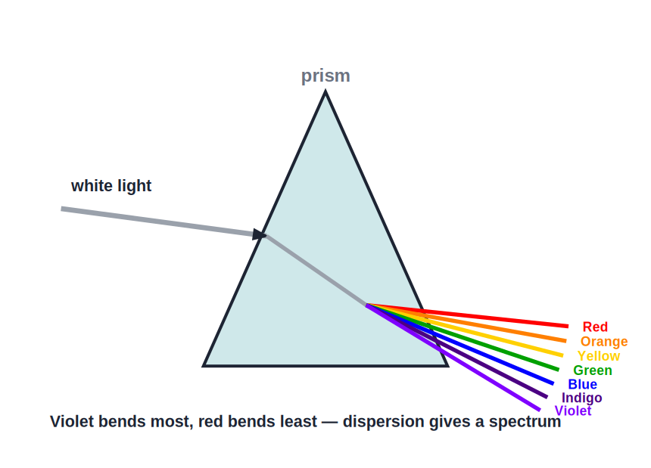
DISPERSION
Dispersion of White Light
White light → a spectrum
• White light is a mixture of seven colours.
• Each colour travels at a slightly different speed in glass, so each has a different refractive index.
• The prism therefore deviates each colour by a different amount, spreading them out.
• This splitting of white light into its colours is called dispersion; the band of colours is the spectrum.
The seven colours: VIBGYOR
Notes:
Define dispersion. The cause is that refractive index depends on colour (wavelength). Mention Newton's prism experiment.

Slide 6


WHY IT SPLITS
Why the Colours Separate
Different speeds
Different index
In glass, violet light travels slowest and red fastest.
So glass has the highest refractive index for violet and the lowest for red.
Different deviation
In a vacuum
Higher index → more bending, so violet is deviated most and red least.
All colours travel at the same speed c, so there is no dispersion in vacuum.
Notes:
Hammer the chain: speed → refractive index → deviation. Note there is NO dispersion in vacuum, where all colours share speed c.

Slide 7
THE COLOURS
VIBGYOR — Wavelength & Frequency
From violet to red
• Violet shortest wavelength (~400 nm), highest frequency, deviated most.
• Through to Red wavelength increases and frequency decreases across the spectrum.
• Red longest visible wavelength (~700 nm), lowest frequency, deviated least.
• Order Violet, Indigo, Blue, Green, Yellow, Orange, Red — remember VIBGYOR.
Notes:
Anchor the two ends: violet (short λ, high f) and red (long λ, low f). Everything else lies between.

Slide 8
NEWTON'S PROOF
Showing White Light Is Composite
Experiment 1
Experiment 2
A single prism spreads white light into the seven colours — dispersion.
A second, inverted prism recombines those colours back into white light.
Experiment 3
Conclusion
Passing just one colour of the spectrum through another prism gives no new colours.
The colours are already present in white light; the prism only separates them.
Notes:
Newton's three classic experiments. The third (single-colour test) clinches that the prism does not manufacture colour.

Slide 9
PURE VS IMPURE
Pure and Impure Spectrum
In an impure spectrum the colours overlap; in a pure spectrum each colour is sharply separated.
• A simple prism alone gives an impure spectrum — neighbouring colours overlap.
• Adding lenses to focus each colour to a sharp band gives a pure spectrum.
• A pure spectrum needs the colours to be parallel and separately focused.
Notes:
Distinguish pure (sharp, focused) from impure (overlapping) spectra; a pure spectrum needs lenses plus the prism, not the prism alone.

Slide 10
RECOMBINATION
White Light Can Be Re-made
A second, inverted prism can recombine the spectrum back into white light — proving the colours were always in the white light.
• A single prism disperses; a matched inverted prism recombines.
• This shows the prism does not 'create' colour — it only separates what is already there.
• A disc painted with the seven colours (Newton's disc) looks white when spun fast.
Notes:
Use Newton's two-prism and spinning-disc demonstrations to prove white light is a mixture, not the prism's creation.

Slide 11
ONE COLOUR VS MANY
Monochromatic and Polychromatic Light
Light of a single wavelength is monochromatic; light made of many wavelengths is polychromatic.
• Monochromatic light (e.g. from a sodium lamp) is not split by a prism — it has only one colour.
• White light is polychromatic — a mixture of all seven colours, so a prism disperses it.
• The visible spectrum is continuous: the colours merge smoothly from violet to red.
Notes:
Define monochromatic vs polychromatic. A prism cannot disperse monochromatic light — a useful test and a common exam point.

Slide 12
QUIZ 1
Check Your Understanding
5 questions • think before the answer reveals on the next slide

Slide 13
QUIZ QUESTION
Q1 — Most Deviated
When white light passes through a glass prism, which colour emerges closest to the base of the prism (deviated most)?
Red
Yellow
A
B
Green
Violet
C
D

Slide 14
ANSWER REVEALED
Q1 — Most Deviated
When white light passes through a glass prism, which colour emerges closest to the base of the prism (deviated most)?
Red
Yellow
A
B
Green
Violet
C
✓
WHY
Glass has the highest refractive index for violet (it travels slowest), so violet bends the most and emerges nearest the base. Red, with the lowest index, deviates least.

Slide 15
QUIZ QUESTION
Q2 — No Dispersion
White light passes through a thick glass slab with parallel sides instead of a prism. The emergent light is white because:
Glass cannot disperse light
The colours recombine as they leave the parallel face
A
B
White light has only one colour
The slab is too thick
C
D

Slide 16
ANSWER REVEALED
Q2 — No Dispersion
White light passes through a thick glass slab with parallel sides instead of a prism. The emergent light is white because:
Glass cannot disperse light
The colours recombine as they leave the parallel face
A
✓
White light has only one colour
The slab is too thick
C
D
WHY
A slab does disperse light inside, but because its faces are parallel the colours bend back and recombine on emerging, so the output is white (just slightly shifted). A prism's inclined faces keep them separated.

Slide 17
QUIZ QUESTION
Q3 — Spinning Disc
Newton's disc, painted with the seven spectrum colours, appears white when spun rapidly. This shows that:
The colours disappear when moving
White light is a combination of the seven colours
A
B
The disc reflects only white light
Fast motion removes colour
C
D

Slide 18
ANSWER REVEALED
Q3 — Spinning Disc
Newton's disc, painted with the seven spectrum colours, appears white when spun rapidly. This shows that:
The colours disappear when moving
White light is a combination of the seven colours
A
✓
The disc reflects only white light
Fast motion removes colour
C
D
WHY
The eye blends the rapidly changing colours together. Their recombination producing white proves white light is a mixture of all seven colours.

Slide 19
QUIZ QUESTION
Q4 — Monochromatic
A beam of pure yellow sodium light is passed through a glass prism. What happens?
It splits into seven colours
It is deviated but not dispersed (stays one colour)
A
B
It disappears
It turns white
C
D

Slide 20
ANSWER REVEALED
Q4 — Monochromatic
A beam of pure yellow sodium light is passed through a glass prism. What happens?
It splits into seven colours
It is deviated but not dispersed (stays one colour)
A
✓
It disappears
It turns white
C
D
WHY
Sodium light is monochromatic — a single wavelength. The prism bends (deviates) it, but with only one colour present there is nothing to split, so no spectrum forms.

Slide 21
QUIZ QUESTION
Q5 — Cause of Dispersion
Dispersion occurs in glass but not in vacuum because, in glass, different colours have different:
Frequencies
Speeds (and so refractive indices)
A
B
Amplitudes
Energies
C
D

Slide 22
ANSWER REVEALED
Q5 — Cause of Dispersion
Dispersion occurs in glass but not in vacuum because, in glass, different colours have different:
Frequencies
Speeds (and so refractive indices)
A
✓
Amplitudes
Energies
C
D
WHY
In glass each colour travels at a slightly different speed, so the refractive index differs by colour and each is deviated differently. In vacuum all colours share speed c, so there is no dispersion.

Slide 23
PART 2
The Electromagnetic Spectrum
2
Visible light is one small part of a much larger family

Slide 24
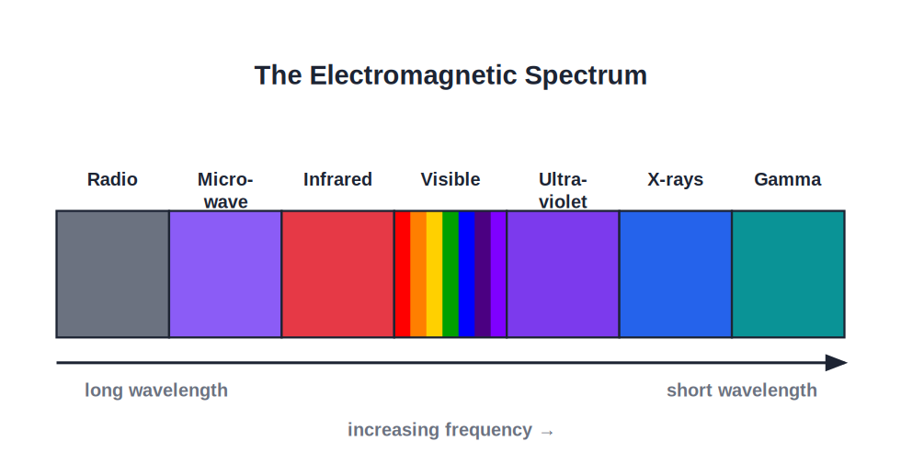
EM SPECTRUM
The Electromagnetic Spectrum
One family, many wavelengths
• Visible light is just one small band of a huge family of electromagnetic waves.
• In order of increasing frequency: radio, microwave, infrared, visible, ultraviolet, X-rays, gamma rays.
• Wavelength decreases and frequency (and energy) increases from radio to gamma.
• All of them are electromagnetic waves — only their wavelength differs.
Radio (long λ) → Gamma (short λ)
Notes:
Stress that visible light is a tiny slice. Learn the order both ways: by increasing frequency and by decreasing wavelength.

Slide 25


WAVELENGTH RANGES
Each Band by Wavelength and Source
Radio (> 0.1 m)
Microwave (mm–cm)
Made by oscillating circuits/aerials; received by aerials and tuned circuits.
From klystrons/magnetrons and masers; detected by aerials and crystal detectors.
Infrared (700 nm–1 mm)
UV → X-ray → Gamma (< 400 nm)
Emitted by all warm bodies; detected by thermopiles, blackened thermometers, IR cameras.
From the Sun/sparks, X-ray tubes and radioactive nuclei; detected by photographic plates and fluorescence/Geiger tubes.
Notes:
Selina wants the wavelength range, a source and a means of detection for each band. Visible sits at 400–700 nm between IR and UV.

Slide 26

SHARED PROPERTIES
What All EM Waves Have in Common
Same speed
No medium needed
All travel at 3 × 10⁸ m/s in vacuum — the speed of light, c.
They are transverse waves that can travel through a vacuum.
Carry energy
c = f λ
Higher frequency means higher energy per wave.
For every member, speed = frequency × wavelength.
Notes:
These four shared properties are commonly examined. Contrast with sound, which needs a medium.

Slide 27
WAVE RELATION
Speed, Frequency & Wavelength
For any electromagnetic wave, the speed equals the frequency multiplied by the wavelength.
c = f × λ (c = 3 × 10⁸ m/s)
• If frequency goes up, wavelength goes down (c is fixed).
• Gamma rays: very high f, very short λ.
• Radio waves: low f, very long λ.
Notes:
Introduce c = fλ for the numerical that follows. Emphasise the inverse relation between f and λ.

Slide 28
WORKED EXAMPLE
Using c = f λ
Problem. A radio station broadcasts at a frequency of 100 MHz (1 × 10⁸ Hz). Find the wavelength of the waves. (c = 3 × 10⁸ m/s)
c = f × λ → λ = c / f
λ = (3 × 10⁸) / (1 × 10⁸)
λ = 3 m
Answer: λ = 3 m — typical of FM radio waves
Notes:
Rearrange c = fλ for λ. Note radio waves are metres long, unlike the nanometre wavelengths of light.

Slide 29

IN NATURE
Dispersion Around Us
Rainbow
CD / DVD surface
Raindrops act like tiny prisms, dispersing sunlight into an arc of colours.
Fine grooves split white light into a shifting spectrum of colours.
Oil film & bubbles
Diamond fire
Thin films break white light into colours by interference and dispersion.
Strong dispersion inside diamond spreads light into flashes of colour.
Notes:
Connect dispersion to familiar sights. A rainbow is nature's prism made of raindrops.

Slide 30
RAINBOW
How a Rainbow Forms
Each drop is a tiny prism + mirror
• Sunlight enters a raindrop and refracts, dispersing into colours.
• The light reflects once off the back of the drop.
• It refracts again on leaving, spreading the colours further.
• Red appears on the outer edge of the bow and violet on the inner.
Notes:
Trace the path: refraction → internal reflection → refraction. The geometry puts red outside and violet inside.

Slide 31
WORKED EXAMPLE
Frequency of Light
Problem. Yellow light has a wavelength of 600 nm (6 × 10⁻⁷ m) in vacuum. Find its frequency. (c = 3 × 10⁸ m/s)
c = f × λ → f = c / λ
f = (3 × 10⁸) / (6 × 10⁻⁷)
f = 5 × 10¹⁴ Hz
Answer: f = 5 × 10¹⁴ Hz — visible light has frequencies near 10¹⁴ Hz
Notes:
Rearrange c = fλ for f, keeping powers of ten tidy. Visible frequencies are around 10¹⁴ Hz.

Slide 32
WRAP UP
Quick Recap
✓ Deviation — a prism bends light toward its base by angle δ
✓ Dispersion — white light splits because index depends on colour
✓ VIBGYOR — violet shortest λ / most deviated; red longest / least
✓ Recombination — an inverted prism re-makes white light
✓ EM spectrum — radio → micro → IR → visible → UV → X-ray → gamma
✓ c = f λ — all EM waves travel at c = 3 × 10⁸ m/s in vacuum
Notes:
Rapid recap; cold-call the order of the EM spectrum.

Slide 33
QUIZ 2
Final Check — Spectra & Waves
5 questions • think before the answer reveals on the next slide

Slide 34
QUIZ QUESTION
Q1 — Order
Which list is in order of INCREASING frequency?
Gamma, X-ray, UV, visible
Radio, infrared, visible, ultraviolet
A
B
Visible, infrared, microwave, radio
X-ray, UV, visible, infrared
C
D

Slide 35
ANSWER REVEALED
Q1 — Order
Which list is in order of INCREASING frequency?
Gamma, X-ray, UV, visible
Radio, infrared, visible, ultraviolet
A
✓
Visible, infrared, microwave, radio
X-ray, UV, visible, infrared
C
D
WHY
Frequency increases from radio waves (lowest) up through infrared and visible to ultraviolet and beyond. Wavelength does the opposite — it decreases.

Slide 36
QUIZ QUESTION
Q2 — Find the Wavelength
An X-ray has a frequency of 3 × 10¹⁸ Hz. Its wavelength is (c = 3 × 10⁸ m/s):
1 × 10⁻¹⁰ m
1 × 10¹⁰ m
A
B
9 × 10²⁶ m
1 × 10⁻²⁶ m
C
D

Slide 37
ANSWER REVEALED
Q2 — Find the Wavelength
An X-ray has a frequency of 3 × 10¹⁸ Hz. Its wavelength is (c = 3 × 10⁸ m/s):
1 × 10⁻¹⁰ m
1 × 10¹⁰ m
✓
B
9 × 10²⁶ m
1 × 10⁻²⁶ m
C
D
WHY
λ = c / f = (3 × 10⁸) / (3 × 10¹⁸) = 1 × 10⁻¹⁰ m. Such tiny wavelengths are why X-rays can pass between atoms in the body.

Slide 38
QUIZ QUESTION
Q3 — Which Travels Fastest?
In a vacuum, which travels fastest — a radio wave, green light, or a gamma ray?
The radio wave
Green light
A
B
The gamma ray
They all travel at the same speed
C
D

Slide 39
ANSWER REVEALED
Q3 — Which Travels Fastest?
In a vacuum, which travels fastest — a radio wave, green light, or a gamma ray?
The radio wave
Green light
A
B
The gamma ray
They all travel at the same speed
C
✓
WHY
All electromagnetic waves travel at c = 3 × 10⁸ m/s in a vacuum, regardless of frequency. They differ in wavelength and energy, not speed.

Slide 40
QUIZ QUESTION
Q4 — Highest Energy
Which of these electromagnetic radiations carries the most energy per wave?
Radio waves
Infrared
A
B
Visible light
Gamma rays
C
D

Slide 41
ANSWER REVEALED
Q4 — Highest Energy
Which of these electromagnetic radiations carries the most energy per wave?
Radio waves
Infrared
A
B
Visible light
Gamma rays
C
✓
WHY
Energy increases with frequency. Gamma rays have the highest frequency (shortest wavelength) of all, so they carry the most energy — which is why they are so penetrating and dangerous.

Slide 42
QUIZ QUESTION
Q5 — Same Speed?
Radio waves have a much longer wavelength than visible light. In vacuum, the radio waves therefore have a:
Lower speed
Higher speed
A
B
Lower frequency
Higher frequency
C
D

Slide 43
ANSWER REVEALED
Q5 — Same Speed?
Radio waves have a much longer wavelength than visible light. In vacuum, the radio waves therefore have a:
Lower speed
Higher speed
A
B
Lower frequency
Higher frequency
✓
D
WHY
All EM waves share the same speed c in vacuum, so from c = fλ a longer wavelength must mean a lower frequency. Speed is unchanged — only f and λ trade off.

Slide 44
From Rainbows to Gamma Rays
A prism reveals the colours hidden in white light — and visible light is just one note in a vast electromagnetic symphony.

