Slide 1
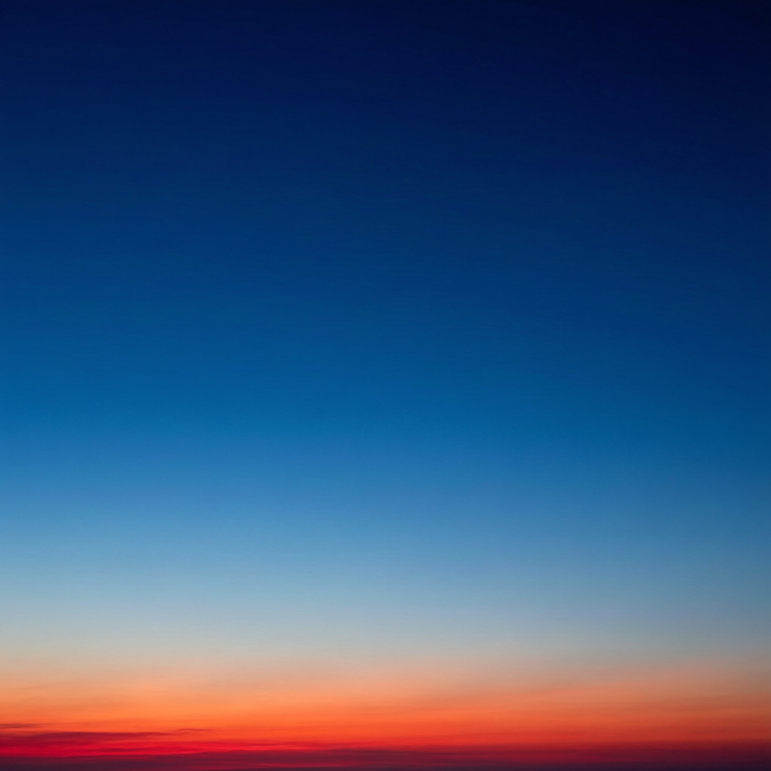
ICSE • CLASS 10 • OPTICS
EM Radiations & Scattering
Uses of each radiation • UV, visible & infrared • Why the sky is blue

Slide 2
INTRODUCTION
Learning Objectives
1
State the properties and uses of each EM radiation
2
Distinguish ultraviolet, visible and infrared radiation
3
Explain the scattering of light
4
Explain why the daytime sky is blue
5
Explain why the sky looks red at sunrise and sunset
6
Describe everyday consequences of scattering
Notes:
Open by previewing these objectives so students know what they should be able to do by the end of the session.

Slide 3
PART 1
Radiations and Their Uses
1
What each part of the spectrum does for us

Slide 4
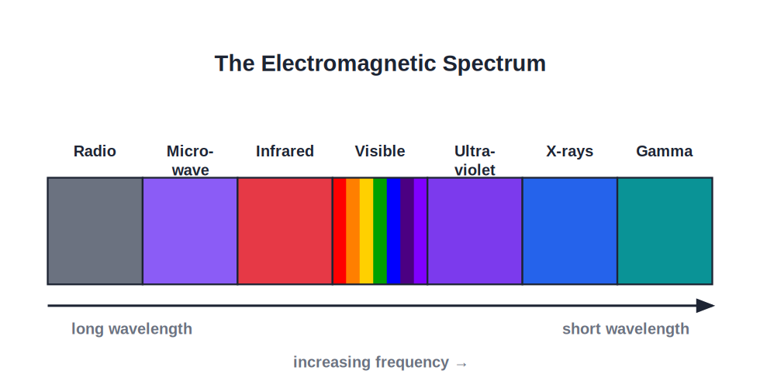
OVERVIEW
Seven Bands, Many Uses
Matching use to wavelength
• Each EM band has properties suited to particular uses.
• Lower-frequency waves (radio, microwave) are used mainly for communication.
• Middle bands (infrared, visible) we feel as heat and see as light.
• High-frequency waves (UV, X-rays, gamma) carry enough energy to be useful — and harmful.
From communication to medical imaging
Notes:
Frame the band-by-band tour: properties decide uses. Energy rises left to right.

Slide 5



LOW FREQUENCY
Radio & Microwaves
Radio waves
Microwaves
Carry TV and radio broadcasts and mobile-phone signals over long distances.
Used in microwave ovens (heating water in food) and in satellite and mobile communication.
Why for comms?
Heating
Long wavelengths travel far and bend around obstacles.
Microwaves are absorbed by water molecules, warming food from within.
Notes:
Connect long wavelength to communication. Microwaves: resonance with water molecules heats food.

Slide 6


MIDDLE BANDS
Infrared & Visible Light
Infrared
Visible light
Felt as heat; used in remote controls, thermal cameras and night-vision.
The only band our eyes detect; lets us see and drives photosynthesis.
Infrared heating
Optical use
Warm objects emit infrared — how we sense heat from a fire.
Visible light is used in photography, fibre-optic signals and illumination.
Notes:
Infrared = heat radiation (remotes, thermal imaging). Visible = the band the eye is tuned to.

Slide 7

HIGH FREQUENCY
Ultraviolet, X-rays & Gamma
Ultraviolet
X-rays
Causes tanning and vitamin D; sterilises water; makes things fluoresce. Excess causes sunburn.
Pass through soft tissue but not bone — used to image fractures and in airport scanners.
Gamma rays
Hazard
Kill cancer cells and sterilise medical equipment; very penetrating.
All three are ionising in excess and can damage living cells.
Notes:
High-energy bands: powerful and useful but hazardous. Link energy (high f) to penetrating, ionising power.

Slide 8
DISTINCTION
Ultraviolet vs Visible vs Infrared
Three neighbouring bands
• Ultraviolet shorter wavelength than violet; invisible; high energy; causes sunburn and fluorescence.
• Visible the band 400–700 nm that the eye can see as colours.
• Infrared longer wavelength than red; invisible; felt as heat.
• Order of energy UV > visible > infrared (energy follows frequency).
Notes:
These three are commonly compared. Anchor by where they sit around the visible band and by energy order.

Slide 9
INFRARED IN DETAIL
Infrared — Source, Property, Detection
Source
Property
Emitted by every warm body — the Sun, fires, our own skin.
Invisible; strong heating effect; longer wavelength than red light.
Detection
Uses
A blackened-bulb thermometer, a thermopile or an infrared camera.
Remote controls, thermal/night-vision cameras, physiotherapy heat lamps, weather satellites.
Notes:
Selina asks for source/property/detection/use of IR. Anchor: hot bodies emit it; it is the heat radiation just beyond red.

Slide 10
ULTRAVIOLET IN DETAIL
Ultraviolet — Source, Property, Detection
Source
Property
The Sun, electric sparks and mercury-vapour (UV) lamps.
Invisible; higher energy than visible; causes fluorescence and affects photographic film.
Detection
Uses
Photographic plates, or the fluorescence (glow) it produces in certain materials.
Sterilising water and instruments, detecting forged notes, producing vitamin D in skin.
Notes:
UV source/property/detection/use. Most solar UV is absorbed by the ozone layer — link to the protection slide.

Slide 11
X-RAYS IN DETAIL
X-rays — Source, Property, Detection
Source
Property
Produced in an X-ray tube when fast electrons strike a metal target.
Very penetrating and ionising; pass through flesh but not bone or metal.
Detection
Uses
Photographic plates and fluorescent screens.
Imaging bones and teeth, airport security scanning, studying crystal structures.
Notes:
X-ray source/property/detection/use. Penetrating power and the flesh-vs-bone contrast are the key facts.

Slide 12
GAMMA RAYS IN DETAIL
Gamma Rays — Source, Property, Use
Source
Property
Emitted by the nuclei of radioactive atoms.
The most penetrating and most energetic EM radiation; strongly ionising.
Detection
Uses
Geiger–Müller tube and photographic film.
Killing cancer cells (radiotherapy), sterilising medical equipment and food, industrial flaw detection.
Notes:
Gamma: highest energy, most penetrating, from the nucleus. Tie uses to its penetrating, cell-killing power.

Slide 13

PROTECTION
Living With Radiation Safely
Ozone layer
Sunscreen & shades
High in the atmosphere it absorbs most harmful UV from the Sun, shielding life below.
Block UV to protect skin and eyes from long-term damage.
Lead aprons
Controlled doses
Worn during X-ray imaging to stop rays reaching parts of the body not being scanned.
Gamma and X-ray equipment is shielded and carefully dosed to limit exposure.
Notes:
Tie protection measures to the hazard of high-energy radiation. The ozone layer is the planet's natural UV shield.

Slide 14
QUIZ 1
Check Your Understanding
5 questions • think before the answer reveals on the next slide

Slide 15
QUIZ QUESTION
Q1 — Match the Use
A TV remote control sends a signal to the television using:
Ultraviolet
Infrared
A
B
X-rays
Radio waves of visible light
C
D

Slide 16
ANSWER REVEALED
Q1 — Match the Use
A TV remote control sends a signal to the television using:
Ultraviolet
Infrared
A
✓
X-rays
Radio waves of visible light
C
D
WHY
Remote controls use infrared, which is invisible to us but easily produced and detected over short distances. Infrared is also why we feel heat from warm objects.

Slide 17
QUIZ QUESTION
Q2 — Through the Body
X-rays are used to photograph broken bones because they:
Are reflected by skin
Pass through soft tissue but are absorbed by bone
A
B
Are visible to the eye
Cannot pass through the body
C
D

Slide 18
ANSWER REVEALED
Q2 — Through the Body
X-rays are used to photograph broken bones because they:
Are reflected by skin
Pass through soft tissue but are absorbed by bone
A
✓
Are visible to the eye
Cannot pass through the body
C
D
WHY
X-rays penetrate soft tissue but are stopped by dense bone, so bones cast a shadow on the film — producing the familiar X-ray image of the skeleton.

Slide 19
QUIZ QUESTION
Q3 — Sunburn
Spending too long in strong sunlight causes sunburn. The radiation mainly responsible is:
Infrared
Visible light
A
B
Ultraviolet
Radio waves
C
D

Slide 20
ANSWER REVEALED
Q3 — Sunburn
Spending too long in strong sunlight causes sunburn. The radiation mainly responsible is:
Infrared
Visible light
A
B
Ultraviolet
Radio waves
✓
D
WHY
Ultraviolet has more energy than visible light and damages skin cells, causing sunburn (and, in excess, skin cancer). Sunscreen and the ozone layer block much of it.

Slide 21
QUIZ QUESTION
Q4 — Night Vision
A security camera can 'see' a warm person in complete darkness. It must be detecting:
Ultraviolet given off by the person
Infrared (heat) radiation from the person
A
B
X-rays from the person
Visible light only
C
D

Slide 22
ANSWER REVEALED
Q4 — Night Vision
A security camera can 'see' a warm person in complete darkness. It must be detecting:
Ultraviolet given off by the person
Infrared (heat) radiation from the person
A
✓
X-rays from the person
Visible light only
C
D
WHY
Warm bodies emit infrared radiation. A thermal/IR camera detects this heat radiation, so it works even with no visible light — the basis of night vision.

Slide 23
QUIZ QUESTION
Q5 — Detecting UV
Ultraviolet radiation is often detected by the fact that it:
Feels hot on the skin
Makes certain materials fluoresce (glow)
A
B
Is easily seen as violet
Bends around corners
C
D

Slide 24
ANSWER REVEALED
Q5 — Detecting UV
Ultraviolet radiation is often detected by the fact that it:
Feels hot on the skin
Makes certain materials fluoresce (glow)
A
✓
Is easily seen as violet
Bends around corners
C
D
WHY
UV itself is invisible, but it makes some substances glow with visible light (fluorescence) and darkens photographic film — both used to detect it, as in checking banknotes.

Slide 25
PART 2
Scattering of Light
2
Why the sky is blue and sunsets are red

Slide 26
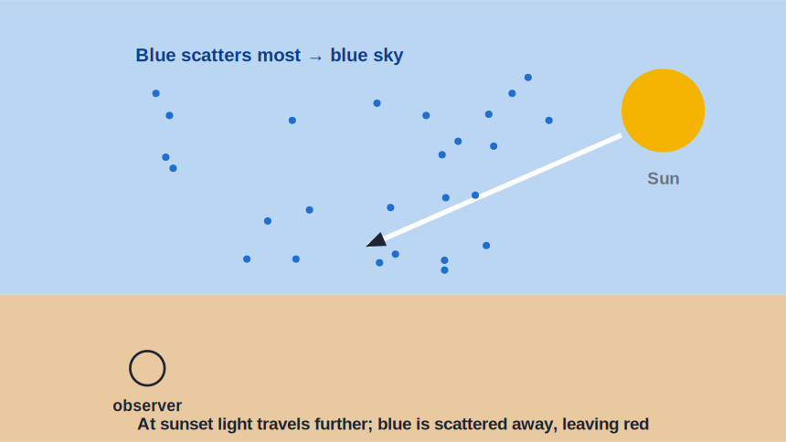
SCATTERING
What Is Scattering?
Light redirected by the air
• Tiny particles and air molecules redirect light in all directions — this is scattering.
• Shorter wavelengths (blue, violet) are scattered much more than longer ones (red).
• So blue light is scattered all across the sky.
• Scattering depends strongly on wavelength — blue scatters far more than red.
Blue is scattered most by air molecules
Notes:
Define scattering and the key fact: shorter wavelength scatters more. This single idea explains the next two slides.

Slide 27
HOW MUCH?
Scattering Depends Strongly on Wavelength
The amount of scattering by tiny particles rises very steeply as the wavelength gets shorter.
amount of scattering ∝ 1 / λ⁴
• Halving the wavelength scatters light about 16 times more.
• So blue/violet (short λ) scatter far more than red (long λ).
• Scattering of light by fine (colloidal) particles is called the Tyndall effect.
Notes:
The 1/λ⁴ rule (Rayleigh) explains why blue dominates the sky. Name the Tyndall effect — scattering by colloidal particles such as dust, smoke and fine droplets.

Slide 28
CONSEQUENCES
Blue Skies and Red Sunsets
Why the sky is blue
Why sunsets are red
Air scatters blue sunlight in all directions, so the whole sky glows blue.
At sunset light travels through more air; blue is scattered away, leaving red and orange to reach us.
Why space is black
Danger signals are red
With no air to scatter light, the sky away from the Sun is black to astronauts.
Red scatters least, so red light travels furthest through fog — used for stop signs and signals.
Notes:
Each consequence follows from 'blue scatters more'. The red danger-signal point is a favourite application question.

Slide 29
MORE EFFECTS
Scattering Around Us
Everyday sights explained
• Clouds look white Large water droplets scatter all colours equally, so clouds appear white.
• Why blue, not violet? Violet scatters even more, but the Sun sends less violet and our eyes are less sensitive to it — so the sky looks blue.
• Reddened Sun The rising or setting Sun itself looks red for the same reason its surroundings do.
• Clear vs hazy More dust and particles mean more scattering and a paler sky.
Notes:
Extend the idea to clouds (all colours scattered → white) and haze. Reinforces wavelength-dependence.

Slide 30
WRAP UP
Quick Recap
✓ Radio / microwave — communication; microwaves also heat food
✓ Infrared / visible — heat we feel; light we see
✓ UV / X-ray / gamma — useful but hazardous high-energy radiation
✓ UV vs visible vs IR — energy order UV > visible > infrared
✓ Scattering — shorter wavelengths scatter more than longer ones
✓ Sky & sunset — blue sky from scattered blue; red sunset as blue is removed
Notes:
Rapid recap; cold-call a use for each band and the scattering explanations.

Slide 31
QUIZ 2
Final Check — Radiations & Scattering
5 questions • think before the answer reveals on the next slide

Slide 32
QUIZ QUESTION
Q1 — Astronaut's Sky
An astronaut in space, looking away from the Sun, sees a black sky instead of a blue one because:
The Sun is switched off
There is no air to scatter sunlight
A
B
Space absorbs all blue light
Their visor blocks blue
C
D

Slide 33
ANSWER REVEALED
Q1 — Astronaut's Sky
An astronaut in space, looking away from the Sun, sees a black sky instead of a blue one because:
The Sun is switched off
There is no air to scatter sunlight
A
✓
Space absorbs all blue light
Their visor blocks blue
C
D
WHY
The sky is blue because air scatters blue sunlight toward us. In space there are no air molecules to scatter light, so the sky (away from the Sun) looks black.

Slide 34
QUIZ QUESTION
Q2 — Why Red at Sunset
The setting Sun appears red because, near the horizon, sunlight:
Travels through more air, so blue is scattered away
Slows down and turns red
A
B
Reflects off clouds
Changes frequency
C
D

Slide 35
ANSWER REVEALED
Q2 — Why Red at Sunset
The setting Sun appears red because, near the horizon, sunlight:
Travels through more air, so blue is scattered away
Slows down and turns red
✓
B
Reflects off clouds
Changes frequency
C
D
WHY
At sunset light skims through a long path of atmosphere. Most of the blue is scattered out before it reaches us, leaving the red and orange that we see.

Slide 36
QUIZ QUESTION
Q3 — Best for Signals
Why are danger and stop signals coloured red rather than blue?
Red is brighter than blue
Red is scattered least, so it travels furthest through fog
A
B
Blue is invisible at night
Red light is faster
C
D

Slide 37
ANSWER REVEALED
Q3 — Best for Signals
Why are danger and stop signals coloured red rather than blue?
Red is brighter than blue
Red is scattered least, so it travels furthest through fog
A
✓
Blue is invisible at night
Red light is faster
C
D
WHY
Because red has the longest wavelength it is scattered the least by fog and dust, so it remains visible from a greater distance — ideal for warnings.

Slide 38
QUIZ QUESTION
Q4 — Sterilising Water
Some water purifiers use ultraviolet lamps because UV radiation:
Is visible and bright
Has enough energy to kill germs
A
B
Heats the water quickly
Is a type of sound wave
C
D

Slide 39
ANSWER REVEALED
Q4 — Sterilising Water
Some water purifiers use ultraviolet lamps because UV radiation:
Is visible and bright
Has enough energy to kill germs
A
✓
Heats the water quickly
Is a type of sound wave
C
D
WHY
Ultraviolet carries more energy than visible light — enough to damage the cells of bacteria and viruses, sterilising the water without chemicals.

Slide 40
QUIZ QUESTION
Q5 — Clouds
Clouds usually look white, not blue, because their water droplets:
Absorb all blue light
Scatter all colours of light about equally
A
B
Reflect only white paint
Emit their own light
C
D

Slide 41
ANSWER REVEALED
Q5 — Clouds
Clouds usually look white, not blue, because their water droplets:
Absorb all blue light
Scatter all colours of light about equally
A
✓
Reflect only white paint
Emit their own light
C
D
WHY
Cloud droplets are much larger than air molecules, so they scatter every colour by roughly the same amount. The mixture of all colours scattered together looks white.

Slide 42
Light Tells a Story
The same scattering that paints the sky blue sets it ablaze at sunset — physics you can watch every evening.

