Slide 1
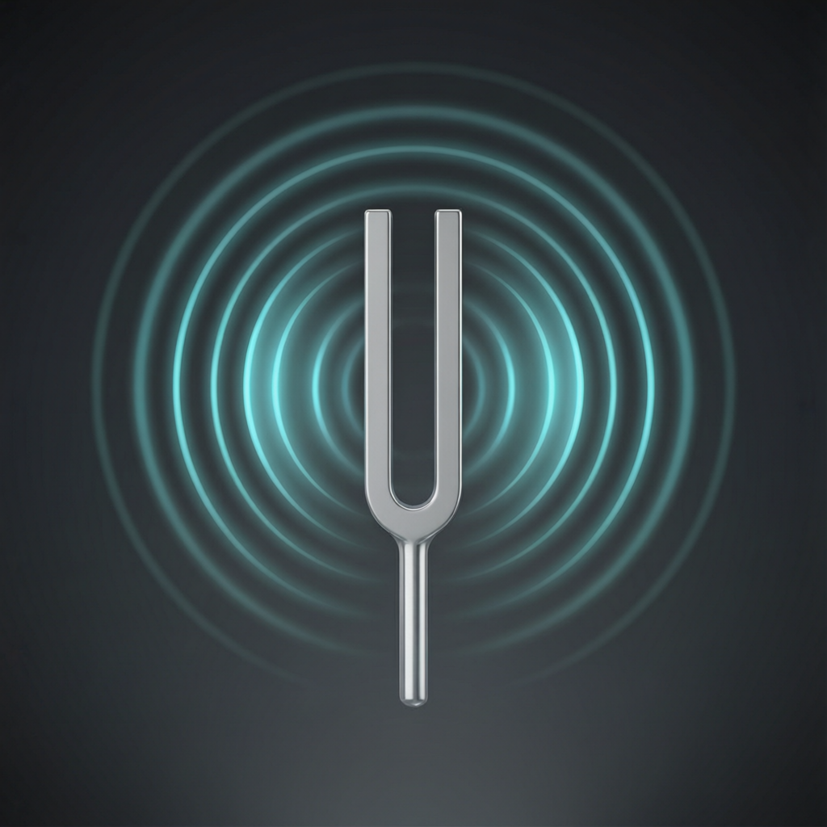
ICSE • CLASS 10 • SOUND
Sound Waves & Echo
How sound travels • Reflection of sound • Echo • Speed of sound by echo

Slide 2
INTRODUCTION
Learning Objectives
1
Describe sound as a longitudinal wave needing a medium
2
State the laws governing the reflection of sound
3
Define an echo and the condition for hearing one
4
Calculate distances using the echo method
5
Determine the speed of sound by an echo experiment
6
List practical uses of the echo (SONAR, depth-finding)
Notes:
Open by previewing these objectives so students know what they should be able to do by the end of the session.

Slide 3
PART 1
Sound Waves & Reflection
1
What sound is and how it bounces

Slide 4
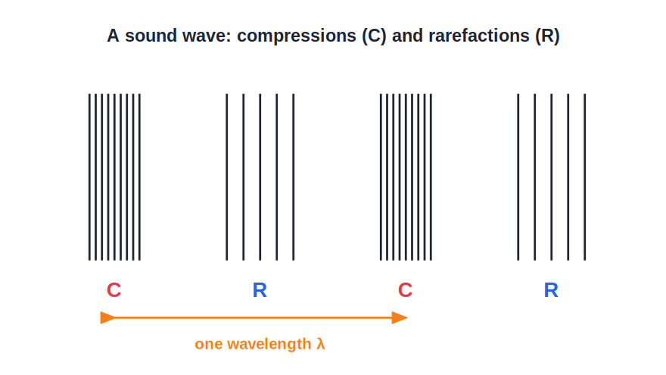
SOUND WAVES
Sound Is a Longitudinal Wave
Compressions & rarefactions
• Sound travels as compressions and rarefactions of the medium.
• The particles vibrate back and forth along the direction the wave travels.
• Sound needs a material medium — it cannot travel through a vacuum.
• It travels fastest in solids, slower in liquids, slowest in gases.
Particles vibrate along the wave direction
Notes:
Contrast with light (transverse, no medium needed). A ringing bell in a vacuum jar goes silent — sound needs matter.

Slide 5


SPEED FACTORS
What the Speed of Sound Depends On
Medium
Temperature
Fastest in solids (~5000 m/s in steel), slower in liquids (~1500 m/s in water), slowest in gases (~340 m/s in air).
In air the speed rises by about 0.6 m/s for every 1 °C rise in temperature.
Humidity
Independent of pressure
Moist air is less dense than dry air, so sound travels a little faster in humid air.
At constant temperature, changing the pressure of a gas does not change the speed.
Notes:
Selina detail: speed depends on medium, temperature (+0.6 m/s per °C) and humidity, but not on pressure alone. Contrast the three states' speeds.

Slide 6


REFLECTION
Sound Reflects Like Light
Same laws
Hard surfaces
The angle of incidence equals the angle of reflection, and all lie in one plane.
Smooth, hard walls reflect sound well; soft surfaces absorb it.
Echo
Reverberation
A reflected sound heard distinctly after the original is an echo.
Many quick overlapping reflections in a hall are heard as reverberation.
Notes:
Sound obeys the same reflection laws as light. Distinguish a clean echo from blurred reverberation.

Slide 7
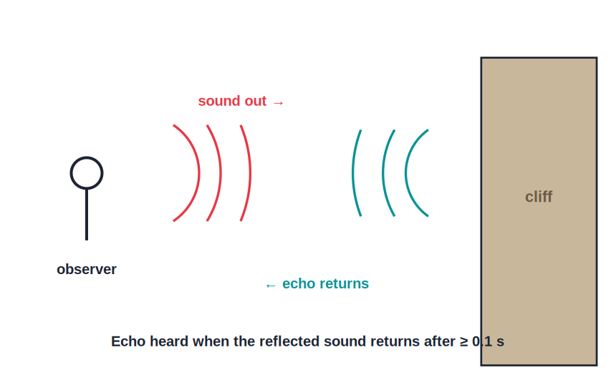
ECHO
What Is an Echo?
Reflected sound, heard again
• An echo is sound heard again after being reflected from a distant surface.
• The ear can separate two sounds only if they arrive at least 0.1 s apart.
• In that time sound travels about 34 m (there and back), so the reflector must be at least ~17 m away.
• Closer than this, the reflection merges with the original sound.
Echo needs a gap of at least 0.1 s
Notes:
Derive the 17 m minimum from 0.1 s and 340 m/s. This 0.1 s 'persistence of hearing' is key to echo problems.

Slide 8
MINIMUM DISTANCE
Why 17 Metres?
To hear a distinct echo the reflecting surface must be far enough that the echo returns at least 0.1 s later.
d = (v × t) / 2 = (340 × 0.1) / 2 = 17 m
• The sound travels to the wall and back — twice the distance.
• Using v = 340 m/s and t = 0.1 s gives a minimum of 17 m.
• This is why echoes are heard in large empty halls and valleys, not small rooms.
Notes:
Show the factor of 2 for the round trip. Reinforce that small rooms give reverberation, not echo.

Slide 9
GOOD ECHO
Conditions for Hearing a Distinct Echo
Far enough
Large & hard
The reflecting surface must be at least about 17 m away (so the echo returns ≥ 0.1 s later).
The reflector should be large and hard (a cliff, a wall), not small or soft.
Loud enough
Low noise
The original sound must be loud, as some energy is lost on reflection.
Surroundings should be quiet so the echo is not masked.
Notes:
List the conditions for a clear echo: distance ≥ 17 m, a large hard reflector, a loud source and quiet surroundings.

Slide 10
REVERBERATION
Reverberation and Its Control
Reverberation is the persistence of sound in a hall caused by repeated reflections that overlap the original.
• It happens when reflectors are nearer than 17 m, so reflections merge instead of forming clear echoes.
• Too much reverberation blurs speech and music.
• It is reduced by absorbent materials — curtains, carpets, perforated ceilings and soft seating.
Notes:
Distinguish reverberation (overlapping reflections, < 17 m) from a clean echo. Control it with sound-absorbing materials in halls.

Slide 11
WORKED EXAMPLE
Distance From an Echo
Problem. A person shouts toward a cliff and hears the echo 3 seconds later. If the speed of sound is 340 m/s, how far away is the cliff?
Total distance travelled = v × t = 340 × 3 = 1020 m
This is to the cliff AND back, so it is twice the distance.
Distance to cliff = 1020 / 2 = 510 m
Answer: The cliff is 510 m away
Notes:
The classic trap: the echo time covers the round trip, so divide by 2. Students who forget this double their answer.

Slide 12
QUIZ 1
Check Your Understanding
5 questions • think before the answer reveals on the next slide

Slide 13
QUIZ QUESTION
Q1 — Through a Vacuum
An astronaut on the airless Moon strikes a bell. A nearby astronaut hears nothing because:
The bell is too quiet
Sound cannot travel without a medium
A
B
The Moon absorbs all sound
Sound travels too fast there
C
D

Slide 14
ANSWER REVEALED
Q1 — Through a Vacuum
An astronaut on the airless Moon strikes a bell. A nearby astronaut hears nothing because:
The bell is too quiet
Sound cannot travel without a medium
A
✓
The Moon absorbs all sound
Sound travels too fast there
C
D
WHY
Sound is a mechanical wave that needs particles to vibrate. The Moon has no air, so there is nothing to carry the sound — unlike light, which crosses the vacuum freely.

Slide 15
QUIZ QUESTION
Q2 — Echo or Not?
Why do you hear an echo in a large empty hall but not in a small bedroom?
Bedrooms have no walls
In a small room the reflection returns in under 0.1 s and merges with the original
A
B
Sound is louder in halls
Bedrooms absorb all sound
C
D

Slide 16
ANSWER REVEALED
Q2 — Echo or Not?
Why do you hear an echo in a large empty hall but not in a small bedroom?
Bedrooms have no walls
In a small room the reflection returns in under 0.1 s and merges with the original
A
✓
Sound is louder in halls
Bedrooms absorb all sound
C
D
WHY
An echo needs the reflected sound to arrive at least 0.1 s later, i.e. the wall must be ≥ 17 m away. A bedroom wall is far closer, so the reflection overlaps the original sound.

Slide 17
QUIZ QUESTION
Q3 — Find the Distance
A boy claps and hears the echo from a wall after 0.8 s. Taking the speed of sound as 340 m/s, the wall is:
272 m away
136 m away
A
B
425 m away
68 m away
C
D

Slide 18
ANSWER REVEALED
Q3 — Find the Distance
A boy claps and hears the echo from a wall after 0.8 s. Taking the speed of sound as 340 m/s, the wall is:
272 m away
136 m away
A
✓
425 m away
68 m away
C
D
WHY
Total path = 340 × 0.8 = 272 m. That is to the wall and back, so the wall is 272 / 2 = 136 m away.

Slide 19
QUIZ QUESTION
Q4 — Speed Changes
Sound travels fastest through which of these?
Air
Water
A
B
A steel rail
A vacuum
C
D

Slide 20
ANSWER REVEALED
Q4 — Speed Changes
Sound travels fastest through which of these?
Air
Water
A
B
A steel rail
A vacuum
✓
D
WHY
Sound travels fastest in solids, where particles are tightly packed and pass on the vibration quickly. It is slower in water, slower still in air, and impossible in a vacuum.

Slide 21
QUIZ QUESTION
Q5 — Hotter Day
On a hot afternoon the speed of sound in air is compared with a cold morning. It is:
Lower, because heat slows sound
Higher, because speed rises with temperature
A
B
Exactly the same
Zero
C
D

Slide 22
ANSWER REVEALED
Q5 — Hotter Day
On a hot afternoon the speed of sound in air is compared with a cold morning. It is:
Lower, because heat slows sound
Higher, because speed rises with temperature
A
✓
Exactly the same
Zero
C
D
WHY
The speed of sound in air increases by about 0.6 m/s for each 1 °C rise. So on a warm afternoon sound travels faster than on a cold morning — temperature, not loudness, sets the speed.

Slide 23
PART 2
Speed of Sound & Uses of Echo
2
Measuring sound and putting echoes to work

Slide 24
EXPERIMENT
Speed of Sound by the Echo Method
v = 2d / t
• Stand a measured distance d from a large reflecting wall (say 80 m).
• Clap and start timing; listen for the echo and stop timing.
• The sound has travelled 2d (to the wall and back) in time t.
• Speed of sound v = 2d / t.
• Repeat several times and average to reduce error.
Notes:
A doable open-ground experiment. Stress 2d for the round trip and averaging to cut timing error.

Slide 25
WORKED EXAMPLE
Speed of Sound From an Echo
Problem. A girl stands 170 m from a cliff, claps, and hears the echo after 1.0 s. Find the speed of sound.
Distance travelled by sound = 2 × 170 = 340 m
v = distance / time = 340 / 1.0
v = 340 m/s
Answer: Speed of sound ≈ 340 m/s
Notes:
Reinforces 2d again. The answer matches the standard speed of sound in air at room temperature.

Slide 26
WORKED EXAMPLE
Thunder and Lightning
Problem. A student sees a lightning flash and hears the thunder 5 s later. How far away was the lightning? (speed of sound = 340 m/s; light is effectively instant)
The light reaches the eye almost instantly.
The sound takes the full 5 s for the one-way trip.
distance = v × t = 340 × 5
Answer: Distance ≈ 1700 m (1.7 km) away
Notes:
Unlike an echo, this is a ONE-way trip, so do NOT divide by 2. Light arrives instantly; the sound delay gives the distance.

Slide 27
USES OF ECHO
Putting Echoes to Work
SONAR
Depth sounding
Ships send sound pulses and time the echo from the seabed to measure depth and find shoals or wrecks.
Depth = (v × t) / 2, using the echo's round-trip time.
Ultrasound scans
Bats & dolphins
High-frequency echoes build images of a baby or internal organs.
They navigate and hunt by echolocation — natural SONAR.
Notes:
Each use is the echo principle applied. The depth/SONAR formula is the same 'divide by 2' idea.

Slide 28
ECHO VS REVERB
Echo Compared With Reverberation
Echo
Reverberation
A single, clearly separate repetition of the sound.
Many overlapping reflections heard as a prolonged 'tail' of sound.
Distance
Where
Echo needs a reflector ≥ 17 m away; reverberation comes from nearer surfaces.
Echoes in open valleys and large halls; reverberation inside ordinary rooms.
Notes:
Crisp comparison: echo = one distinct repeat; reverberation = overlapping reflections. Distance is the deciding factor.

Slide 29
ULTRASOUND
Ultrasonic Sound and Its Uses
Above 20 kHz
• What it is Sound above 20,000 Hz — beyond the range of human hearing.
• Narrow beam Its short wavelength lets it travel as a fine, directed beam carrying fine detail.
• Industry Cleaning delicate parts, drilling, welding plastics and detecting cracks/flaws in metals.
• Medicine & SONAR Scanning the body and unborn babies, and echo-ranging the seabed and shoals.
Notes:
Ultrasonics: above 20 kHz, narrow beam, fine detail. List the industrial and medical uses Selina expects.

Slide 30
SONAR
How SONAR Finds the Seabed
Echo-sounding under water
• A ship sends a pulse of sound straight down into the water.
• The pulse reflects off the seabed and returns as an echo.
• The time t for the round trip is measured.
• Depth = (speed of sound in water × t) / 2.
Depth from the echo's round-trip time
Notes:
Note the speed of sound in water (~1500 m/s) is much greater than in air. Same halving idea for depth.

Slide 31
WRAP UP
Quick Recap
✓ Sound wave — longitudinal; needs a medium; fastest in solids
✓ Reflection — obeys the same laws as light
✓ Echo — reflected sound heard ≥ 0.1 s later; wall ≥ 17 m away
✓ Round trip — echo distance covers 2d — always divide by 2
✓ Speed by echo — v = 2d / t
✓ Uses — SONAR, depth-sounding, ultrasound, echolocation
Notes:
Rapid recap; the '2d / divide by 2' idea is the through-line.

Slide 32
QUIZ 2
Final Check — Speed & Uses
5 questions • think before the answer reveals on the next slide

Slide 33
QUIZ QUESTION
Q1 — SONAR Depth
A SONAR pulse returns from the seabed after 0.4 s. If sound travels at 1500 m/s in water, the sea is:
600 m deep
300 m deep
A
B
1200 m deep
150 m deep
C
D

Slide 34
ANSWER REVEALED
Q1 — SONAR Depth
A SONAR pulse returns from the seabed after 0.4 s. If sound travels at 1500 m/s in water, the sea is:
600 m deep
300 m deep
A
✓
1200 m deep
150 m deep
C
D
WHY
Total path = 1500 × 0.4 = 600 m for the round trip, so the depth is 600 / 2 = 300 m. Always halve the echo distance.

Slide 35
QUIZ QUESTION
Q2 — Why High Frequency?
Ultrasound (not ordinary sound) is used for medical scans and SONAR mainly because it:
Travels faster
Can be directed in a narrow beam and gives finer detail
A
B
Is louder
Is audible to humans
C
D

Slide 36
ANSWER REVEALED
Q2 — Why High Frequency?
Ultrasound (not ordinary sound) is used for medical scans and SONAR mainly because it:
Travels faster
Can be directed in a narrow beam and gives finer detail
A
✓
Is louder
Is audible to humans
C
D
WHY
High-frequency ultrasound has a short wavelength, so it can be sent as a narrow beam and resolve small details — ideal for imaging and precise echo-location.

Slide 37
QUIZ QUESTION
Q3 — Hall Design
Concert halls are lined with soft curtains and carpets to:
Make sound travel faster
Absorb sound and reduce excessive reverberation
A
B
Create more echoes
Increase the pitch
C
D

Slide 38
ANSWER REVEALED
Q3 — Hall Design
Concert halls are lined with soft curtains and carpets to:
Make sound travel faster
Absorb sound and reduce excessive reverberation
A
✓
Create more echoes
Increase the pitch
C
D
WHY
Soft, porous materials absorb sound instead of reflecting it. This cuts down repeated reflections (reverberation) that would otherwise blur the music or speech.

Slide 39
QUIZ QUESTION
Q4 — Two Claps
Standing between two parallel cliffs, a climber claps once but hears several echoes. This is because:
The clap was very loud
Sound reflects back and forth repeatedly between the cliffs
A
B
Sound speeds up between cliffs
Echoes change pitch
C
D

Slide 40
ANSWER REVEALED
Q4 — Two Claps
Standing between two parallel cliffs, a climber claps once but hears several echoes. This is because:
The clap was very loud
Sound reflects back and forth repeatedly between the cliffs
A
✓
Sound speeds up between cliffs
Echoes change pitch
C
D
WHY
Each cliff reflects the sound to the other, which reflects it back again. These multiple reflections reach the ear at successive intervals, heard as a series of echoes.

Slide 41
QUIZ QUESTION
Q5 — Estimate the Time
For an echo to be heard, the reflecting wall must be at least about 17 m away. This distance comes from requiring the echo to return after at least:
0.01 s
0.1 s
A
B
1 s
10 s
C
D

Slide 42
ANSWER REVEALED
Q5 — Estimate the Time
For an echo to be heard, the reflecting wall must be at least about 17 m away. This distance comes from requiring the echo to return after at least:
0.01 s
0.1 s
A
✓
1 s
10 s
C
D
WHY
The ear separates two sounds only if they are ≥ 0.1 s apart. In 0.1 s sound covers 34 m round-trip, i.e. a wall 17 m away — the minimum distance for a distinct echo.

Slide 43
The Physics of Echoes
From a shout in a valley to a ship mapping the seabed — every echo is just reflection, timed.

