Slide 1
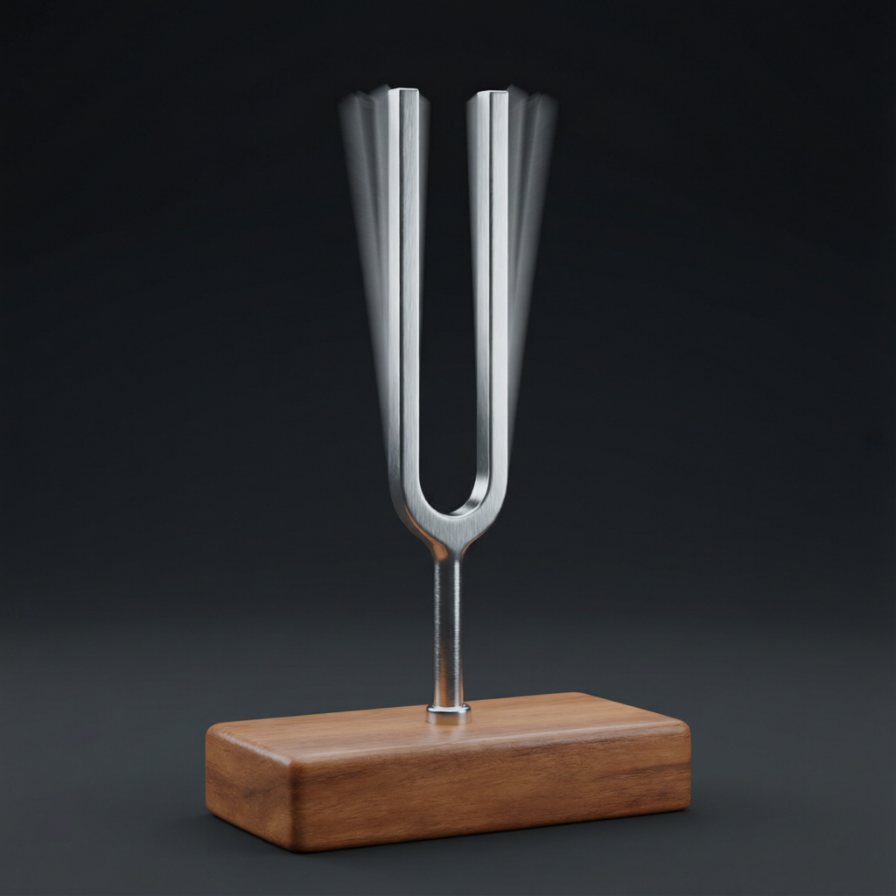
ICSE • CLASS 10 • SOUND
Vibrations & Sound Quality
Free, damped & forced vibrations • Resonance • Loudness, pitch & quality

Slide 2
INTRODUCTION
Learning Objectives
1
Distinguish free, damped and forced vibrations
2
Define resonance and give everyday examples
3
Relate loudness to amplitude
4
Relate pitch to frequency
5
Explain the quality (timbre) of a sound
6
Distinguish music from noise
Notes:
Open by previewing these objectives so students know what they should be able to do by the end of the session.

Slide 3
PART 1
Vibrations & Resonance
1
How objects vibrate and when they sing

Slide 4
FREE VIBRATIONS
Natural (Free) Vibrations
Every object has a natural frequency
• Natural frequency Every object has its own frequency at which it vibrates when disturbed.
• Free vibration Vibration at the natural frequency with no outside force, e.g. a struck tuning fork.
• Depends on the body The natural frequency depends on the object's size, shape, tension and material.
• In a vacuum Free vibrations would continue unchanged with no air resistance to slow them.
Notes:
Define natural frequency and free vibration. A pendulum or tuning fork left alone vibrates at its own rate.

Slide 5

TYPES
Free, Damped & Forced Vibrations
Free
Damped
At the natural frequency, with constant amplitude (ideal, no friction).
Amplitude steadily dies away as friction/air resistance removes energy.
Forced
Everyday
An outside periodic force drives the object at the force's frequency.
A guitar string left to ring is damped; a sewing machine shaking the table is forced.
Notes:
Three categories. Damped = dying away; forced = driven by an external periodic push.

Slide 6
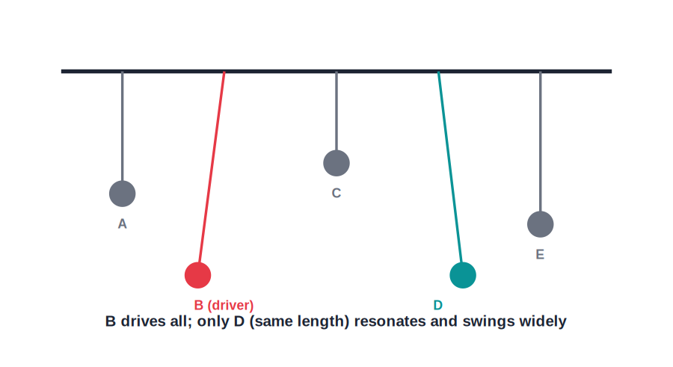
RESONANCE
Resonance
Matching frequencies
• Resonance occurs when the driving frequency equals the object's natural frequency.
• The object then absorbs energy efficiently and vibrates with a large amplitude.
• In coupled pendulums, only the one matching the driver's length swings strongly.
• Resonance can be useful — or destructive if amplitudes grow too large.
Only the matching pendulum resonates
Notes:
Define resonance as a frequency match giving large amplitude. The pendulum demo makes it visual.

Slide 7
FORCED & SOUNDING BOARDS
Forced Vibrations in Instruments
Driving a larger surface
• Forced vibration A body driven to vibrate at the frequency of an applied periodic force, not its own.
• Sounding board The hollow body of a guitar or violin is forced to vibrate, pushing far more air and so sounding louder.
• Tuning fork on a table A struck fork held on a table forces the table to vibrate, making the sound much louder.
• Why louder A larger surface sets more air in motion, increasing the loudness.
Notes:
Forced vibration plus a large sounding board is how instruments get their loudness — a bigger area moves more air.

Slide 8


EXAMPLES
Resonance Around Us
Tuning a radio
Pushing a swing
We match the circuit's frequency to the station's to pick out one signal.
Pushing in time with the swing's natural rhythm builds a big swing.
Musical instruments
Bridges
Air columns and strings resonate to amplify particular notes.
Marching in step can resonate a bridge dangerously — soldiers break step.
Notes:
Mix useful (radio, instruments) and dangerous (bridge) resonance. The swing is the most intuitive example.

Slide 9
QUIZ 1
Check Your Understanding
5 questions • think before the answer reveals on the next slide

Slide 10
QUIZ QUESTION
Q1 — Identify the Vibration
A child on a swing is given a small push exactly once each time the swing returns. The swing's amplitude grows larger and larger. This is an example of:
Damped vibration
Resonance
A
B
Free vibration
An echo
C
D

Slide 11
ANSWER REVEALED
Q1 — Identify the Vibration
A child on a swing is given a small push exactly once each time the swing returns. The swing's amplitude grows larger and larger. This is an example of:
Damped vibration
Resonance
A
✓
Free vibration
An echo
C
D
WHY
The pushes are timed to match the swing's natural frequency, so energy is added in step every cycle. The amplitude builds up — the defining feature of resonance.

Slide 12
QUIZ QUESTION
Q2 — Dying Away
A plucked guitar string gradually becomes quieter and finally stops. Its vibration is best described as:
Forced
Resonant
A
B
Damped
Free and unending
C
D

Slide 13
ANSWER REVEALED
Q2 — Dying Away
A plucked guitar string gradually becomes quieter and finally stops. Its vibration is best described as:
Forced
Resonant
A
B
Damped
Free and unending
✓
D
WHY
Friction and air resistance, plus energy passed to the sound, steadily remove energy from the string, so its amplitude decays. That is damping.

Slide 14
QUIZ QUESTION
Q3 — Break Step
Soldiers are ordered to 'break step' when crossing a footbridge to avoid:
Tiring their legs
Driving the bridge at its natural frequency and resonating it
A
B
Making too much noise
Slipping on the bridge
C
D

Slide 15
ANSWER REVEALED
Q3 — Break Step
Soldiers are ordered to 'break step' when crossing a footbridge to avoid:
Tiring their legs
Driving the bridge at its natural frequency and resonating it
A
✓
Making too much noise
Slipping on the bridge
C
D
WHY
If their rhythmic marching happened to match the bridge's natural frequency, resonance could build dangerously large oscillations. Breaking step keeps the force out of time.

Slide 16
QUIZ QUESTION
Q4 — Same Note
Two identical tuning forks stand side by side. One is struck, and soon the other begins to hum. This happens because they:
Are touching
Have the same natural frequency, so the second resonates
A
B
Are made of magnets
Share the same air pressure
C
D

Slide 17
ANSWER REVEALED
Q4 — Same Note
Two identical tuning forks stand side by side. One is struck, and soon the other begins to hum. This happens because they:
Are touching
Have the same natural frequency, so the second resonates
A
✓
Are made of magnets
Share the same air pressure
C
D
WHY
Sound from the struck fork drives the second at exactly its natural frequency, so it resonates and starts to vibrate audibly — sympathetic resonance.

Slide 18
QUIZ QUESTION
Q5 — Mismatched Fork
If the second tuning fork had a small lump of wax added to one prong, striking the first fork would now make the second:
Resonate even more strongly
Barely respond, because their frequencies no longer match
A
B
Melt the wax
Change to a higher pitch
C
D

Slide 19
ANSWER REVEALED
Q5 — Mismatched Fork
If the second tuning fork had a small lump of wax added to one prong, striking the first fork would now make the second:
Resonate even more strongly
Barely respond, because their frequencies no longer match
A
✓
Melt the wax
Change to a higher pitch
C
D
WHY
The wax changes the second fork's natural frequency, so the driving sound is no longer in tune with it. Without a frequency match there is no resonance, and it stays almost silent.

Slide 20
PART 2
Characteristics of Sound
2
Loudness, pitch and quality — and music vs noise

Slide 21
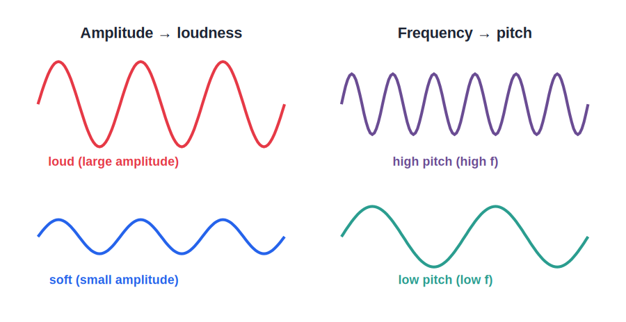
LOUDNESS & PITCH
Loudness and Pitch
Amplitude vs frequency
• Loudness depends on the amplitude of the wave — bigger amplitude, louder sound.
• Pitch depends on the frequency — higher frequency, higher pitch.
• A drum gives a loud, low-pitched sound; a whistle a high-pitched one.
• Loudness and pitch are independent: a sound can be loud and low, or soft and high.
Amplitude → loudness; frequency → pitch
Notes:
Keep loudness (amplitude) and pitch (frequency) strictly separate — a common confusion.

Slide 22

LOUDNESS FACTORS
What the Loudness Depends On
Amplitude
Distance
Greater amplitude of vibration gives a louder sound.
Loudness falls as we move away from the source.
Area of vibrating body
Density & resonance
A larger vibrating surface (sounding board) makes a louder sound.
A denser medium and the presence of resonating bodies both increase loudness.
Notes:
Selina lists several factors for loudness: amplitude, distance, area of the vibrating body, density of medium and resonance.

Slide 23
INTENSITY & DECIBEL
Loudness, Intensity and the Decibel
Intensity is the sound energy crossing unit area per second; loudness is how loud that sound seems to the listener.
Loudness level is measured in decibels (dB)
• Greater intensity is heard as greater loudness.
• Loudness also depends on the listener's ear, not on intensity alone.
• Rough levels: whisper ~10 dB, talk ~60 dB, traffic ~80 dB, jet ~120 dB (painful).
Notes:
Distinguish intensity (physical, energy/area) from loudness (perceived). Unit is the decibel; give a feel for the scale.

Slide 24
AUDIBLE RANGE
What We Can — and Cannot — Hear
20 Hz – 20,000 Hz
• Audible range Humans hear roughly 20 Hz to 20,000 Hz.
• Infrasonic Below 20 Hz — too low to hear; produced by earthquakes and large machines. Elephants use it.
• Ultrasonic Above 20,000 Hz — too high to hear; used in SONAR, scans and cleaning. Bats and dogs hear it.
• With age The upper limit of hearing falls as we grow older.
Notes:
Anchor the 20 Hz–20 kHz range, then place infrasonic below and ultrasonic above it, each with examples.

Slide 25
PITCH FACTORS
What Decides the Pitch of a String or Pipe
Length
Tension
A shorter string or air column vibrates faster, giving a higher pitch.
A tighter string vibrates faster — higher pitch.
Thickness / mass
In tune
A thinner, lighter string vibrates faster — higher pitch.
Players adjust length and tension to set the frequency, and hence the pitch.
Notes:
Frequency (pitch) of a string rises with tension, and falls with length and thickness — the basis of tuning instruments.

Slide 26
HARMONICS
Overtones, Harmonics and Waveform
A real musical note is the lowest (fundamental) frequency plus quieter higher frequencies called overtones or harmonics.
• The fundamental sets the pitch we hear.
• The particular mix of overtones gives the note its waveform shape.
• That waveform shape is what we perceive as the quality (timbre) of the sound.
Notes:
Quality comes from overtones. Same fundamental + different overtone mix = different waveform = different timbre.

Slide 27
QUALITY
Quality (Timbre) of Sound
Why instruments differ
Quality / timbre
A piano and a violin playing the same note still sound different.
This difference is the quality, set by the mixture of overtones in the sound.
Same pitch, same loudness
Recognising voices
Quality is what remains different even when pitch and loudness match.
We recognise people by the quality of their voices.
Notes:
Quality explains why the same note differs between instruments. It comes from the blend of harmonics.

Slide 28
MUSIC VS NOISE
Music and Noise
Music
Noise
A pleasant sound from regular, periodic vibrations.
An unpleasant sound from irregular, non-periodic vibrations.
Regularity
It can vary
Music has a steady, repeating waveform; noise is jumbled.
Very loud 'music' can become noise; context matters too.
Notes:
Music = regular/periodic; noise = irregular. Tie back to waveform shape.

Slide 29
NOISE POLLUTION
Noise Pollution and Its Control
What it is
Sources
Unwanted, excessively loud sound that disturbs and harms us.
Traffic, loudspeakers, machinery, construction and crackers.
Effects
Control
Stress, loss of sleep, poor concentration and gradual hearing damage.
Silencers, sound barriers and trees, limits on horns, and noise-free zones near schools and hospitals.
Notes:
Noise pollution: sources, health effects and control measures — a commonly examined application.

Slide 30
WRAP UP
Quick Recap
✓ Free vibration — at the natural frequency, no outside force
✓ Damped — amplitude dies away as energy is lost
✓ Forced & resonance — driven externally; resonance when frequencies match
✓ Loudness — depends on amplitude
✓ Pitch — depends on frequency
✓ Quality & music — timbre from overtones; music is regular, noise irregular
Notes:
Rapid recap; cold-call the amplitude/frequency/quality distinctions.

Slide 31
QUIZ 2
Final Check — Characteristics
5 questions • think before the answer reveals on the next slide

Slide 32
QUIZ QUESTION
Q1 — Turn It Up
Turning up the volume on a speaker, without changing the song, increases the sound's:
Frequency
Pitch
A
B
Amplitude (loudness)
Speed
C
D

Slide 33
ANSWER REVEALED
Q1 — Turn It Up
Turning up the volume on a speaker, without changing the song, increases the sound's:
Frequency
Pitch
A
B
Amplitude (loudness)
Speed
✓
D
WHY
Volume controls how much the speaker cone moves — the amplitude. Greater amplitude means a louder sound, while the pitch (frequency) of the notes is unchanged.

Slide 34
QUIZ QUESTION
Q2 — Same Note, Different Sound
A flute and a violin play the exactly same note equally loudly, yet sound different. They differ in:
Pitch
Loudness
A
B
Quality (timbre)
Speed
C
D

Slide 35
ANSWER REVEALED
Q2 — Same Note, Different Sound
A flute and a violin play the exactly same note equally loudly, yet sound different. They differ in:
Pitch
Loudness
A
B
Quality (timbre)
Speed
✓
D
WHY
Same note means same pitch; equally loud means same amplitude. The remaining difference is the quality, set by each instrument's particular mix of overtones.

Slide 36
QUIZ QUESTION
Q3 — Higher Pitch
To make a guitar string play a higher-pitched note you should:
Pluck it harder
Tighten the string (increase its frequency)
A
B
Use a thicker string
Make the string longer
C
D

Slide 37
ANSWER REVEALED
Q3 — Higher Pitch
To make a guitar string play a higher-pitched note you should:
Pluck it harder
Tighten the string (increase its frequency)
A
✓
Use a thicker string
Make the string longer
C
D
WHY
Pitch depends on frequency. Tightening (or shortening, or thinning) a string raises its frequency and so its pitch. Plucking harder only changes loudness.

Slide 38
QUIZ QUESTION
Q4 — Music or Noise?
Physically, the main difference between a musical note and noise is that a musical note has a:
Louder sound
Regular, periodic waveform
A
B
Higher pitch
Faster speed
C
D

Slide 39
ANSWER REVEALED
Q4 — Music or Noise?
Physically, the main difference between a musical note and noise is that a musical note has a:
Louder sound
Regular, periodic waveform
A
✓
Higher pitch
Faster speed
C
D
WHY
Music comes from regular, repeating vibrations that the ear finds pleasant; noise comes from irregular, non-periodic vibrations. Loudness and pitch are not the deciding factor.

Slide 40
QUIZ QUESTION
Q5 — Bat in the Dark
A bat flying in total darkness avoids obstacles by emitting high-pitched sound and listening for echoes. The property it relies on is that sound:
Travels faster in the dark
Reflects off surfaces
A
B
Changes colour
Needs no medium
C
D

Slide 41
ANSWER REVEALED
Q5 — Bat in the Dark
A bat flying in total darkness avoids obstacles by emitting high-pitched sound and listening for echoes. The property it relies on is that sound:
Travels faster in the dark
Reflects off surfaces
A
✓
Changes colour
Needs no medium
C
D
WHY
Echolocation uses the reflection of sound. The bat times the echoes of its calls to judge how far away objects are — natural SONAR.

Slide 42
The Music in Physics
Amplitude, frequency and timbre turn simple vibrations into every sound you have ever heard.

